Slide 1


Slide 2
Let’s Review

Slide 3


Slide 4


Slide 5
Let’s practice
the words

Slide 6

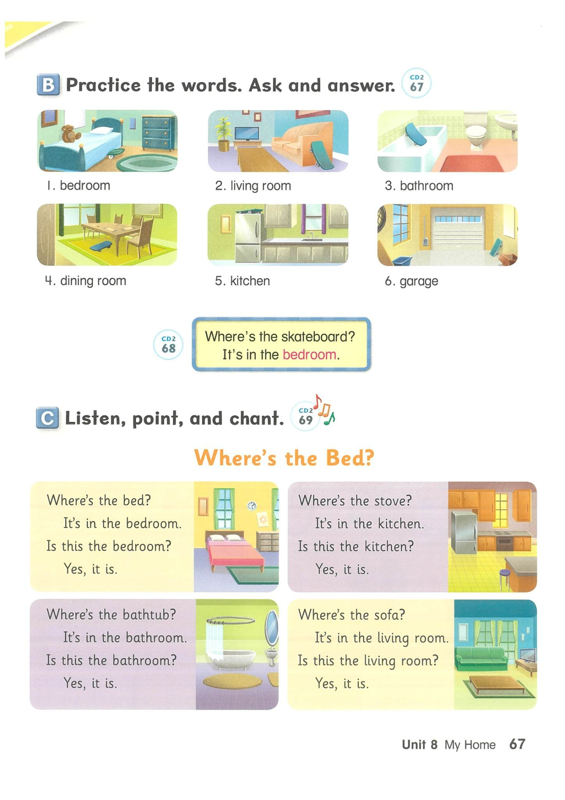
Bedroom

Slide 7
Living room

Slide 8
Bathroom

Slide 9
Dining room

Slide 10
Kitchen

Slide 11
Garage

Slide 12
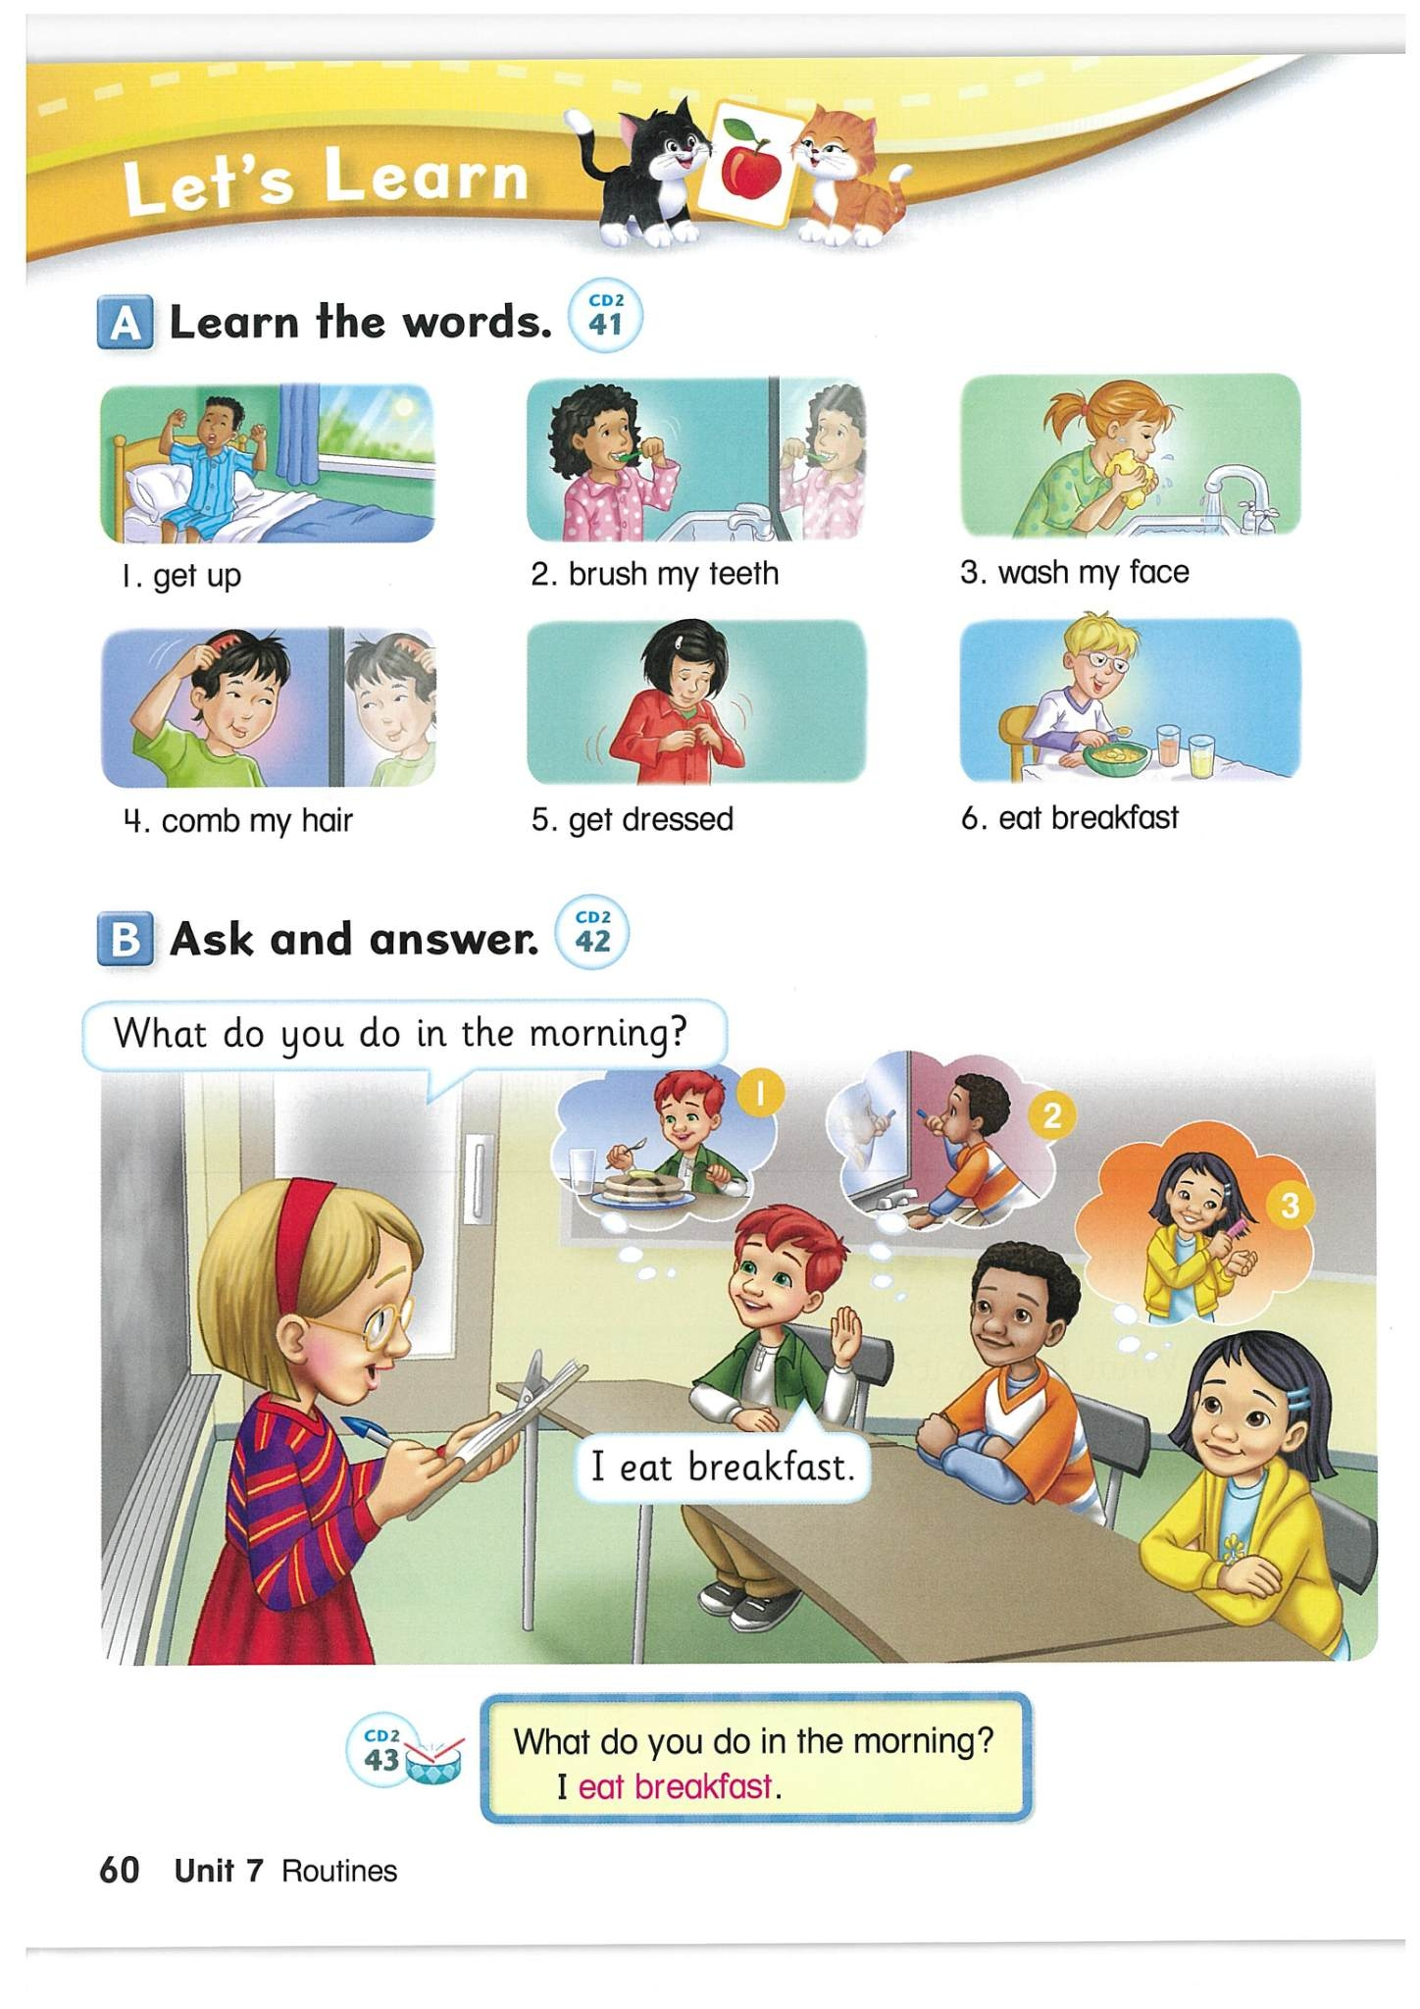
Ask and
answer

Slide 13
Where’s the skateboard?
It’s in the ____________.
bedroom

Slide 14
Where’s the skateboard?
It’s in the ____________.
garage

Slide 15
Where’s the skateboard?
It’s in the ____________.
bathroom

Slide 16
Where’s the skateboard?
It’s in the ____________.
kitchen

Slide 17
Where’s the skateboard?
It’s in the dining room.

Slide 18
Where’s the skateboard?
It’s in the living room.

Slide 19
Ask and answer
Where’s the bed ?
It’s in the bedroom.
Is this the bedroom ?
Yes, it is.

Slide 20
Ask and answer
Where’s the fridge ?
It’s in the kitchen.
Is this the bathroom ?
No, it isn’t.
What is this ?
It’s a kitchen.

Slide 21
Ask and answer
Where’s the mirror ?
It’s in the bathroom.
Is this the bathroom ?
Yes, it is.

Slide 22
Ask and answer
Where’s the table ?
It’s in the living room.
Is this the living room?
No, it isn’t.
What is this ?
It’s a living room.

Slide 23
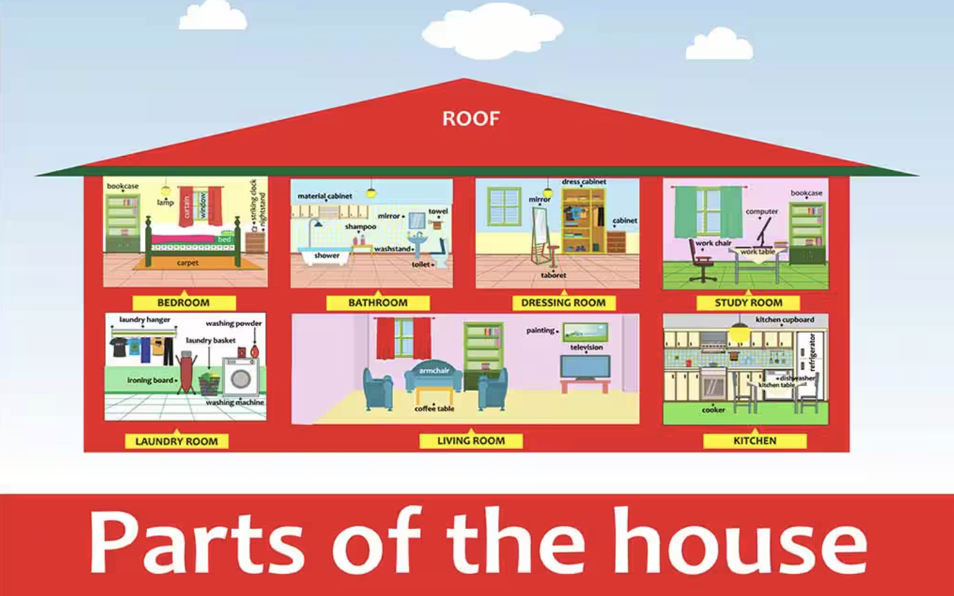
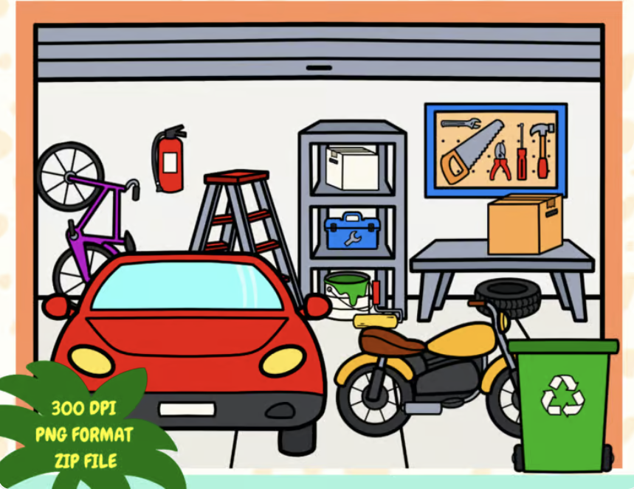
Kitchen Dining room Living room Dressing room
Garage Bathroom Bedroom

Slide 24
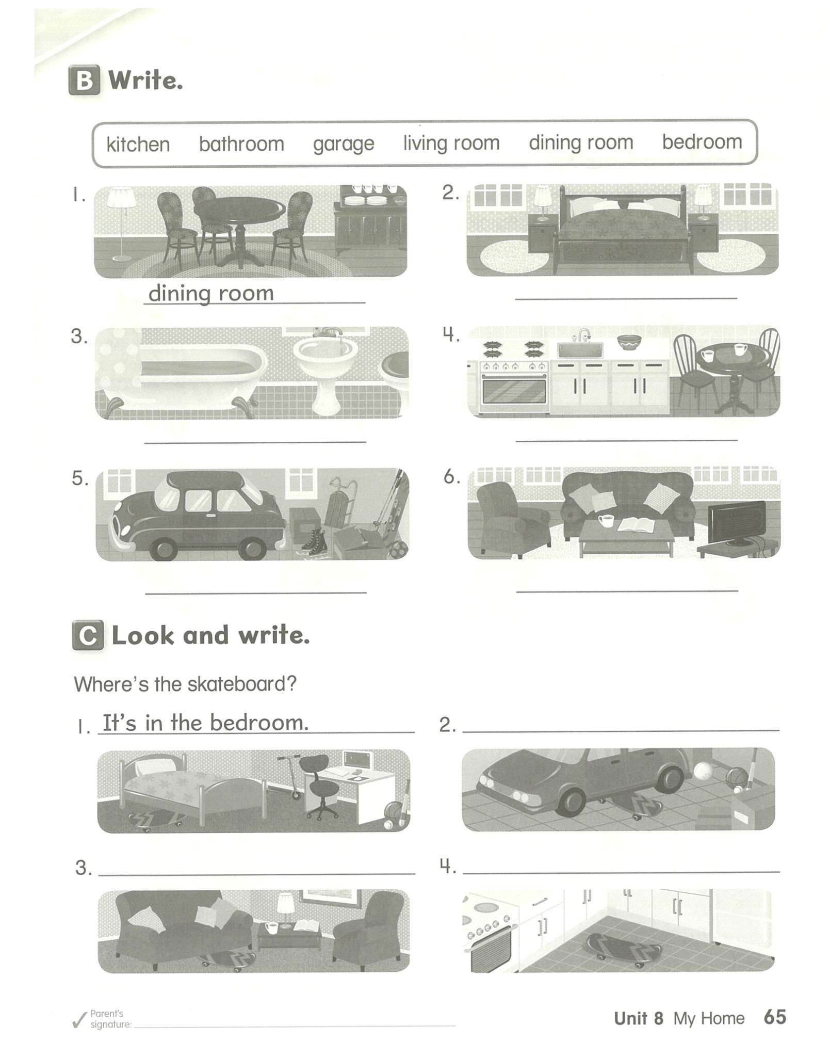
Let’s write
________.
________.
________.
________.
________.
________.
kitchen bathroom garage
bedroom living room dining room

Slide 25
Where’s the skateboard?
1. It’s in the ______.
2. _______________.
3. _____________.
4. _______________.

Slide 26


