Slide 1
NUMBERS
Numbers 1-90

Slide 2
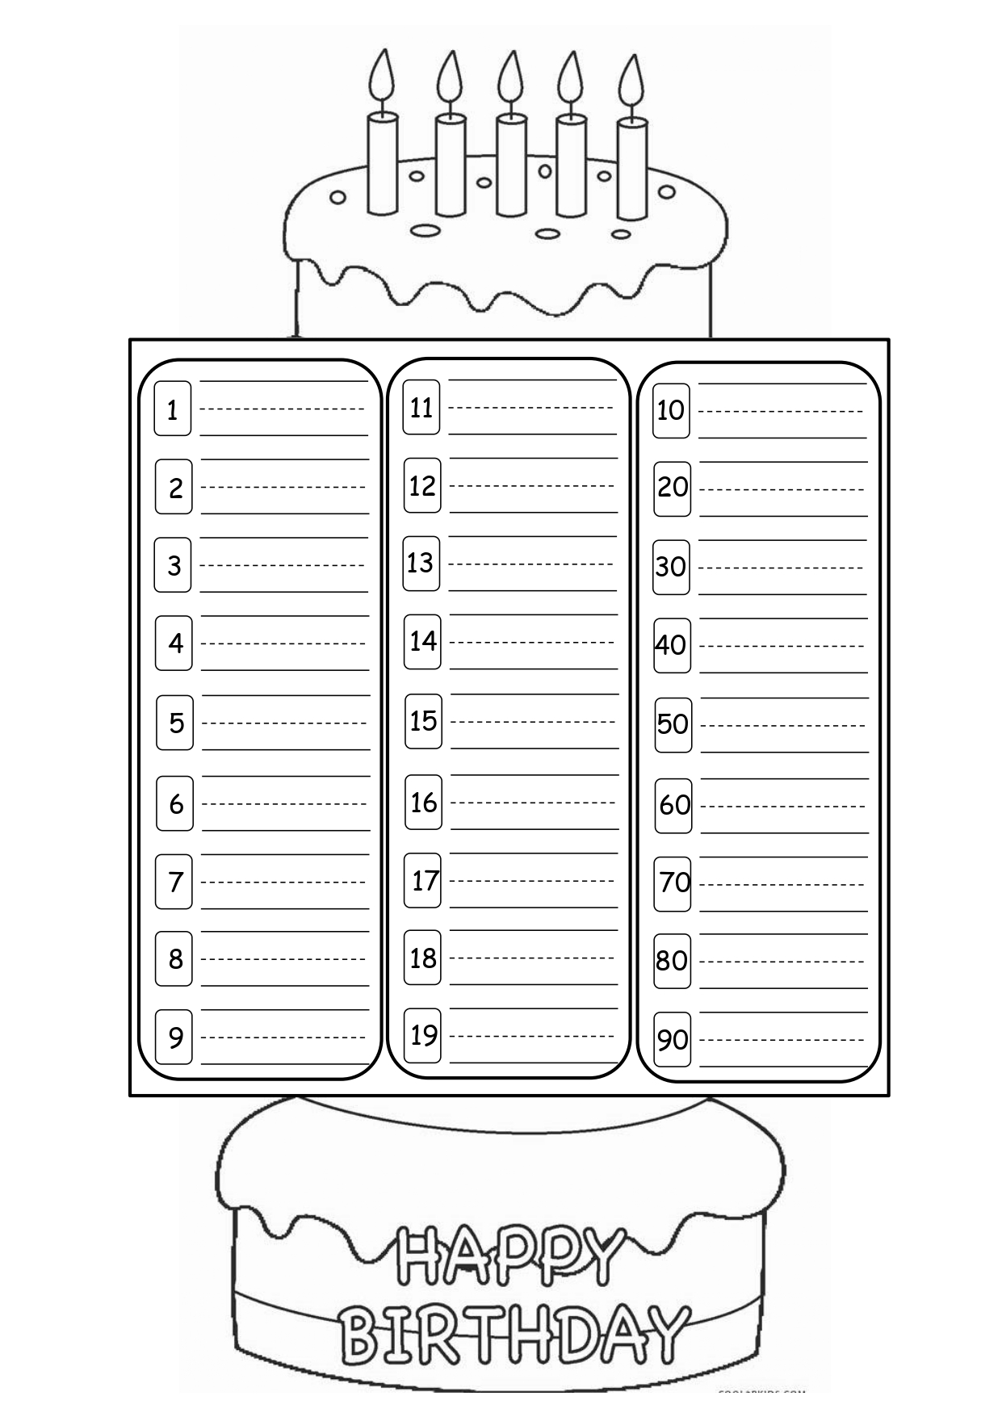


Here are what we need for this class:

Slide 3
It’s time to learn!

Slide 4
one
You could describe the topic of the section here

Slide 5
one
You could describe the topic of the section here

Slide 6
two
You could describe the topic of the section here

Slide 7
one
You could describe the topic of the section here
two

Slide 8
three
You could describe the topic of the section here

Slide 9
one
two
three
You could describe the topic of the section here

Slide 10
four
You could describe the topic of the section here

Slide 11
one
two
three
four
You could describe the topic of the section here

Slide 12
five
You could describe the topic of the section here

Slide 13
one
two
three
four
You could describe the topic of the section here
five

Slide 14
six
You could describe the topic of the section here

Slide 15
six
You could describe the topic of the section here

Slide 16
seven
You could describe the topic of the section here

Slide 17
six
seven
You could describe the topic of the section here

Slide 18
eight
You could describe the topic of the section here

Slide 19
six
seven
eight
You could describe the topic of the section here

Slide 20
nine
You could describe the topic of the section here

Slide 21
six
seven
eight
nine
You could describe the topic of the section here

Slide 22
one
two
three
four
five
six
seven
You could describe the topic of the section here
eight
nine

Slide 23

eleven
You could describe the topic of the section here

Slide 24
one
eleven
You could describe the topic of the section here

Slide 25

twelve
You could describe the topic of the section here

Slide 26
one
eleven
You could describe the topic of the section here
two
twelve

Slide 27

thirteen
You could describe the topic of the section here

Slide 28
one
eleven
two
twelve
three
thirteen
four
You could describe the topic of the section here
five

Slide 29

fourteen
You could describe the topic of the section here

Slide 30
one
eleven
two
twelve
three
thirteen
four
fourteen
You could describe the topic of the section here
five

Slide 31

fifteen
You could describe the topic of the section here

Slide 32
one
eleven
two
twelve
three
thirteen
four
fourteen
You could describe the topic of the section here
five
fifteen

Slide 33

sixteen
You could describe the topic of the section here

Slide 34
six
sixteen
seven
eight
nine
You could describe the topic of the section here

Slide 35

seventeen
You could describe the topic of the section here

Slide 36
six
sixteen
seven
seventeen
eight
nine
You could describe the topic of the section here

Slide 37

eighteen
You could describe the topic of the section here

Slide 38
six
sixteen
seven
seventeen
eight
eighteen
nine
You could describe the topic of the section here

Slide 39

nineteen
You could describe the topic of the section here

Slide 40
six
sixteen
seven
seventeen
eight
eighteen
nine
nineteen
You could describe the topic of the section here

Slide 41
one
eleven
two
twelve
three
thirteen
four
fourteen
five
fifteen
six
sixteen
seven
seventeen
You could describe the topic of the section here
eight
eighteen
nine
nineteen

Slide 42

10
ten
You could describe the topic of the section here

Slide 43
one
eleven
ten
You could describe the topic of the section here

Slide 44
20
twenty
You could describe the topic of the section here

Slide 45
one
eleven
ten
You could describe the topic of the section here
two
twelve
twenty

Slide 46
30
thirty
You could describe the topic of the section here

Slide 47
one
eleven
ten
two
twelve
twenty
three
thirteen
thirty
four
fourteen
You could describe the topic of the section here
five
fifteen

Slide 48
40
forty
You could describe the topic of the section here

Slide 49
one
eleven
ten
two
twelve
twenty
three
thirteen
thirty
four
fourteen
forty
You could describe the topic of the section here
five
fifteen

Slide 50
50
fifty
You could describe the topic of the section here

Slide 51
one
eleven
ten
two
twelve
twenty
three
thirteen
thirty
four
fourteen
forty
You could describe the topic of the section here
five
fifteen
fifty

Slide 52
60
sixty
You could describe the topic of the section here

Slide 53
six
sixteen
sixty
seven
seventeen
eight
eighteen
nine
nineteen
You could describe the topic of the section here

Slide 54
70
seventy
You could describe the topic of the section here

Slide 55
six
sixteen
sixty
seven
seventeen
seventy
eight
eighteen
nine
nineteen
You could describe the topic of the section here

Slide 56
80
eighty
You could describe the topic of the section here

Slide 57
six
sixteen
sixty
seven
seventeen
seventy
eight
eighteen
eighty
nine
nineteen
You could describe the topic of the section here

Slide 58
90
ninety
You could describe the topic of the section here

Slide 59
six
sixteen
sixty
seven
seventeen
seventy
eight
eighteen
eighty
nine
nineteen
ninety
You could describe the topic of the section here

Slide 60
one
eleven
ten
two
twelve
twenty
three
thirteen
thirty
four
fourteen
forty
five
fifteen
fifty
six
sixteen
sixty
seven
seventeen
seventy
You could describe the topic of the section here
eight
eighteen
eighty
nine
nineteen
ninety

Slide 61


It’s time to color!!
You could describe the topic of the section here

Slide 62



It’s time to color!!
You could describe the topic of the section here

Slide 63
Many THANKS!
Do you have any questions?
addyouremail@freepik.com
+91 620 421 838
yourcompany.com
Please keep this slide as attribution

