Slide 1
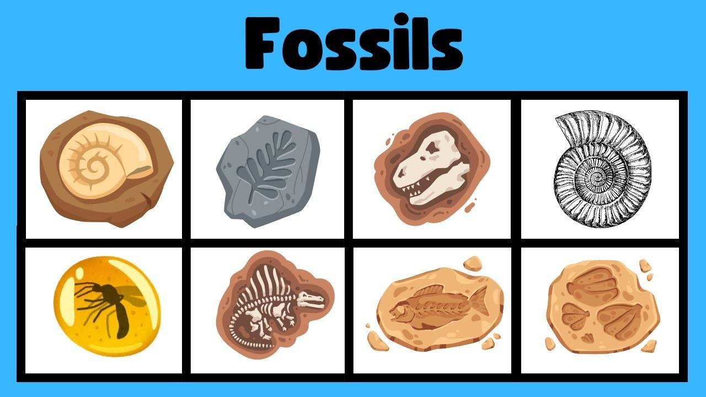
Fossils
Science – Grade 6

Slide 2
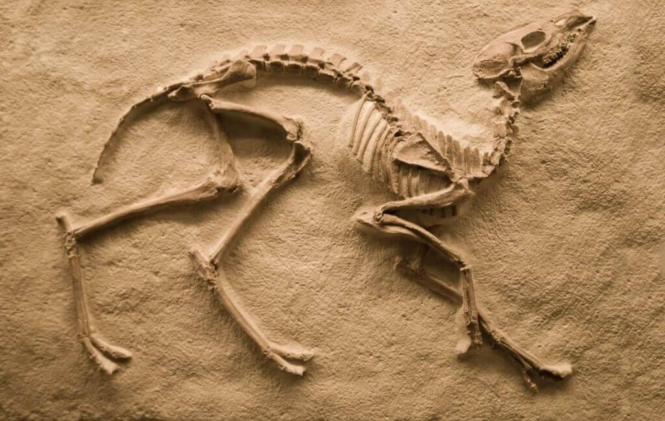
What Are Fossils?
- Fossils are the preserved remains or traces of plants and animals that lived long ago.
- They help scientists understand Earth's history.
- Most fossils are found in sedimentary rocks.

Slide 3
How Fossils Form
1. Organism dies.
2. It is buried by sediments.
3. Sediments harden into rock.
4. Remains are preserved as fossils.

Slide 4
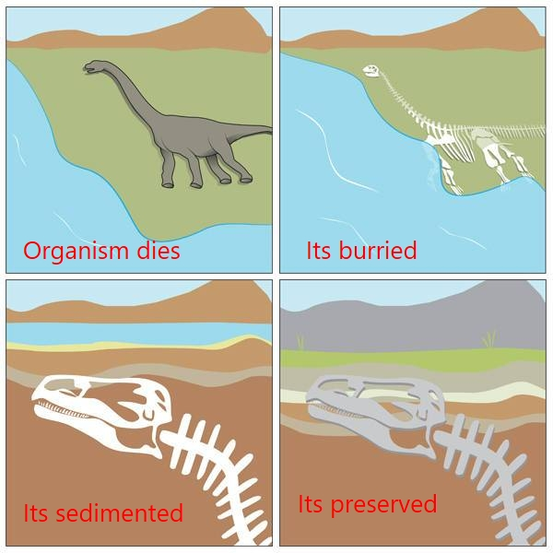
How fossils form

Slide 5
Different Types of Fossils
- **Mold Fossils**: Imprints left in rock.
- **Cast Fossils**: Form when molds are filled with minerals.
- **Petrified Fossils**: Parts replaced with minerals.
- **Carbon Films**: Thin carbon outlines left by organisms.
- **Trace Fossils**: Footprints, burrows, or tracks.

Slide 6
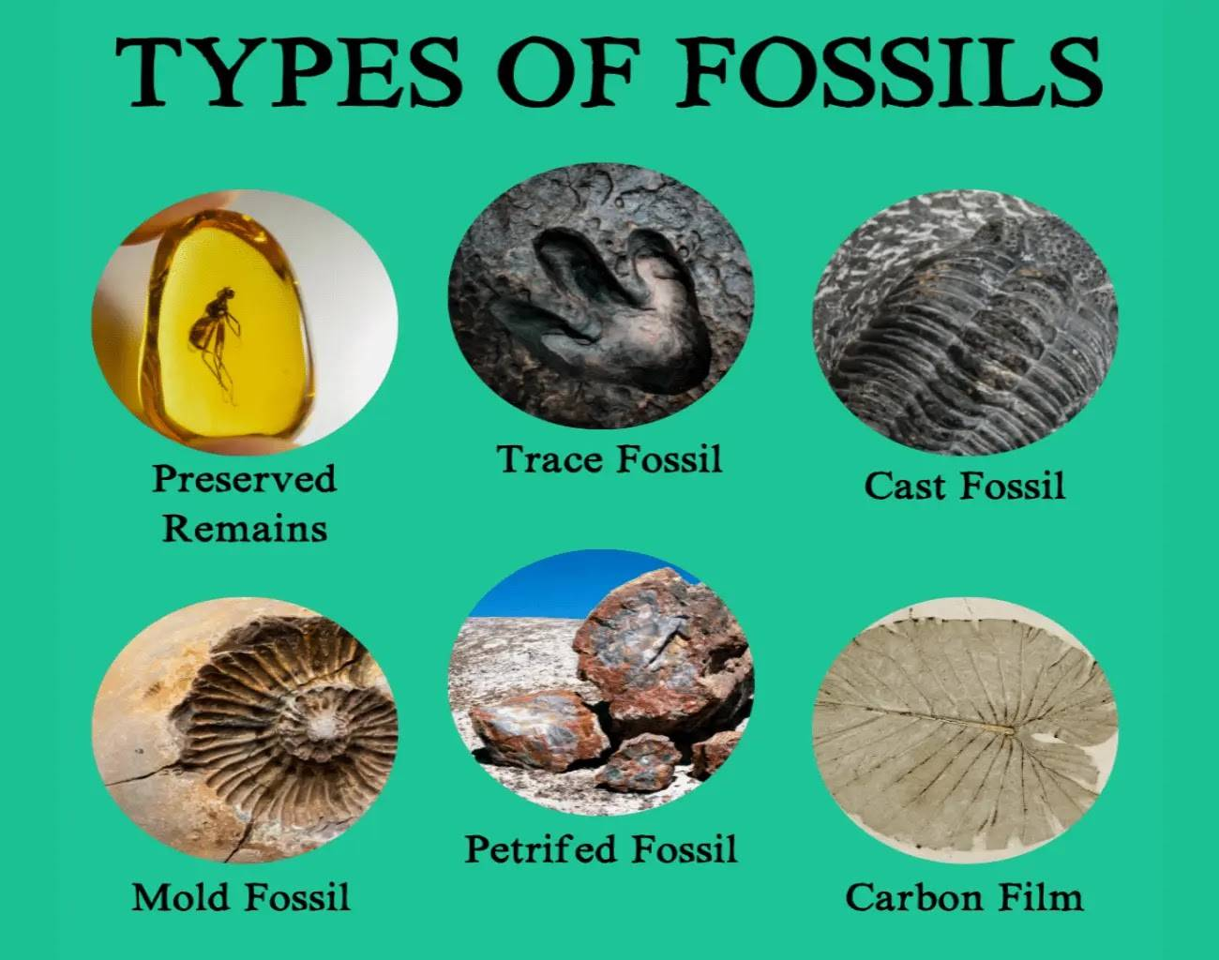

Slide 7
Importance of Fossils
- Show how organisms have changed over time.
- Help identify extinct species.
- Provide clues about past climates and environments.
- Help scientists understand Earth's geological history.

Slide 8
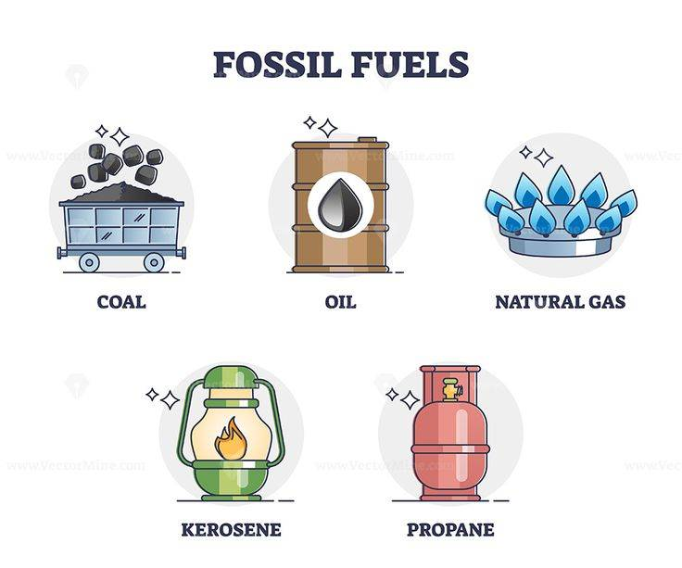

Slide 9
Fossils Found in Thailand
- Thailand has many important fossil sites.
- Dinosaur fossils found in Khon Kaen, Kalasin, and Nakhon Ratchasima.
- Fossilized trees and shells found in the south.
- Important fossils include:
* Phuwiangosaurus (dinosaur)
* Siamotyrannus (dinosaur)
* Early elephants and ancient fish

Slide 10
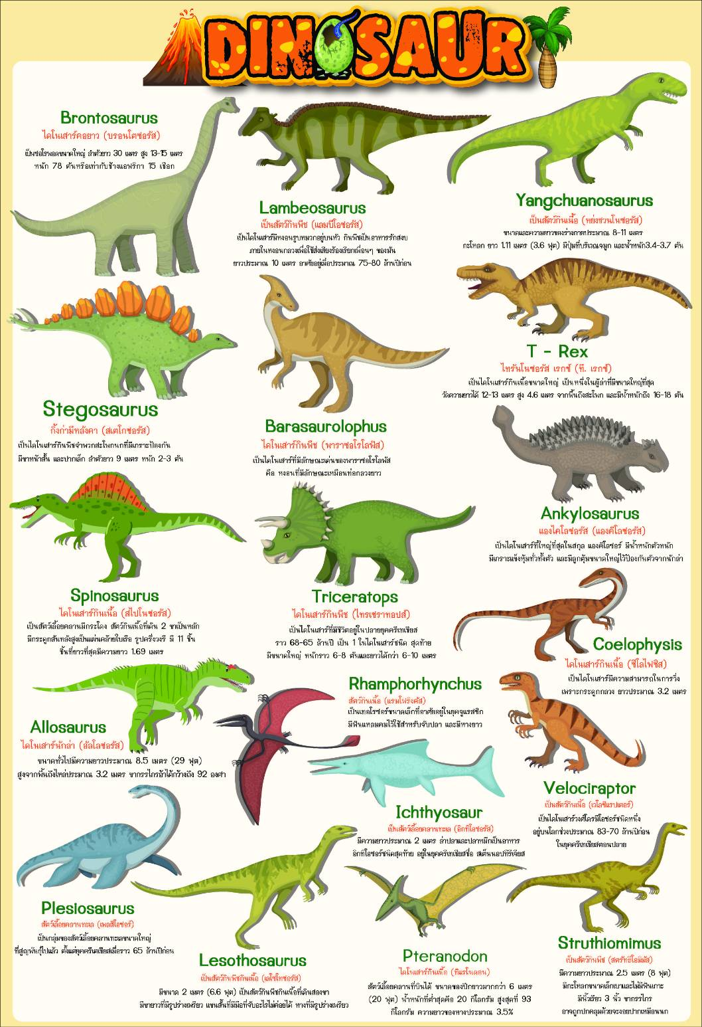

Slide 11
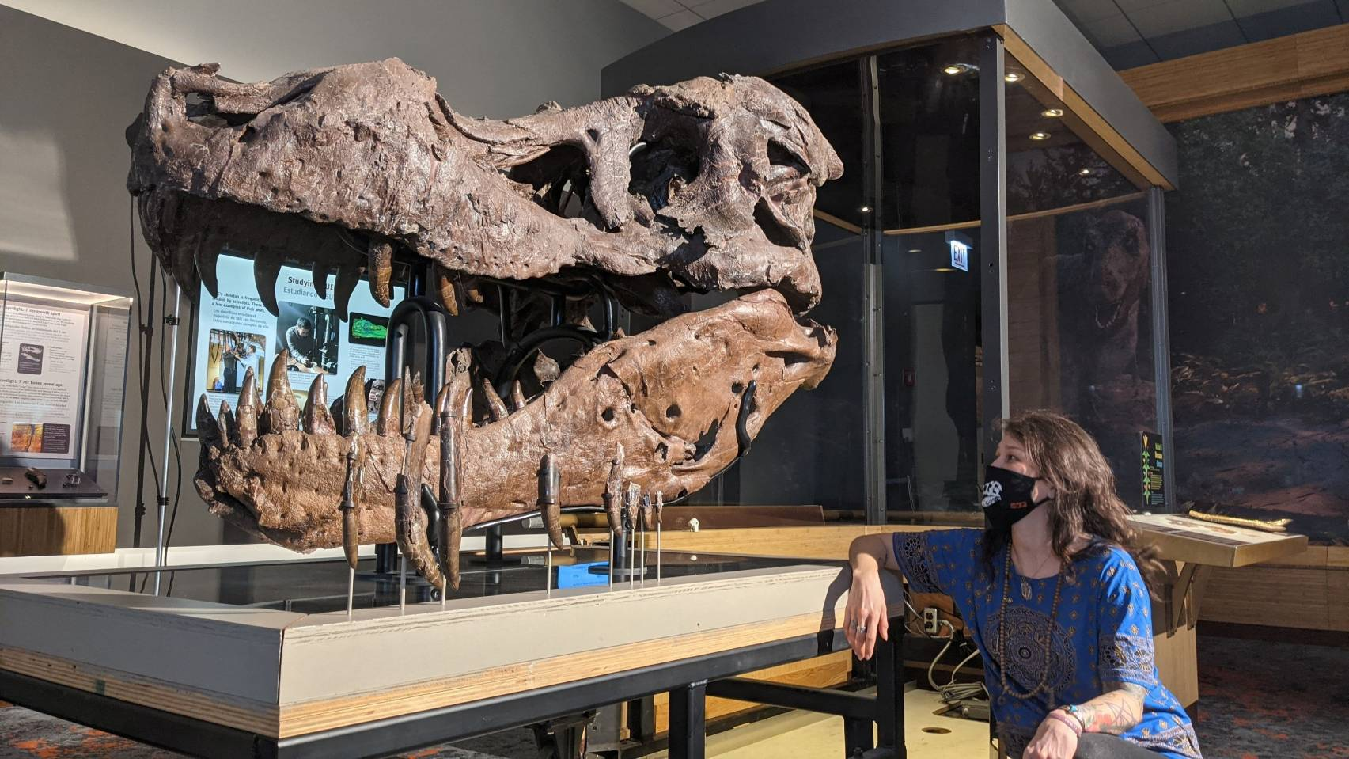

Slide 12
Conclusion
- Fossils help us understand life from millions of years ago.
- They show how the Earth and living things have changed.
- Thailand is rich in fossil discoveries, especially dinosaurs.

