Slide 1



ADDING THREE NUMBERS

Slide 2



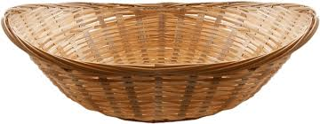

Apples
Bananas
Oranges
How many fruits altogether?

Slide 3

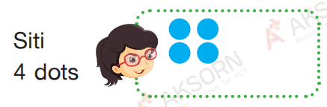

How many dots do they have altogether?

Slide 4

6 Balls
How many balls altogether?
7 Balls
9 Balls

Slide 5



4 dinosaur toys
6 dinosaur toys
9 dinosaur toys
How many dinosaur toys altogether?
4
6
9
10
9
+
+
=
+
=
19
There are 19 dinosaur toys altogether.

Slide 6

2 robot toys
6 robot toys
8 robot toys
How many robot toys altogether?
2
6
8
8
8
+
+
=
+
=
16
There are 19 robot toys altogether.

Slide 7
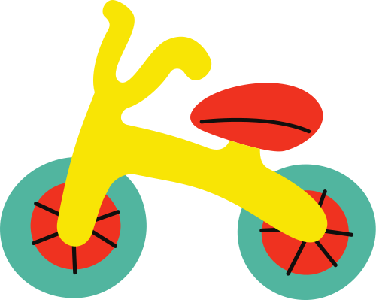
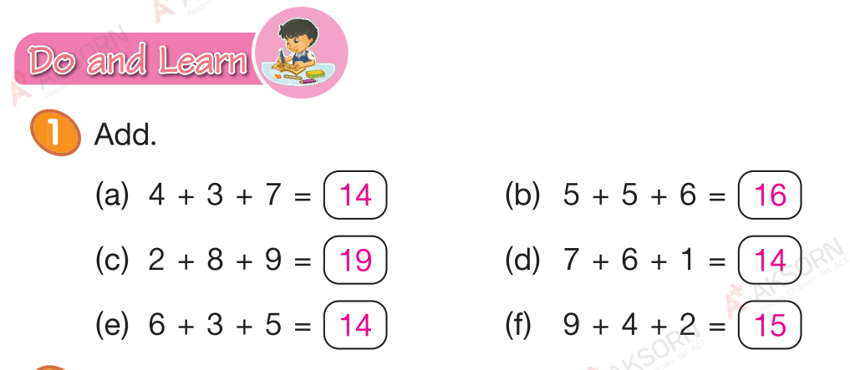
Page: 145

Slide 8
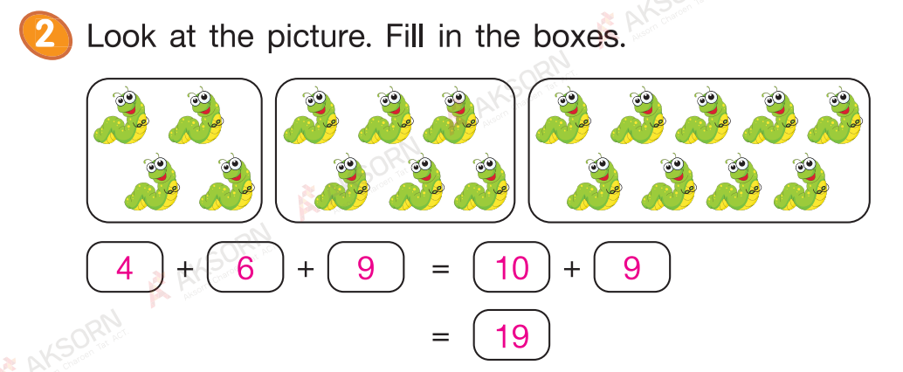

Page: 146

Slide 9


