Slide 1



Slide 2

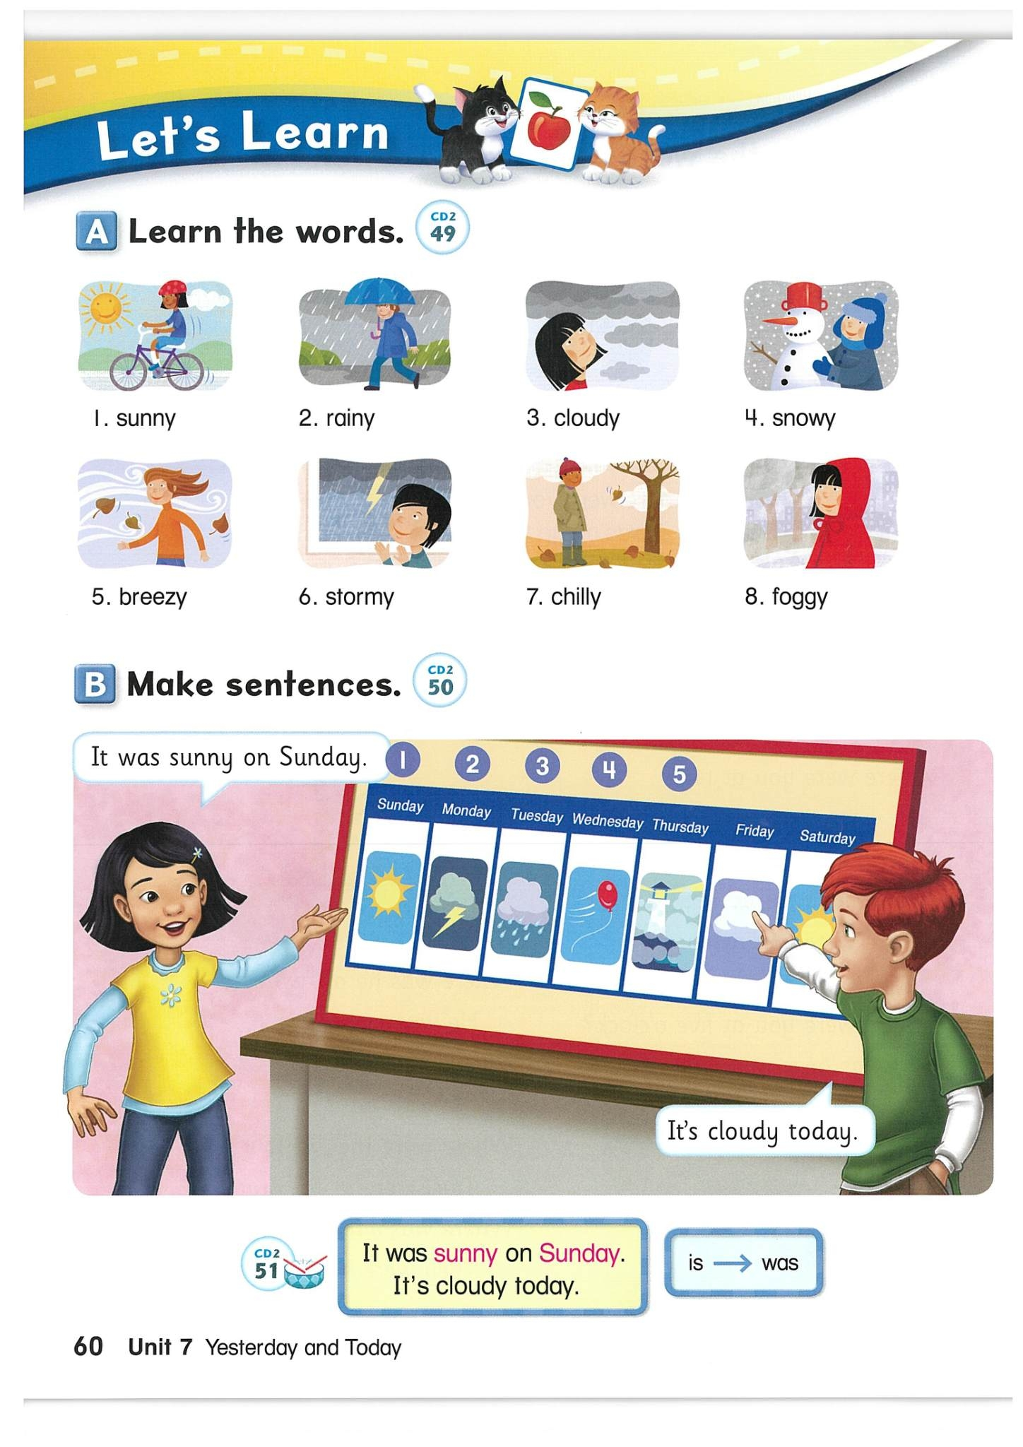
A. Learn the Words

Slide 3
sunny

Slide 4
rainy

Slide 5
cloudy

Slide 6
snowy

Slide 7
breezy

Slide 8
stormy

Slide 9
chilly

Slide 10
foggy

Slide 11

B. Make sentences
It was sunny on Sunday.
It’s cloudy today.
Ask more sentences.

Slide 12
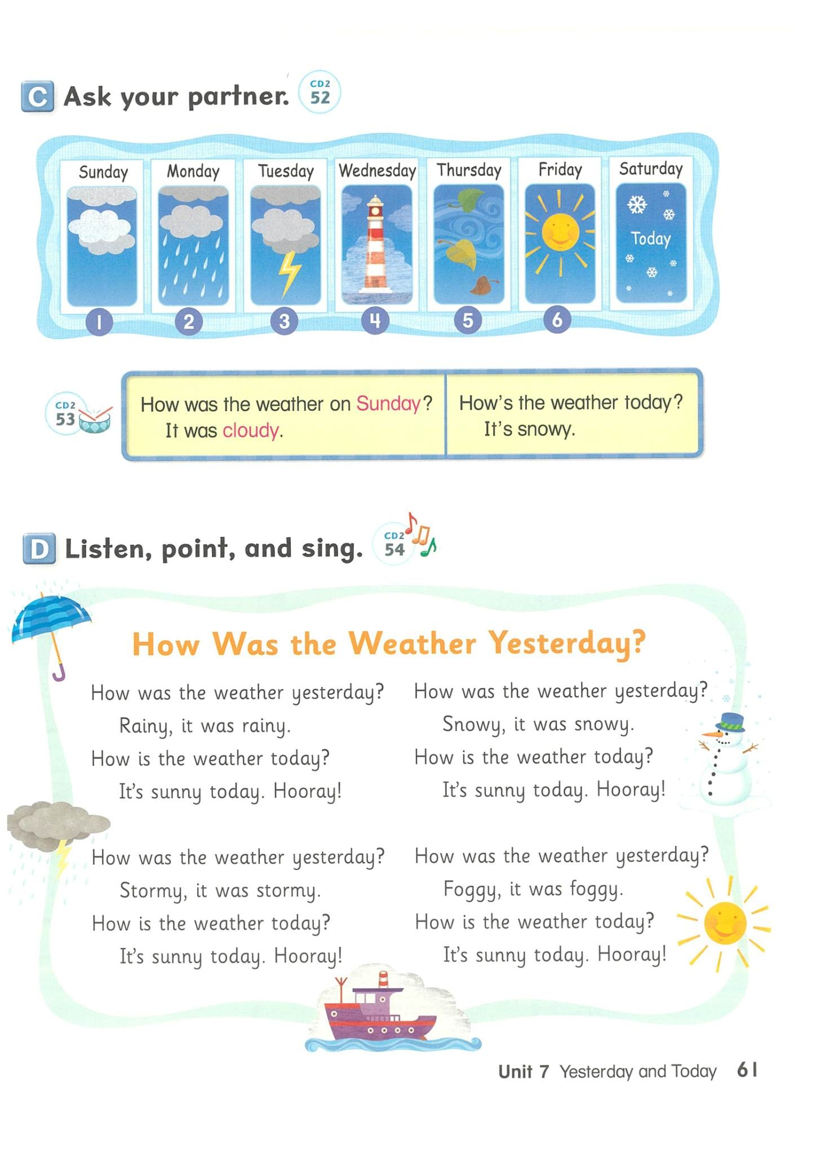
C. Ask you partner.
What was the
weather on
Sunday?
It was ______.

Slide 13
What was the
weather on
Monday?
It was ______.

Slide 14
What was the
weather on
Tuesday?
It was ______.

Slide 15
What was the
weather on
Wednesday?
It was ______.

Slide 16
What was the
weather on
Thursday?
It was ______.

Slide 17
What was the
weather on
Friday?
It was ______.

Slide 18
What is the
weather on
today?
It is ______.

Slide 19
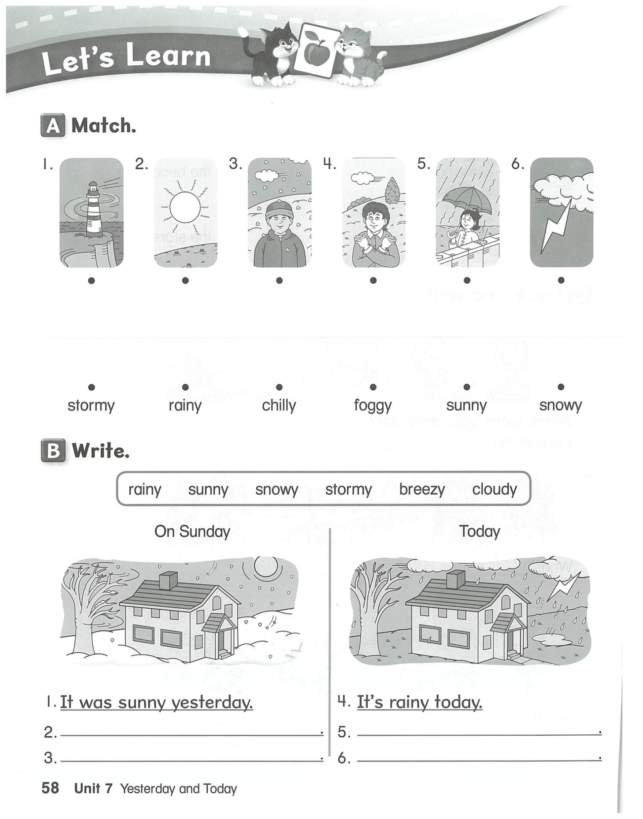
Let’s Learn

Slide 20
Let’s Learn

Slide 21


