Slide 1





THE FIVE SENSES
Sense Verbs English P.5

Slide 2
Our five senses are:
FIVE
SENSES
sight 👀
hear 👂
smell 👃
taste 👅
touch ✋

Slide 3
We see with our eyes.
SIGHT
List 5 things you can see:

Slide 4
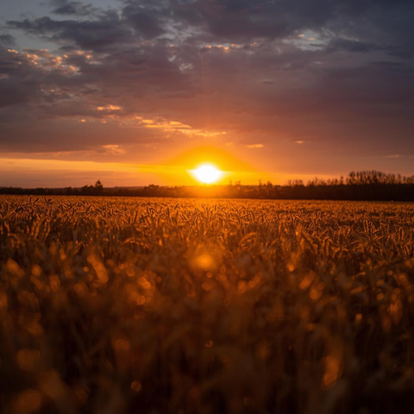
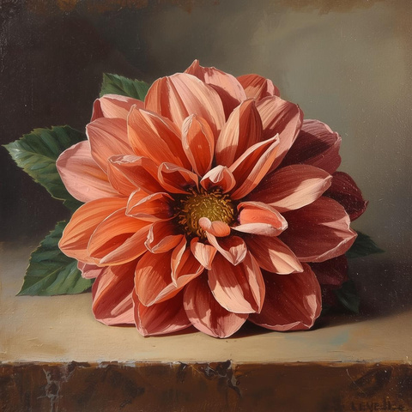
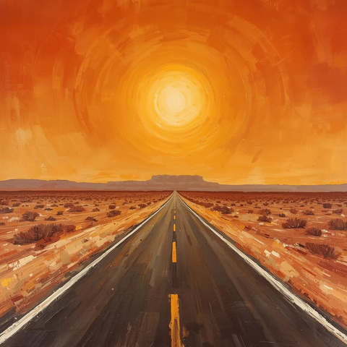
Write words to describe how these things look:
SIGHT
sunset
flower
road

Slide 5
We hear with our ears.
HEAR
List 5 things you can hear:

Slide 6
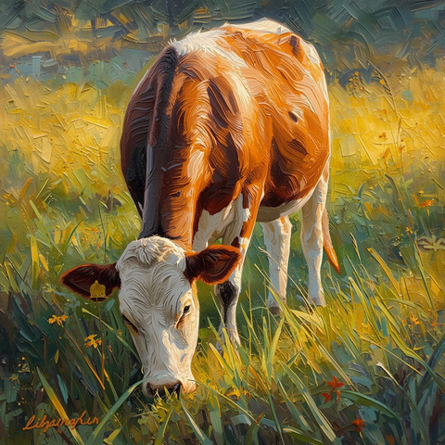
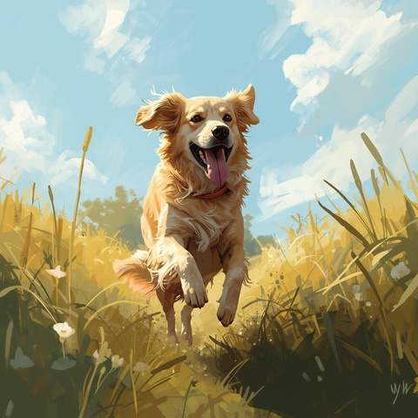
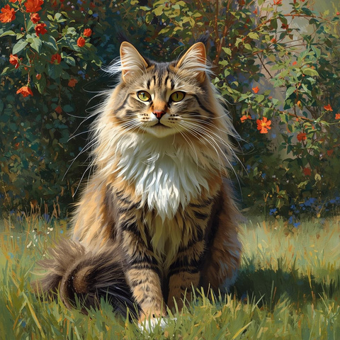
Which animal makes these sounds?
HEAR
moooo
woof
meow

Slide 7
We smell with our nose.
List 5 things you can smell:
SMELL

Slide 8

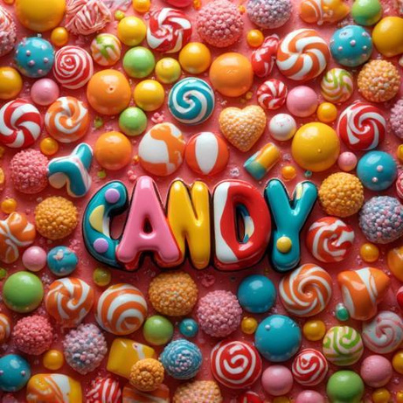

Write words to describe how these foods smell:
SMELL
curry
candy
perfume

Slide 9
We taste with our tongue.
List 5 things you can taste:
TASTE

Slide 10
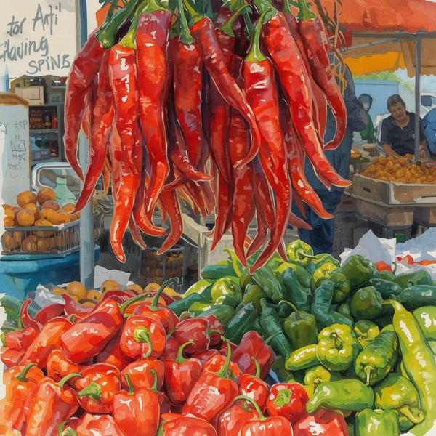
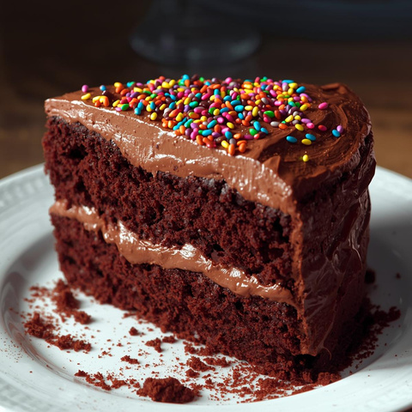
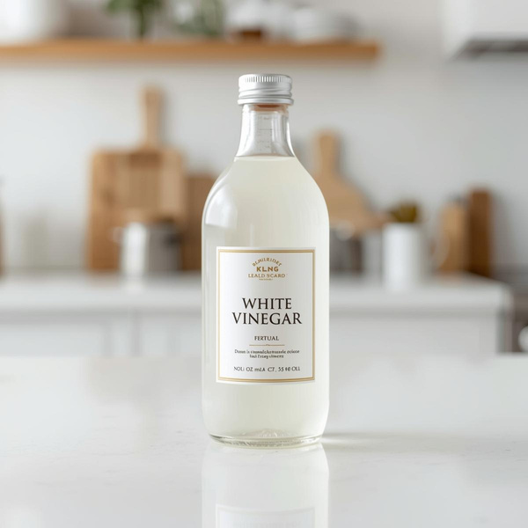
Write Yes or No if you like these flavors:
TASTE
spicy
sweet
sour

Slide 11
We touch with our hands.
TOUCH
List 5 things you can touch:

Slide 12
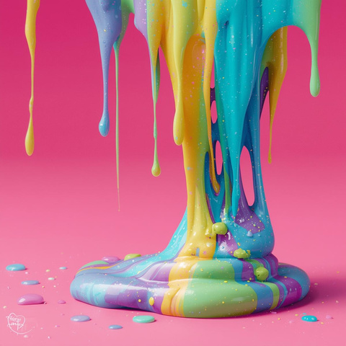
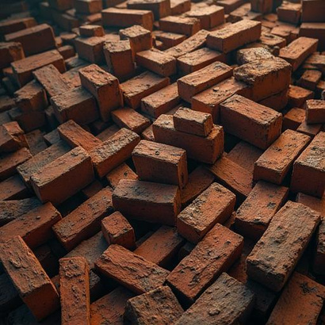

Describe how these things feel:
TOUCH
slime
bricks
cactus

Slide 13
THE FIVE SENSES
TASTE
SIGHT
HEAR
TOUCH
SMELL

Slide 14
CIRCLE THE CORRECT WORD
1. I (see / taste) a sunset.
2. I (hear / smell) a bird.
3. I (feel / see) a pillow.
4. They (hear/taste) the cake.
5. You (touch/smell) the air freshener.

Slide 15
HOMEWORK
Fill in the blanks
  I ___ a butterfly.
  I ___ a rose.
  I ___ a strawberry.
  You___the blanket.
  You___ the song of the choir.

