Slide 1






activities
A Vocabulary Presentation

Slide 2
introduction
Free time activities are a big part of our lives, and being able to talk about them will help you express your interests and preferences.
By learning this vocabulary, you'll be able to have engaging conversations with others about your favorite hobbies and discover new activities to try.

Slide 3
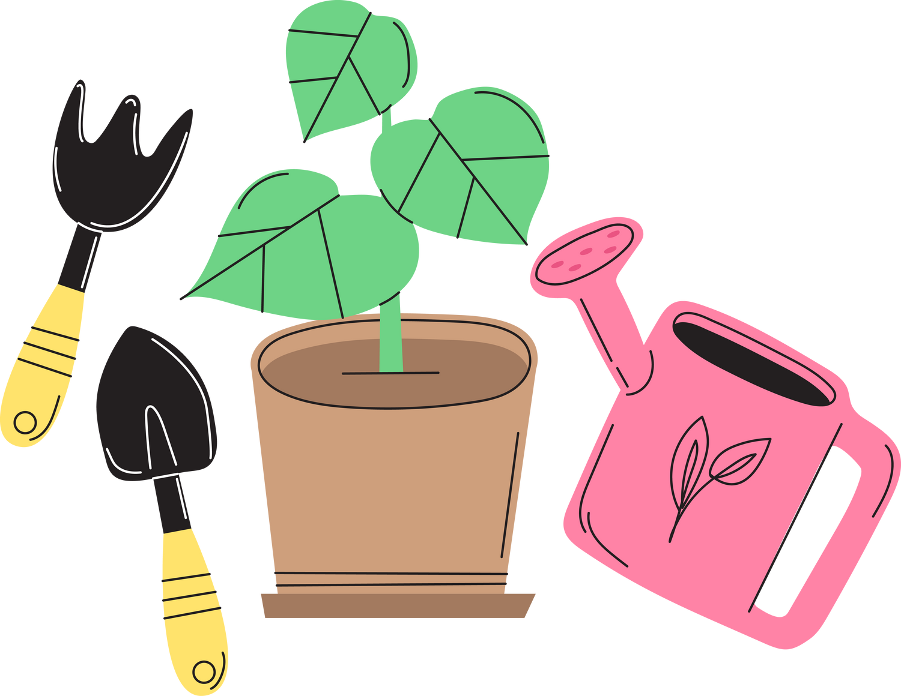
outdoor activities

Slide 4
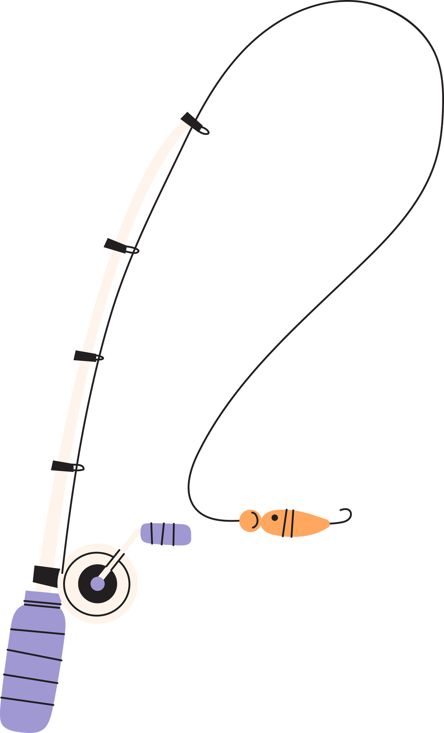
go fishing
"I love going fishing on weekends. It's so peaceful and relaxing.”

Slide 5
do the gardening
“My dad does the gardening every Saturday.”

Slide 6

go swimming
“I go swimming twice a week”

Slide 7

stargazing
“We love stargazing on warm summer nights”

Slide 8
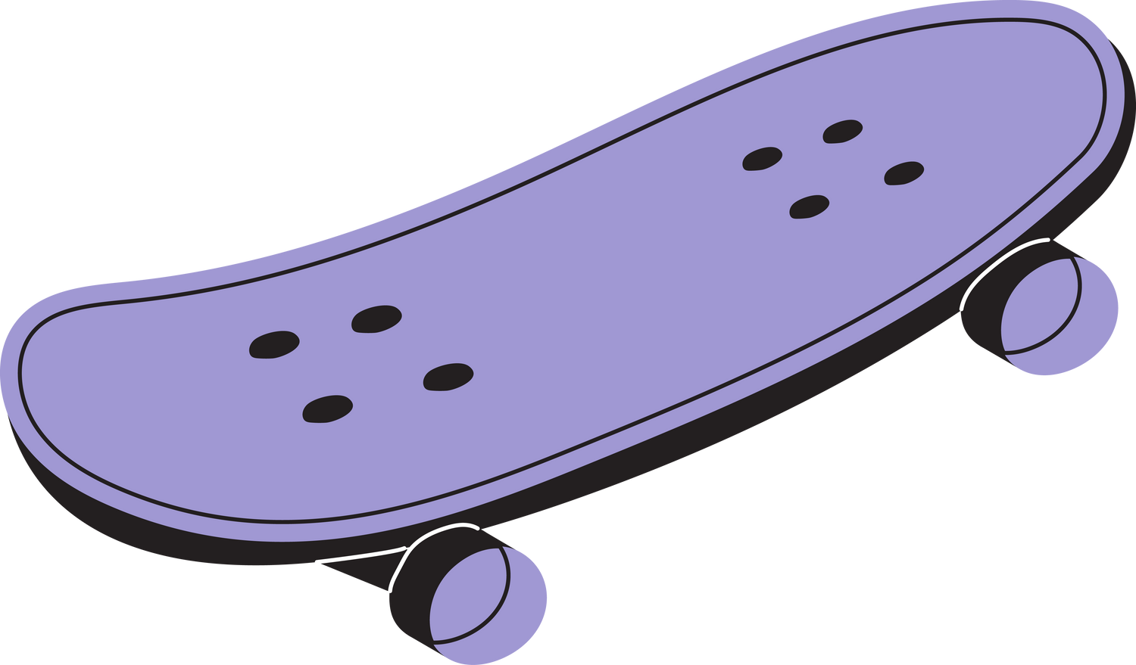
go skateboarding
“My friend and I go skateboarding every Sunday.”

Slide 9
play basketball
“We play basketball on Wednesdays after school.”
“My family and I enjoy going camping twice a year.”

Slide 10
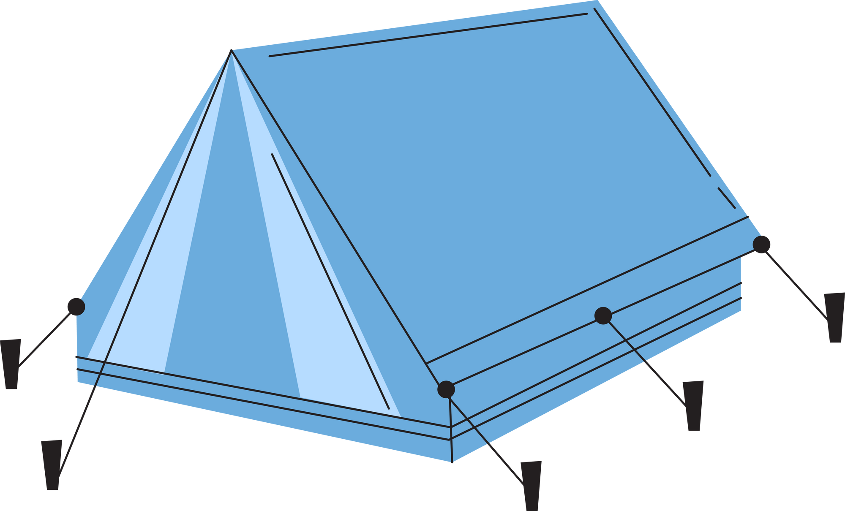
go camping
“My family and I enjoy going camping twice a year.”

Slide 11

indoor activities

Slide 12
painting
"Painting is one of my passions"

Slide 13

listen to music
“ I listen to music whenever I have some free time”

Slide 14
reading
“I enjoy reading before going to bed”

Slide 15
take photos
"I love taking photos. It allows me to capture special moments and express my creativity."

Slide 16
play videogames
“I can spend hours and hours playing my favorite video game”

Slide 17
go to the cinema
“ I like going to the cinema on Sunday evenings”

Slide 18

play chess
“I play chess with my brother twice a week”

Slide 19

What do you do in your free time?

Slide 20
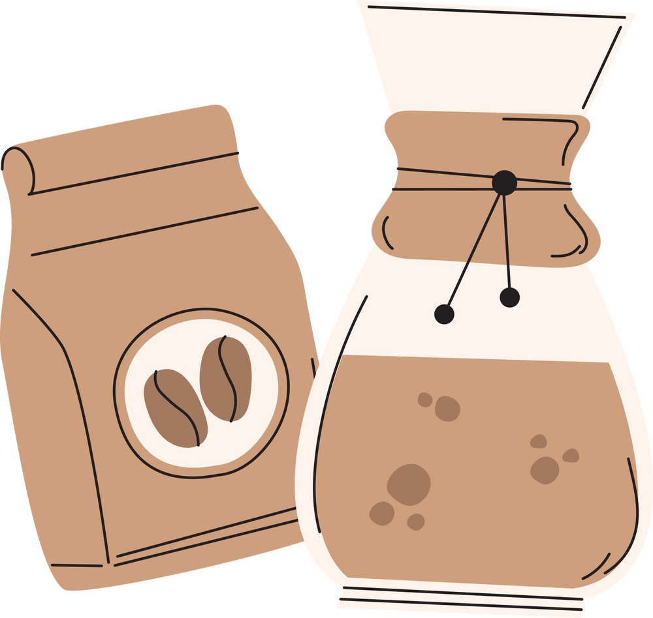
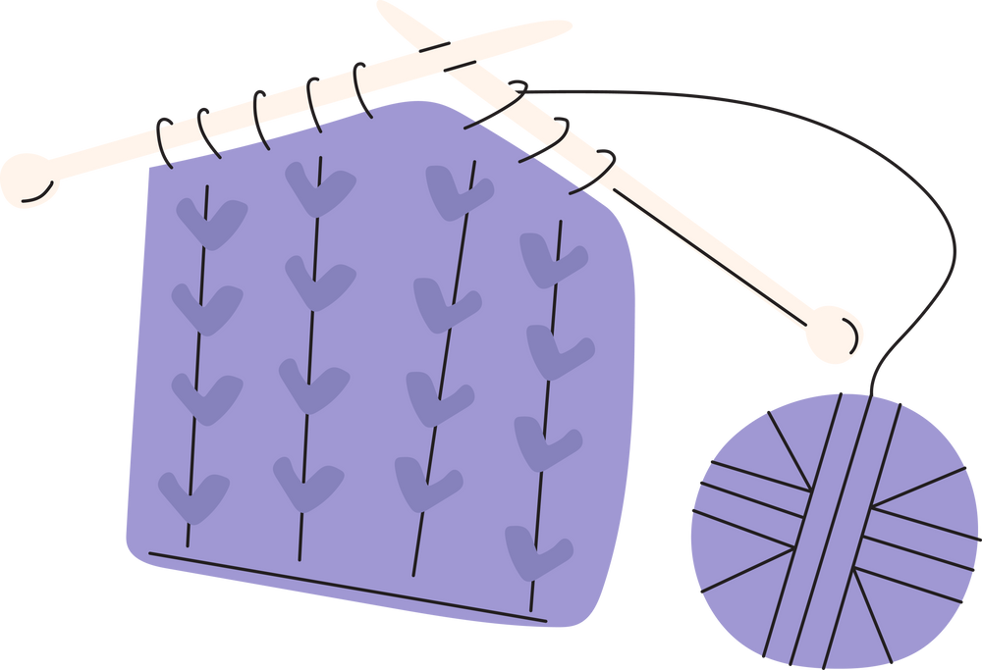
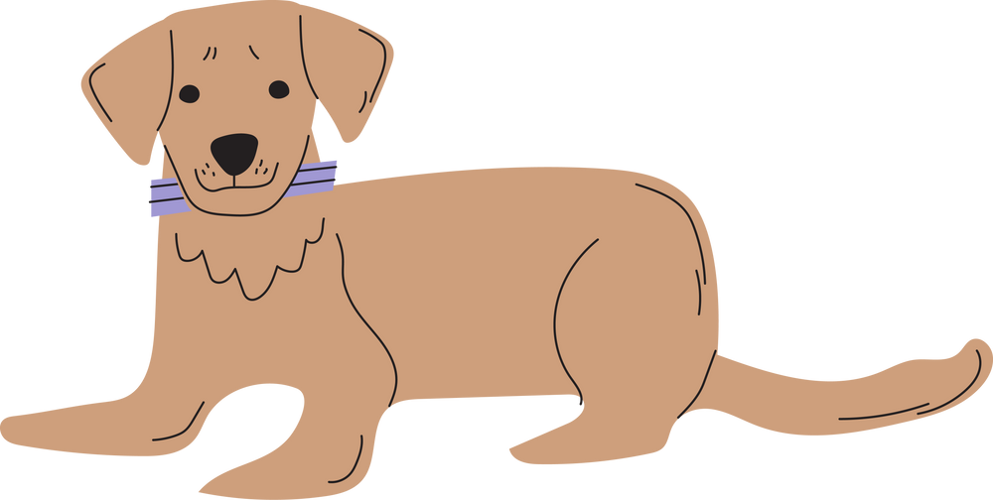



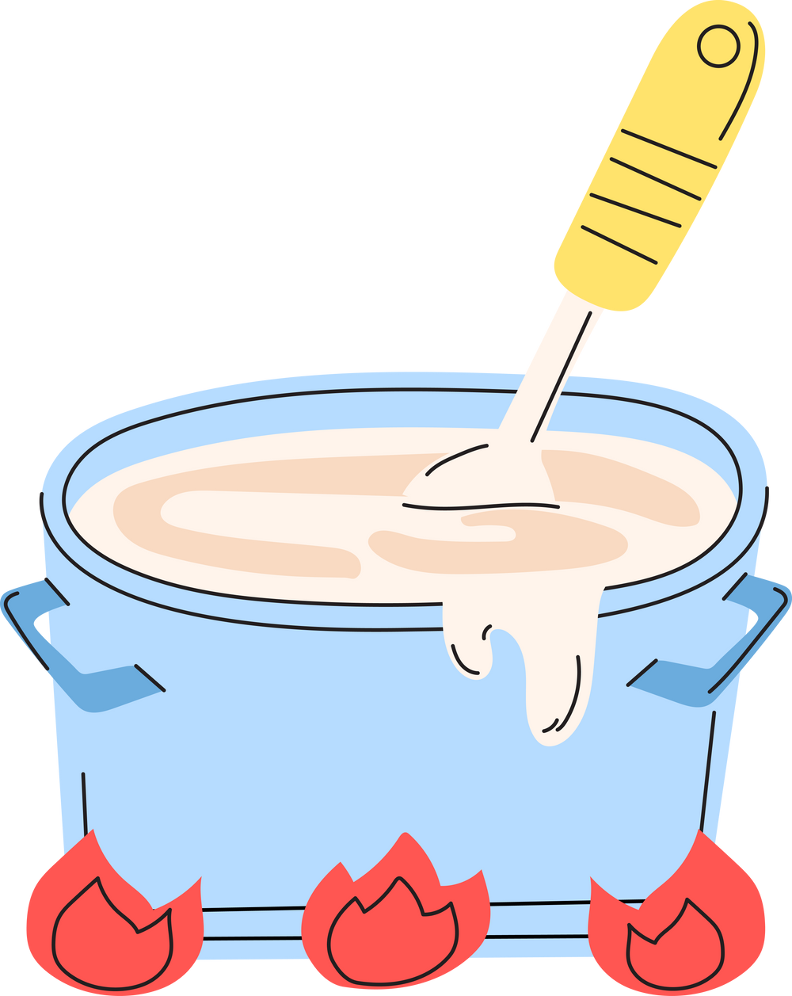

teacher resources page

