Slide 1
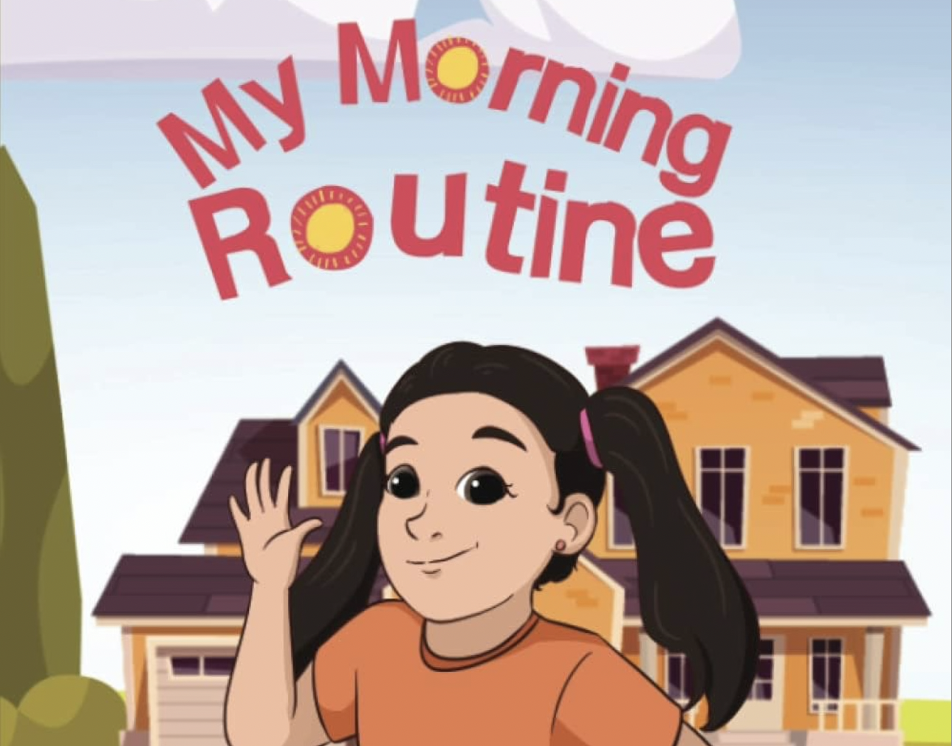

Slide 2
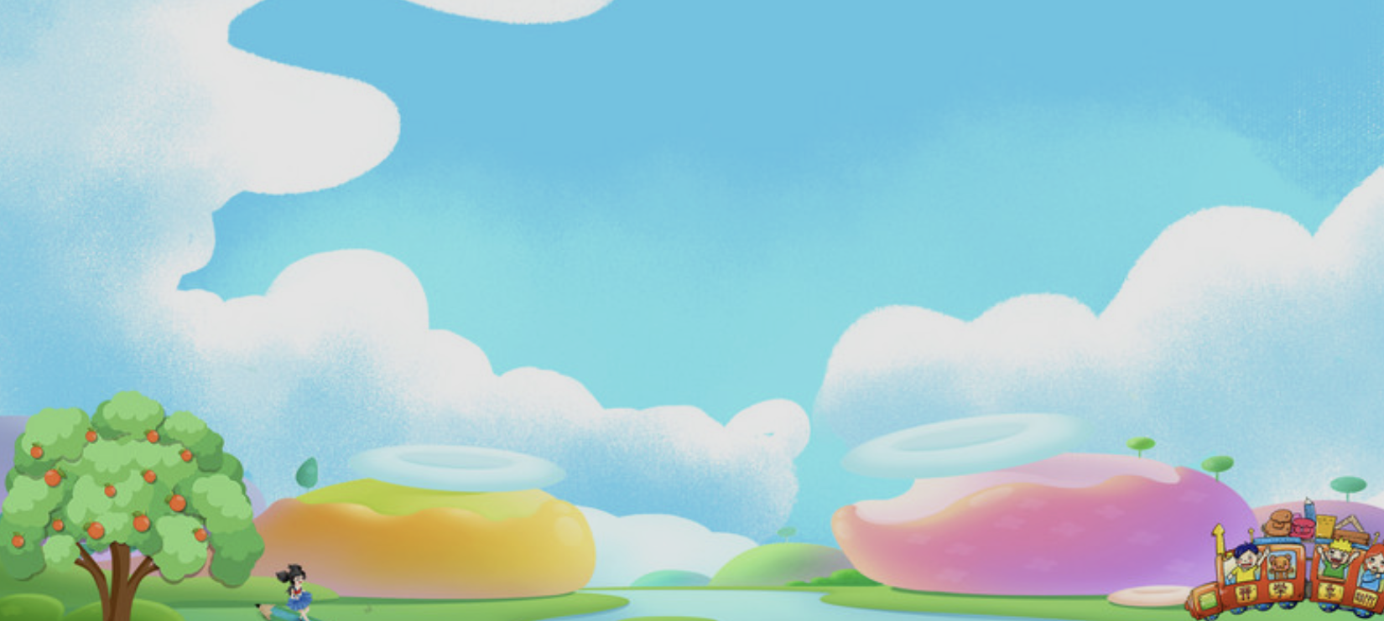
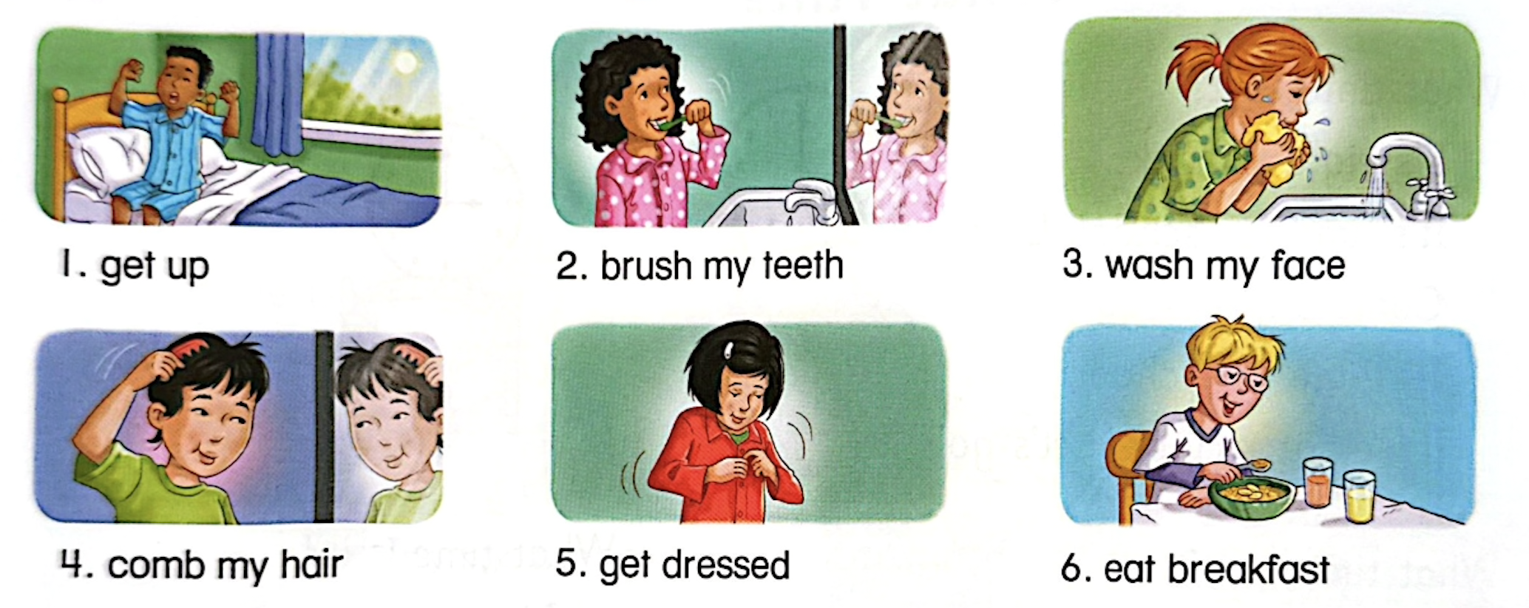
A. Learn the Words

Slide 3
get up

Slide 4
brush my teeth

Slide 5
wash my face

Slide 6
comb my hair

Slide 7
get dressed

Slide 8
eat breakfast

Slide 9
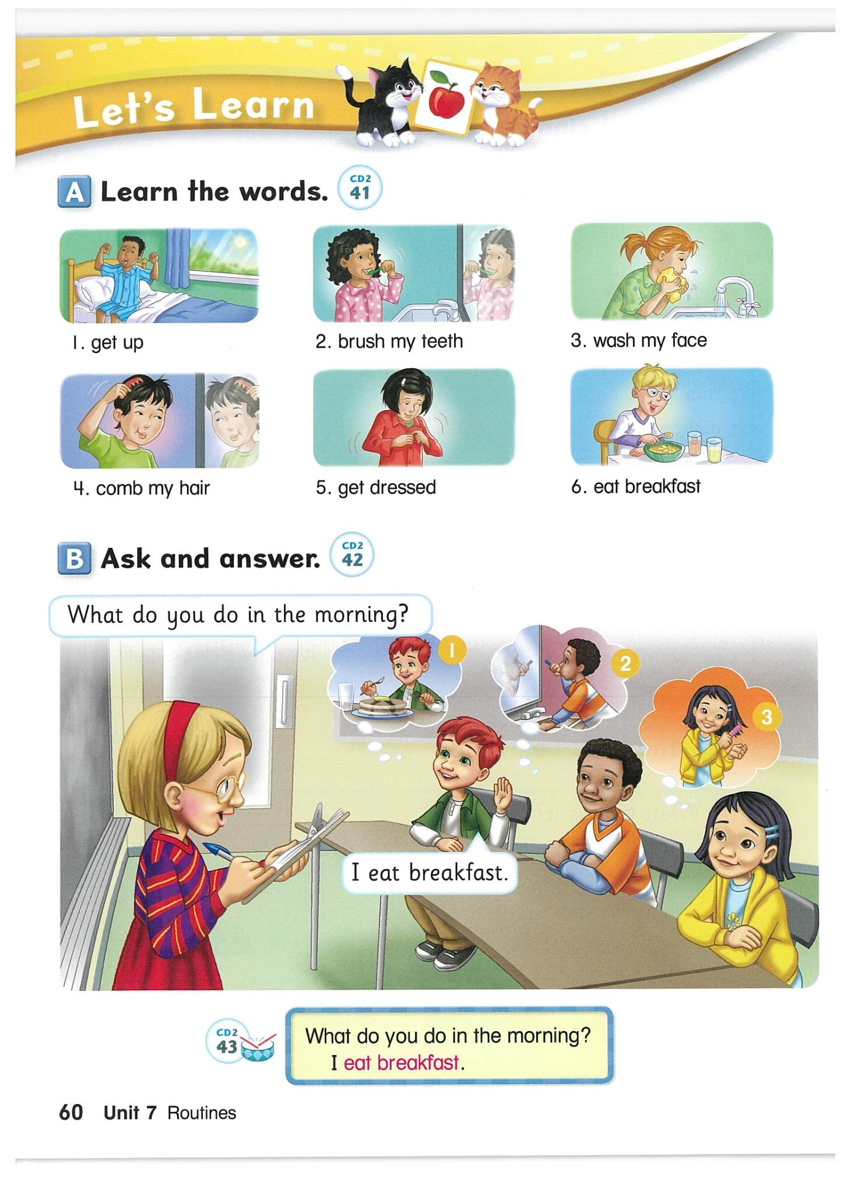
B. Ask and answer

Slide 10
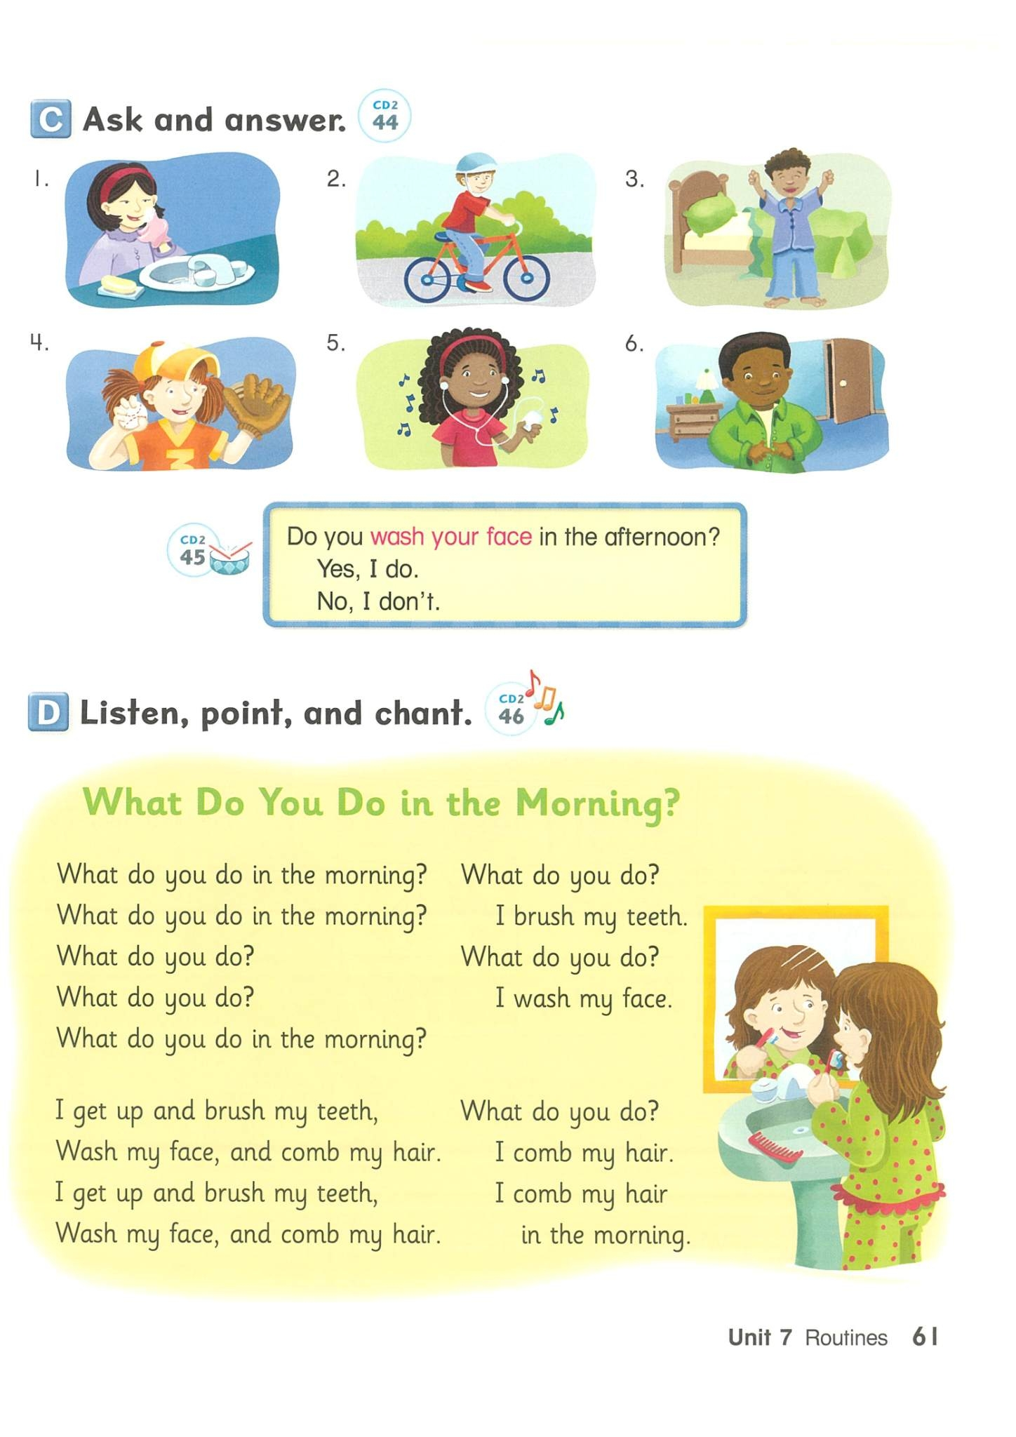
What do you do in the morning?
I ____________.

Slide 11
What do you do in the morning?
I ____________.

Slide 12
What do you do in the morning?
I ____________.

Slide 13
What do you do in the morning?
I ____________.

Slide 14
What do you do in the morning?
I ____________.

Slide 15
What do you do in the morning?
I ____________.

Slide 16
C. Ask and answer
Do you eat breakfast
in the morning?
Yes, I do.
No, I don’t.

Slide 17
Ask and answer
Do you get up
in the morning?
Yes, I do.
No, I don’t.

Slide 18
Ask and answer
Do you get dressed
in the morning?
Yes, I do.
No, I don’t.

Slide 19
Ask and answer
Do you comb your
hair in the morning?
Yes, I do.
No, I don’t.

Slide 20
Ask and answer
Do you brush your
teeth in the morning?
Yes, I do.
No, I don’t.

Slide 21
Ask and answer
Do you wash your
face in the morning?
Yes, I do.
No, I don’t.

Slide 22
Let’s Learn
I ________.
I ________.
I ________.
I ________.
I ________.
I ________.
brush my teeth wash my face get up
get dressed eat breakfast comb my hair

Slide 23


