Slide 1


Slide 2


OCCUPATIONS

Slide 3

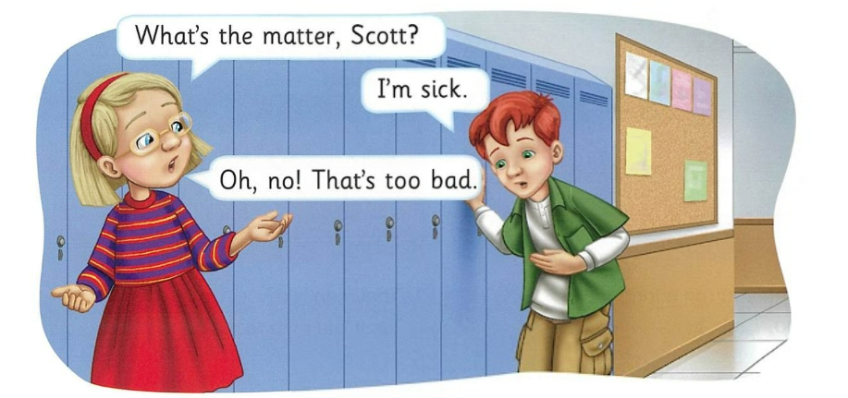


Slide 4
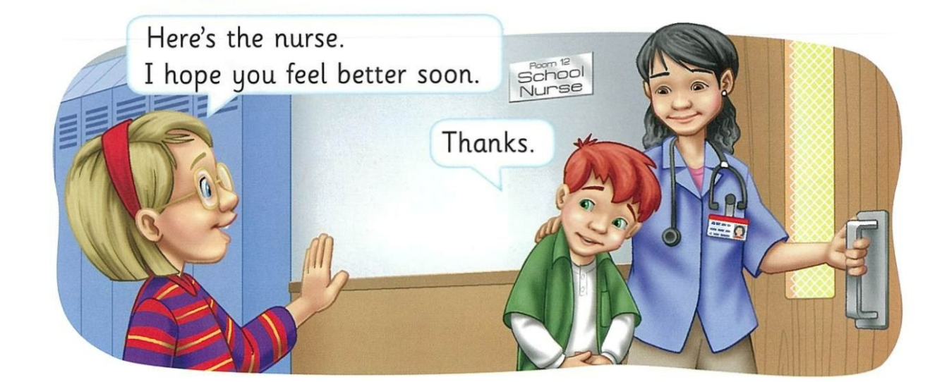

Slide 5
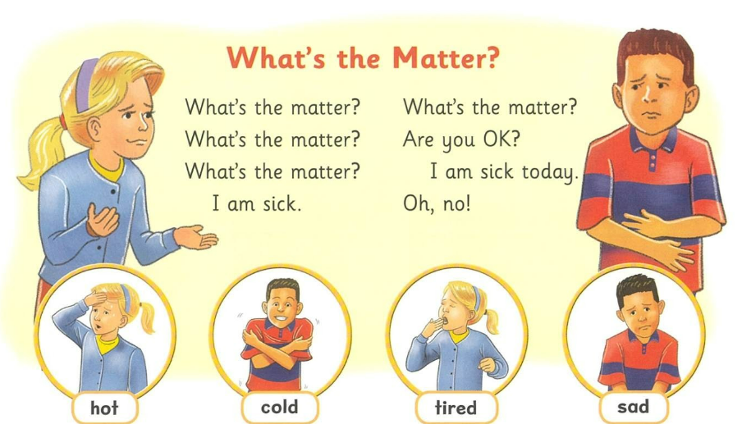

tired
hot
cold
sad
hot
cold
tired
sad

Slide 6
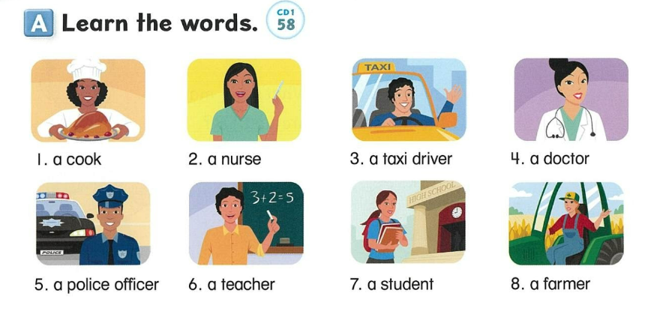


Slide 14
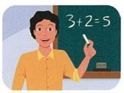
OCCUPATIONS
a teacher

Slide 15

OCCUPATIONS
a student

Slide 16
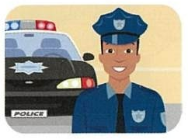
OCCUPATIONS
a police officer

Slide 17
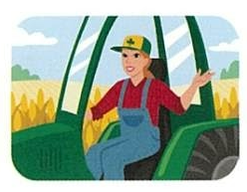
OCCUPATIONS
a farmer

Slide 18

OCCUPATIONS
a nurse

Slide 19

OCCUPATIONS
a doctor

Slide 20
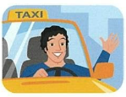
OCCUPATIONS
a taxi driver

Slide 21

OCCUPATIONS
a cook

Slide 22

Let’s Learn More!

Slide 23
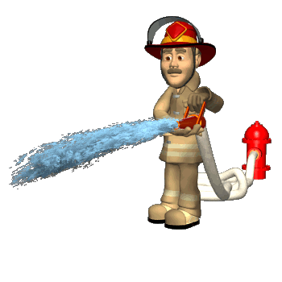
a firefighter

Slide 24
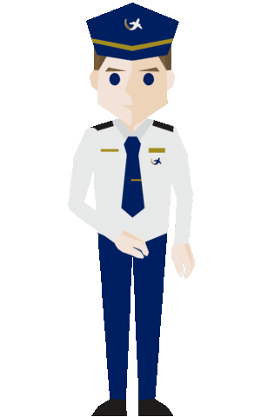

a pilot

Slide 25

a carpenter

Slide 26
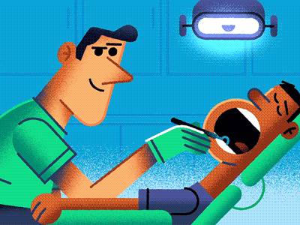
a dentist

Slide 27

a baker

Slide 29
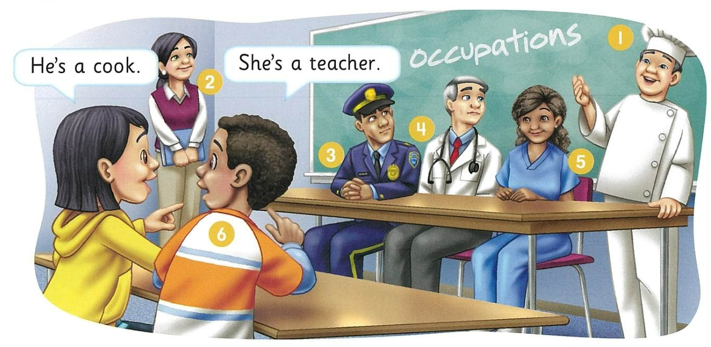
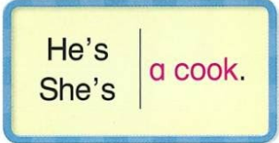

Slide 35
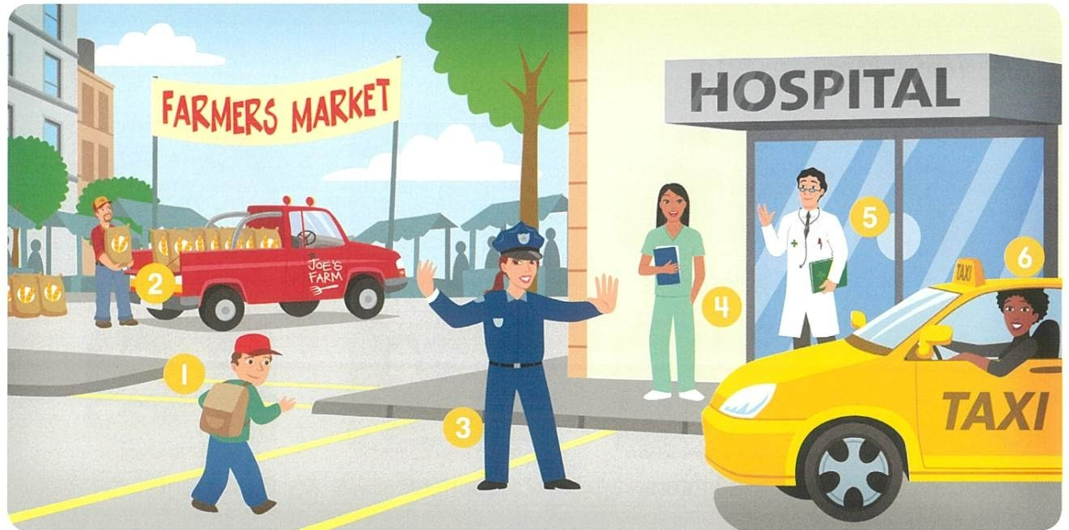
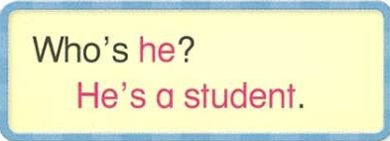

Slide 41


Workbook
Page 30
(A & B)

Slide 42
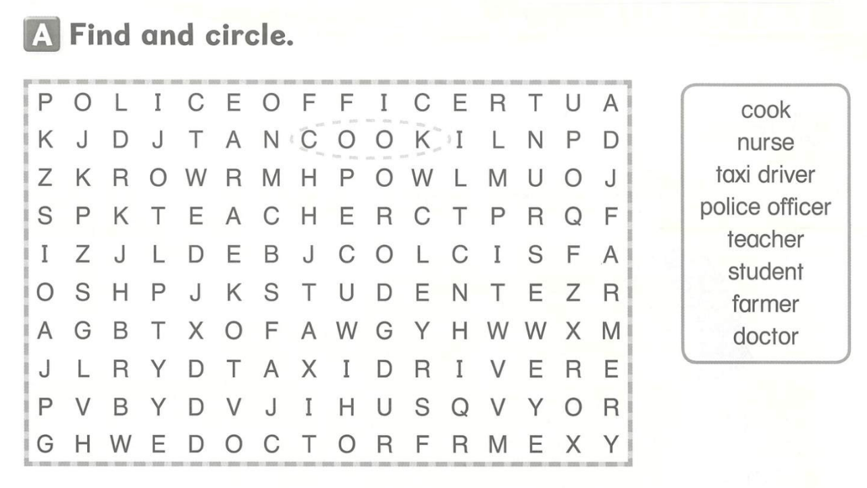

Slide 43
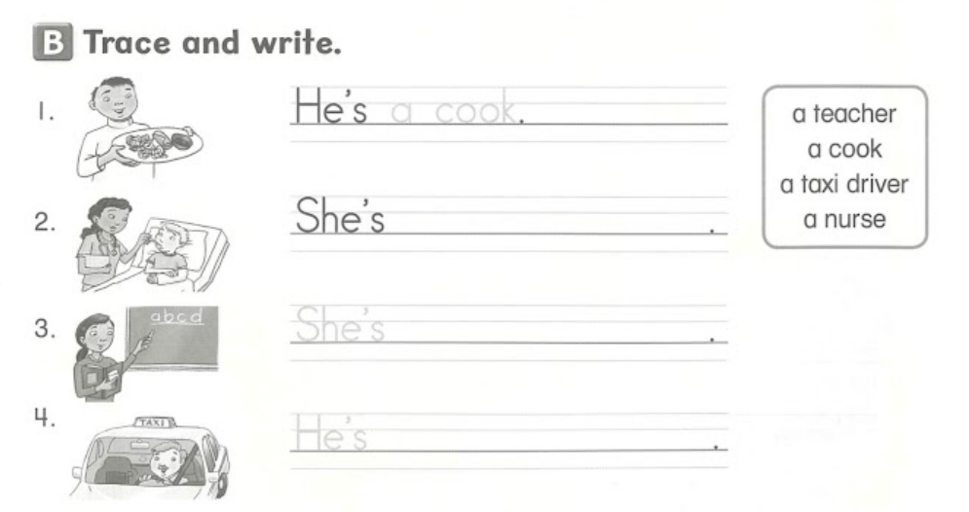

Slide 44
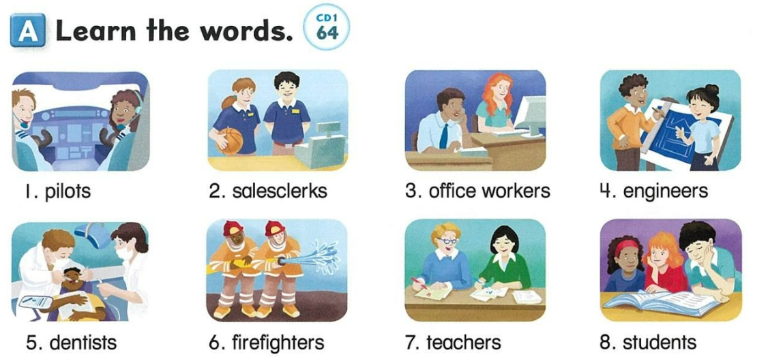

Slide 52
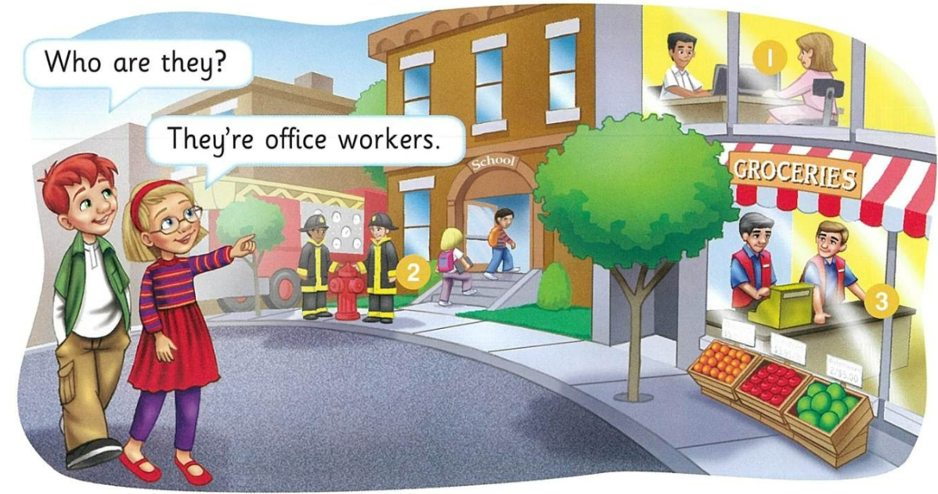
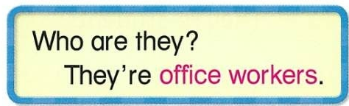

Slide 57
Workbook
page 31-C
page 32-A

Slide 58


Slide 59
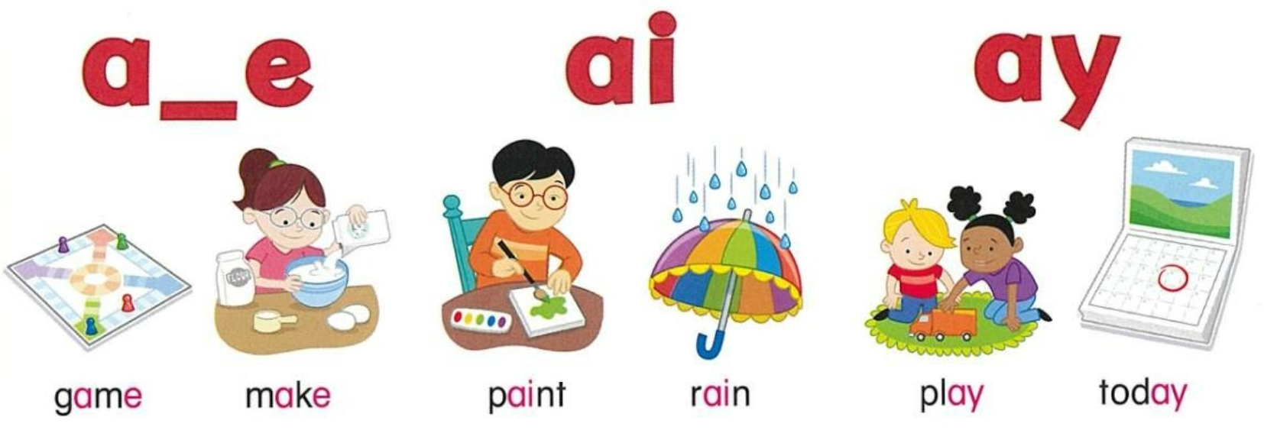

Slide 60
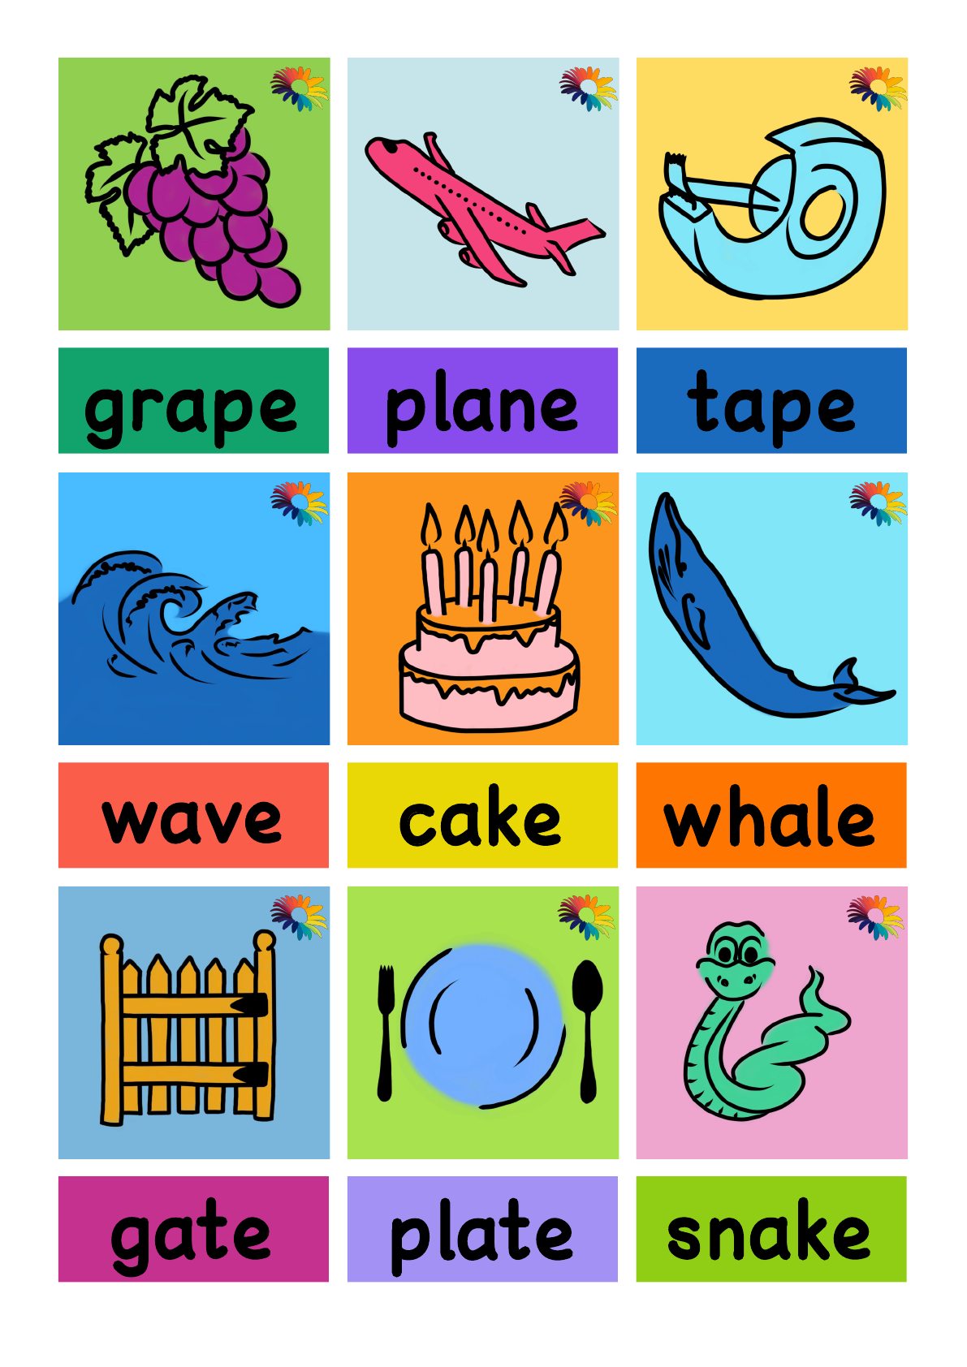

Slide 61


Slide 62
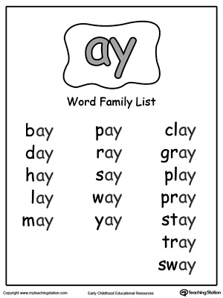

Slide 63
