Slide 1

FOOD

Slide 2
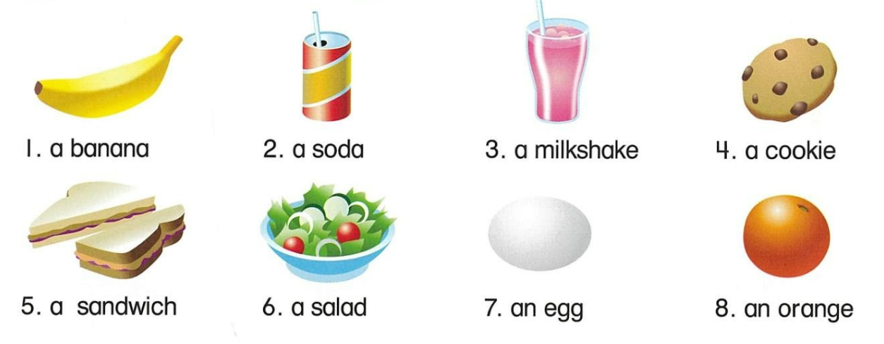
Let’s learn!

Slide 3
Let’s learn!

Slide 4
Let’s learn!

Slide 5
Let’s learn!

Slide 6
Let’s learn!

Slide 7
Let’s learn!

Slide 8
Let’s learn!

Slide 9
Let’s learn!

Slide 10
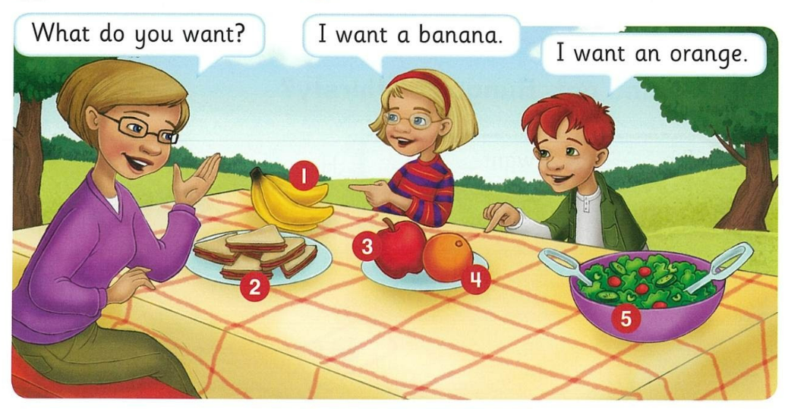

Ask and answer

Slide 11
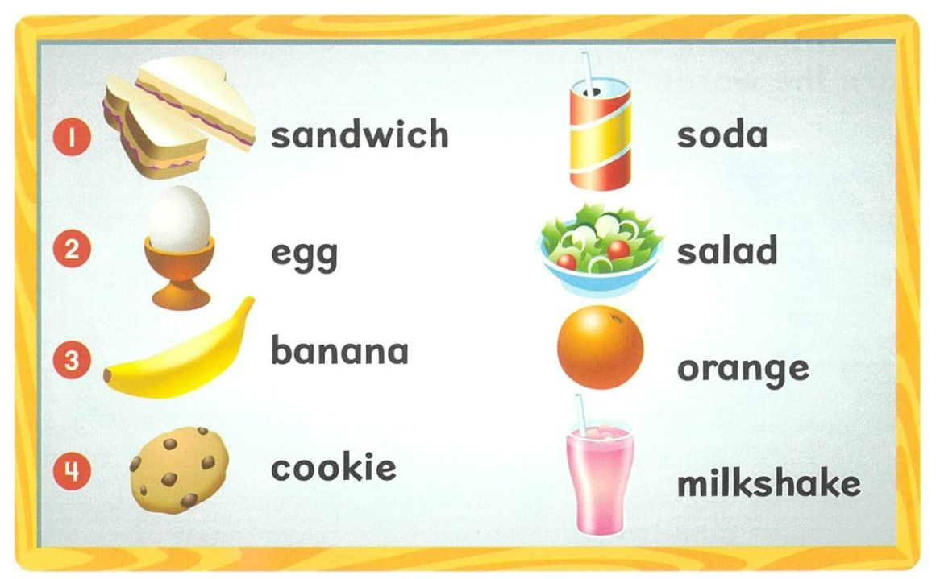
What do you want?

Slide 12
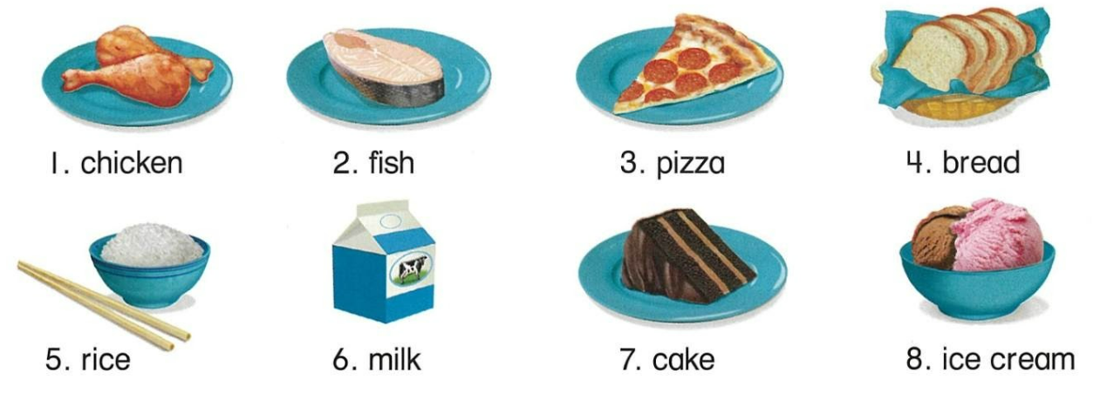
Let’s learn!

Slide 13
Let’s learn!

Slide 14
Let’s learn!

Slide 15
Let’s learn!

Slide 16
Let’s learn!

Slide 17
Let’s learn!

Slide 18
Let’s learn!

Slide 19
Let’s learn!

Slide 20
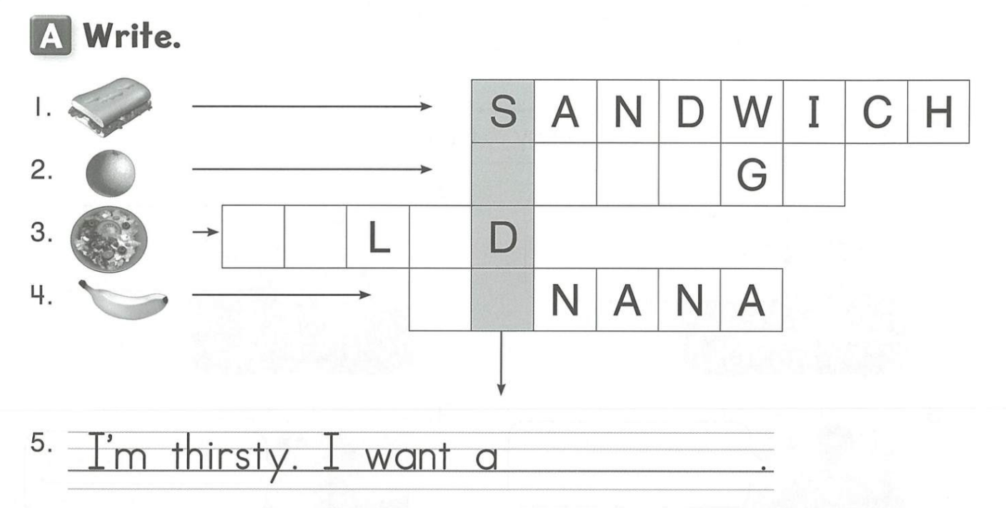
O
R
A
N
E
S
A
A
B
A
soda

Slide 21
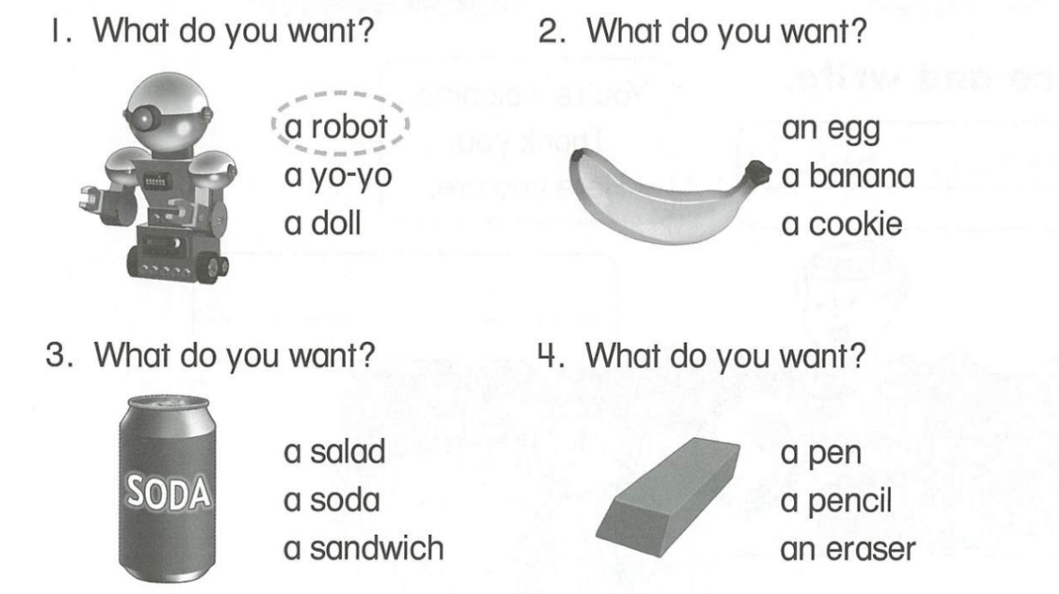



Slide 22
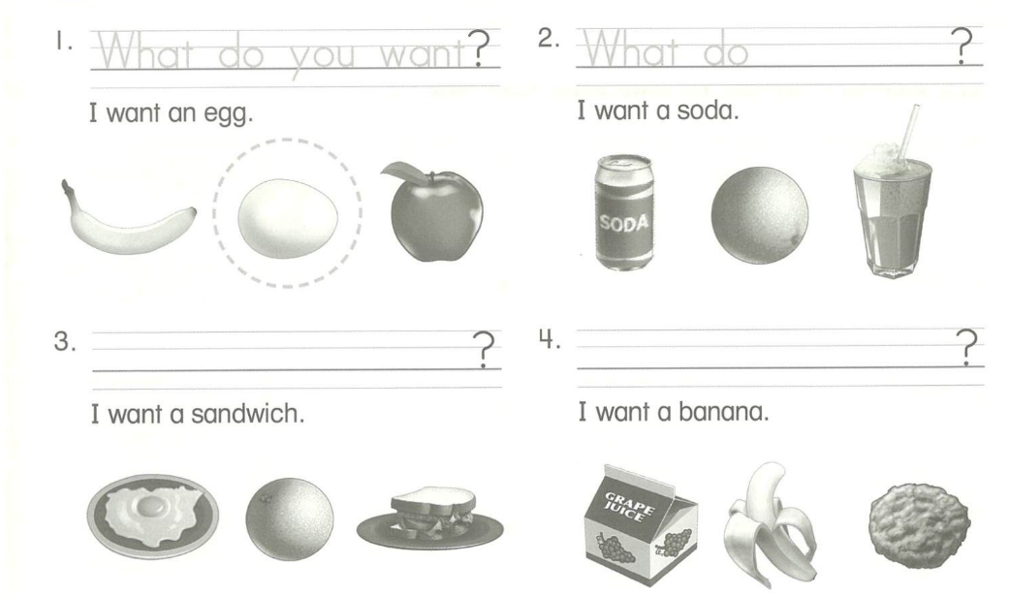

What do you want
What do you want

Slide 23
