Slide 1
Unit 11: Decimals

Slide 2
Tenths

Slide 3
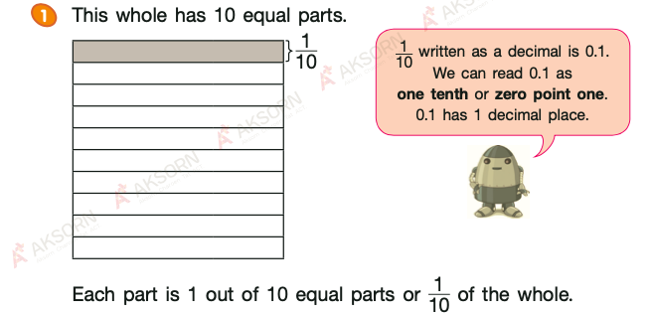

Slide 4
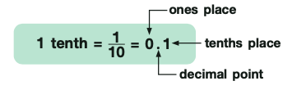

Slide 5
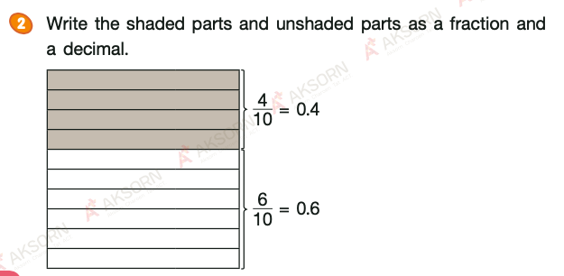

Slide 6
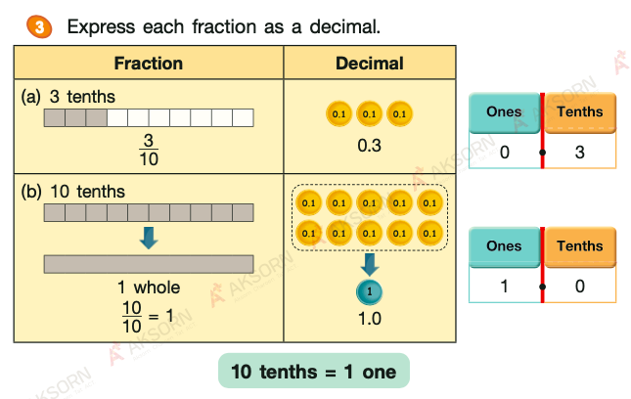

Slide 7
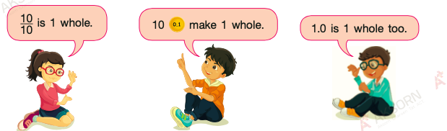

Slide 8
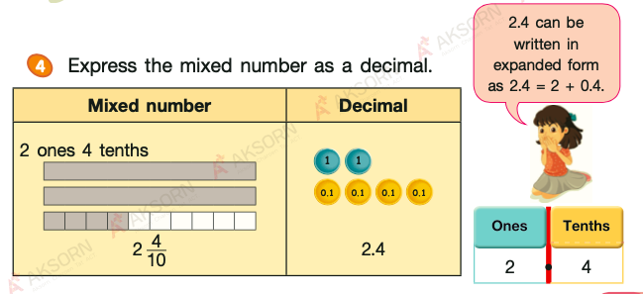

Slide 9
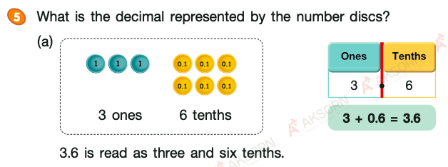

Slide 10
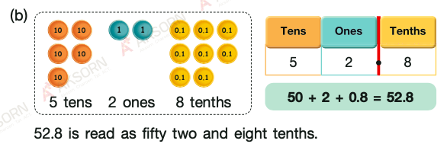

Slide 11
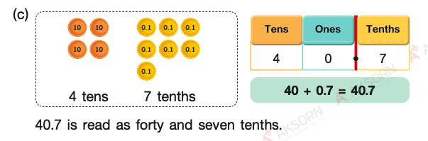

Slide 12
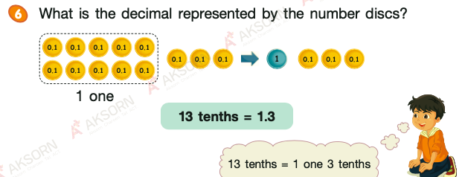

Slide 13
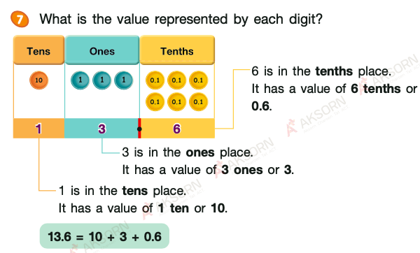

Slide 14
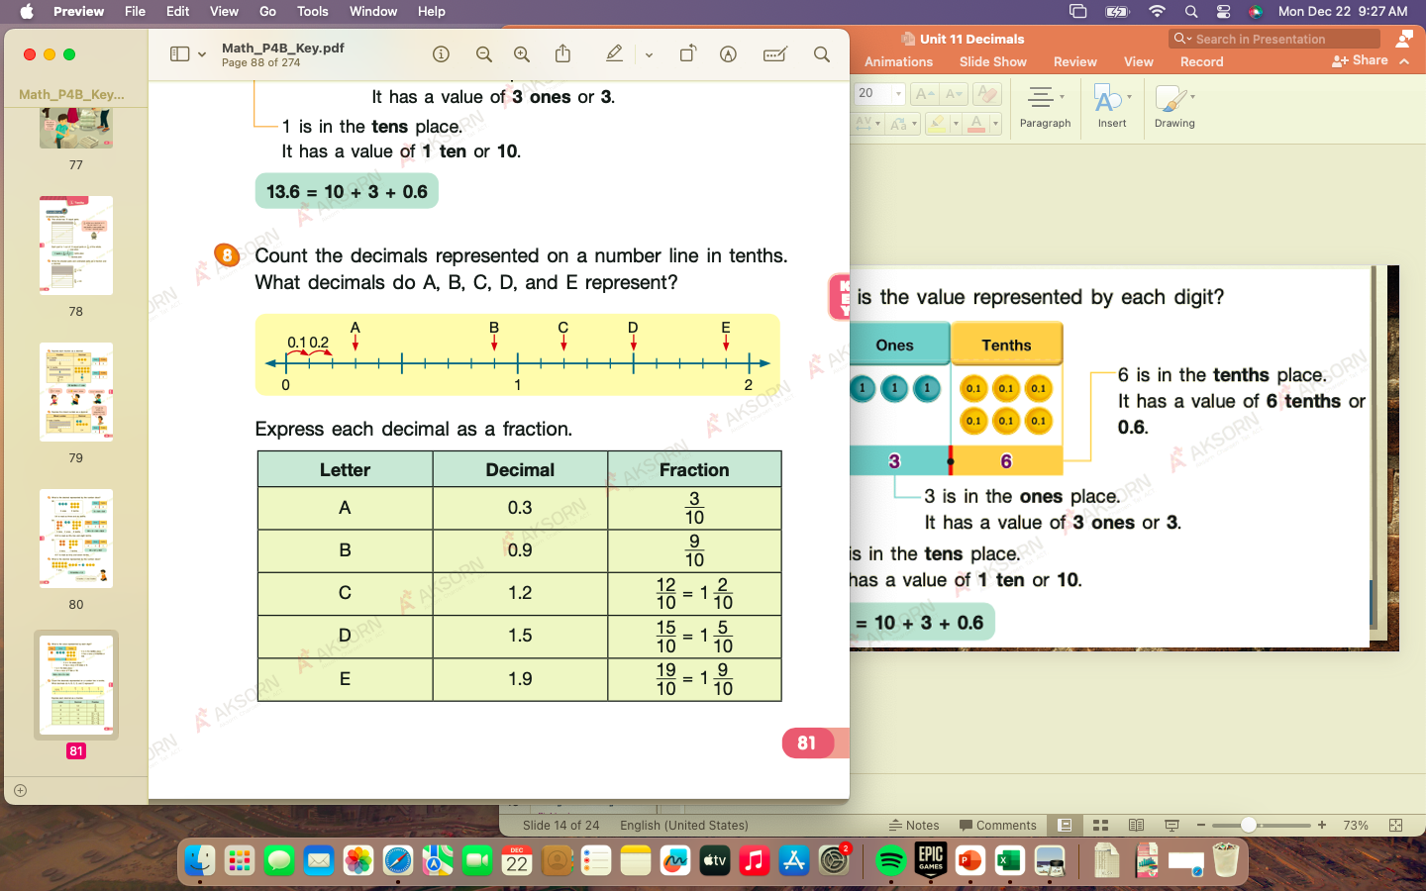

Slide 16
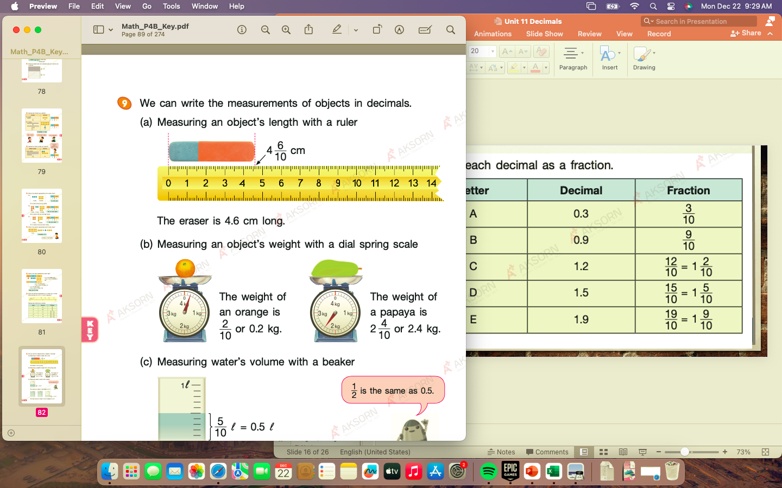

Slide 18
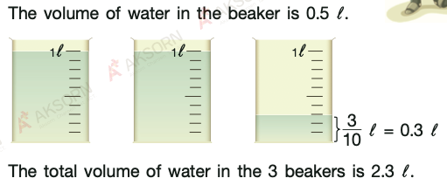

Slide 19
Hundredths

Slide 20
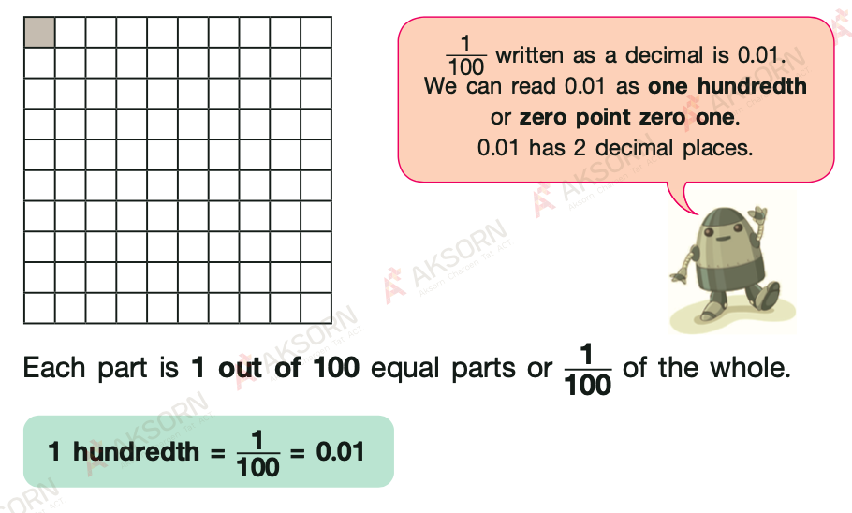

Slide 21
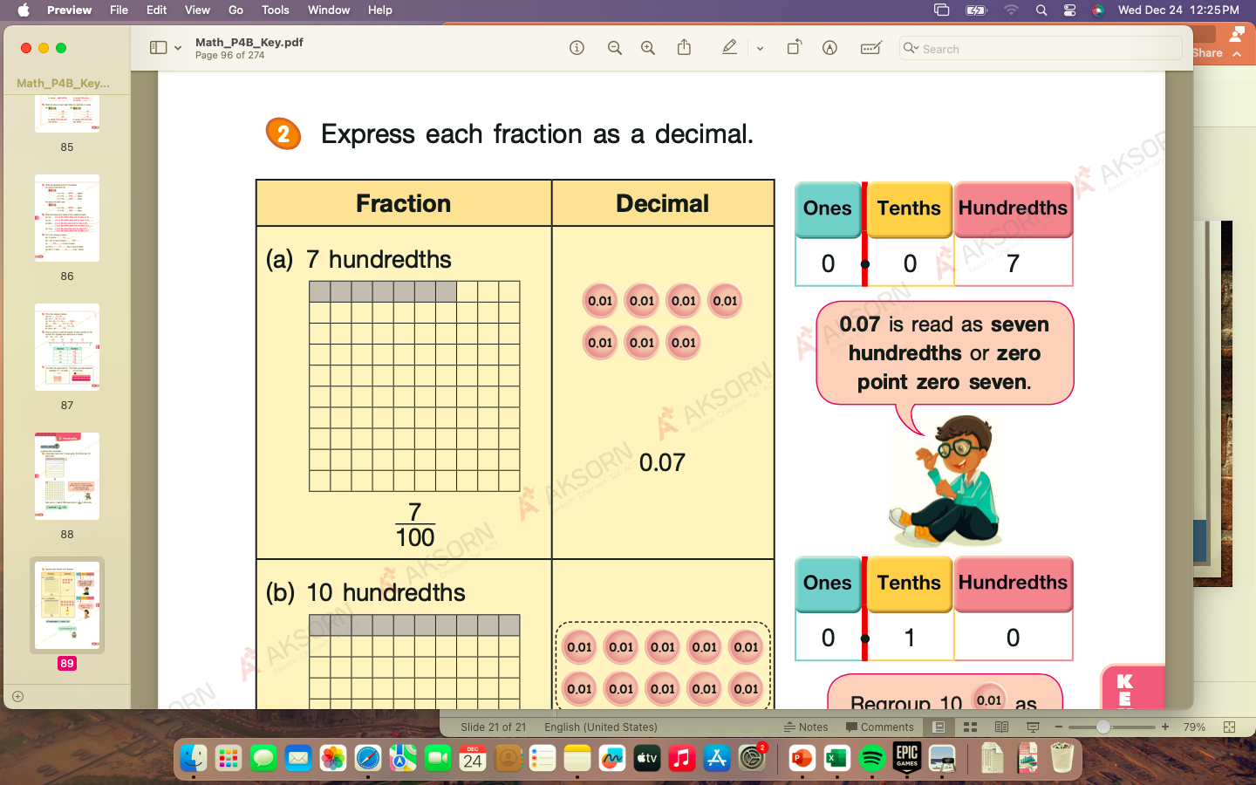

Slide 22
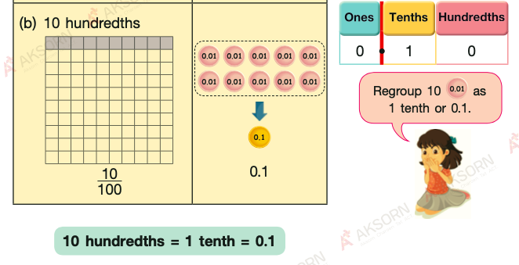

Slide 23
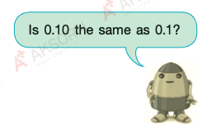

Slide 24
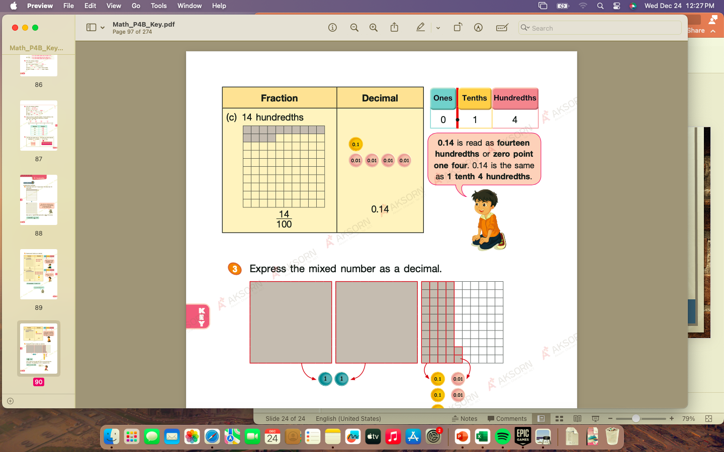

Slide 25
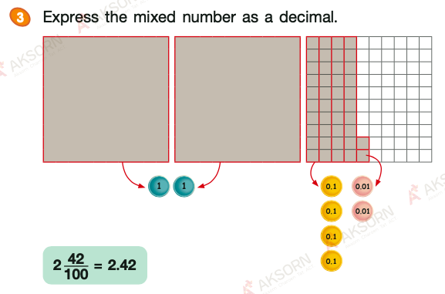

Slide 26
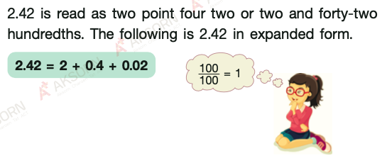

Slide 27
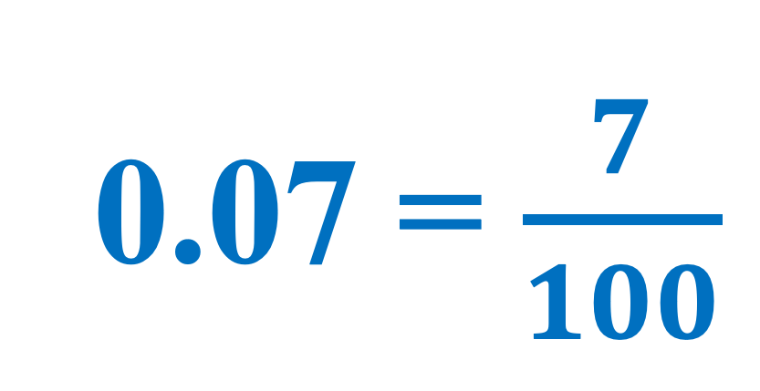
What are the decimals represented by the shaded figures?
Express each decimal as a fraction.
1
0.07 = $\frac{7}{100}$

Slide 28
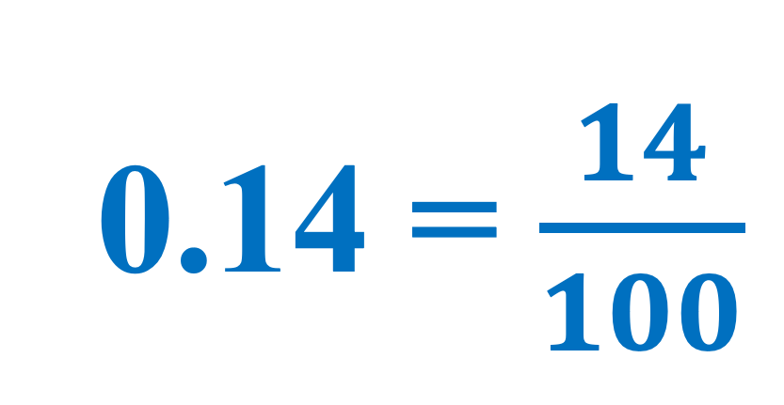
What are the decimals represented by the shaded figures?
Express each decimal as a fraction.
1
0.14 = $\frac{14}{100}$

Slide 29
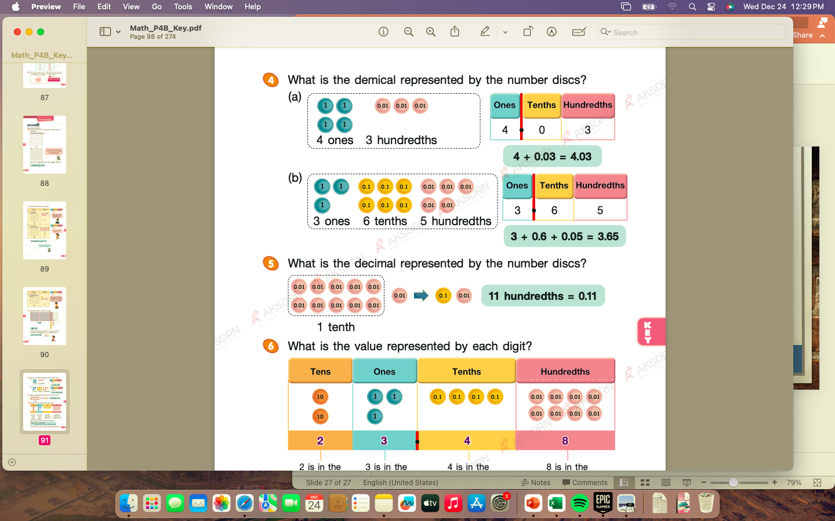
4.03

Slide 30
3.65

Slide 32
3
Write the decimals in words.
Examples:
thirty-two hundredths
0.32
3.45
three and forty-five hundredths
94.51
ninety-four and fifty-one hundredths

Slide 33
4
Write the decimals.
Examples:
four and five hundredths
4.05
ten and fifty hundredths
10.50
one hundredth
0.01

Slide 34
six and eighty-four hundredths
forty hundredths
twenty-five hundredths
one and thirty-two hundredths
three and ninety-nine hundredths
seven and eighteen hundredths
fifteen and six hundredths
nine and ten hundredths

Slide 35
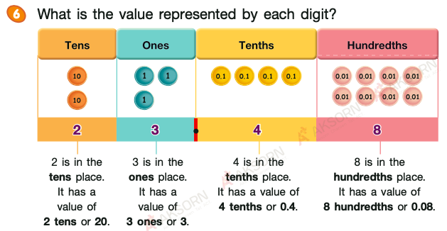

Slide 36
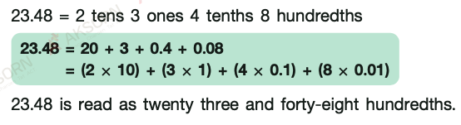

Slide 38
In 43.87,
40
the digit 4 has a value of
the digit 8 has a value of
0.8
the digit 3 has a value of
3
the digit 7 has a value of
0.07

Slide 39
In 43.87,
the digit 4 is in the
tens
place
tenths
place
the digit 8 is in the
the digit 7 is in the
hundredths
place
ones
the digit 3 is in the
place

Slide 40
Thousandths

Slide 41
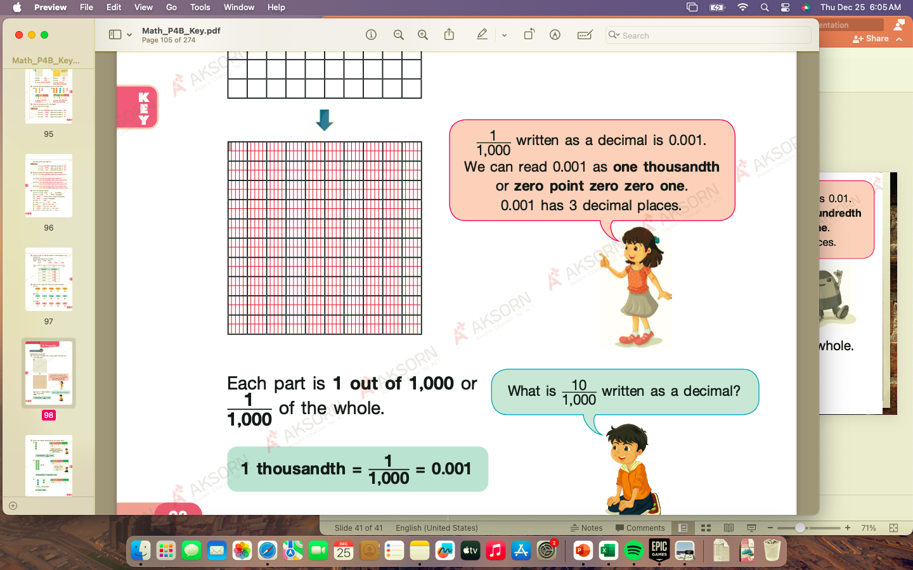

Slide 43
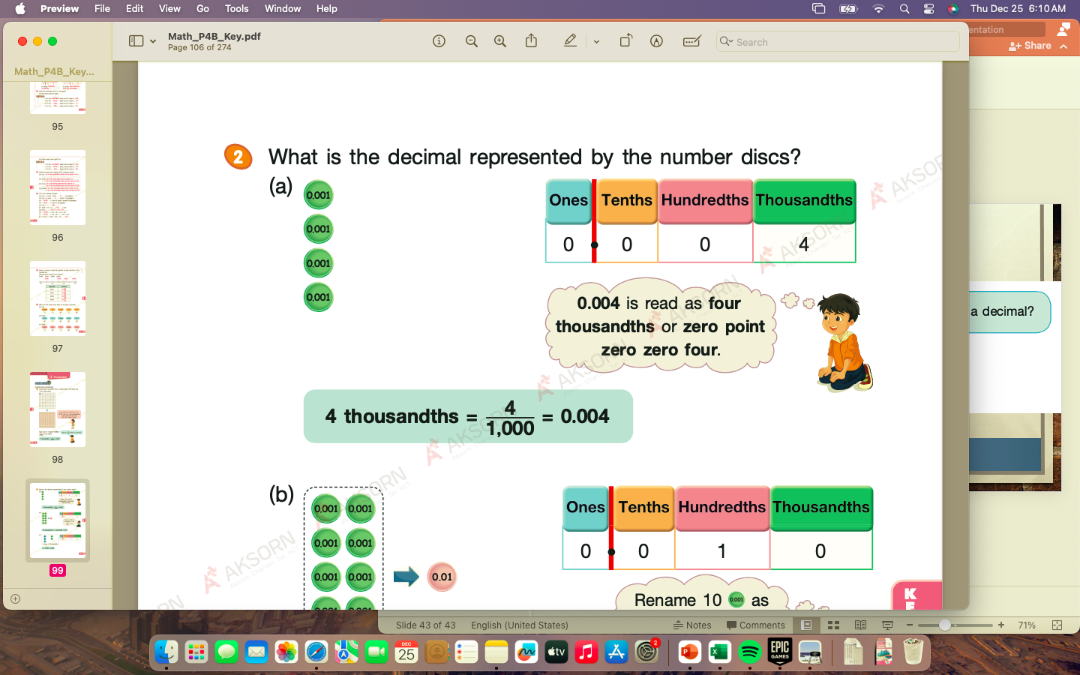

Slide 44
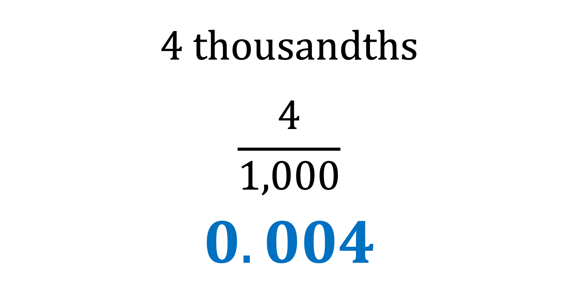
4 thousandths
$$\frac{4}{1,000}$$
$$0.004$$

Slide 45
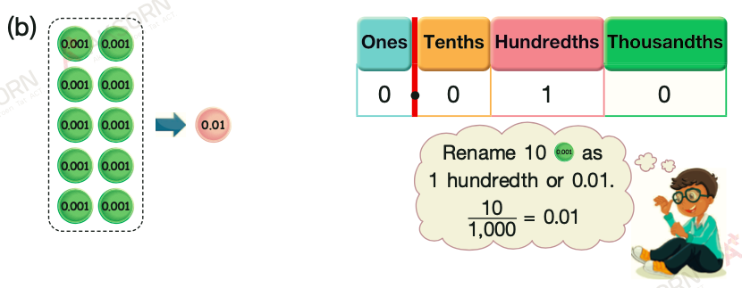

Slide 46
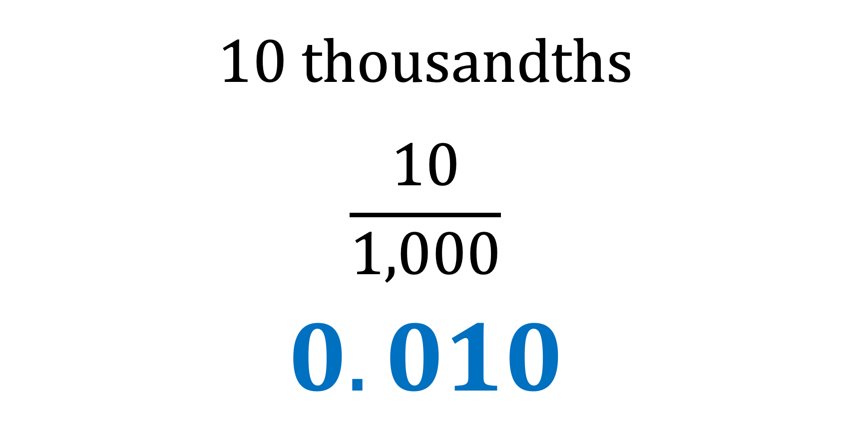
10 thousandths
$$\frac{10}{1,000}$$
$$0.010$$

Slide 47
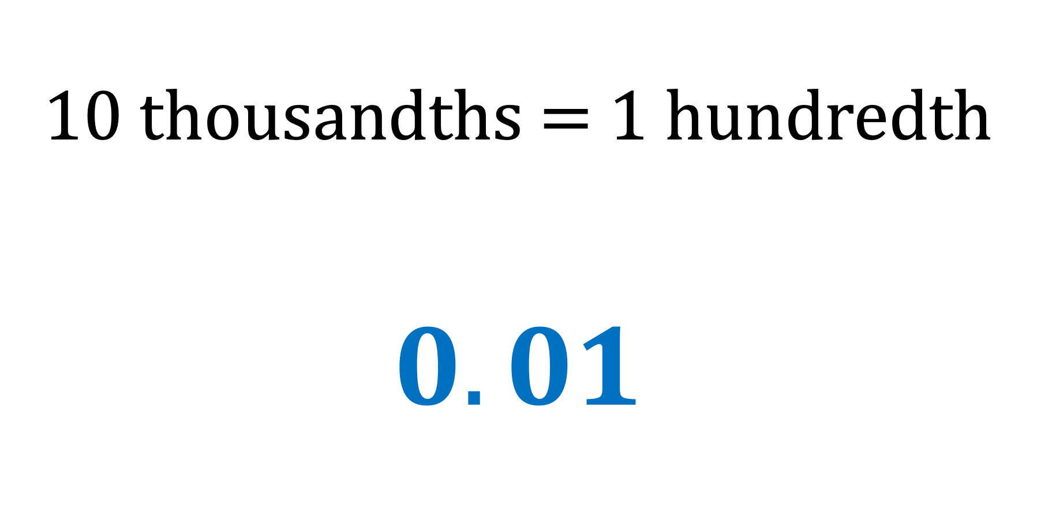
10 thousandths = 1 hundredth
$$0.01$$

Slide 48
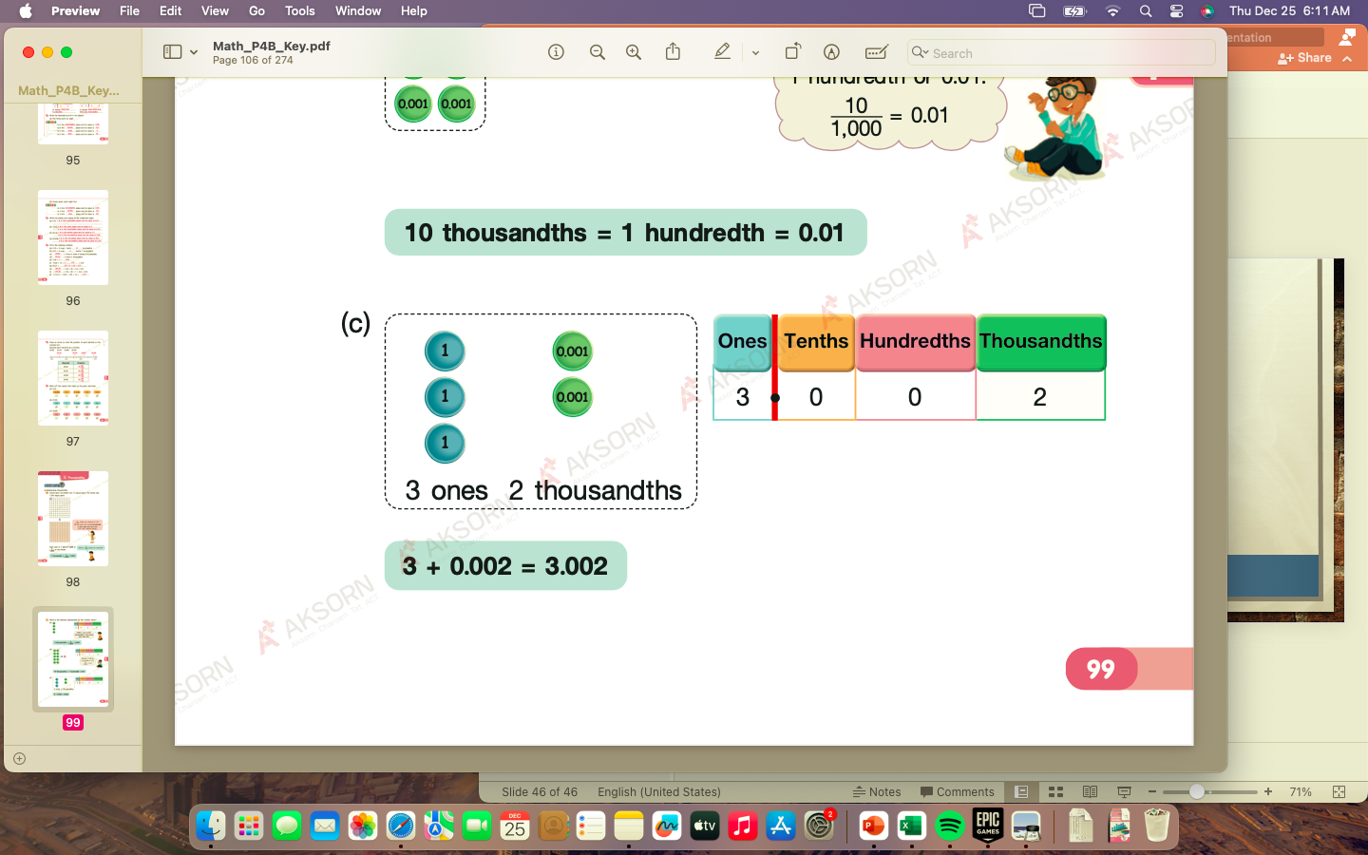
3 + 0.002 =
3.002

Slide 49
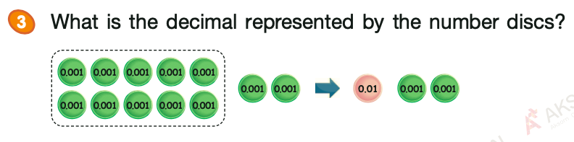
12 thousandths =
0.012

Slide 50
1
Write the decimals represented by the number discs.
Example:
0.004
In words: four thousandths

Slide 51
3.002
In words: three and two thousandths

Slide 52
In 0.924,
the digit 4 has a value of
0.004
0.02
the digit 2 has a value of
0.9
the digit 9 has a value of

Slide 53
In 0.924,
the digit 9 is in the
tenths
place
the digit 2 is in the
hundredths
place
the digit 4 is in the
thousandths
place

Slide 54
In 5.836,
the digit 5 has a value of
5
the digit 8 has a value of
0.8
the digit 3 has a value of
0.03
the digit 6 has a value of
0.006

Slide 55
In 5.836,
the digit 5 is in the
ones
place
the digit 8 is in the
tenths
place
the digit 3 is in the
hundredths
place
the digit 6 is in the
thousandths
place

Slide 56
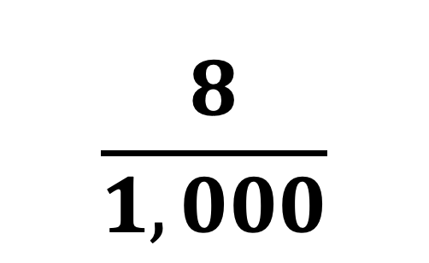
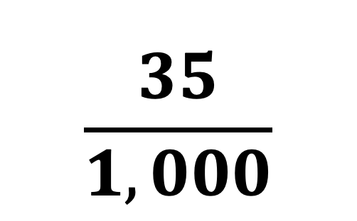
Fraction
Decimal
$$\frac{35}{1,000}$$
0.035
$$\frac{8}{1,000}$$
0.008

Slide 57
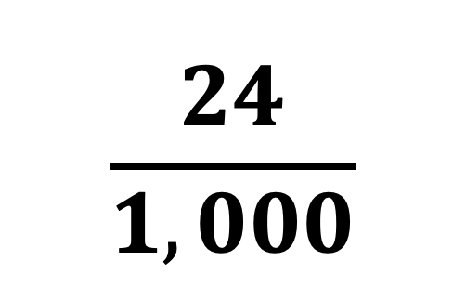
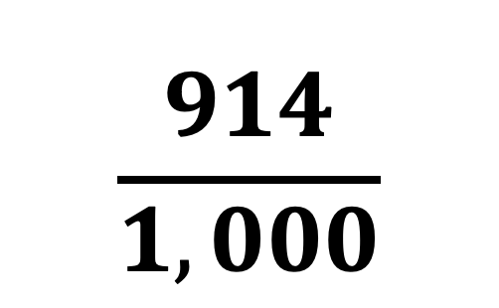
Fraction
Decimal
$$\frac{914}{1,000}$$
0.914
$$\frac{24}{1,000}$$
0.024

Slide 58
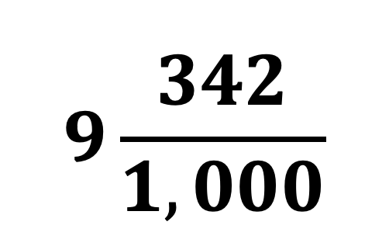
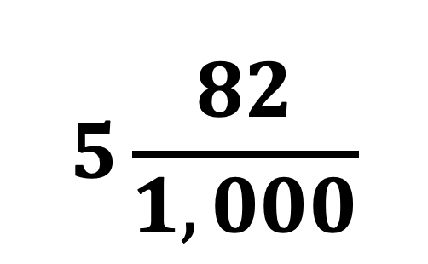
Fraction
Decimal
$$5\frac{82}{1,000}$$
5.082
$$9\frac{342}{1,000}$$
9.342

Slide 59
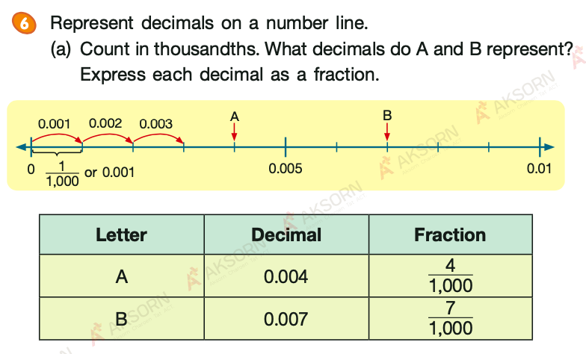

Slide 60
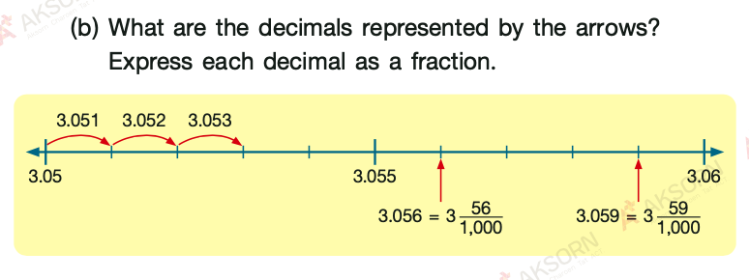

Slide 61
Write the places and values of the underlined digits.
Example:
a) 0.235
2 is in the tenths place and its value is 0.2
b) 0.548
8 is in the thousandths place and its value is 0.008

Slide 62
Comparing and Ordering Decimals up to Thousandths

Slide 63
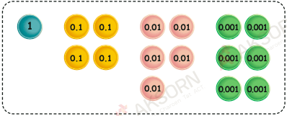
The number discs represent 1.456.

Slide 64
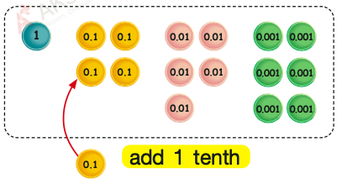
(a) What is 0.1 more than 1.456?
0.1 more than 1.456 is 1.556
1.556 > 1.456

Slide 65
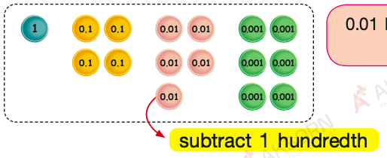
(b) What is 0.01 less than 1.456?
0.01 less than 1.456 is 1.446
1.446 < 1.456

Slide 66
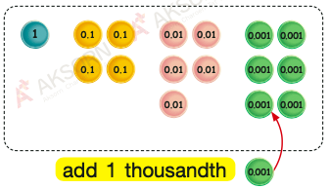
(c) What is 0.001 more than 1.456?
0.001 more than 1.456 is 1.457
1.457 > 1.456

Slide 67
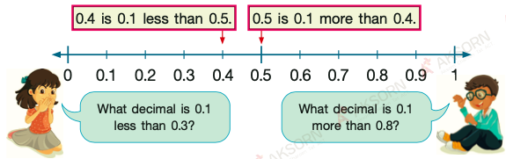
Compare decimals using a number line.
0.2 is 0.1 less than 0.3
0.9 is 0.1 more than 0.8

Slide 68
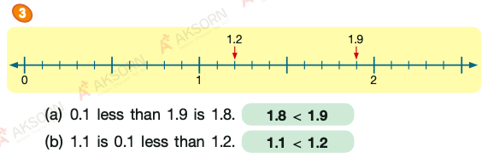

Slide 69
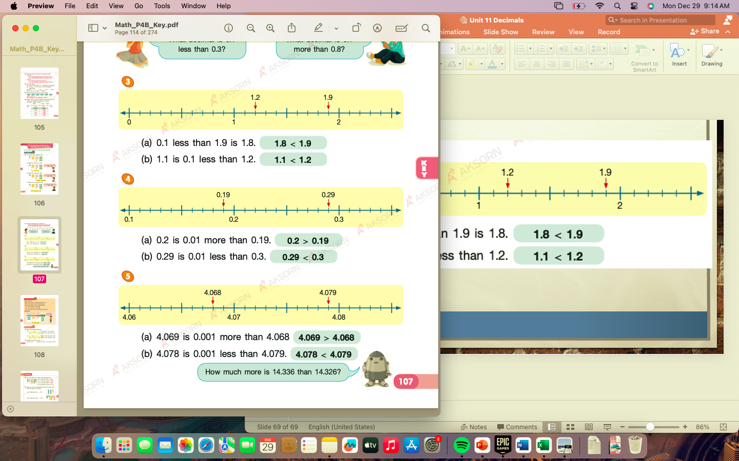

Slide 71
Comparing and Ordering Decimals

Slide 72
1. Which is smaller, 15.5 or 15.4?
2. Which is the greatest, 1.26, 1.24, or 1.22?
3. Compare 2.307, 2.7, and 2.39. Arrange the decimals in decreasing order.

Slide 73
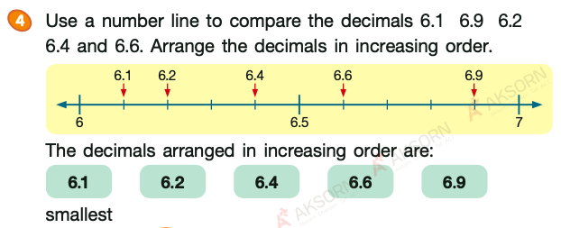

Slide 74


Slide 75


