Slide 1
Division with Remainders

Slide 2
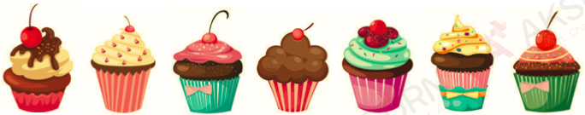
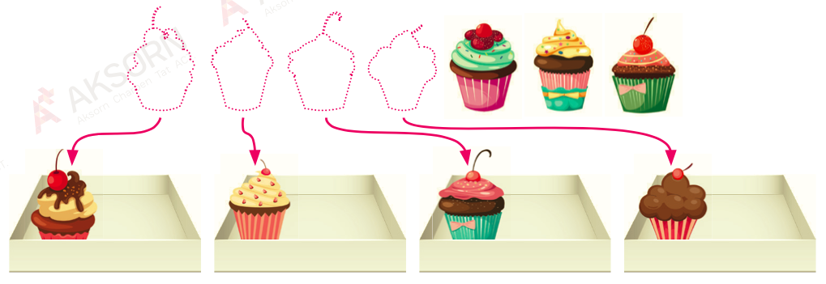
Can we put them equally into 4 trays?

Slide 3
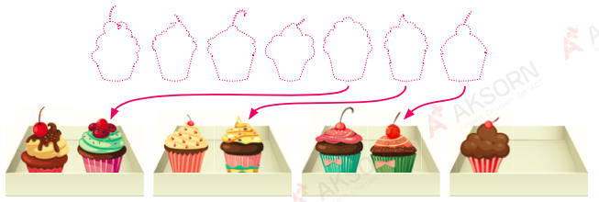
Can we put 3 cupcakes equally into 4 trays?
2 cupcakes
2 cupcakes
2 cupcakes
1 cupcake

Slide 4
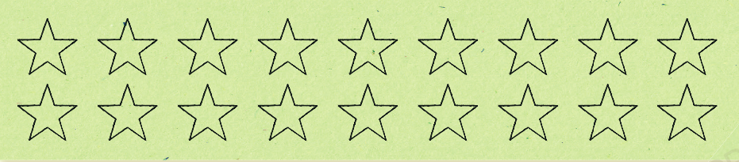

Siti draws 18 stars on a piece of paper.
She puts the stars into groups of 4.
There are 4 groups of stars with 2 stars left over.
$$18÷4=4 R 2$$

Slide 5
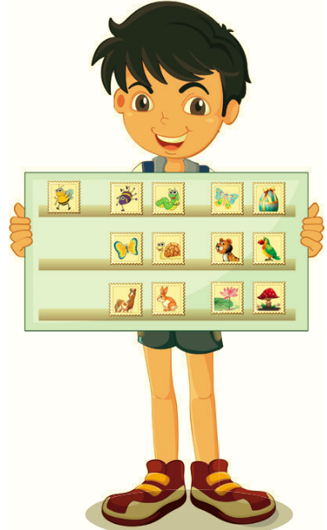
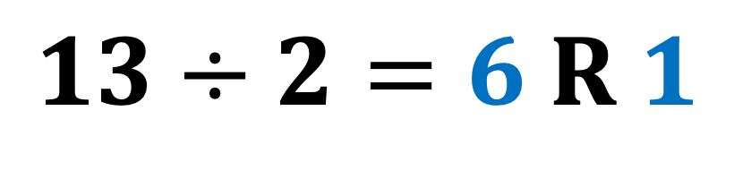
Peter has 13 stamps.
He puts the stamps into groups of 2.
There are 6 groups of stamps with 1 stamp left over.
$$13÷2=6 R 1$$

Slide 6
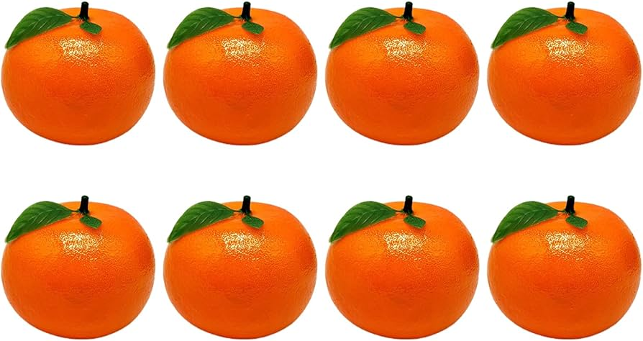
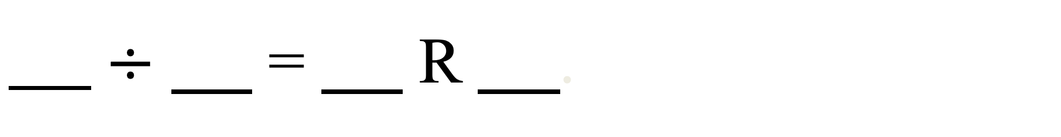
Circle these oranges to show groups of 3.
8
3
There are oranges. Each group has oranges.
2
of the oranges are left over.
$÷$ = R .
8
3
2
2

Slide 7

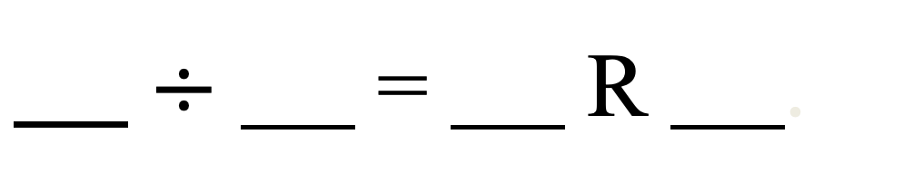
Circle these cubes to show groups of 5.
32
There are cubes divided into groups of .
5
2
There are cubes left over.
32
5
$÷$ = R .
6
2

Slide 8
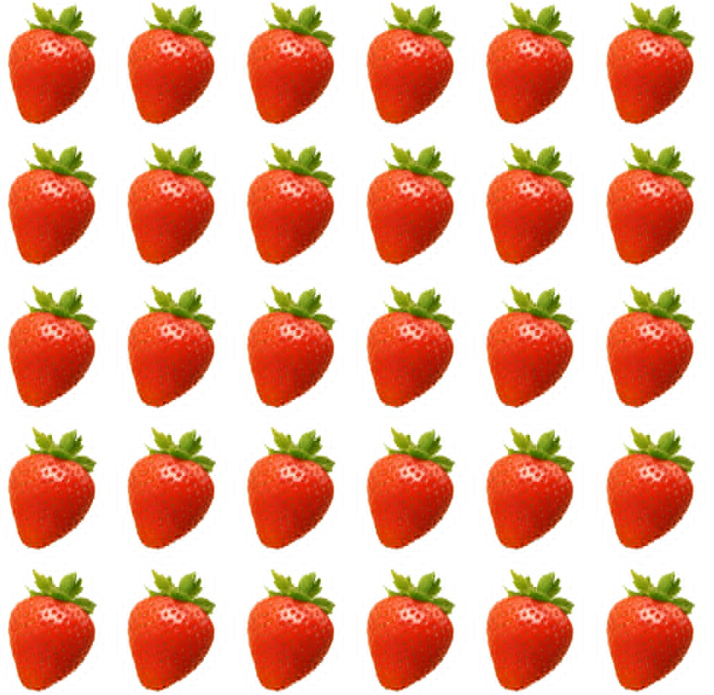
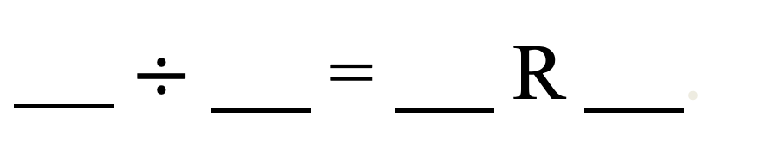
Circle these strawberries to show groups of 8.
30
There are strawberries divided into groups of .
8
6
There are cubes left over.
30
8
3
6
$÷$ = R .

Slide 9
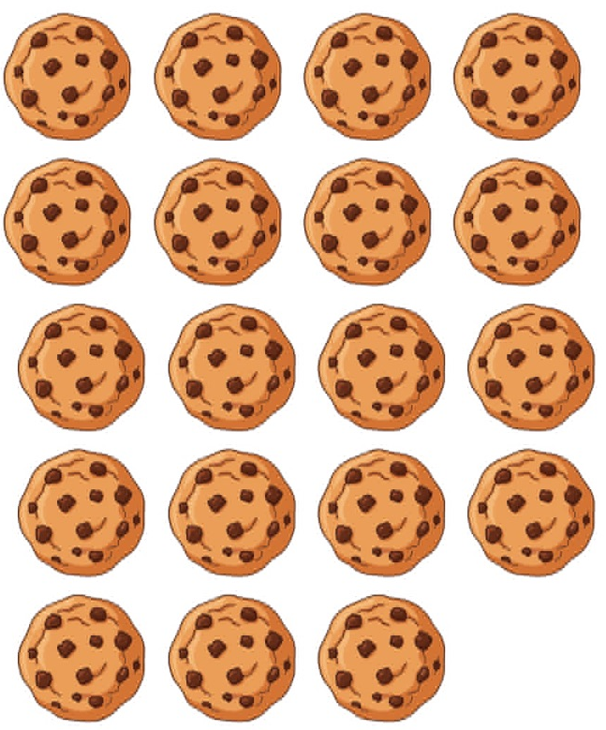
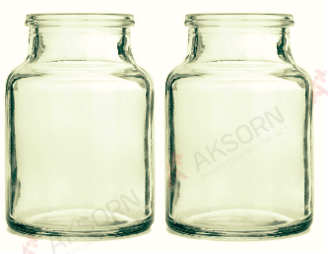

Slide 10
