Slide 1
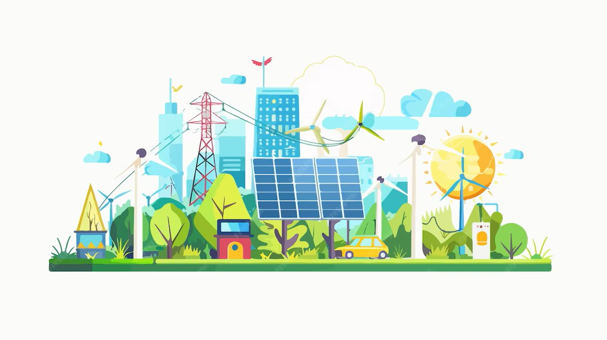
ENERGY SOURCES FOR MAKING ELECTRICITY
WHERE DOES ELECTRICITY COME FROM?

Slide 2
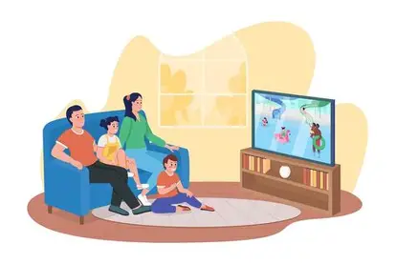
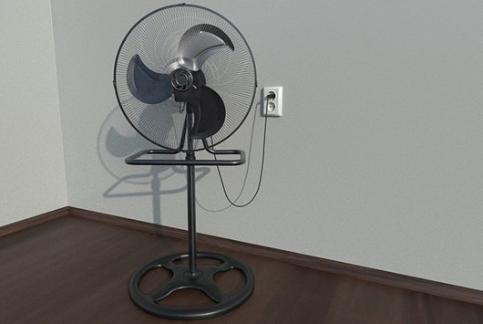

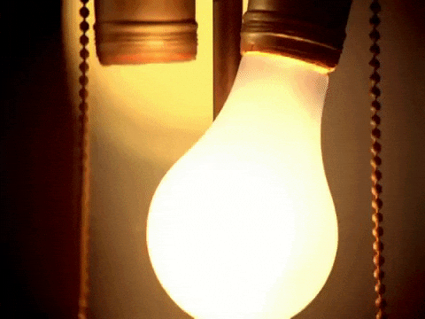
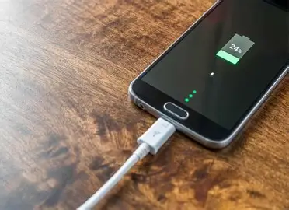


Slide 3
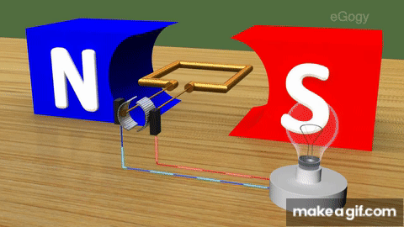
HOW: BY MOVING A COPPER COIL ACROSS A MAGNETIC FIELD. This changes the magnetic field and makes electricity in the copper coil.

Slide 4
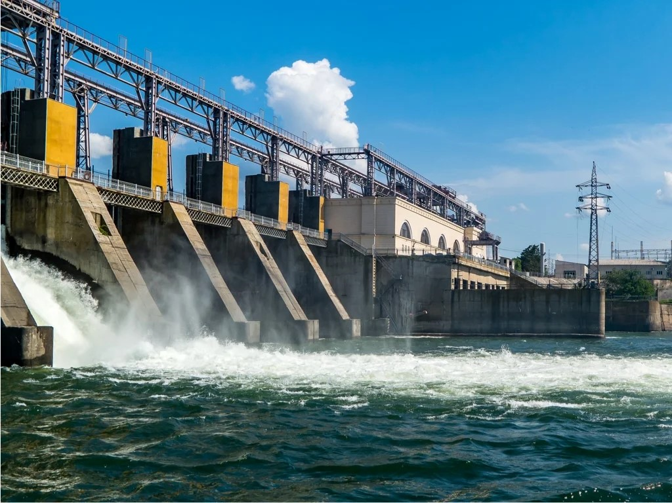
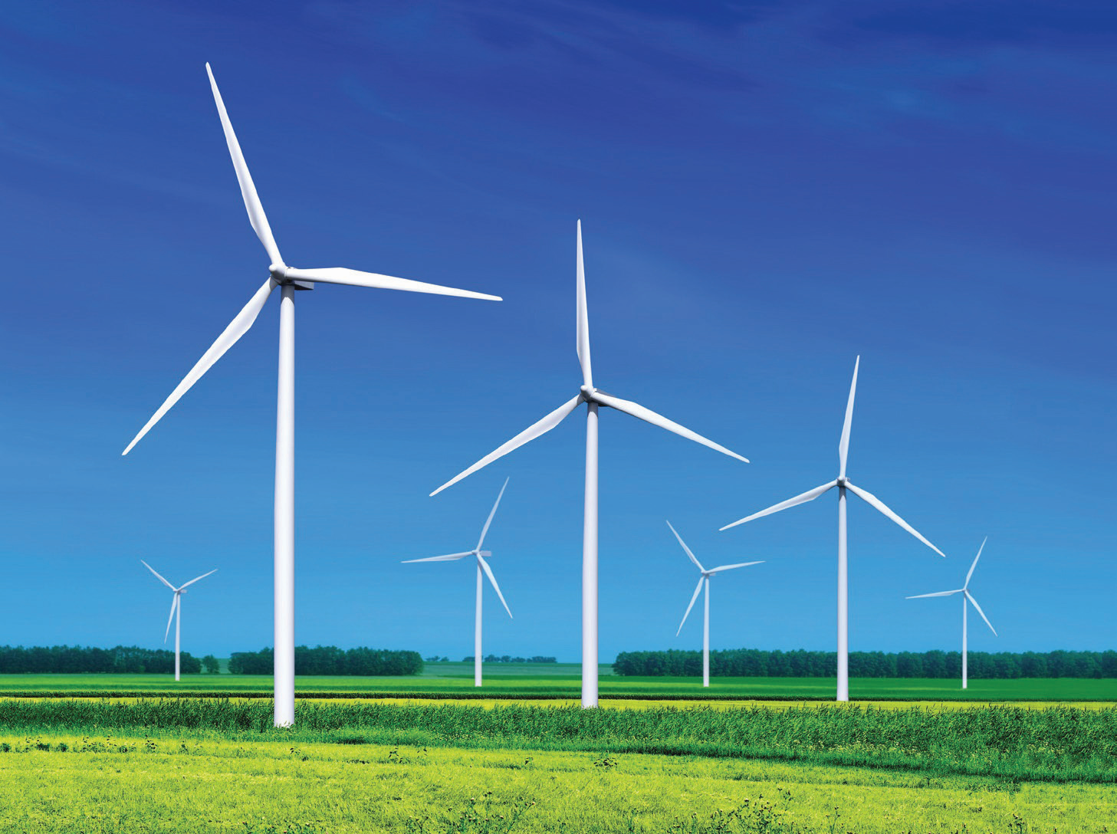
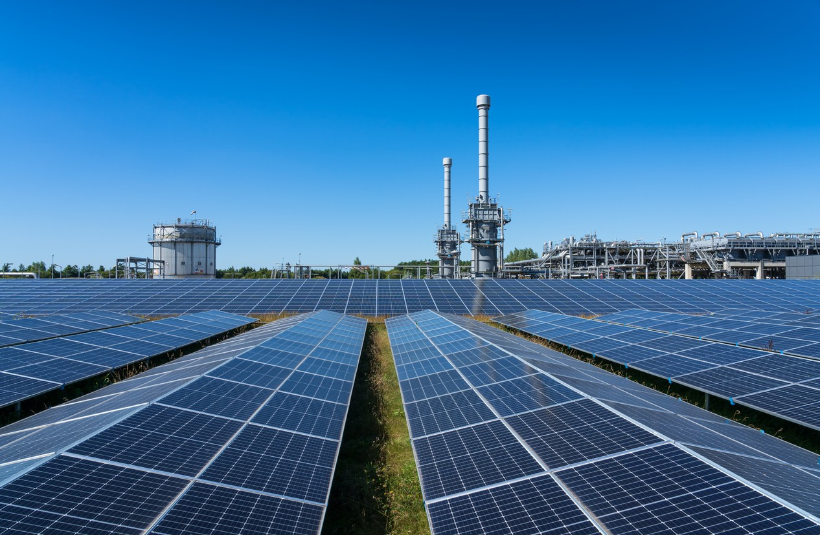
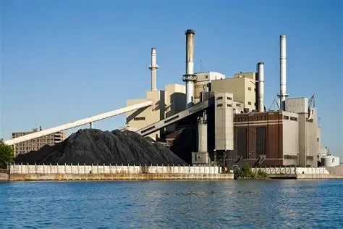
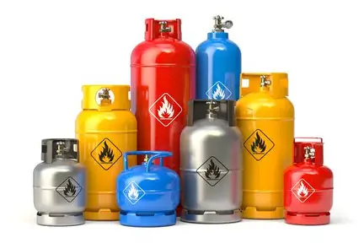
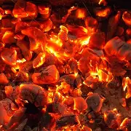
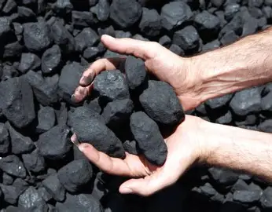
ENERGY SOURCES
Wind
water
(hydro)
Sun
(solar)
coal
Natural gas

Slide 5
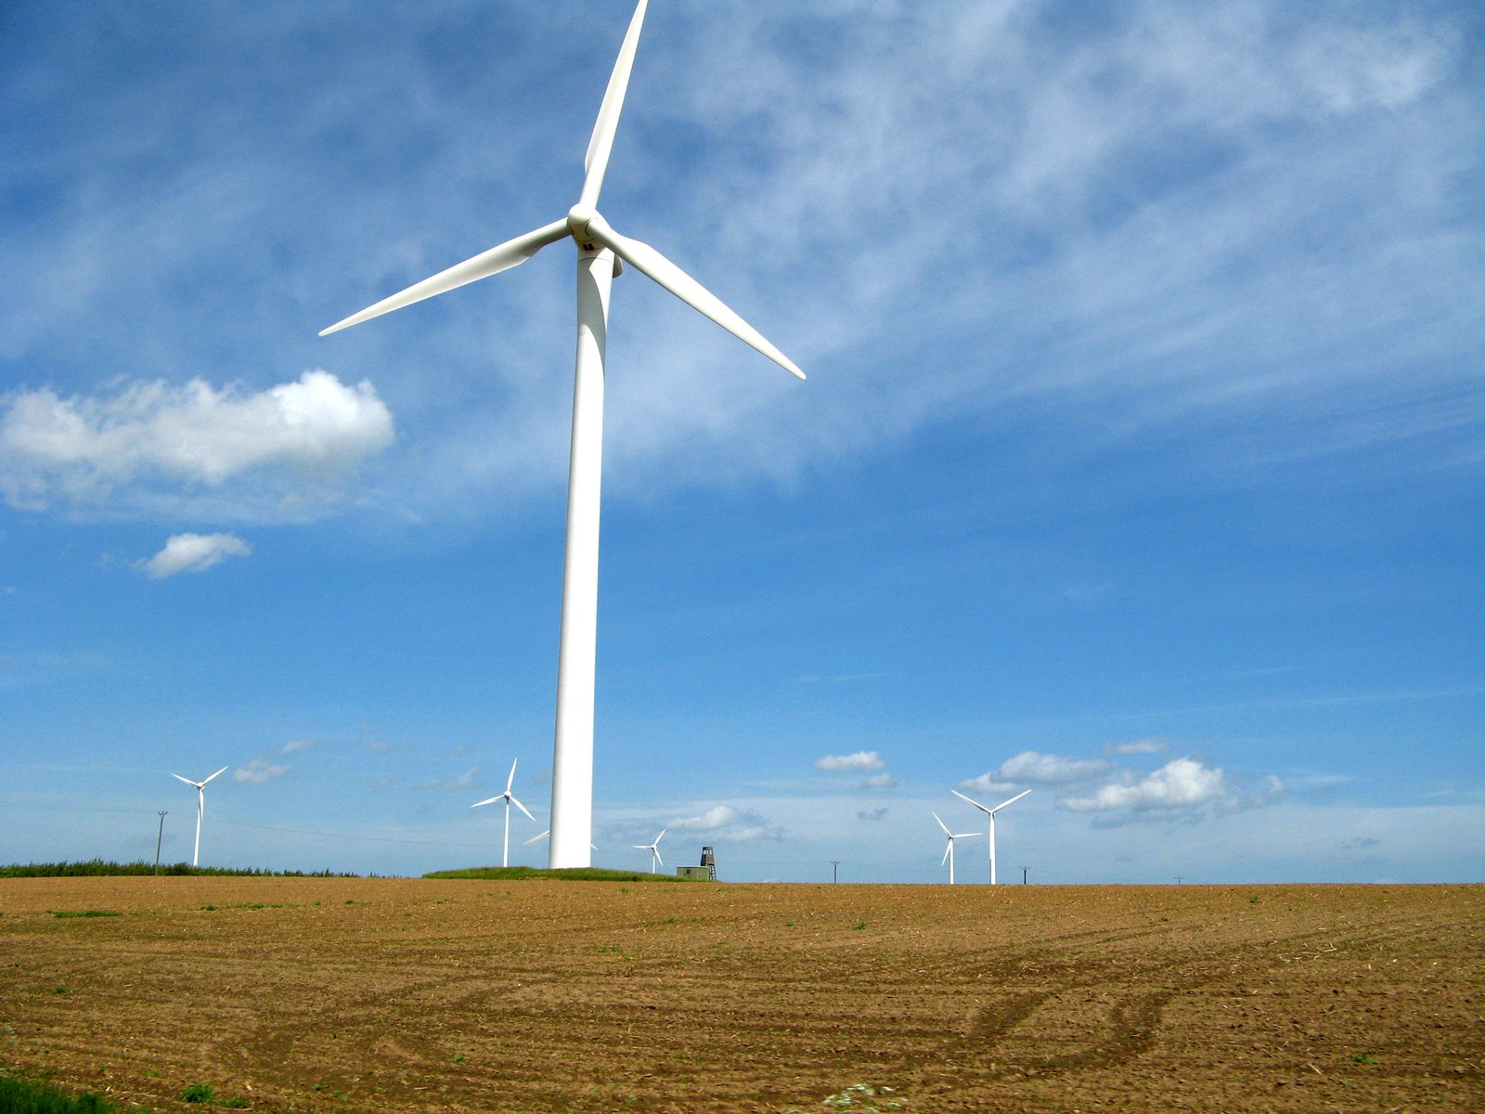
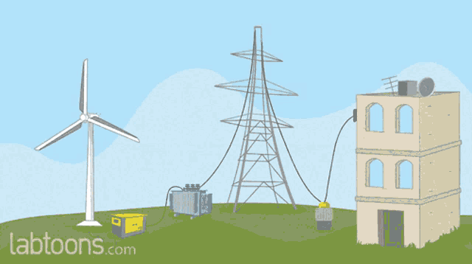
Wind Energy.
Wind spins a turbine to make electricity.

Slide 6
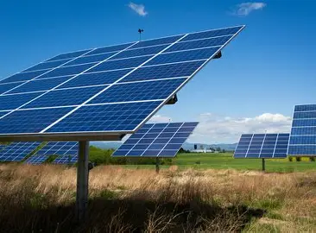
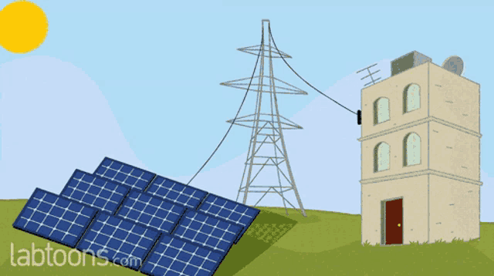
Solar Energy
Solar cells take light energy from the sun and turn it into electricity

Slide 7
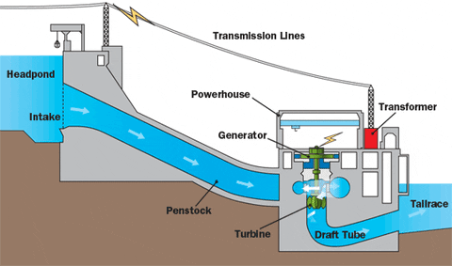
Hydro Energy
Moving water from dams spins turbines to make electricity

Slide 8
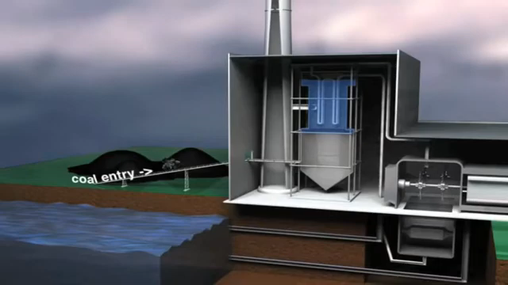
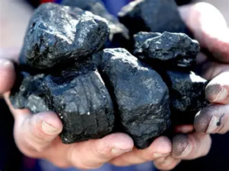
coal
Burning coal is used to make water hot, and the steam from water spins turbines to make electricity

Slide 9
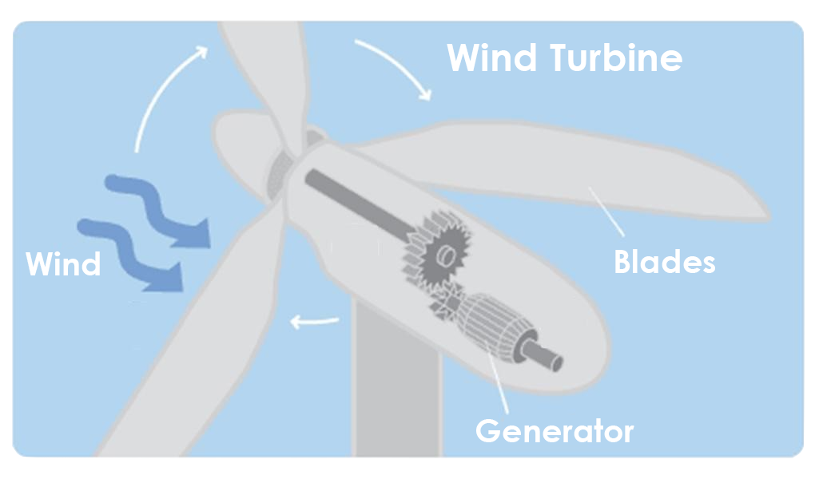
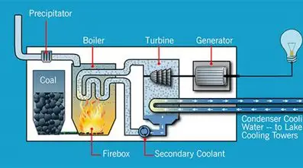
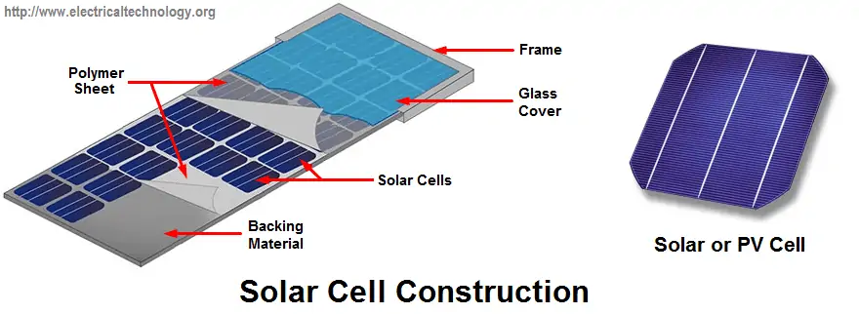

Slide 10
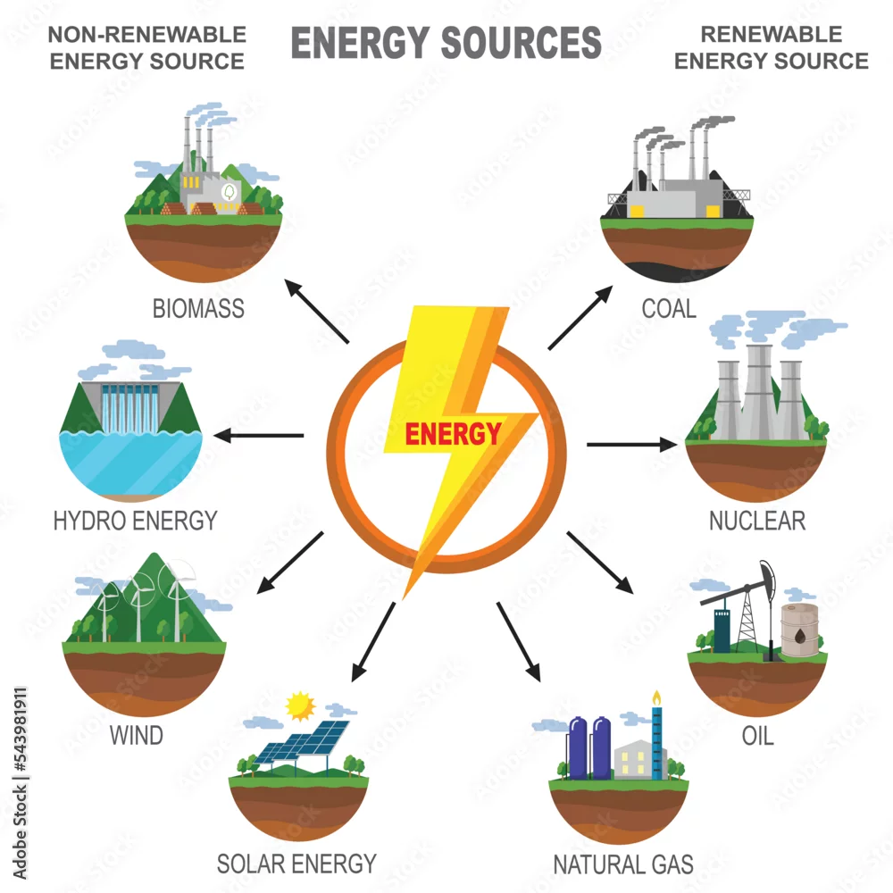

Slide 11

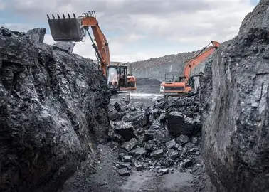
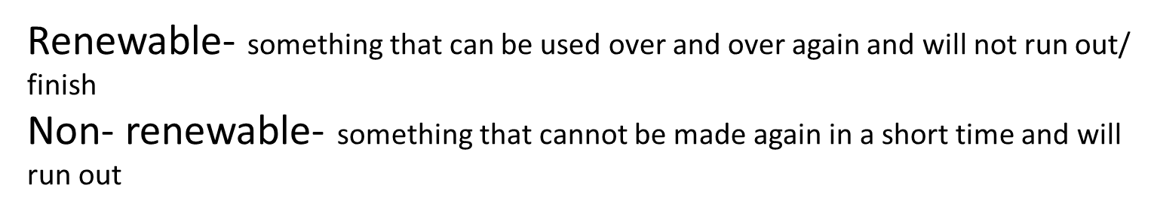

Slide 12

ENERGY SOURCES

Slide 13
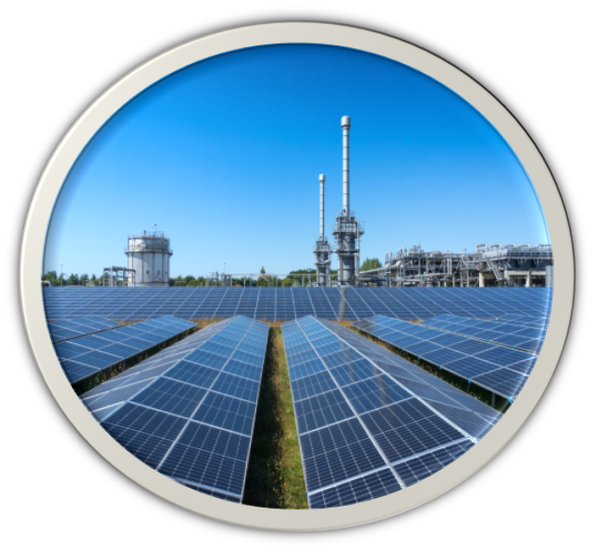
NON- RENEWABLE ENERGY | RENEWABLE ENERGY

Slide 14
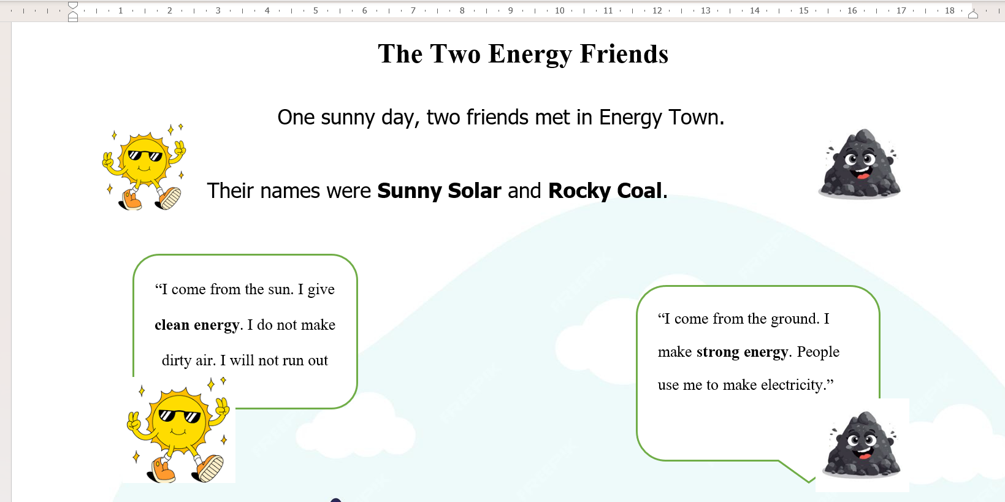

Slide 15
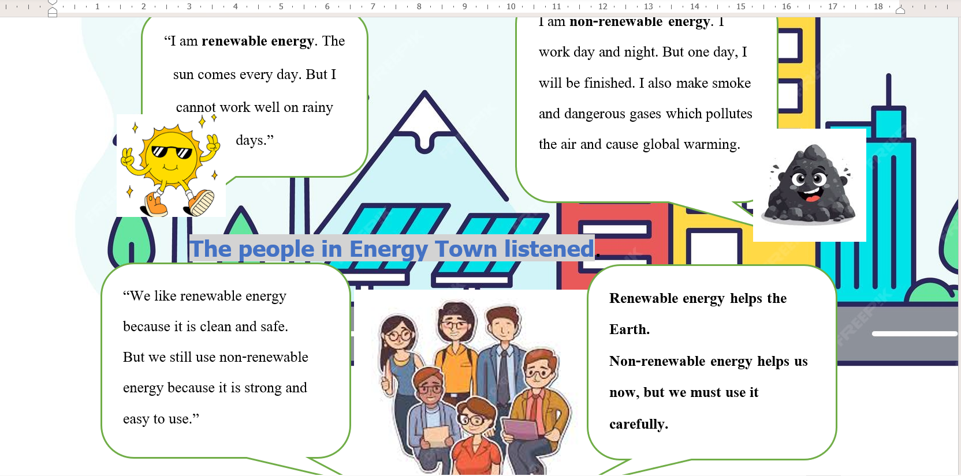

Slide 16
Bad things about energy sources
Renewable
Non- renewable
We cannot make solar energy on rainy days.
We cannot make wind energy if there are no strong winds
The are very expensive
Makes the air dirty ( air pollution) by giving of toxic gases
One day they will finish/ run out

Slide 17
Good things about energy sources
Renewable
Non- renewable
Makes clean energy
Will never finish/ run out
Makes strong energy, a small amount can make a lot of energy.
It is cheap and can be easily moved around.

