Slide 1
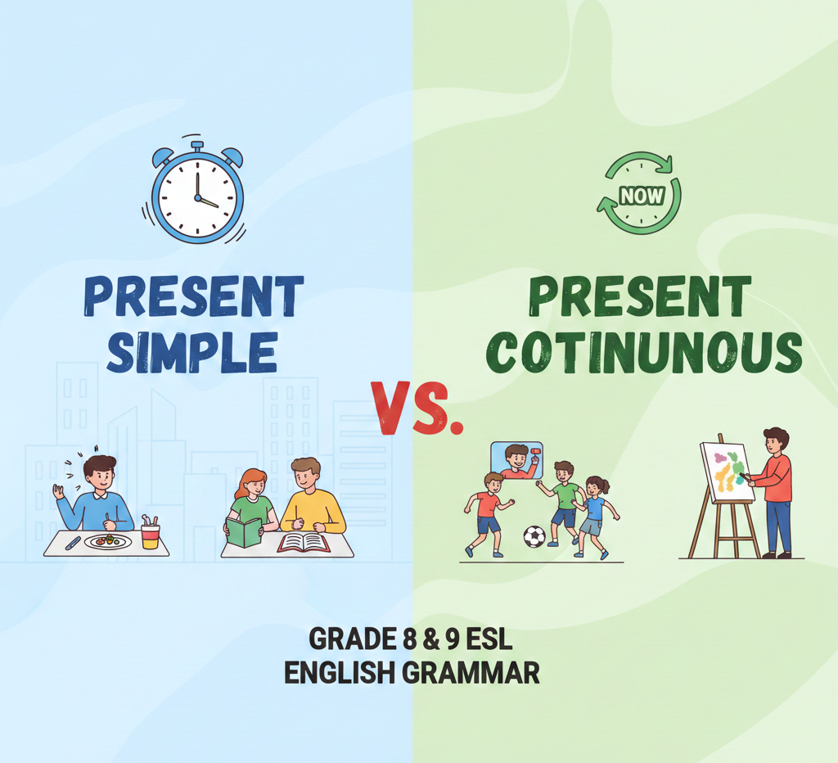

Slide 2
Present Simple Vs Present Continuous
MEP
M2/4-M3/4

Slide 3

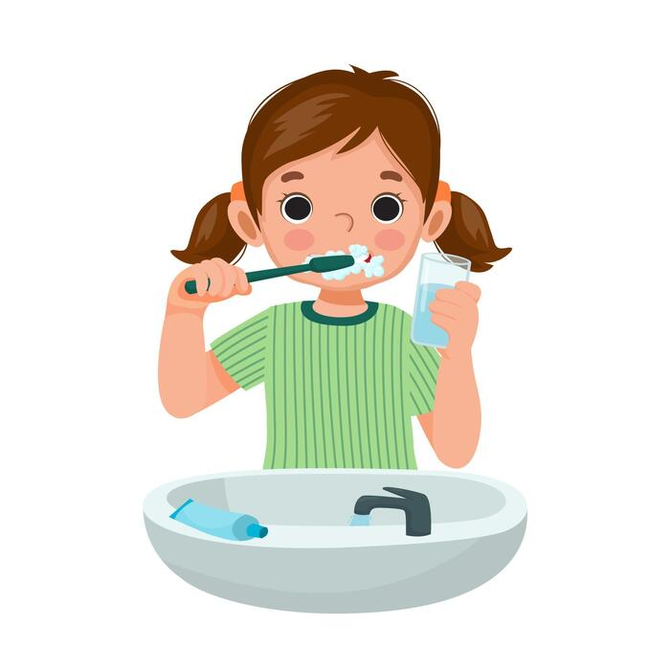
Present Simple
We use the present simple for things that are always true and for habits. Example: I eat breakfast every day.
Permanent States and Facts. - Thai people have black hair.
Habits/routines- I brush my teeth every morning after breakfast
Timetable- The school starts at seven.
Time expressions: every day , on Mondays, often, sometimes

Slide 4
Present continuous
We use the present continuous for things happening now or for a short time. Example: I am eating breakfast now.
Actions happening now/around the time of speaking –Teacher Frank is teaching now
Future arrangements- I am going to Tesco’s tomorrow.
Temporary situations- We are going to Krabi this weekend.
Note: Some verbs don’t have continuous forms because they describe a state rather than an action.- want, like, love, hate, know, believe, need

Slide 5
1. 1. Permanent states / facts
Water ___ at 100°C.
A. is boiling B. boils C. boil D. boiled
✅ Correct answer: B. boils
2. Habits / routines
She ___ to school by bus every day.
A. is going B. goes C. go D. went
✅ Correct answer: B. goes
3. Timetables
The train ___ at 6:30 in the morning.
A. is leaving B. leave C. leaves D. left
✅ Correct answer: C. leaves
4. Actions happening now
Look! The children ___ in the playground.
A. play B. played C. are playing D. plays
✅ Correct answer: C. are playing
5. Future arrangements
We ___ our grandparents this evening.
A. visit B. visited C. are visiting D. visits
✅ Correct answer: C. are visiting
6.

Slide 6
5. Future arrangements
We ___ our grandparents this evening.
A. visit B. visited C. are visiting D. visits
✅ Correct answer: C. are visiting
6. Stative verbs (no continuous form)
He ___ the answer to the question.
A. is knowing B. know C. knows D. knowing
✅ Correct answer: C. knows
7. Temporary situations
My cousin ___ with us for a few days.
A. stays B. is staying C. stayed D. stay
✅ Correct answer: B. is staying

