Slide 1
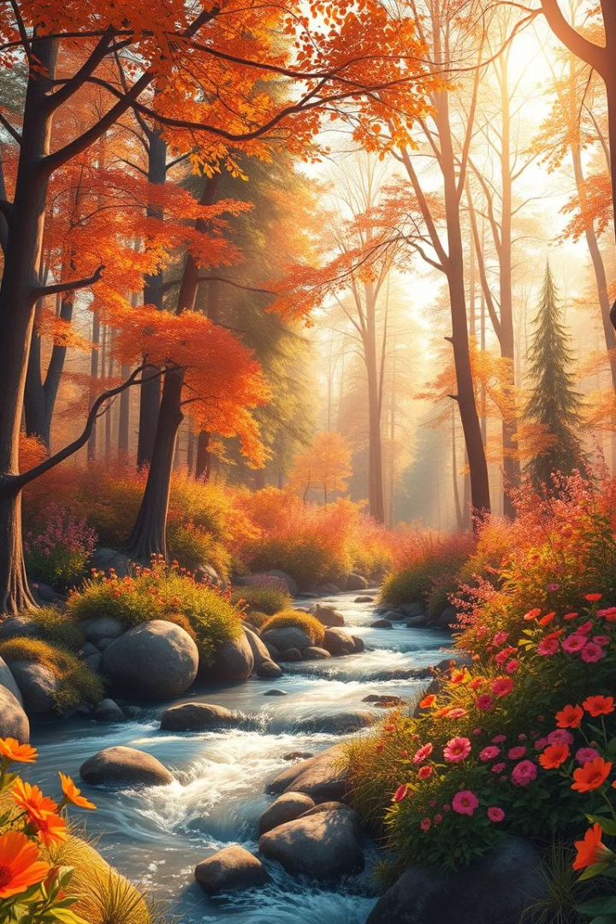

Journey of understanding the different things around us.
by Nicole Keith Maraña

Slide 2
Look around, can you find things that move on their own?
Things that cannot move?
by Nicole Keith Maraña

Slide 3
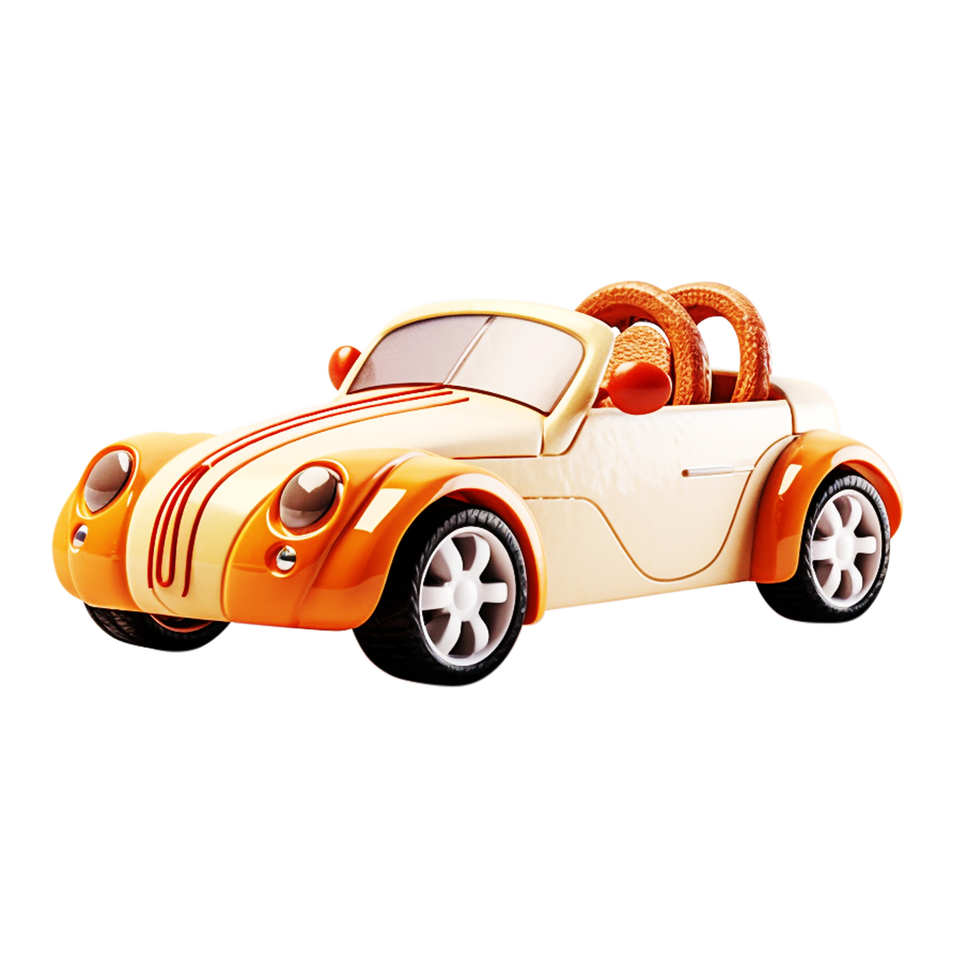
eat?
move?
grow?
by Nicole Keith Maraña

Slide 4


eat?
move?
grow?
by Nicole Keith Maraña

Slide 5
Living Things
and
Non-living Things
by Nicole Keith Maraña

Slide 6
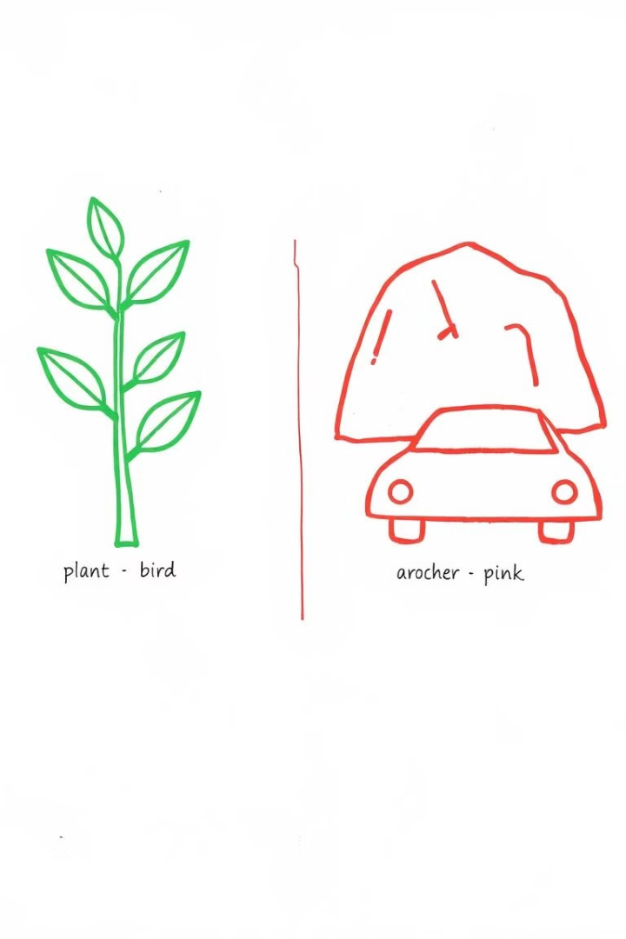
Lesson Objectives
-Identify examples of Living
and non-living things.
-Describe basic characteristics
of Living and non-living things.
-Differentiate living things
from non-living things.
by Nicole Keith Maraña

Slide 7

Living Things
Living things are things that
are alive.
by Nicole Keith Maraña

Slide 8
Characteristics of Living Things
They:
-Need food, water, sunlight, air and
shelter.
-Can grow.
-Can move.
-Can reproduce.
by Nicole Keith Maraña

Slide 9
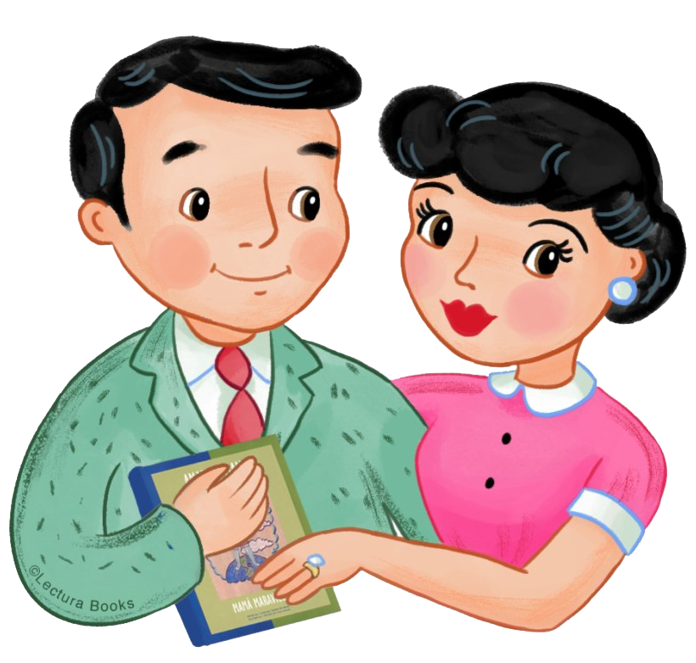
talk?
food?
grow?
Dad
mom
by Nicole Keith Maraña

Slide 10
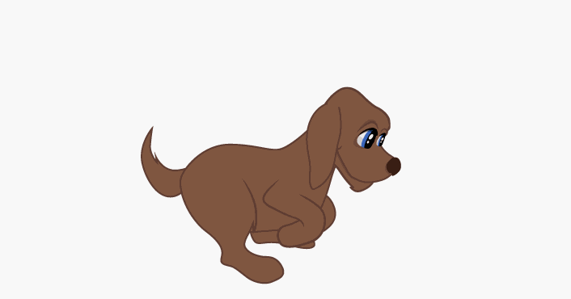
food?
grow?
talk?
Dog
-Five senses.
by Nicole Keith Maraña

Slide 11
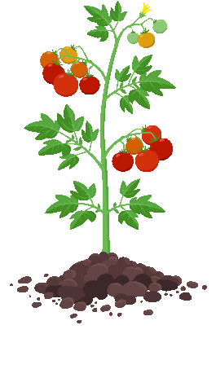



grow?
talk?
food?
Plant
sunlight
water
air
by Nicole Keith Maraña

Slide 12
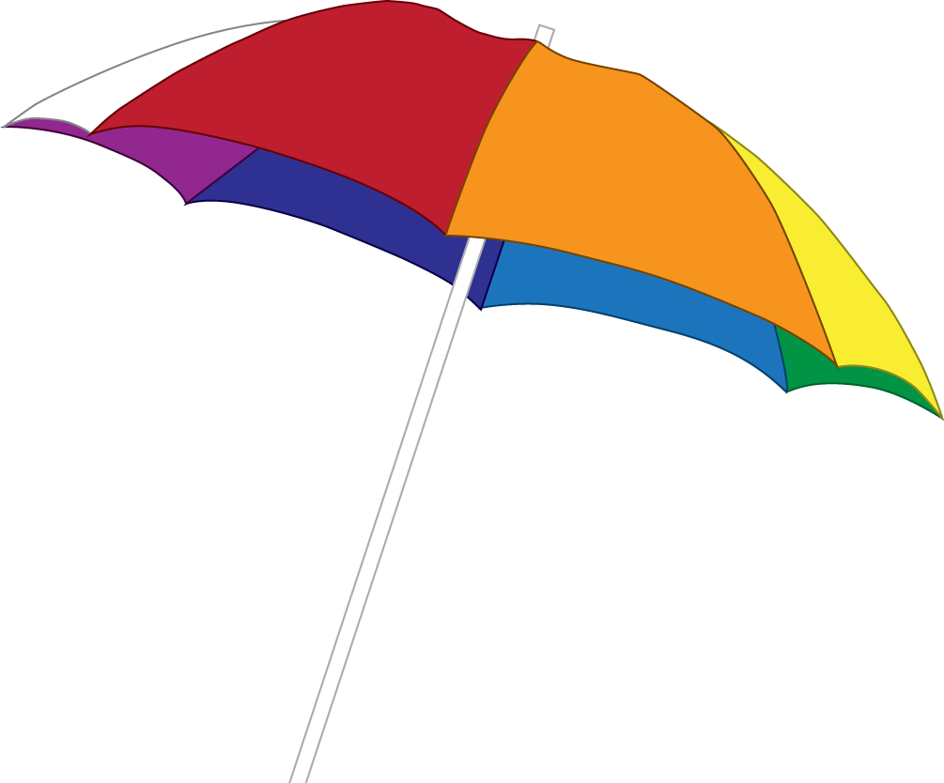

Non-Living Things
move?
food?
grow?
by Nicole Keith Maraña

Slide 13

Define Non-Living Things
Non-Living things are things that
are not alive.
by Nicole Keith Maraña

Slide 14
Characteristics of Non-Living Things
They:
-Do not need food, water, sunlight,
air and shelter.
-Cannot grow.
-Cannot move.
-Cannot reproduce.
by Nicole Keith Maraña

Slide 15

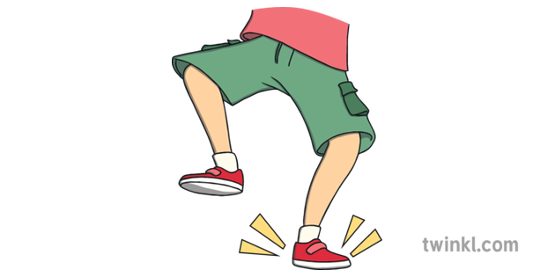
Raise your hand stamp Game
I will show the photo of something. If it’s living thing raise you hand! If it’s not, stamp your feet!
by Nicole Keith Maraña

Slide 16

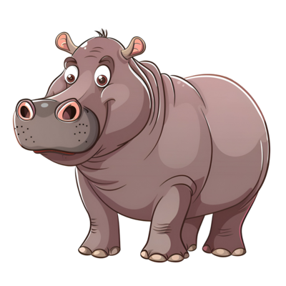
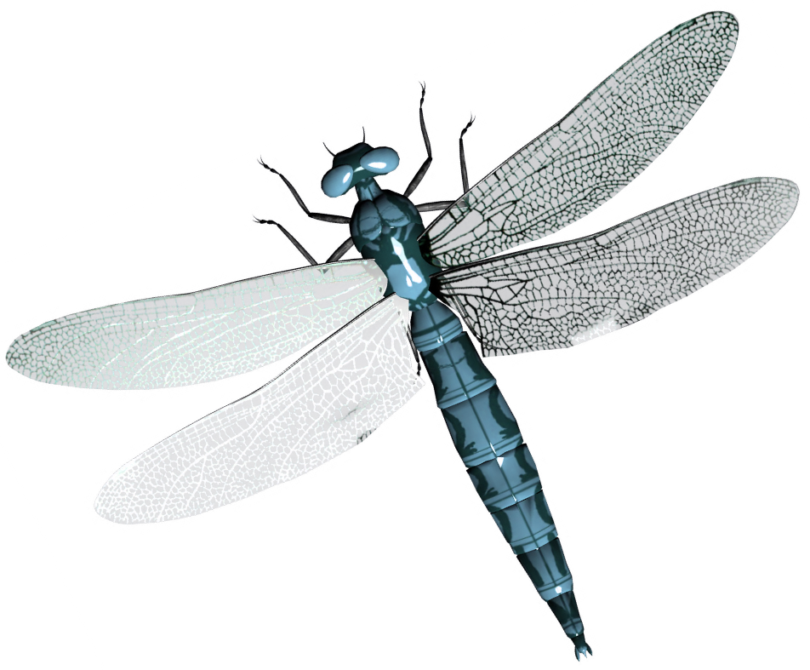
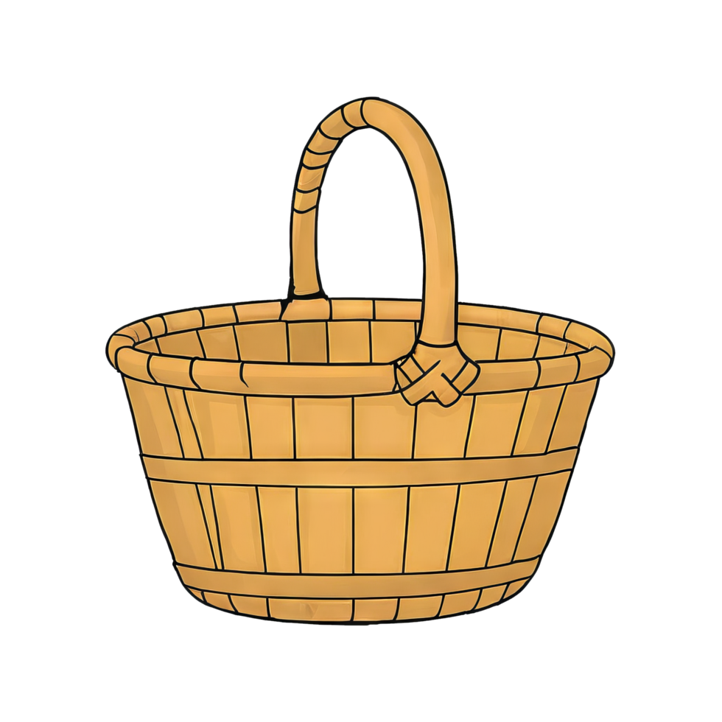

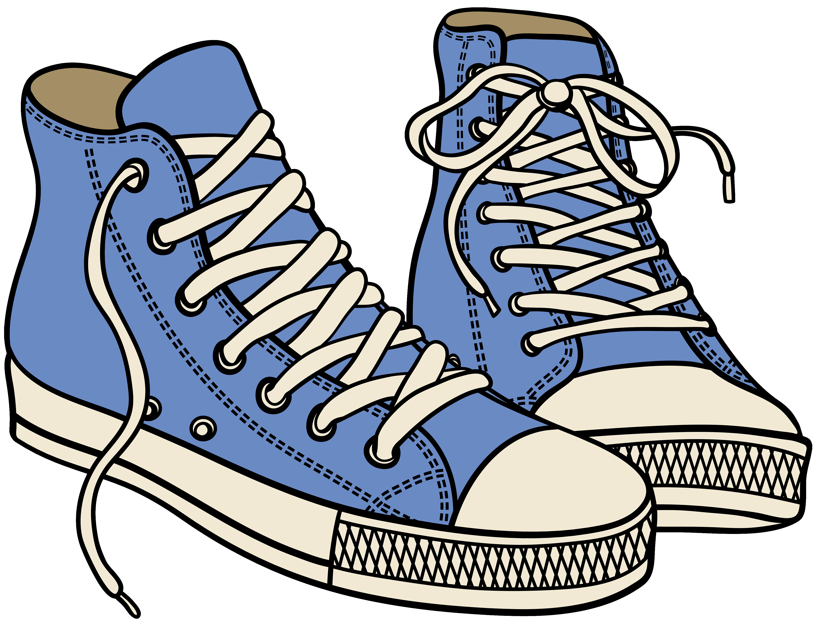
by Nicole Keith Maraña

