Slide 1








R
S
O
N
L
T
Y
P
E
A
I
T
R
A
I
T
S

Slide 2
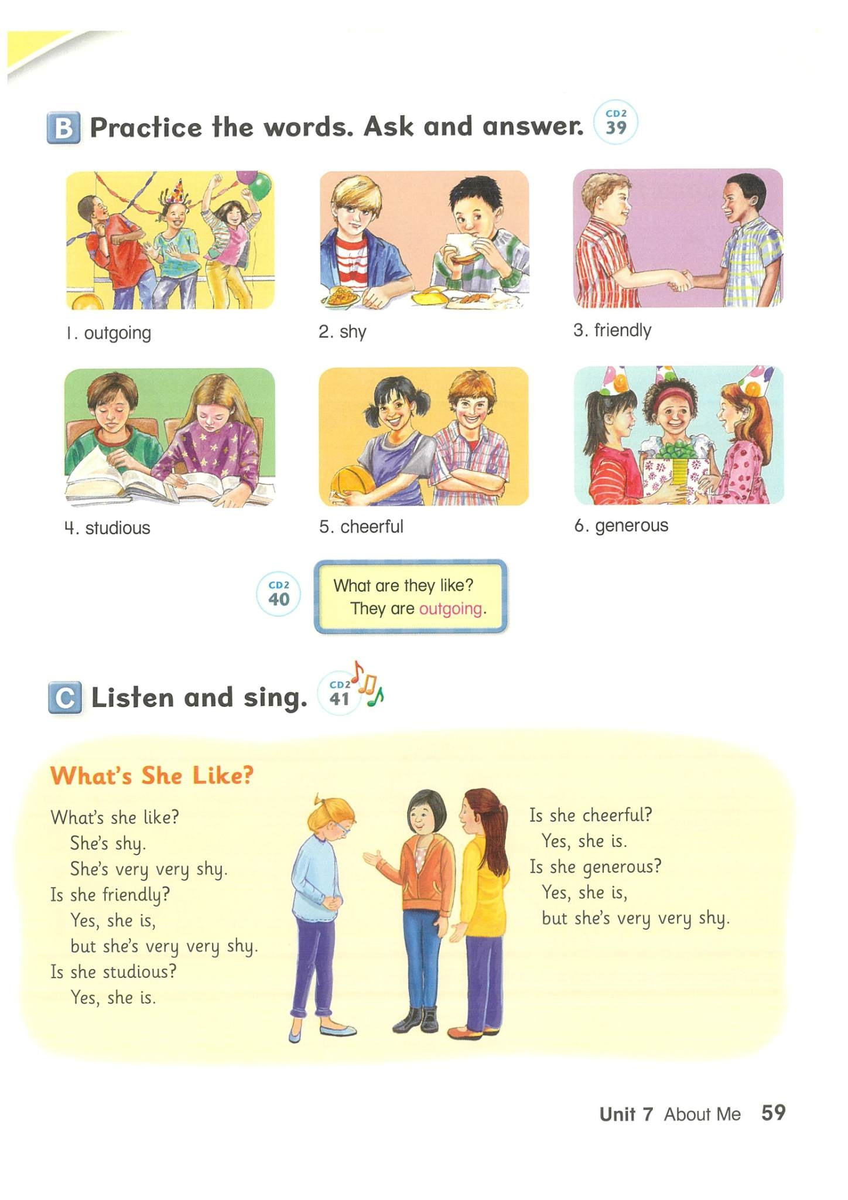

P.59

Slide 3


outgoing

Slide 4


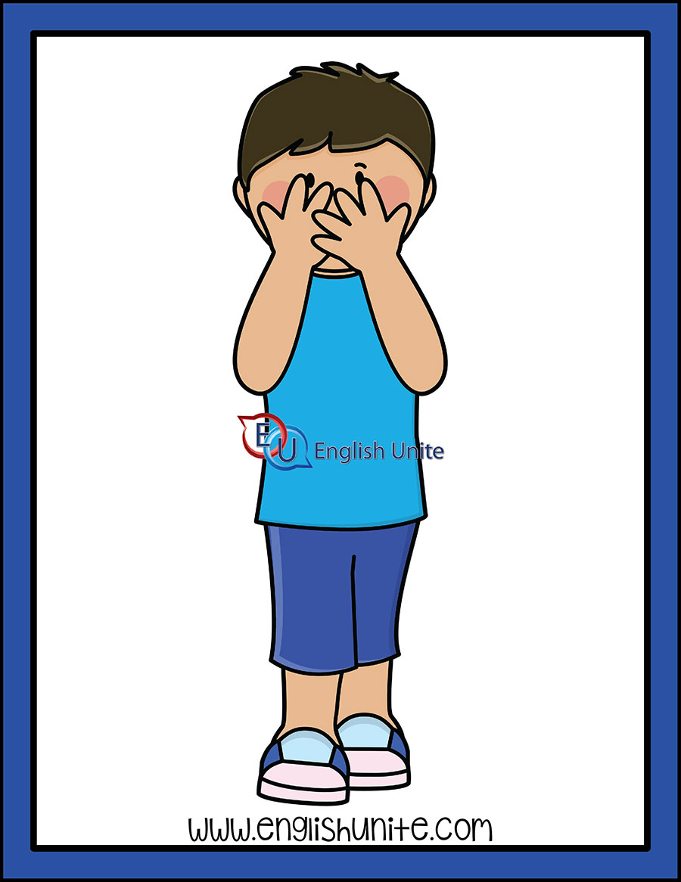
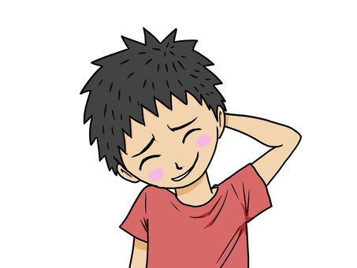
shy

Slide 5

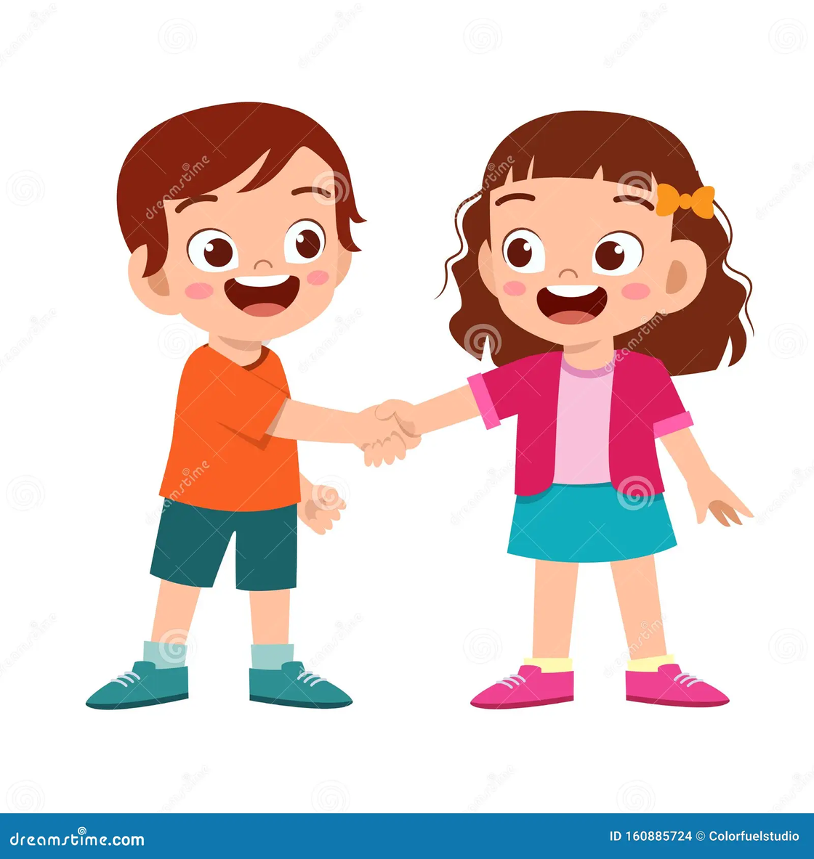
friendly

Slide 6


studious

Slide 7

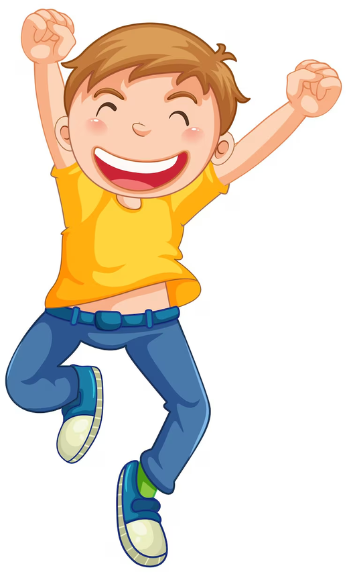

cheerful

Slide 8
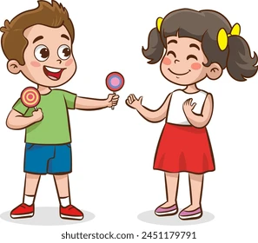
generous

Slide 9




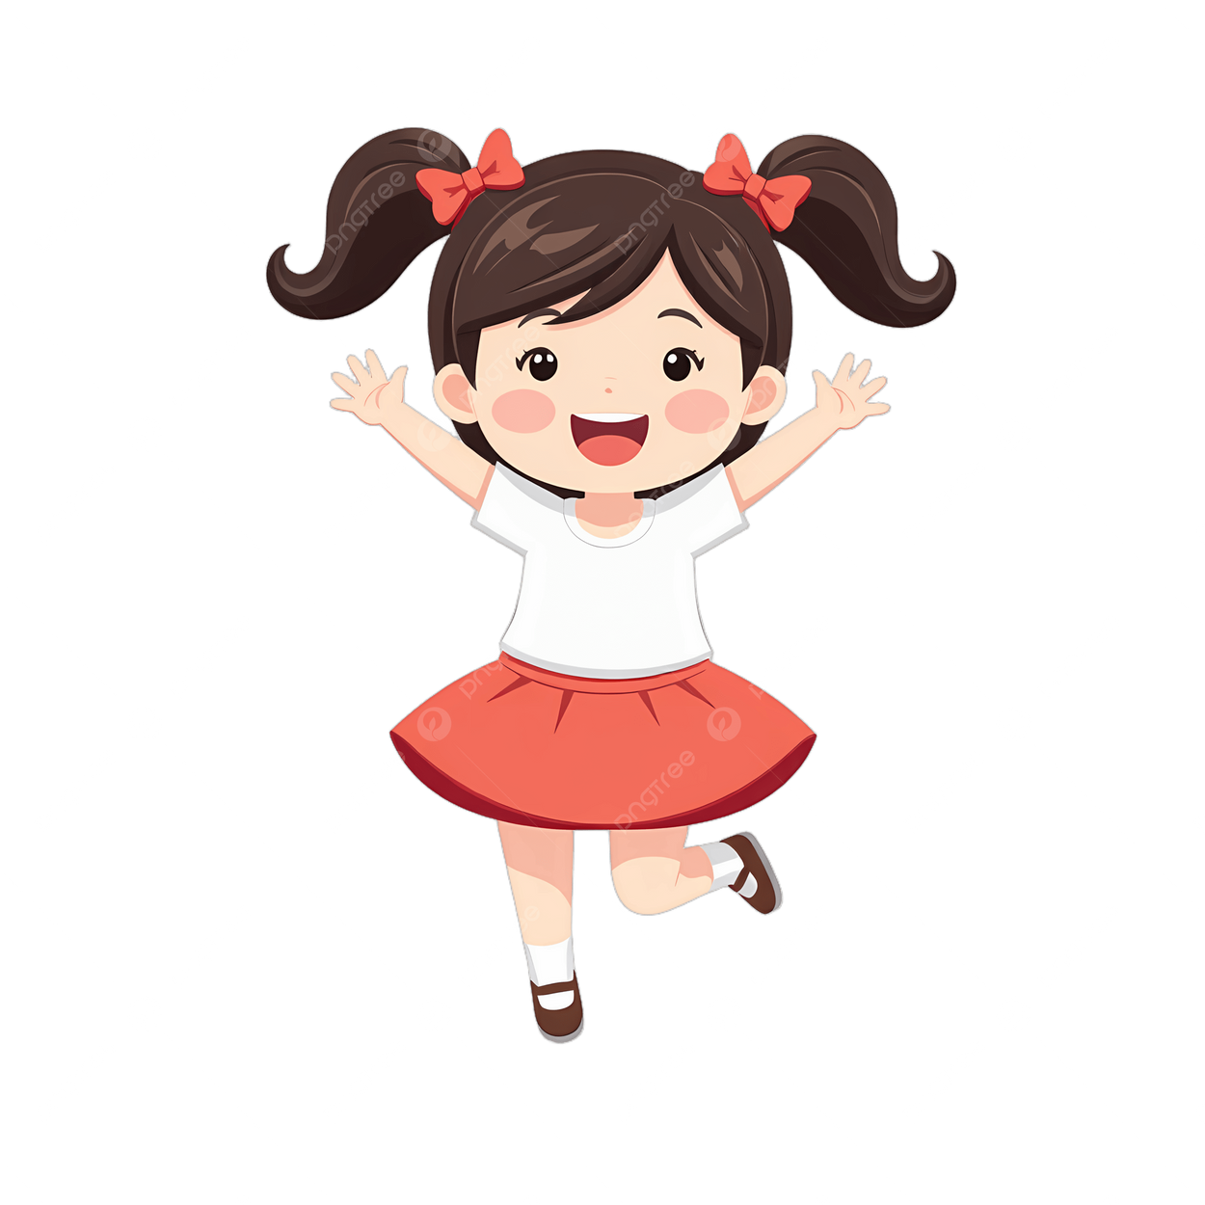

Ask and Answer
What are they like?

Slide 10


What are they like?
They are shy
___________________.

Slide 11
What are they like?
They are generous
___________________.

Slide 12
What are they like?
___________________.

Slide 13
What are they like?
___________________.

Slide 14
What are they like?
___________________.

Slide 15
What are they like?
___________________.

Slide 16

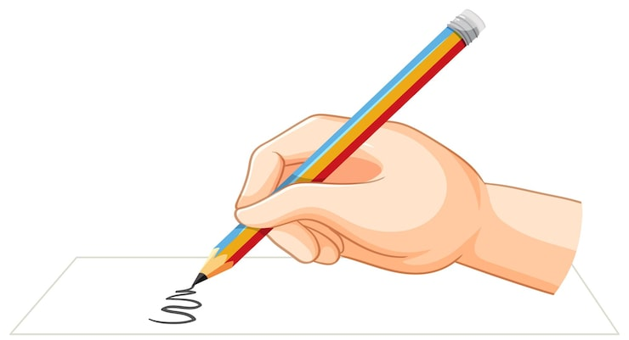
Unscramble the words.

Slide 17
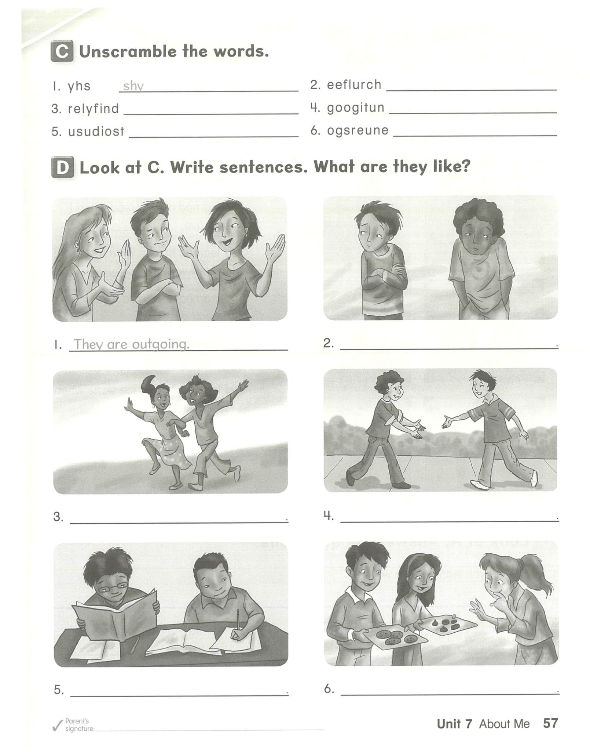
Unscramble the words.

Slide 18





