Slide 1


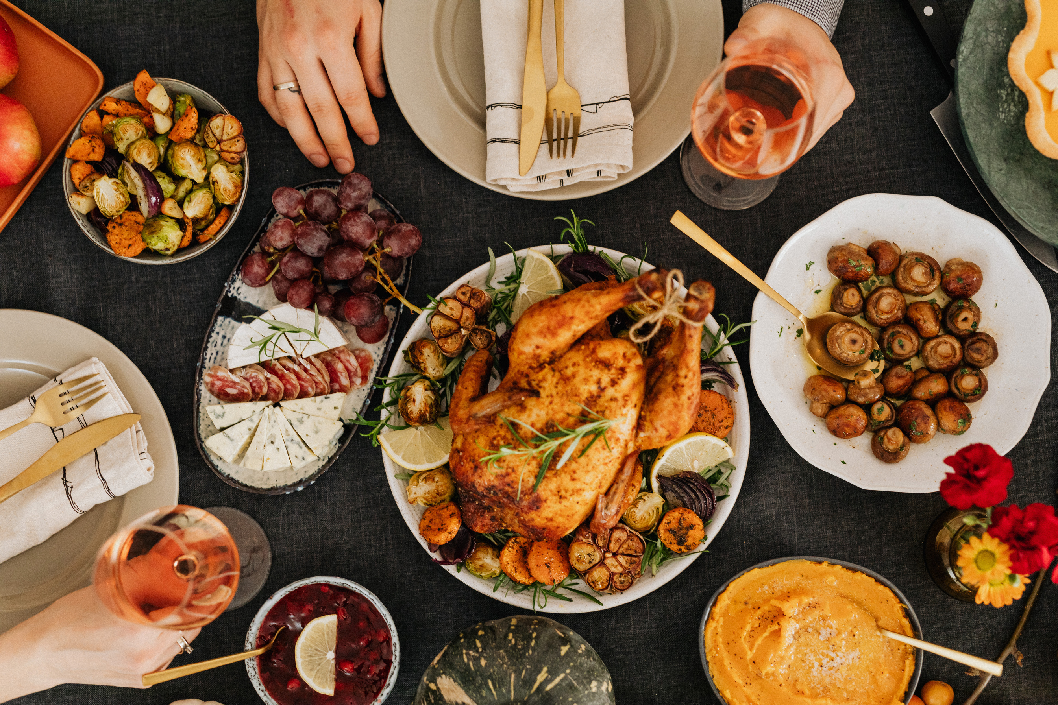


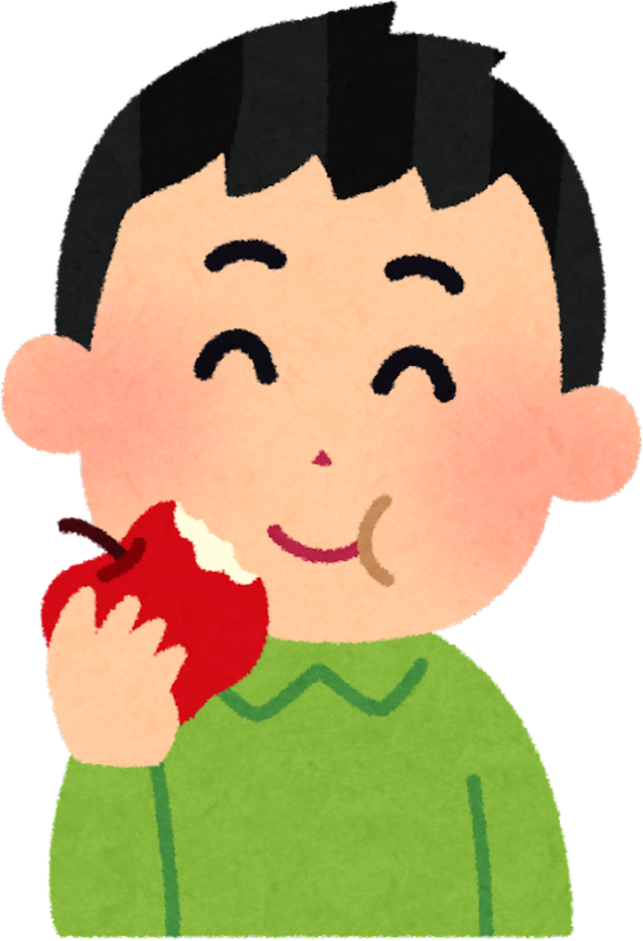

Things to Eat

Slide 2


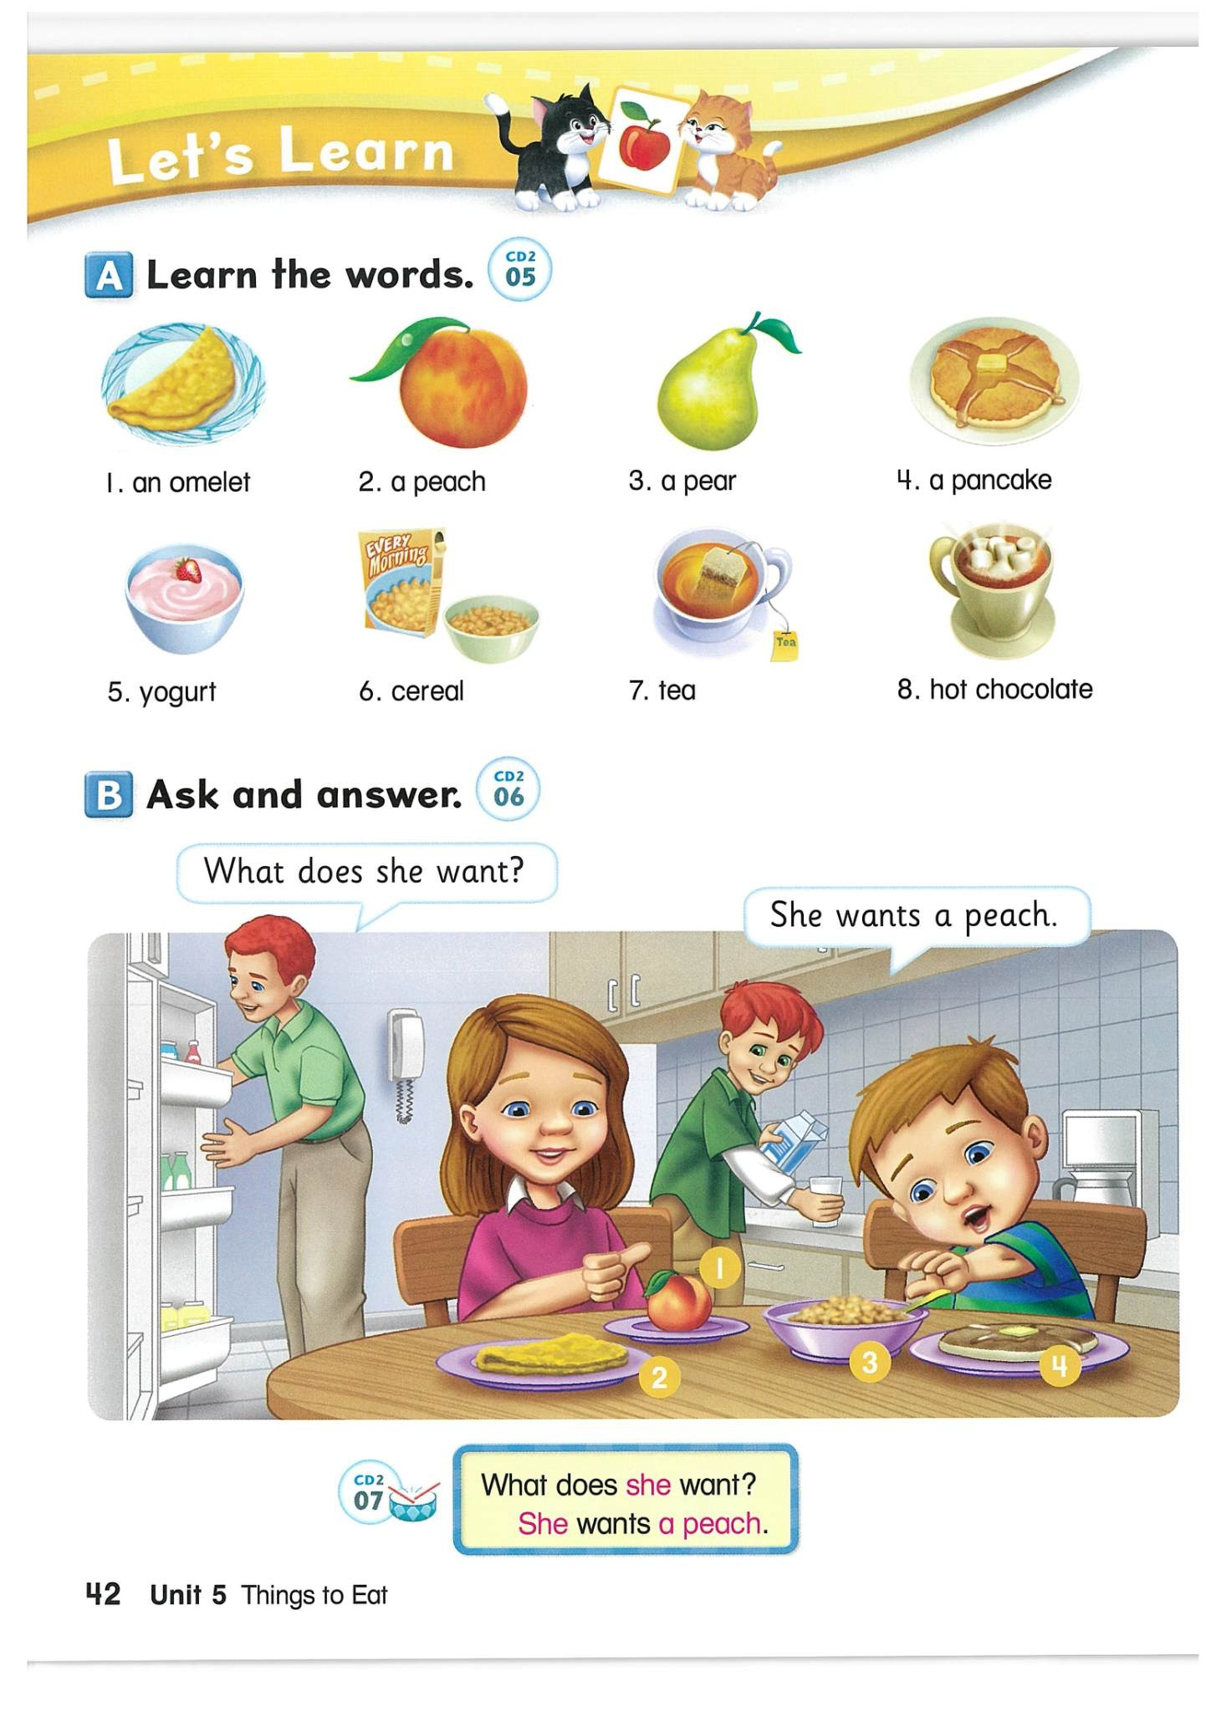

Slide 3

an omelet

Slide 4

a peach

Slide 5

a pear

Slide 6

a pancake

Slide 7

yogurt

Slide 8
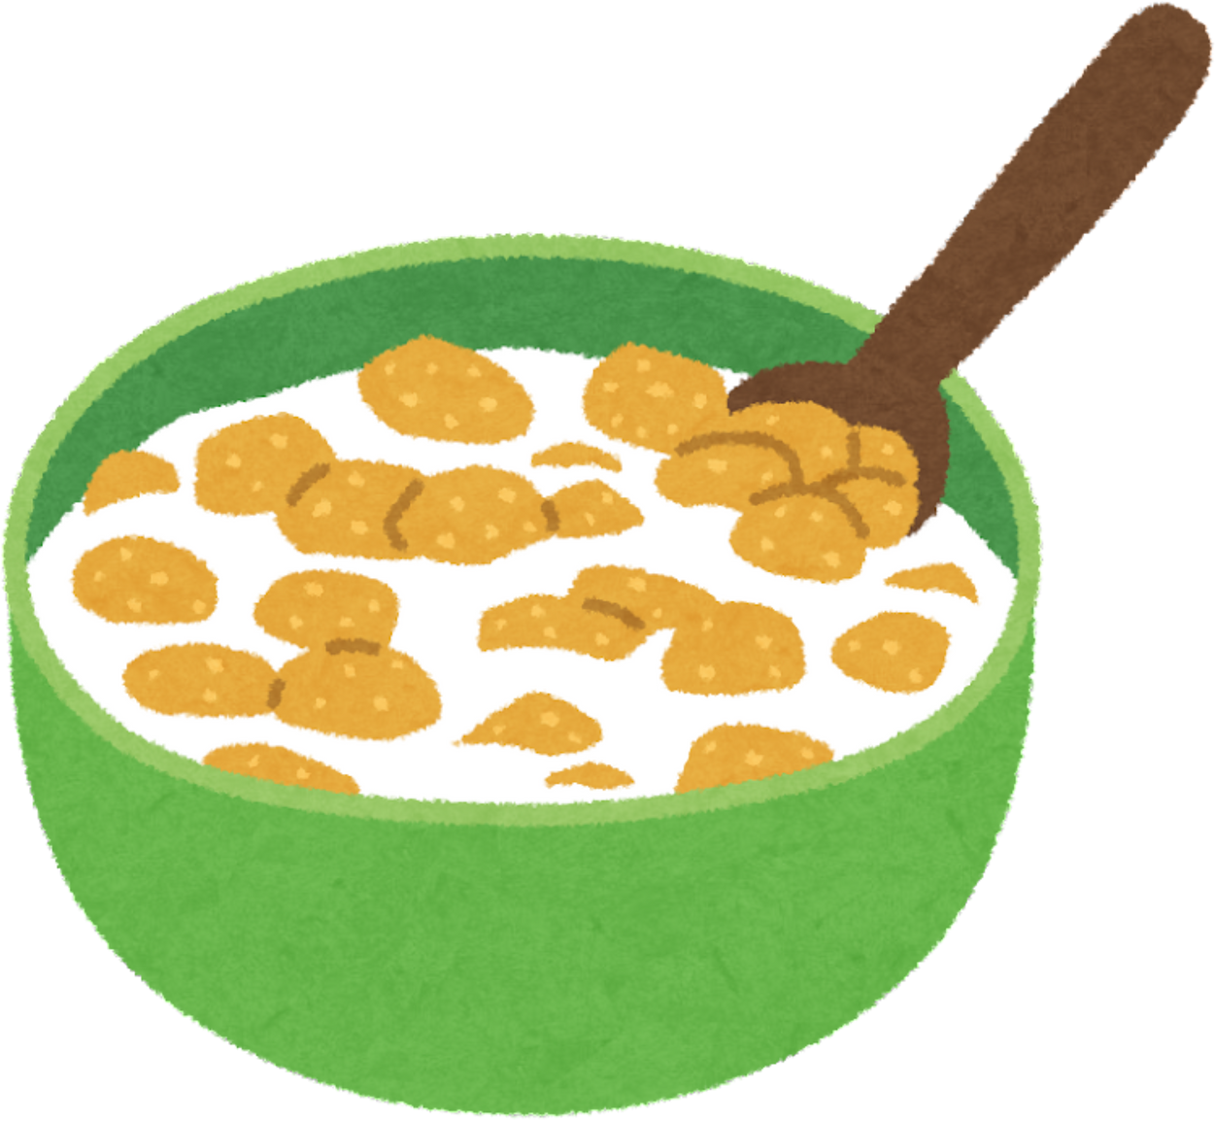
cereal

Slide 9

tea

Slide 10

hot chocolate

Slide 11



Look and write.

Slide 12
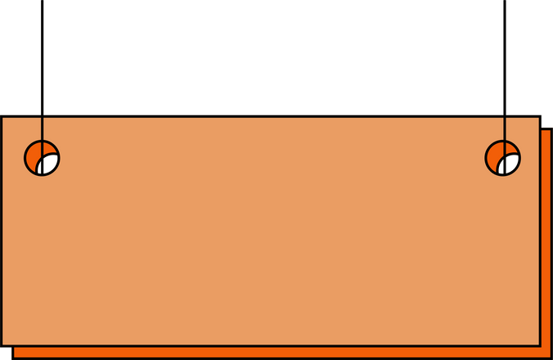

Look and write
an omelet
___________________

Slide 13
Look and write
___________________

Slide 14
Look and write
___________________

Slide 15
Look and write
___________________

Slide 16
Look and write
___________________

Slide 17
Look and write
___________________

Slide 18
Look and write
___________________

Slide 19
Look and write
___________________

Slide 20
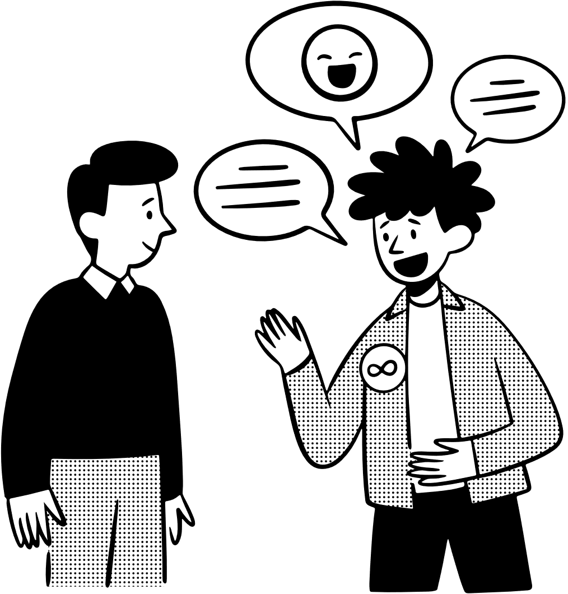
Ask and answer.

Slide 21

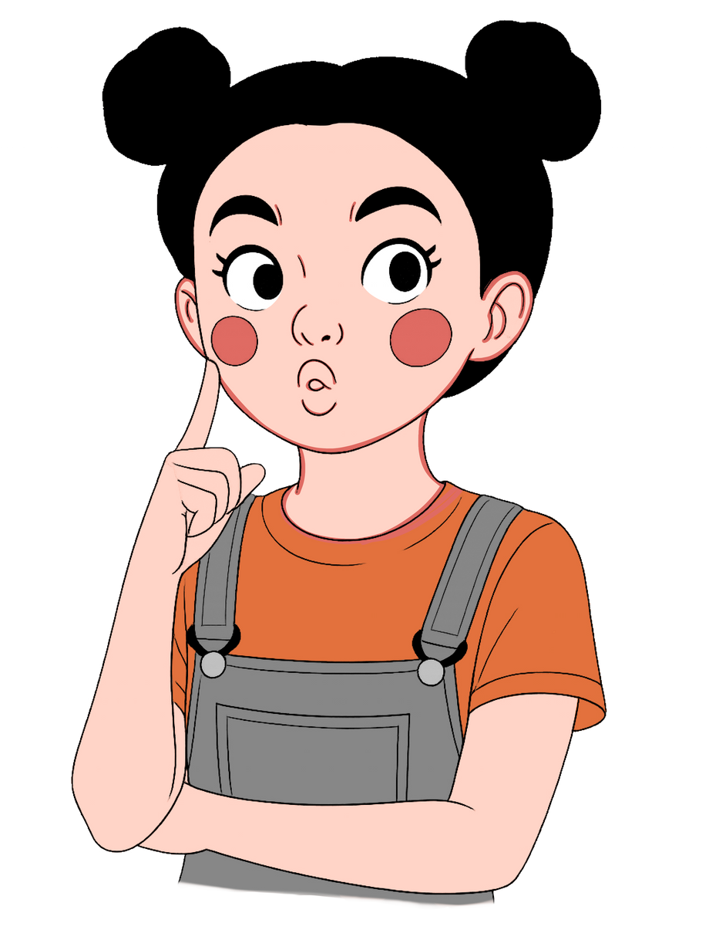
Ask and answer.
What does she want?
She wants an omelet.
___________________

Slide 22
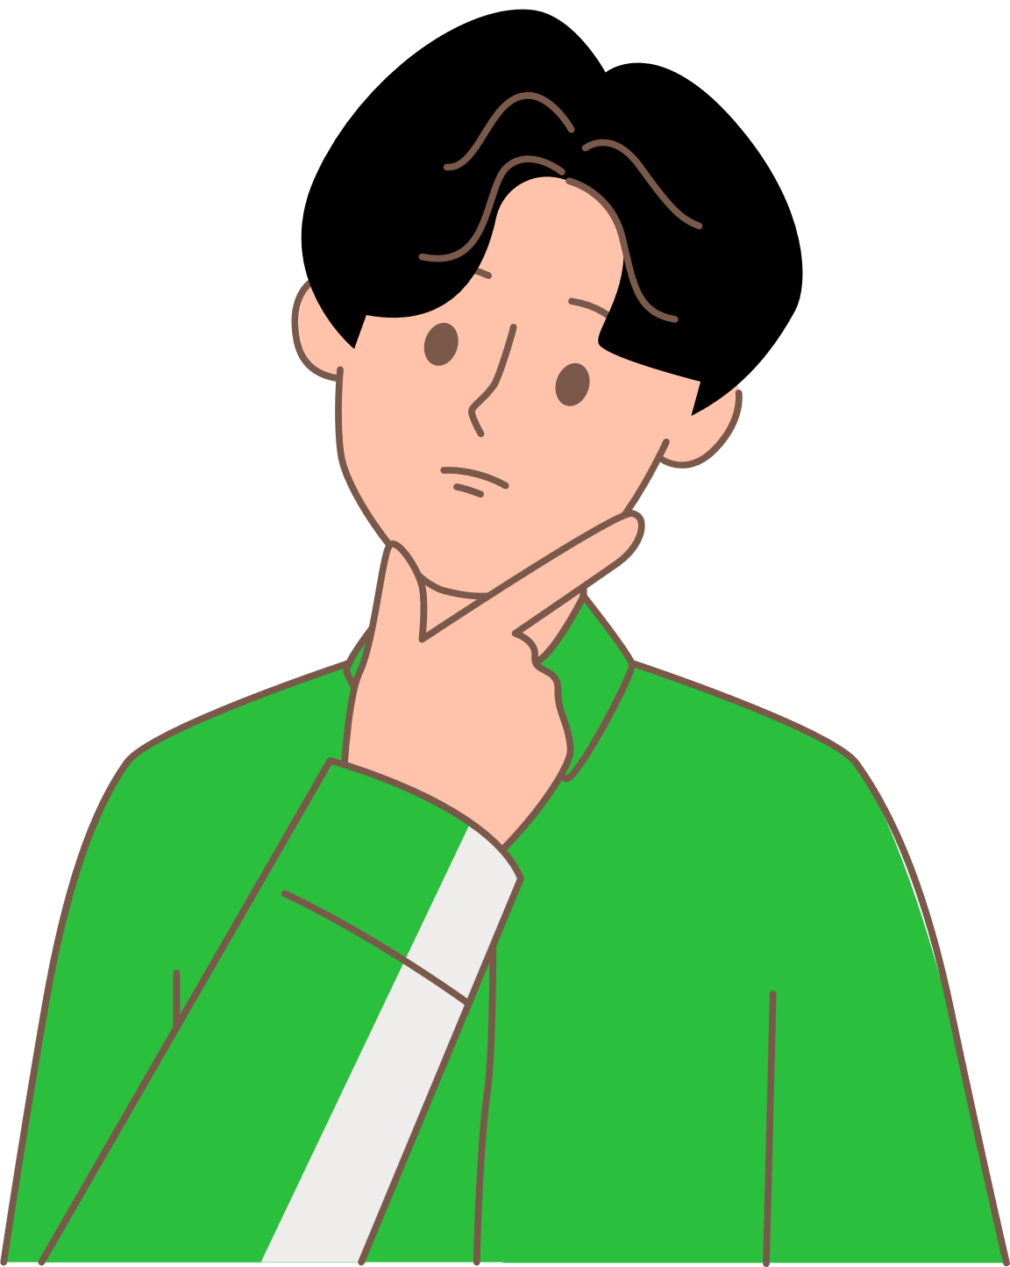
Ask and answer.
What does he want?
He wants a pear.
_______________

Slide 23
Ask and answer.
What does she want?
__________________

Slide 24
Ask and answer.
What does he want?
__________________

Slide 25
Ask and answer.
What does she want?
__________________

Slide 26
Ask and answer.
What does he want?
__________________

Slide 27
Ask and answer.
What does she want?
__________________

Slide 28
Ask and answer.
What does she want?
__________________

Slide 29
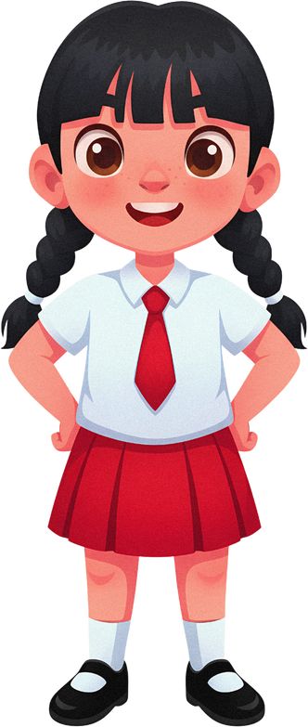



Yes, she does.
No, she doesn’t.
Yes, he does.
No, he doesn’t.
Yes
No

Slide 30




Does he want a pear?
Yes, he does. No, he doesn’t

Slide 31

Does she want cereal?
Yes, she does. No, she doesn’t

Slide 32

Does she want tea?
Yes, she does. No, she doesn’t

Slide 33

Does he want an omelet?
Yes, he does. No, he doesn’t

Slide 34
Does he want yogurt?
Yes, he does. No, he doesn’t

Slide 35

Does she want hot chocolate?
Yes, she does. No, she doesn’t

Slide 36
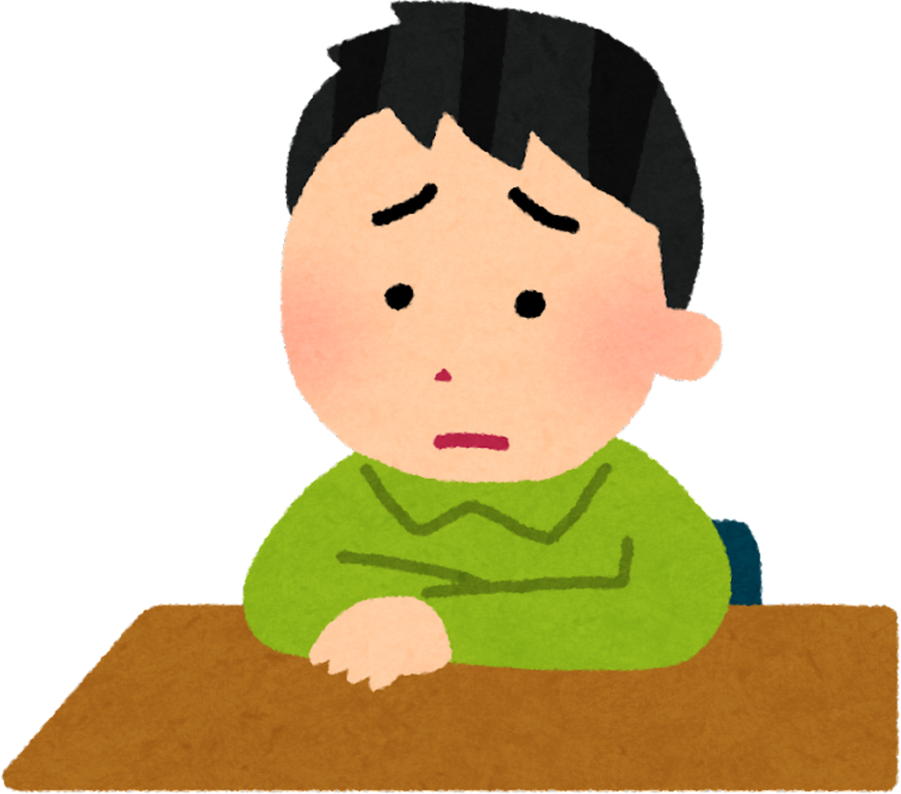
Does he want a peach?
Yes, he does. No, he doesn’t

Slide 37
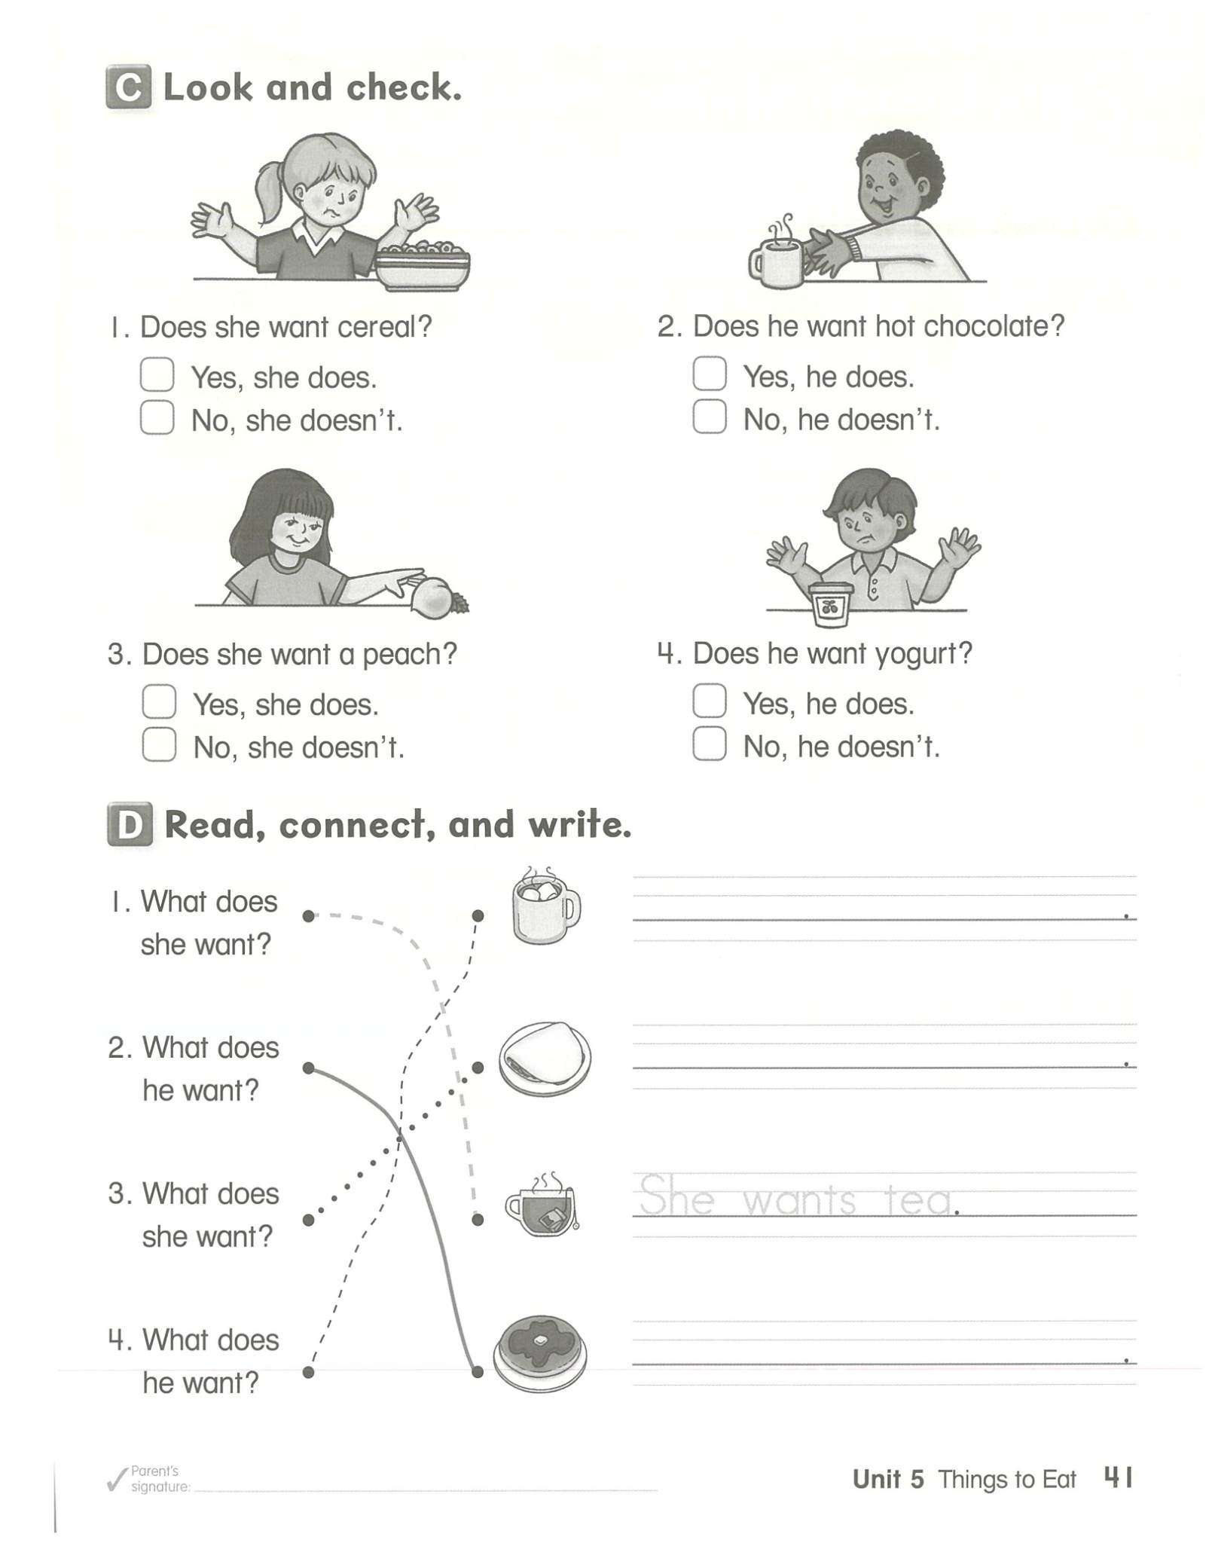
Read, connect and write.
He wants hot chocolate.

Slide 38


