Slide 1
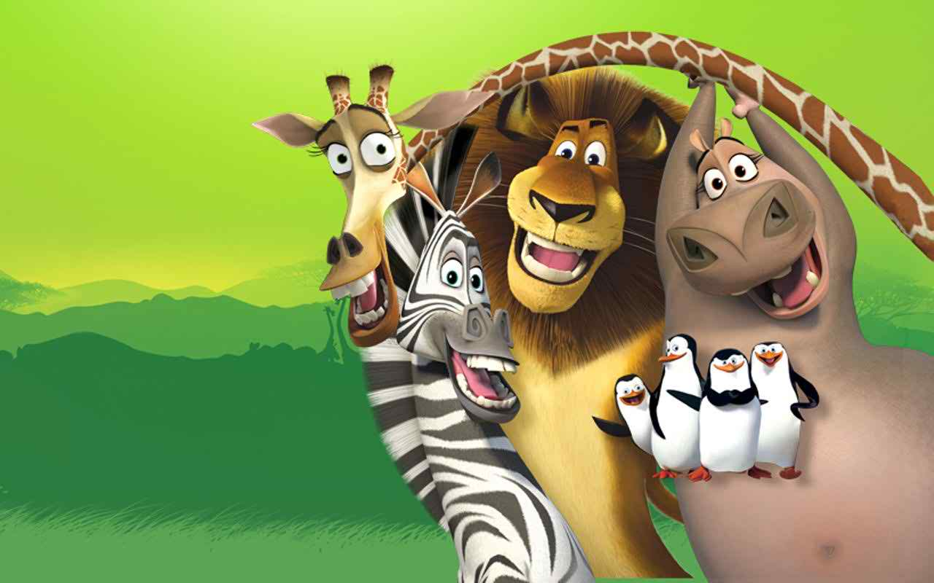
Animals

Slide 2
Animals
Wild animals - animals that live in nature
Farm animals - animals that are raised on a farm
Pets - tamed animal kept for companionship or pleasure

Slide 3
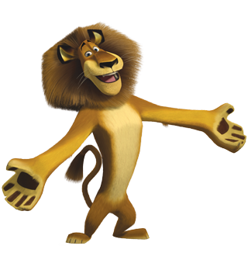
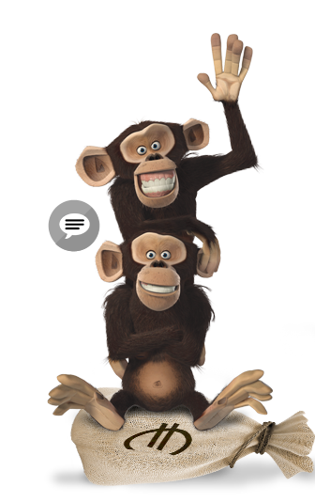
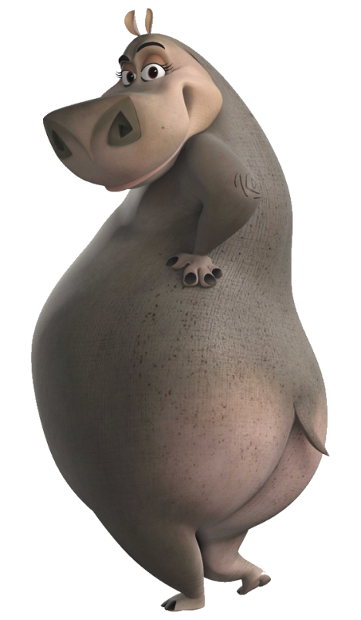
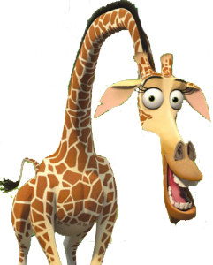
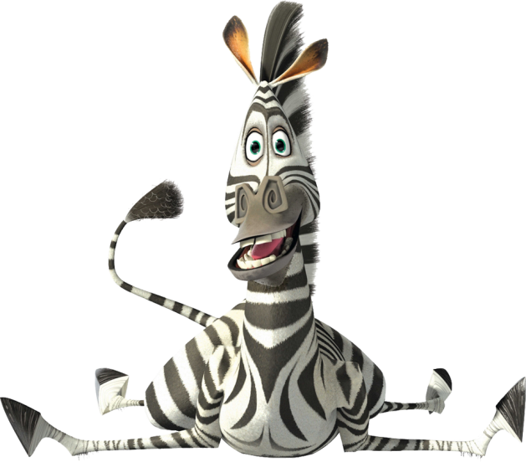
Wild animals
Monkey
Lion
Hippo
Giraffe
Zebra

Slide 4
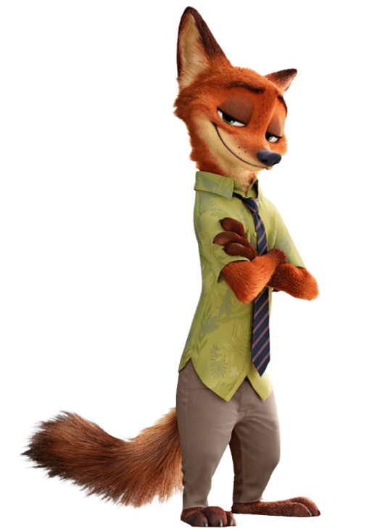
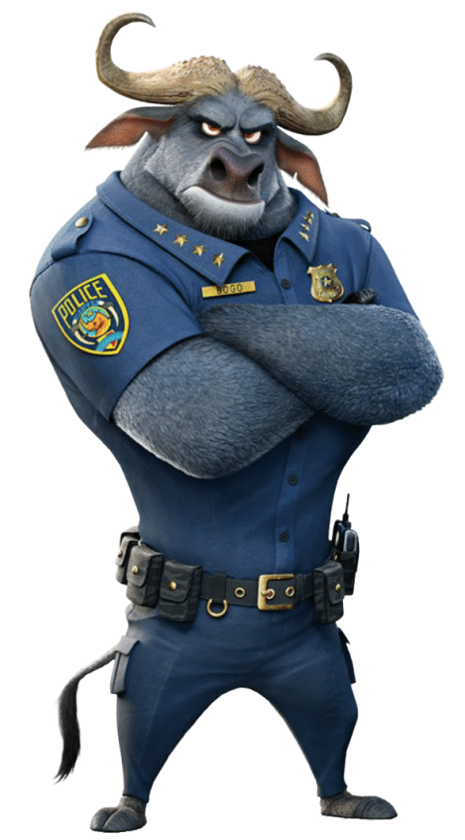
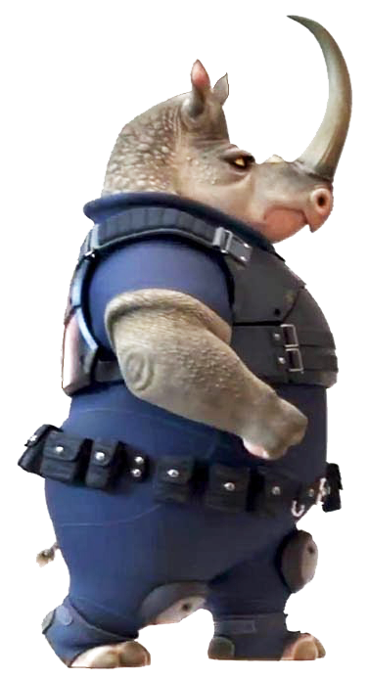
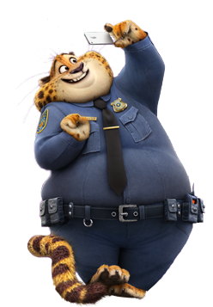
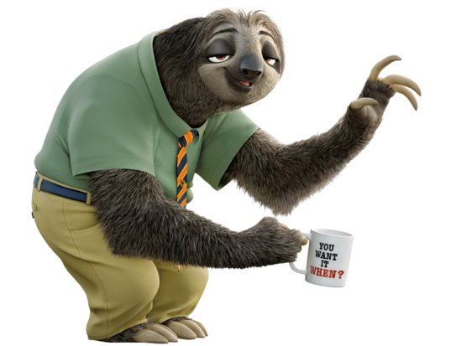
Wild animals
Bull
Fox
Rhino
Cheetah
Sloth

Slide 5
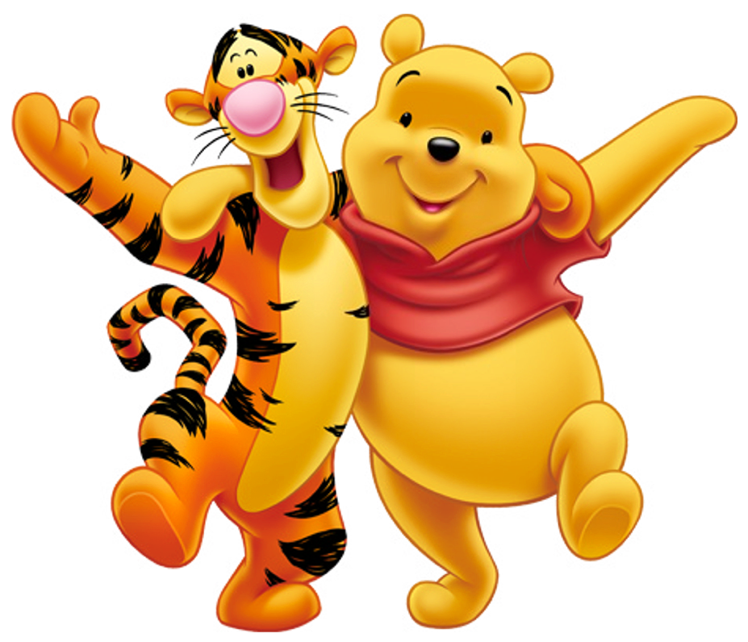
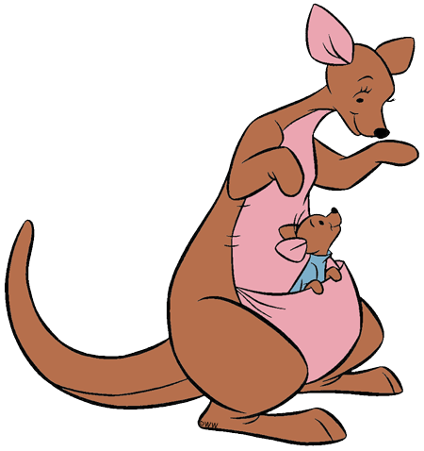
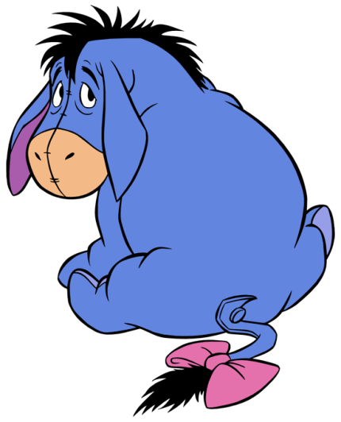
Wild animals
Tiger
Bear
Kangaroo
Donkey

Slide 6
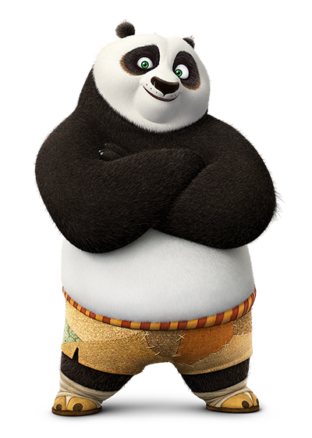
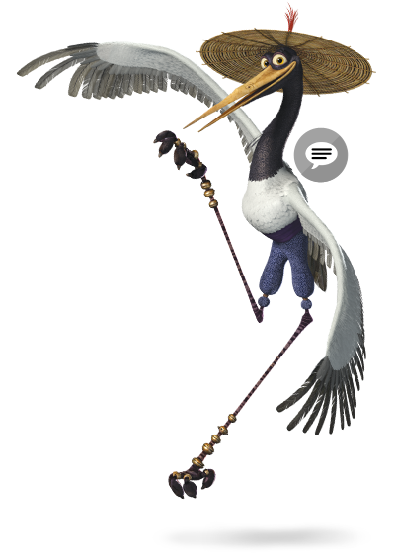
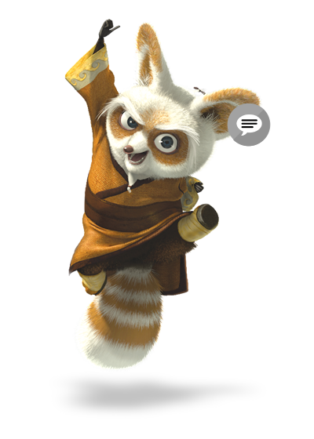
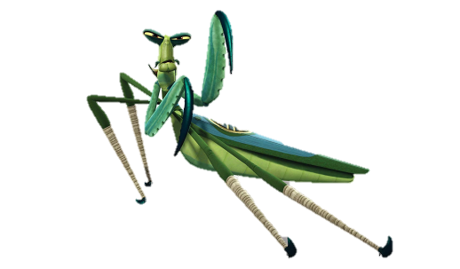
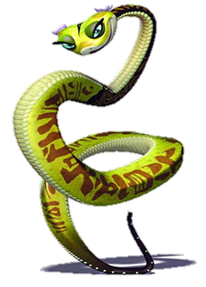
Wild animals
Red panda
Mantis
Crane
Panda
Snake

Slide 7
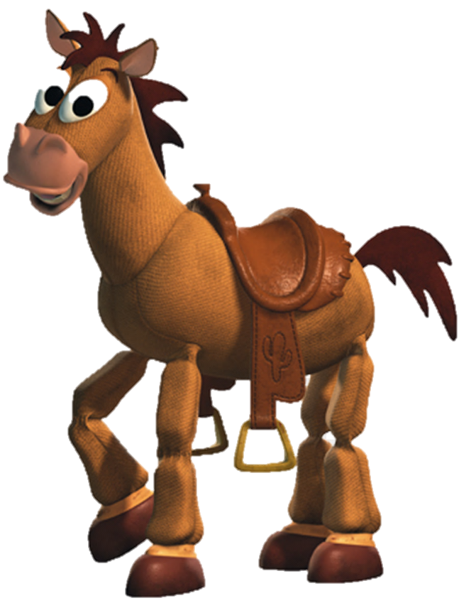
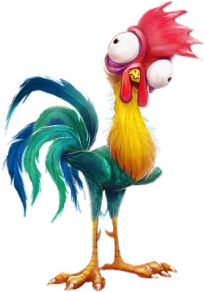
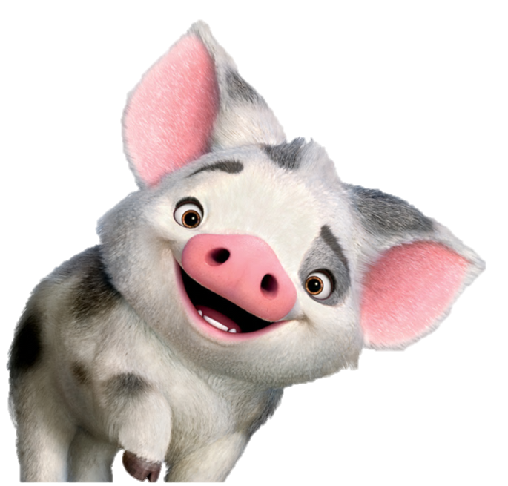
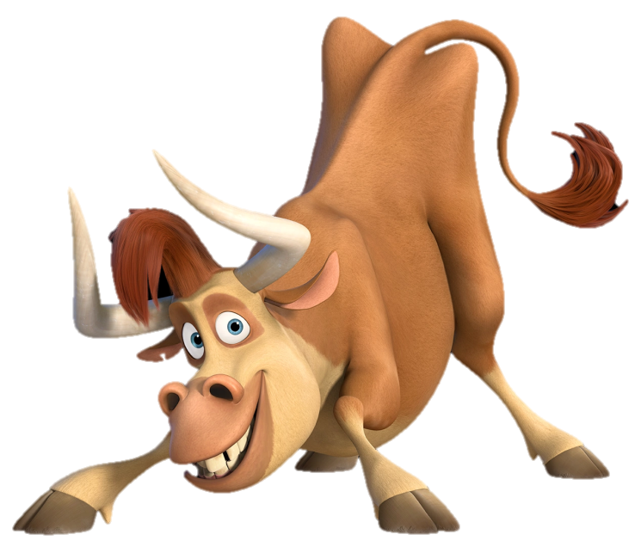
Farm animals
https://www.youtube.com/watch?v=RVJbKPW3Crs

Slide 8
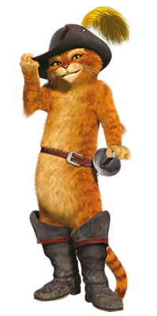
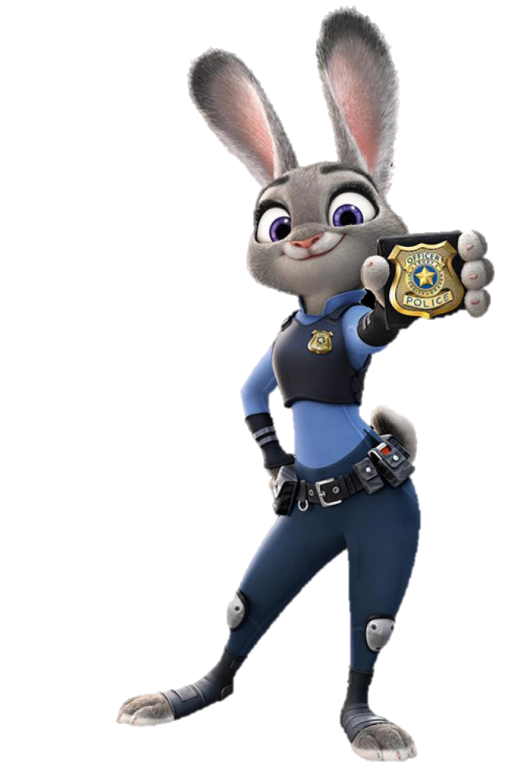
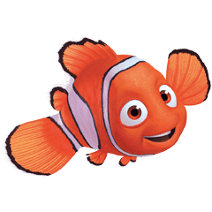
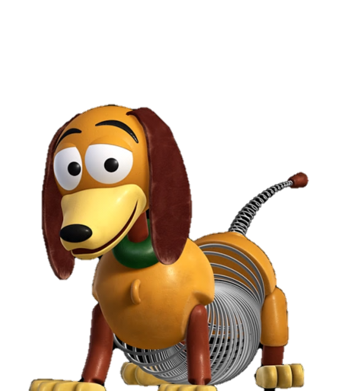
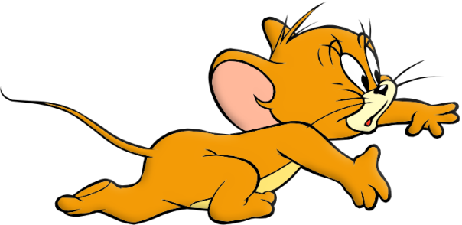
Pets
https://www.youtube.com/watch?v=tj4JdexVNBA

Slide 9
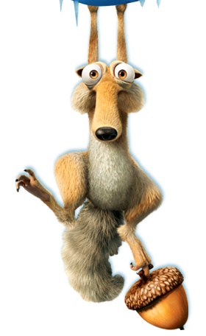
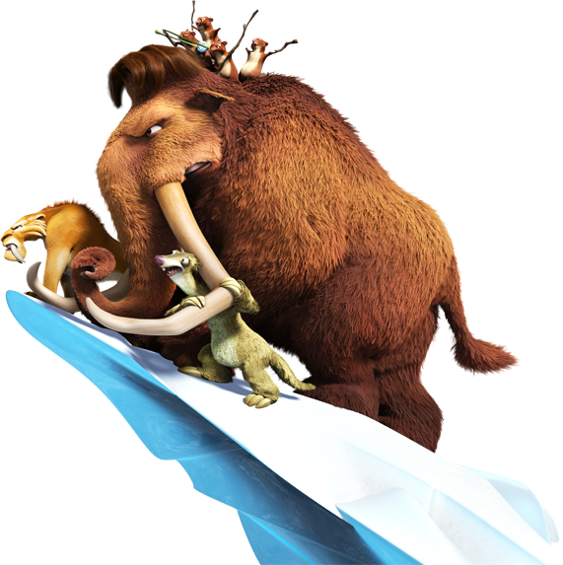
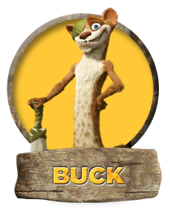
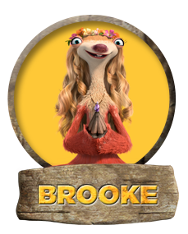
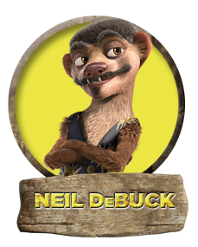
Animal riddles
Can you find out what I am?

Slide 10
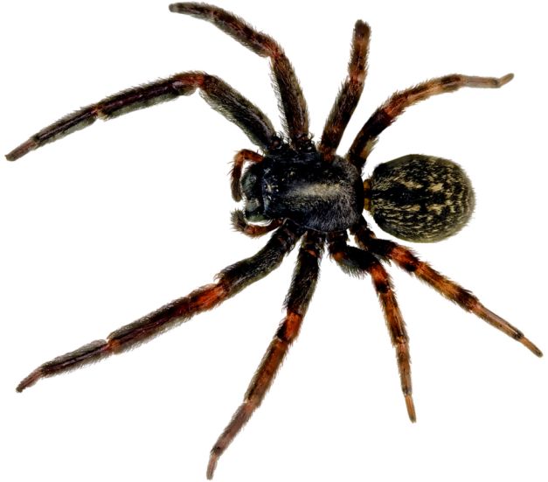
I am small.
I can be scary.
I have eight legs.
I spin a web.
Let find out what I am.
I am a ________.
spider

Slide 11
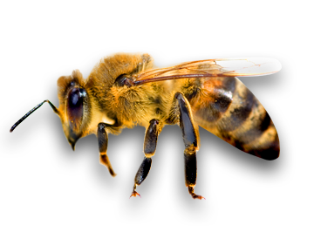
I am black and yellow.
I can fly.
I have six legs.
I eat honey.
Let find out what I am.
I am a ________.
bee

Slide 12
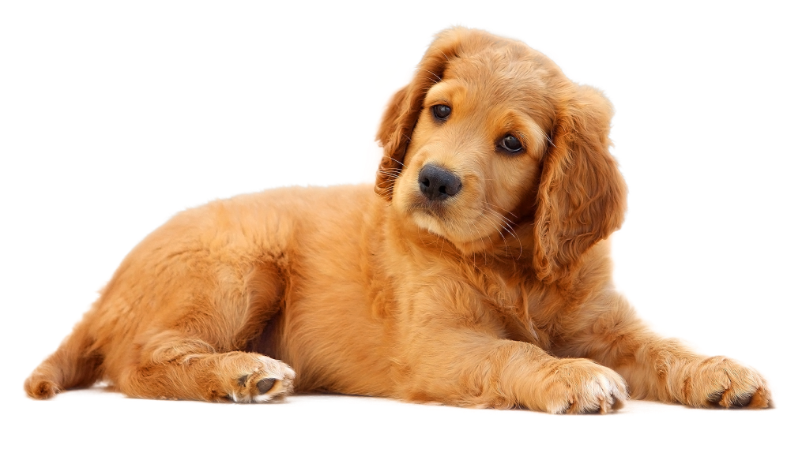
I am a pet.
I hate cats.
I have four legs.
I bark.
Let find out what I am.
I am a ________.
dog

Slide 13
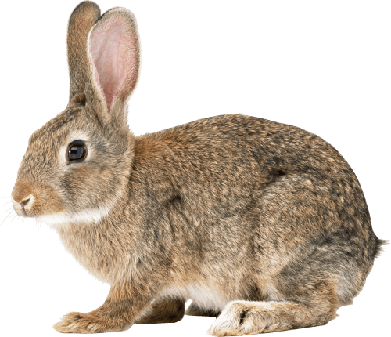
I eat vegetables.
I can be a pet.
I can run fast.
I have long ears.
Let find out what I am.
I am a ________.
rabbit

Slide 14
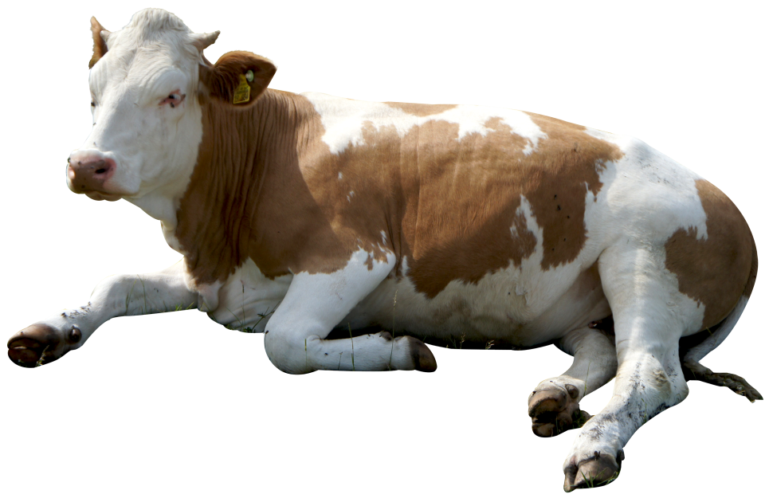
I live on the farm.
I have horns.
I moo.
I give milk.
Let find out what I am.
I am a ________.
cow

Slide 15
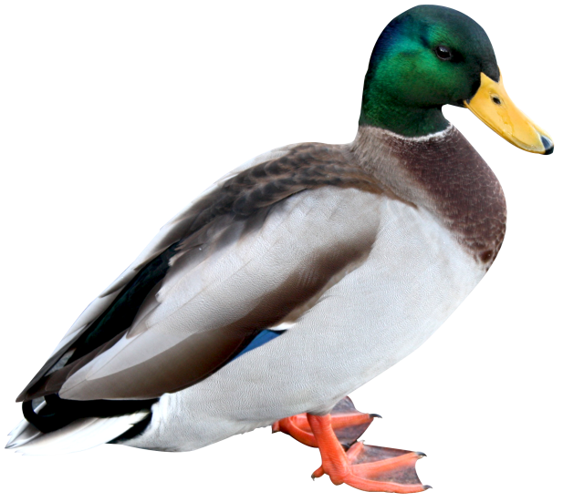
I can swim and dive.
I have two legs.
I have wings.
I quack.
Let find out what I am.
I am a ________.
duck

Slide 16
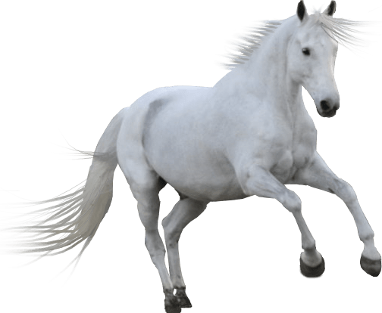
I have a mane.
You can ride me.
I live in a barn.
Let find out what I am.
I am a ________.
horse

Slide 17
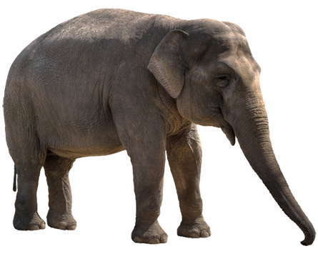
I have four legs.
I have a long nose.
You can ride me.
I have big ears.
Let find out what I am.
I am an ________.
elephant

Slide 18
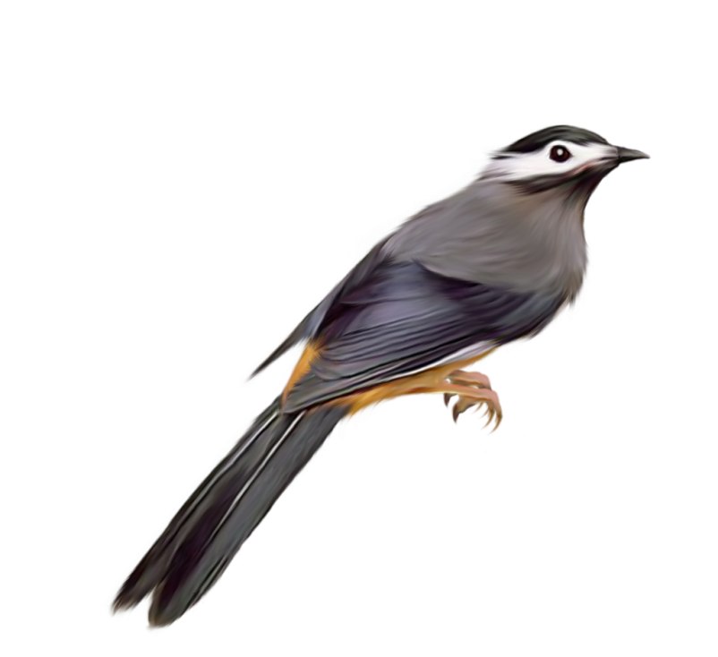
I am small.
I have feathers.
I lay eggs.
I can sing and fly.
Let find out what I am.
I am a ________.
bird

Slide 19
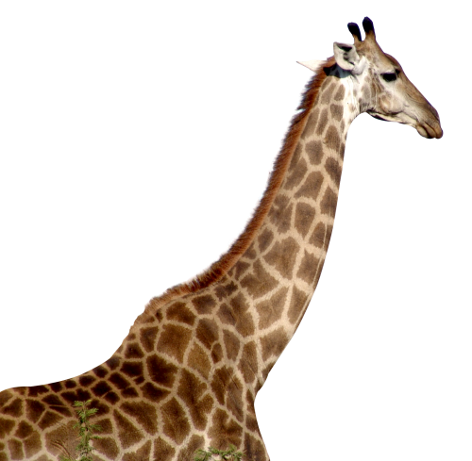
I live in Africa.
I am yellow and brown.
I eat leaves.
I have a long neck.
Let find out what I am.
I am a ________.
giraffe

