Slide 1

Describe Yourself/ your friend

Slide 2
Do and Does
Questions
What do you look like?
wHAt does your friend look like?

Slide 3
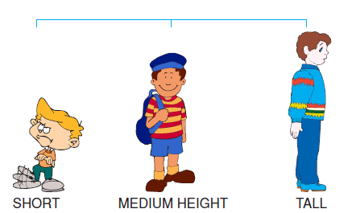
Height

Slide 4
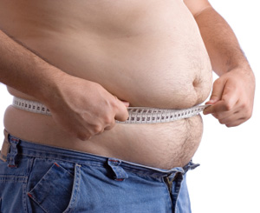
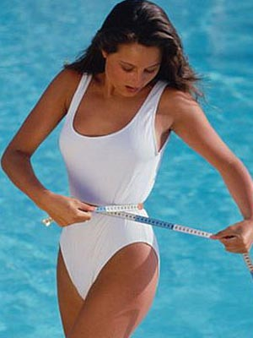
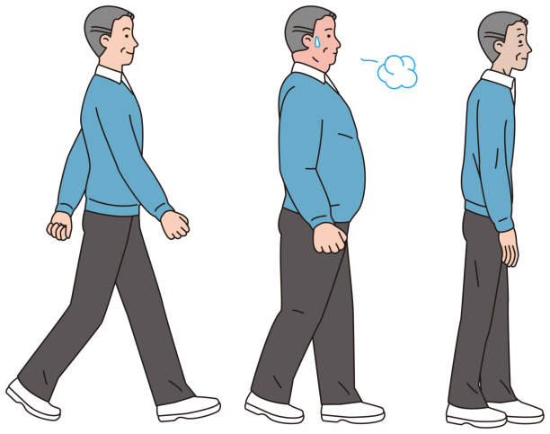
Build
Overweight /Chubby
Slim/Thin/Skinny
Average shape
รูปร่างปานกลาง

Slide 5
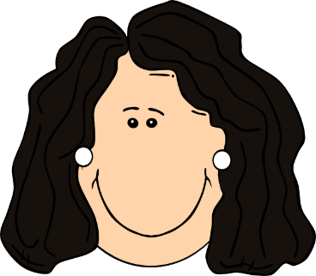
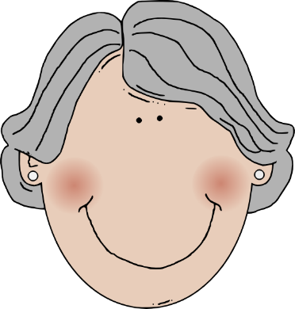
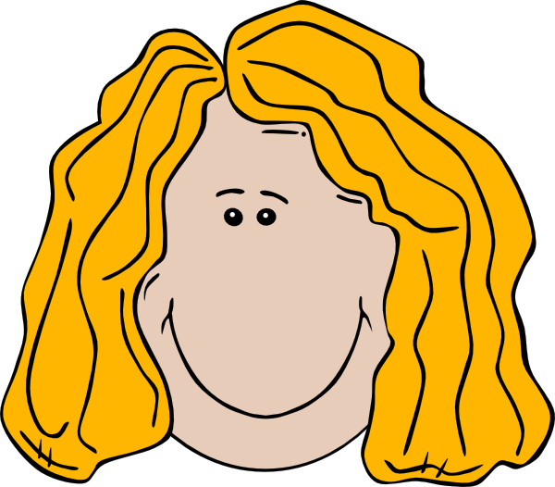
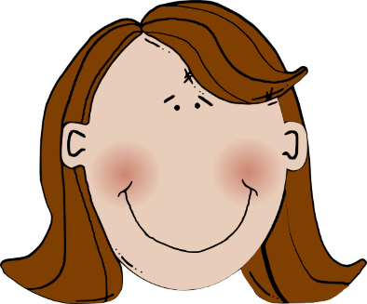
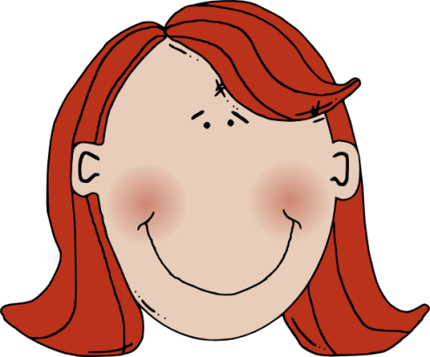
HAIR COLOURS
Blonde/Fair
Dark/Dark Brown/brown
Grey Reddish/ginger

Slide 6
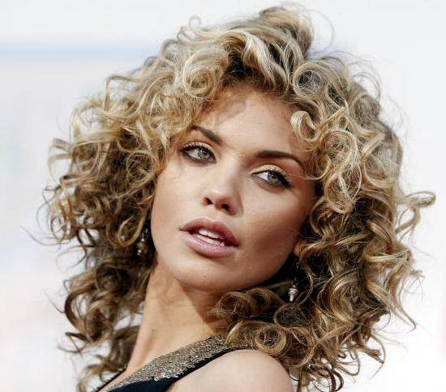
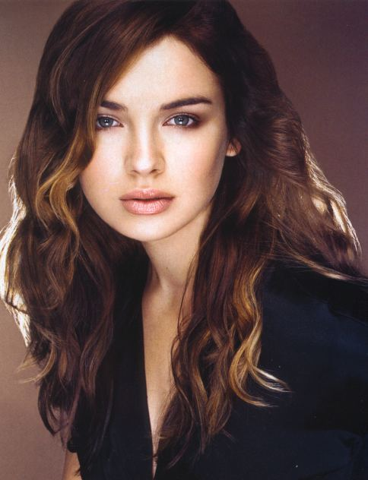
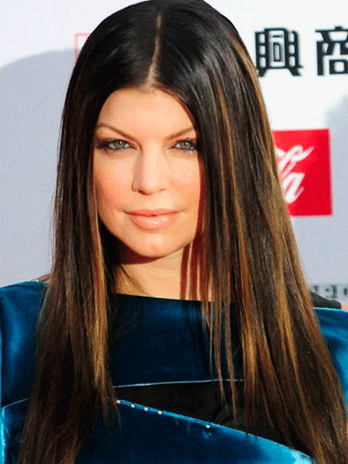
HAIR STYLES
Wavy
Straight
Curly

Slide 7
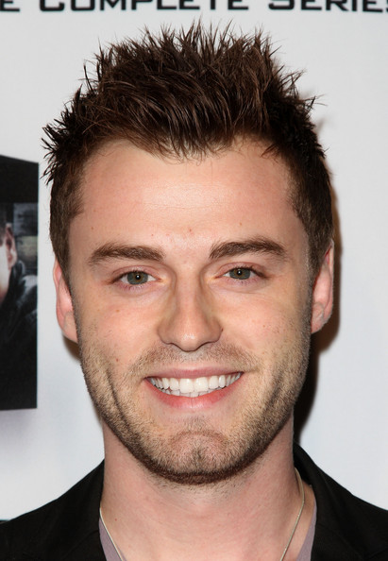
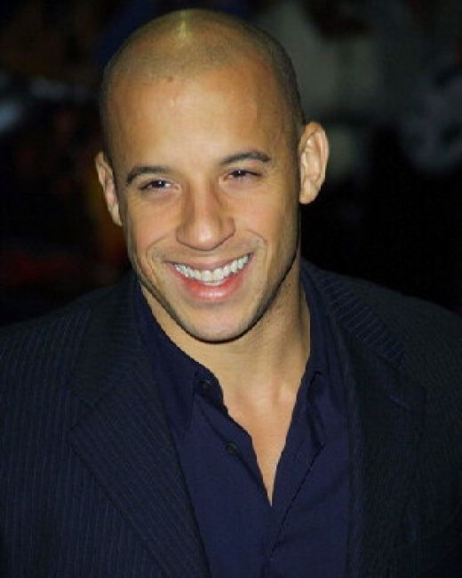
HAIR STYLES
SPIKY BALD

Slide 8
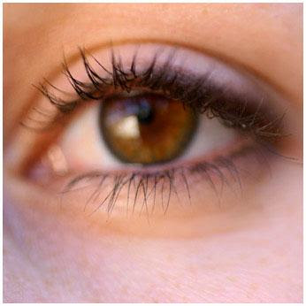
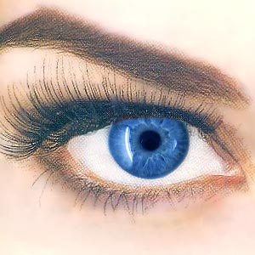
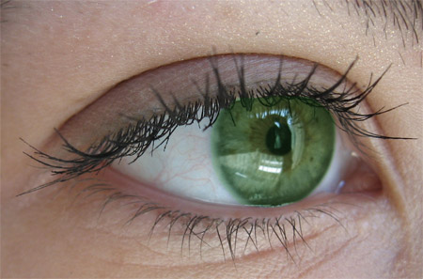
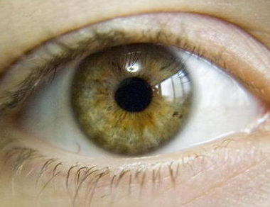
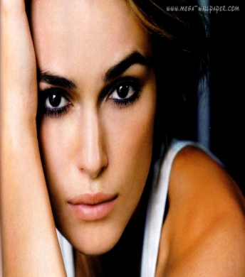
COLOUR EYES
BROWN BLUE GREEN HAZEL BLACK

Slide 9
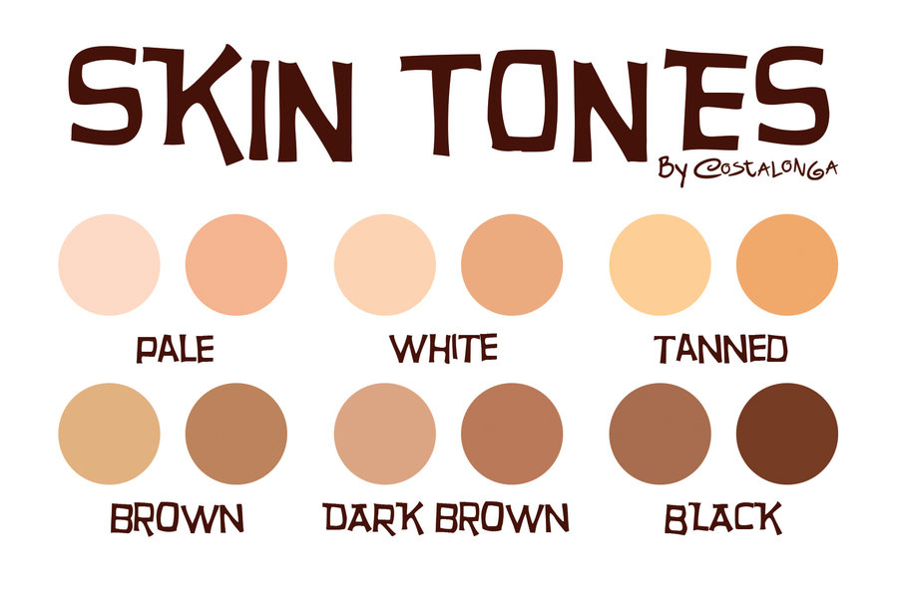
SKIN COLOUR

Slide 10
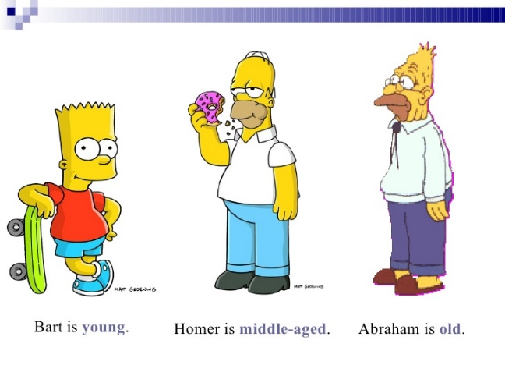
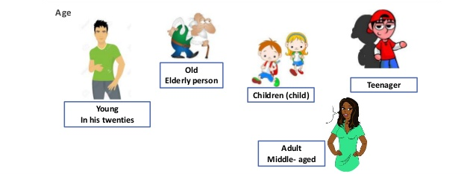
Age
60 - 100
14 – 18
1 - 13
20 - 30 years old
30 - 60

Slide 11
Examples
I’m tall and slim. I’ve got straight, short brown hair, and Small, black eyes. My skin tone is tanned, and I’m a teenager
He’s tall and slim. He’s got straight, short brown hair, and small, black eyes. His skin tone is tanned, and he’s an teenager

Slide 12
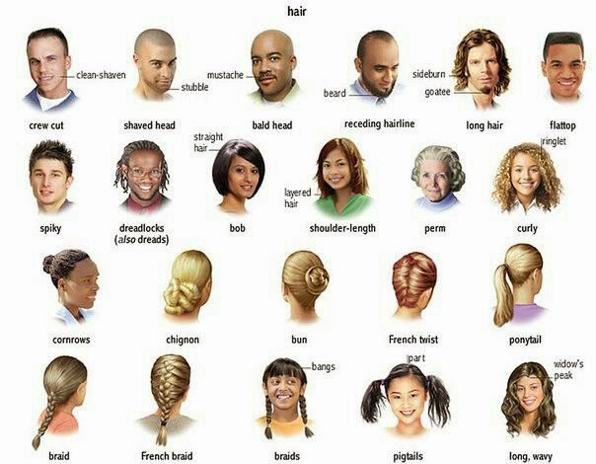
More…

