Slide 1
GOING TO-- FUTURE
Going to is not a tense. It is a special expression to talk about the future.

Slide 2
It is used with expressions such as:
- tomorrow
- tonight
- next week/month/year
- in a few hours/days
- by next week, etc.

Slide 3
Structure of Going to
The structure is:
subject
(I/He/She/We)
Pronoun + (am-is-are) + going to + (verb)

Slide 4
EXAMPLES
I am going to sing at the party.
She is going to sing at the party.
He is going to sing at the party. Singular
It is going to rain.
You are going to sing at the party.
We are going to sing at the party. Plural
They are going to sing at the party.

Slide 5
Negative sentences structure of Going to
The structure is:
(I/He/She/We)
Pronoun + (am-is-are) + not + going to + (verb)
EXAMPLES:
I am not going to sing at the party.
She is not going to sing at the party.
You are not going to sing at the party.

Slide 6
Exercise I / (going to)
Write positive sentences in going to future.
I / work/at the office _______________
you / dance/salsa____________________
it / rain / today ____________________
they / ask / a question___________________
He / stay /at the hotel ___________________
we / speak / French ____________________
I / give /some candies ___________________
she / try /the software _________________
they / help /at home ____________________
he / push /the door)____________________

Slide 7
Exercise 2. Write negative sentences in going to future.
(I / sell / my car) _______________
(he / help / us) _______________
(they / study / harder) _______________
(we / cook / dinner tonight) ___________
(I / celebrate / my birthday this year) _______
(she / clean / her room) _______________
(they / move / house) _______________
(she / stay / with Amy) _______________
(they / change / their clothes) ____________
(we / get up early / next Sunday) ___________

Slide 8

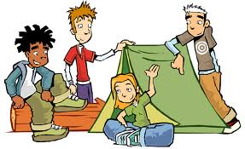


What are they going to do?
click
here
They ____ going to ____
camping.
are
go

Slide 9
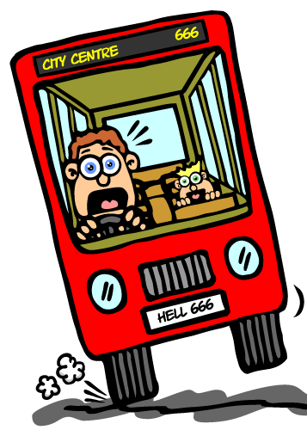
What is going to happen?
click
here
He ____ going to ____
an accident.
is
have

Slide 10
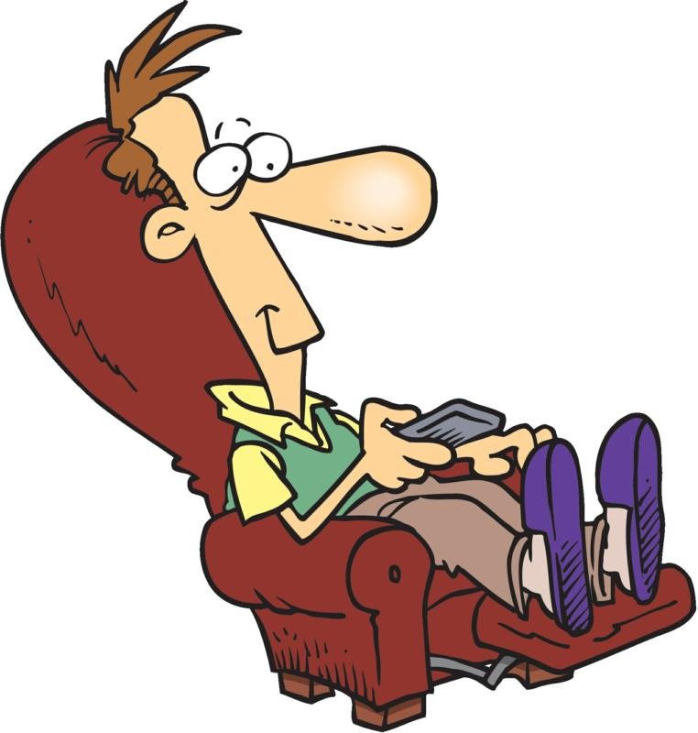
What is he going to do?
click
here
He ____ going to ____
TV.
is
watch

Slide 11

What is going to happen?
click
here
It ____ going to _____ .
is
rain

Slide 12
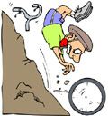
What is going to happen?
click
here
He ____ going to ____
every single bone.
is
break

