Slide 1
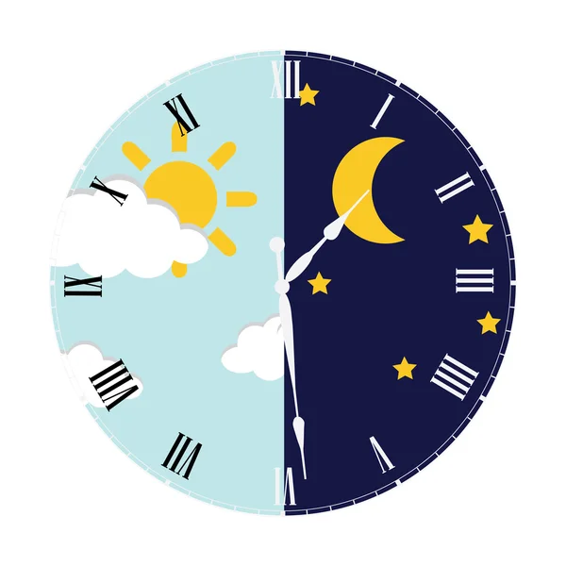
Unit 21: Day and Night

Slide 2
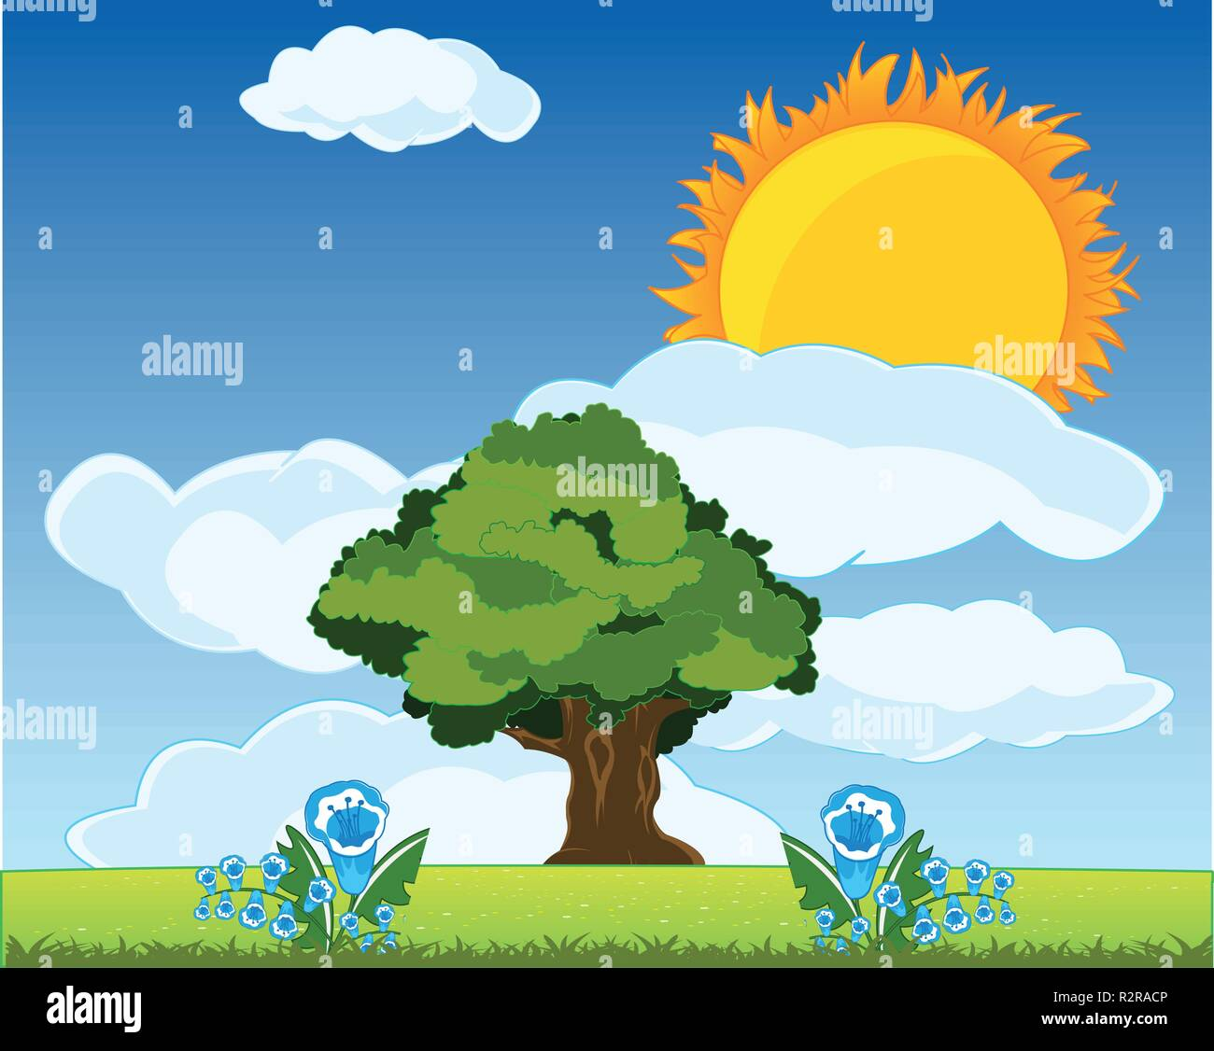
daytime

Slide 3
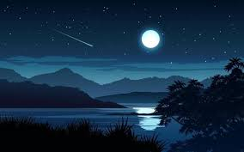
nighttime

Slide 4

light

Slide 5
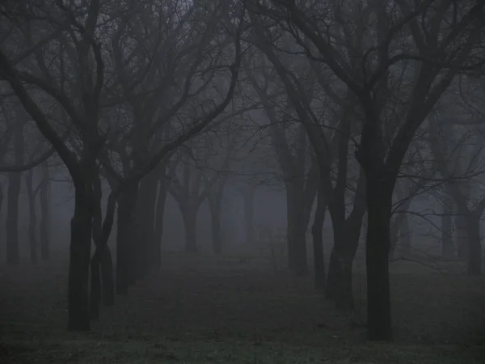
dark

Slide 6
A: When do you go to school?
B: In the daytime.
I go to school during the daytime.

Slide 7
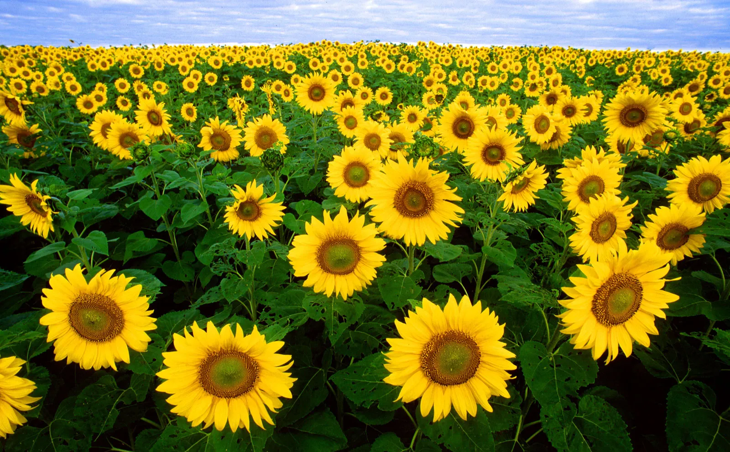
We can see beautiful flowers.

Slide 8
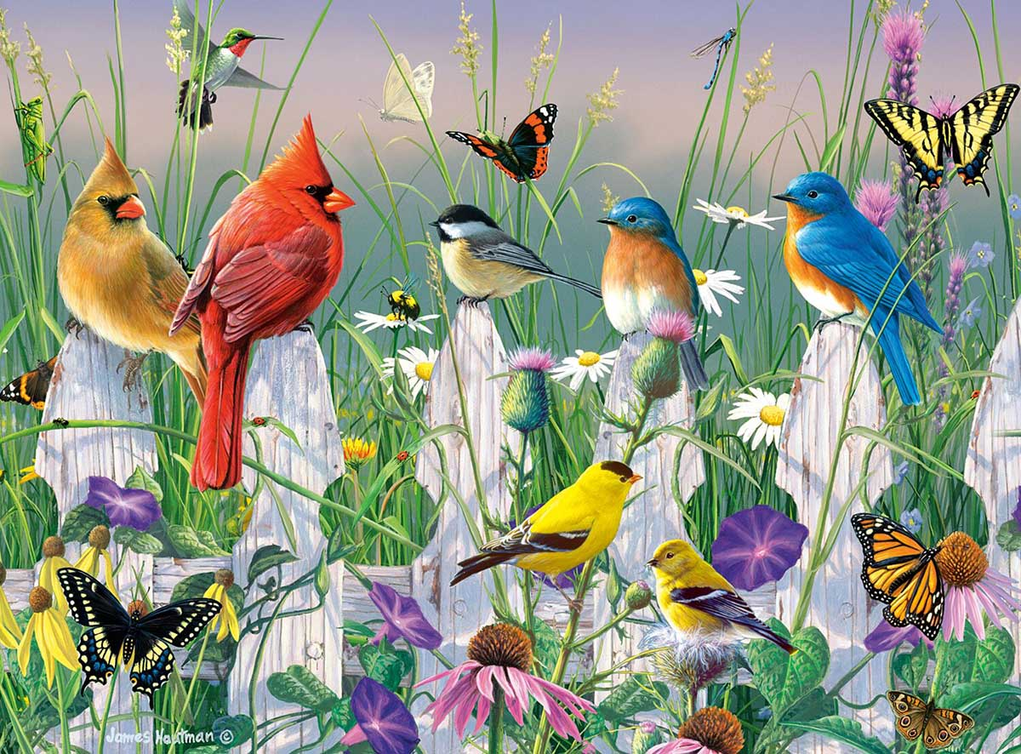
We can see the birds and the butterflies.

Slide 9
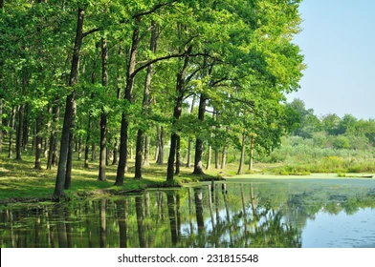
We can see trees and waters.

Slide 10
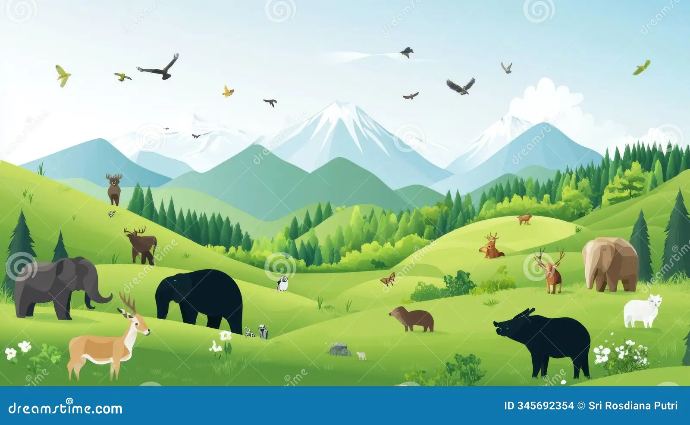
We can see mountains and animals.

Slide 11
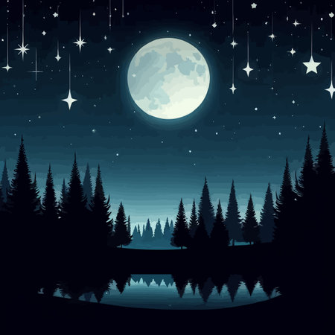
We can see the moon and the stars in nighttime.

Slide 12
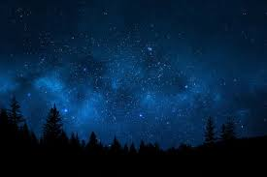
Beautiful sky during nighttime.

