Slide 1
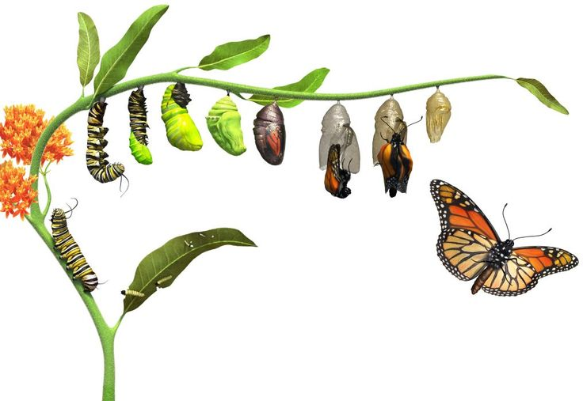
Life Cycle of Animals

Slide 2
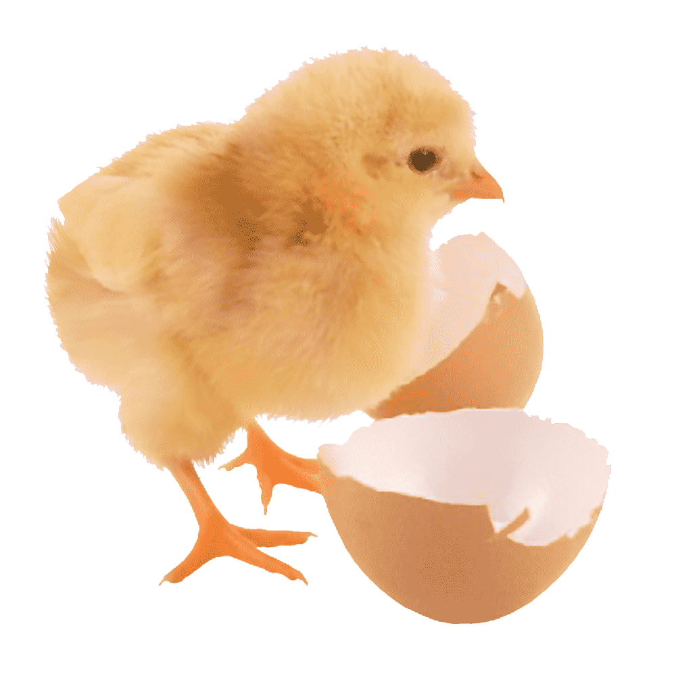
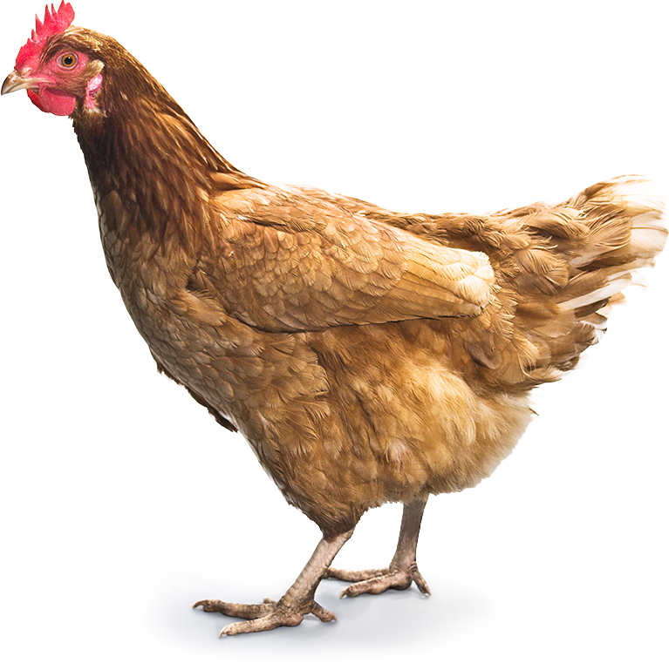
Activity 1: I can identify the fully grown animals and their young.
Here are some examples:
young
Adult

Slide 3
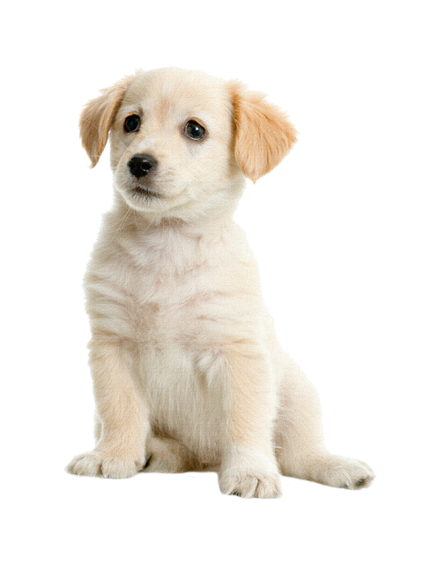
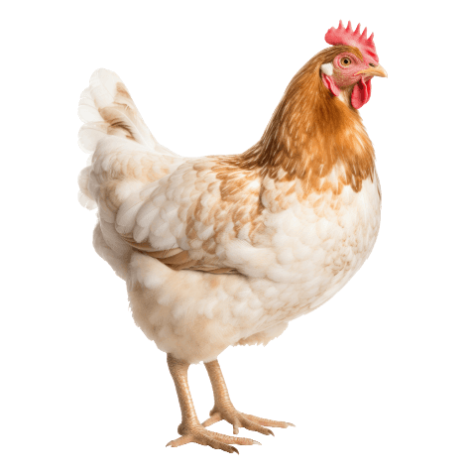
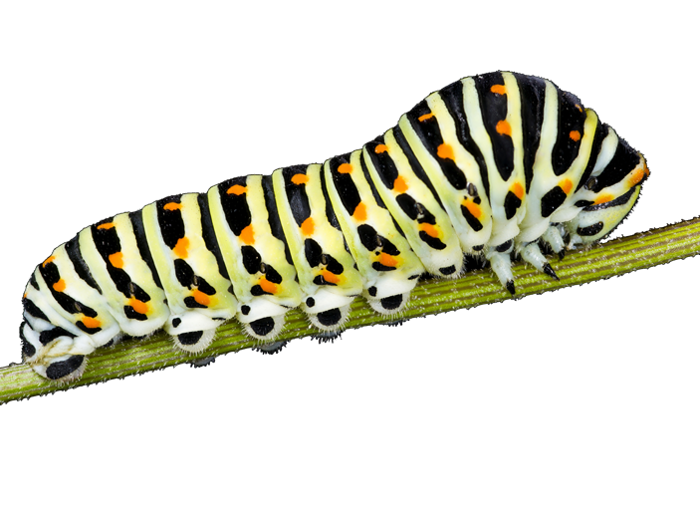
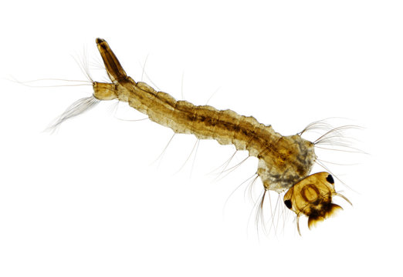

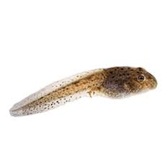
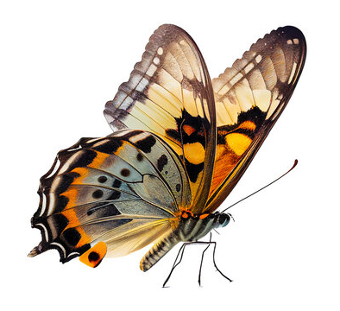
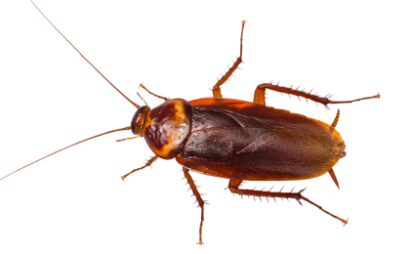
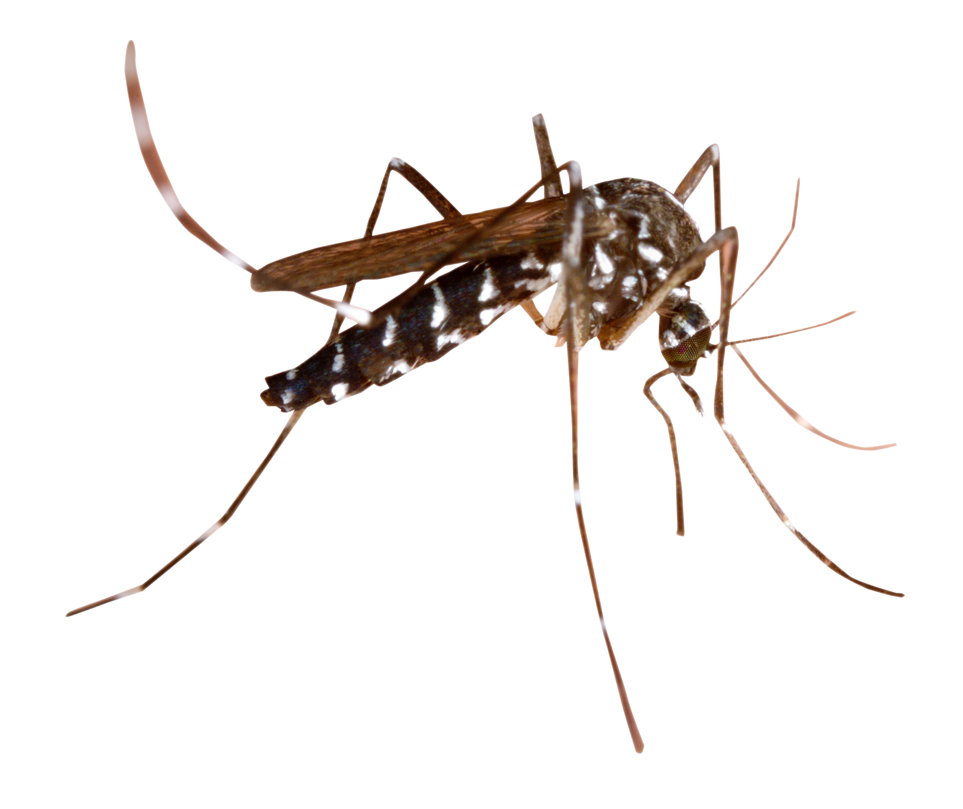
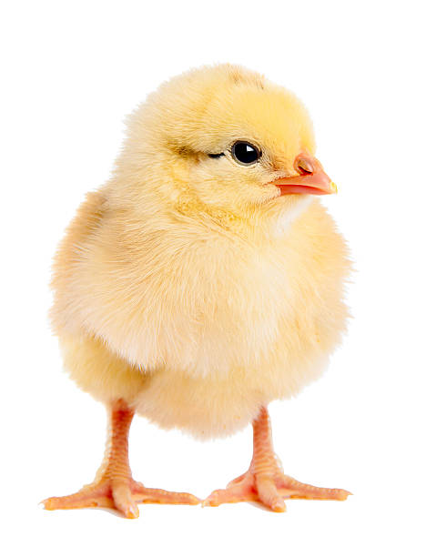
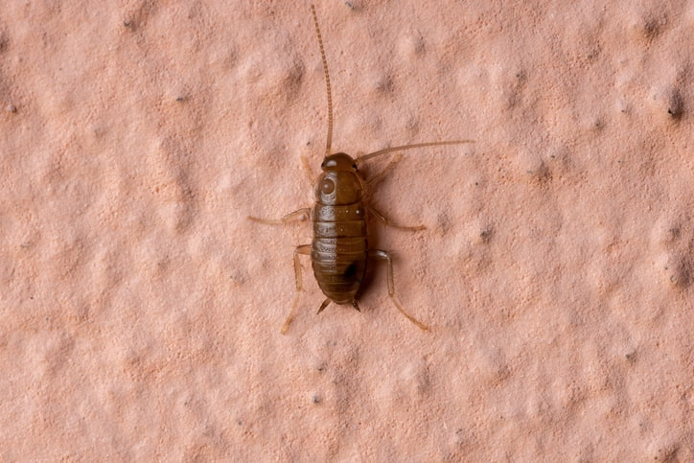
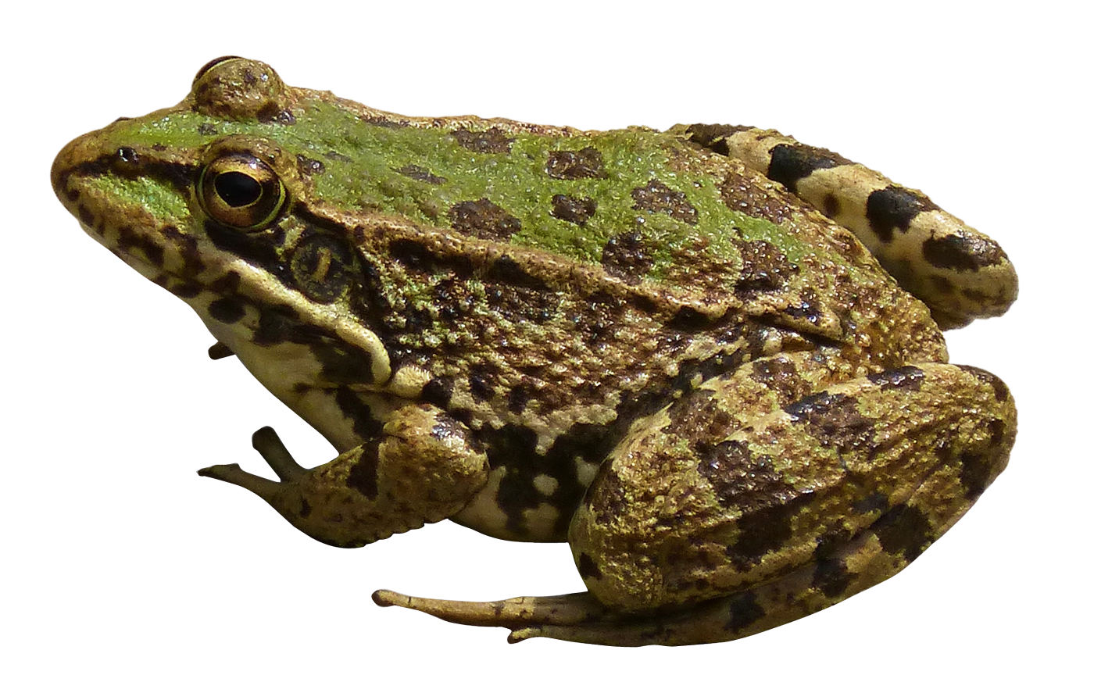
Game Time: Let’s match the fully grown animals to their young.
A
B
C
D
E
F
G
H
I
J
K
L

Slide 4
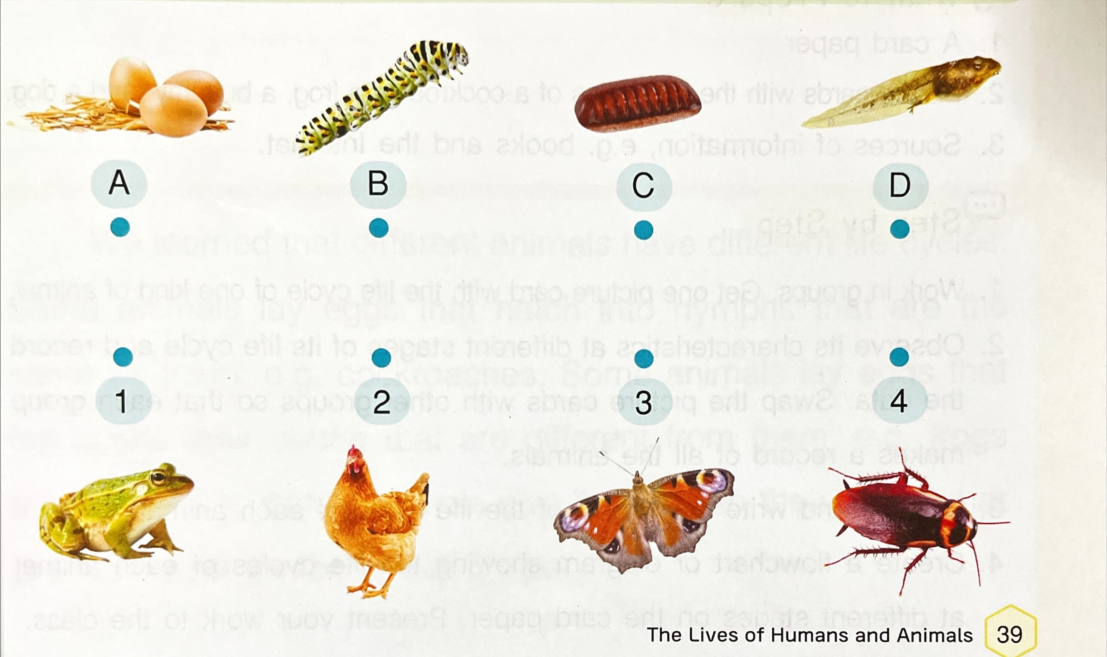
Page 39: Draw lines to match the fully grown animals to their young.

Slide 5
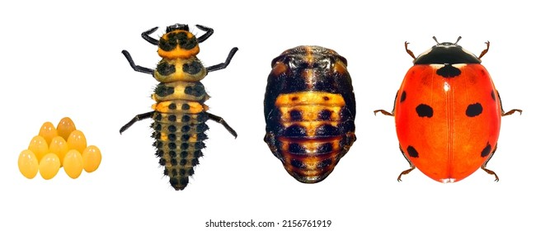
Activity 2: Watch the videos of the life cycle record the data.
Step 1: Watch a video and rearrange the given pictures into the correct stages.
Animal | Stages in their life cycle
 | Stage 1 | Stage 2 | Stage 3 | Stage 4
Ladybug | picture | picture | picture | picture
Ladybug | name | name | name | name

Slide 6
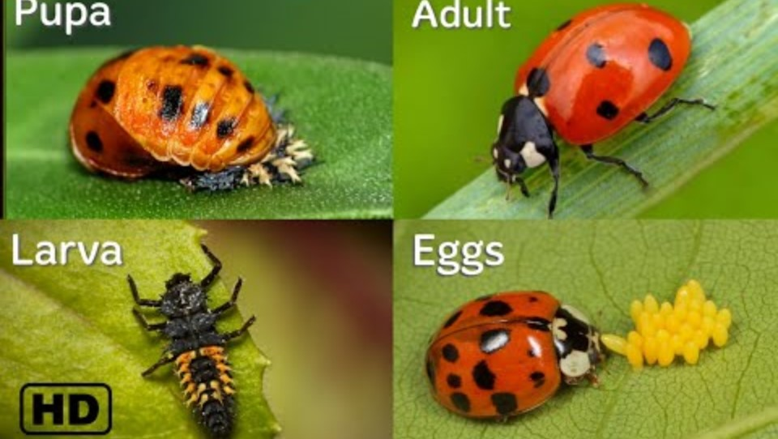
Activity 2: Watch the videos: “The life cycle of a ladybug”.

Slide 7
Activity 2: Watch the videos of the life cycle record the data.
Step 1: Watch a video and rearrange the given pictures into the correct stages.
Animal | Stages in their life cycle
 | Stage 1 | Stage 2 | Stage 3 | Stage 4
Ladybug | picture | picture | picture | picture
Ladybug | name | name | name | name

Slide 8
Activity 2: Watch the videos of the life cycle record the data.
Step 2: Place the given texts below each picture to describe the picture.
Animal | Stages in their life cycle
 | Stage 1 | Stage 2 | Stage 3 | Stage 4
Ladybug | picture | picture | picture | picture
Ladybug | Egg | Larva | Pupa | Adult (Ladybug)

Slide 9
Activity 2: Watch the videos of the life cycle record the data.
Group work: Make a group of five.
Step 1: Each group will get 1 animal, 1 table to record the data.
Step 2: Watch a video and rearrange the given pictures into the correct stages.
Step 3: Place the given texts below each picture to describe the picture.

Slide 10
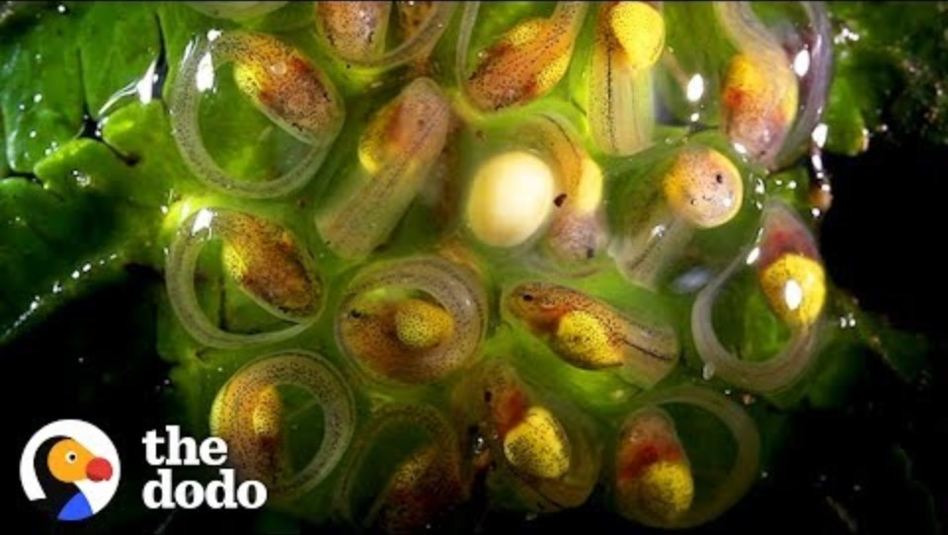
Activity 2: Watch the videos: “The life cycle of a frog”.

Slide 11
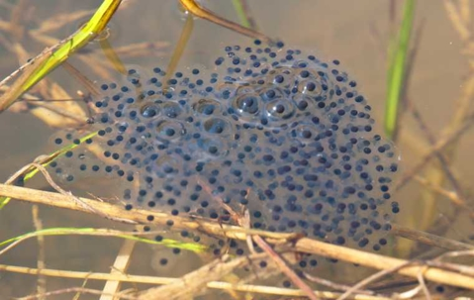
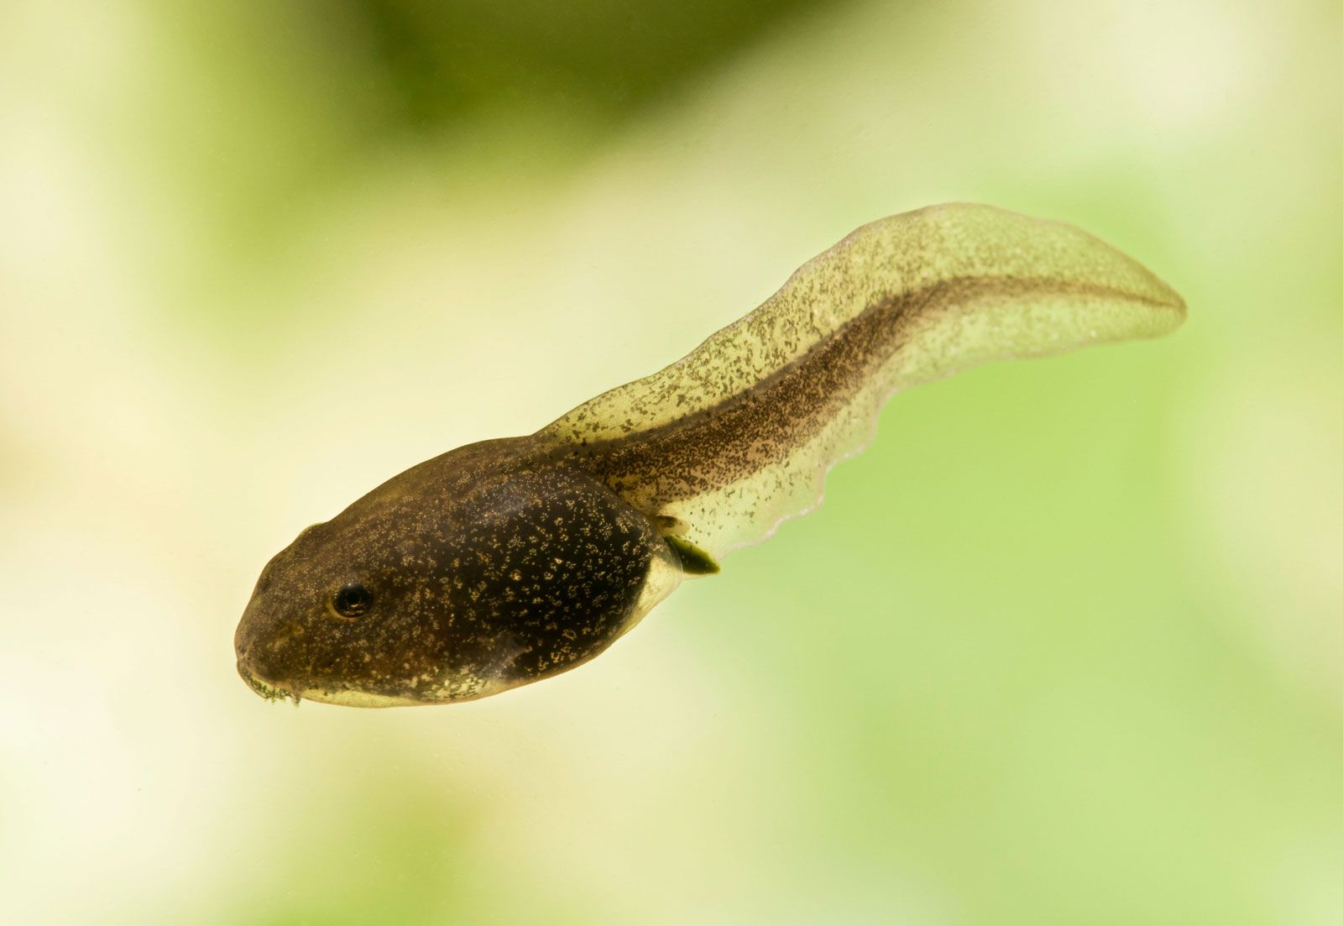
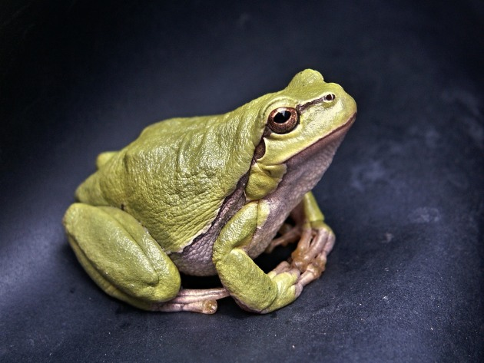
Activity 2: Watch the videos of the life cycle record the data.
Step 2: Place the given texts below each picture to describe the picture.
Animal | Stages in their life cycle
 | Stage 1 | Stage 2 | Stage 3 | Stage 4
Frog | picture | picture | picture | picture
Frog | Egg | Tadpole | Adult (Frog)

Slide 12
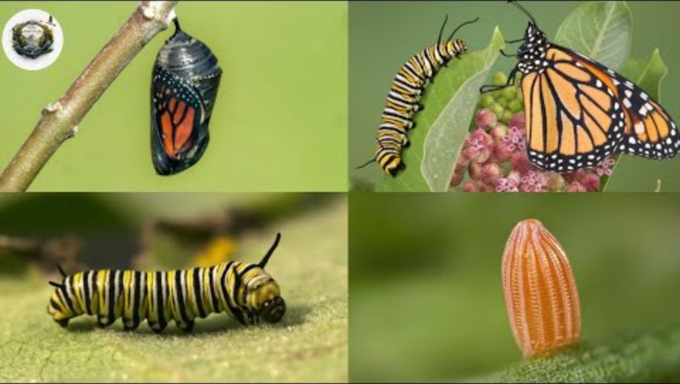
Activity 2: Watch the videos: “The life cycle of a butterfly”.

Slide 13
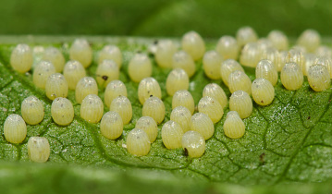
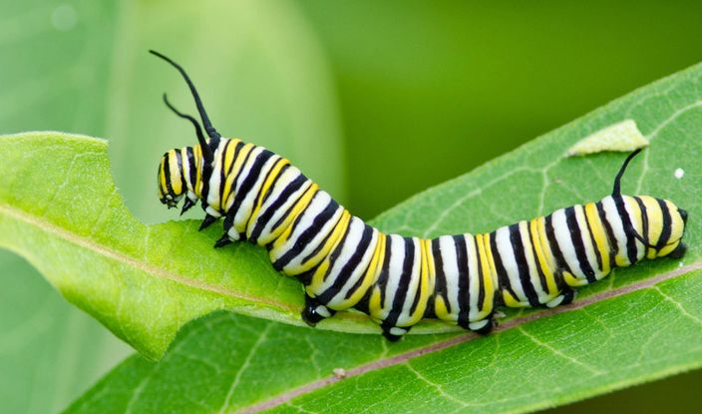
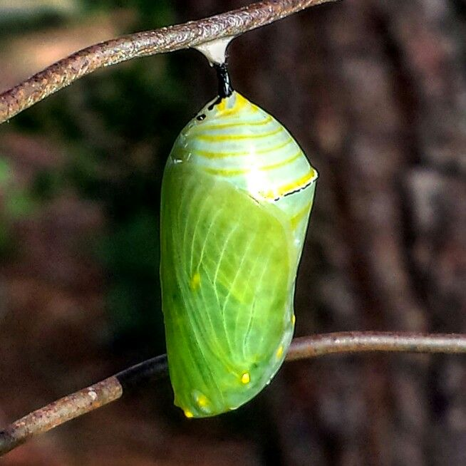
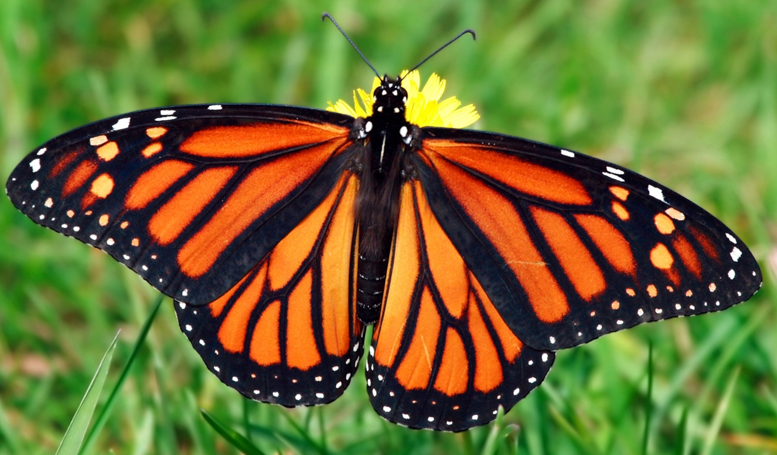
Activity 2: Watch the videos of the life cycle record the data.
Step 2: Place the given texts below each picture to describe the picture.
Animal | Stages in their life cycle
 | Stage 1 | Stage 2 | Stage 3 | Stage 4
Butterfly | picture | picture | picture | picture
Butterfly | Egg | Larva (Caterpillar) | Pupa | Adult (Butterfly)

Slide 14
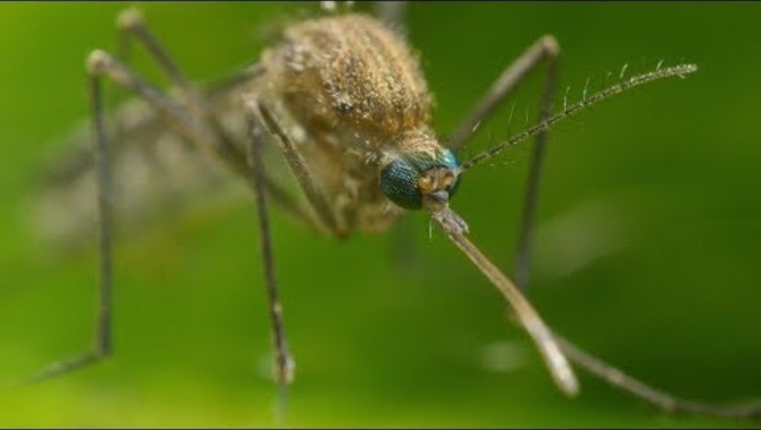
Activity 2: Watch the videos: “The life cycle of a mosquito”.

Slide 15
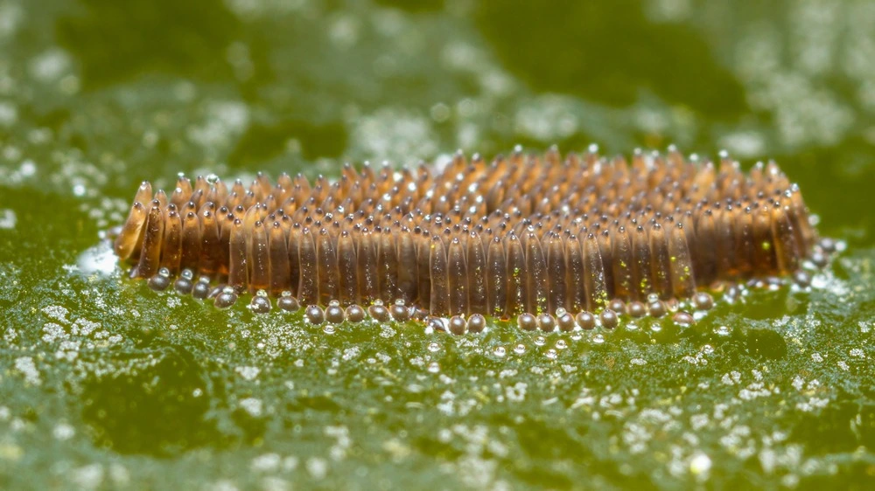
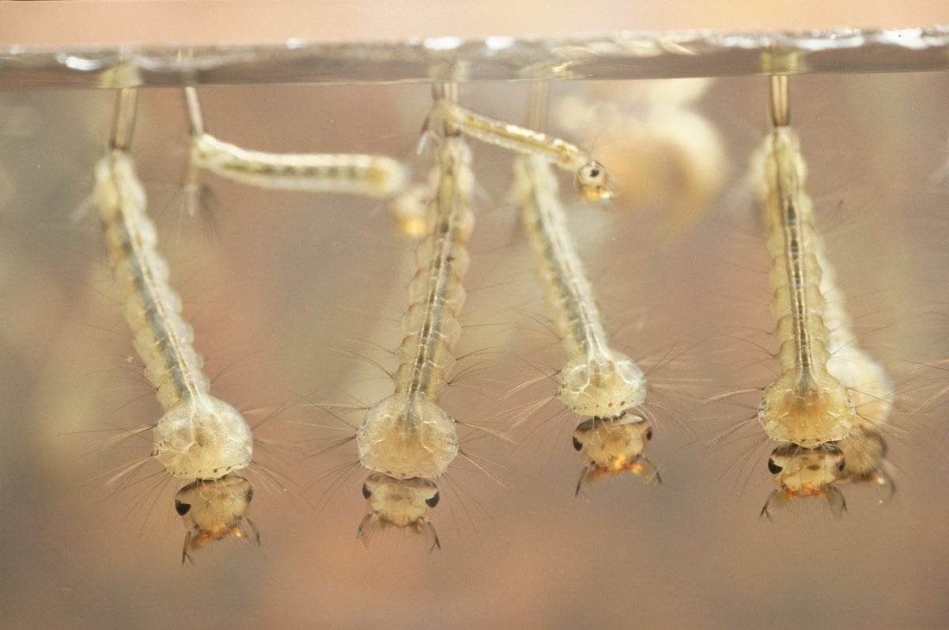
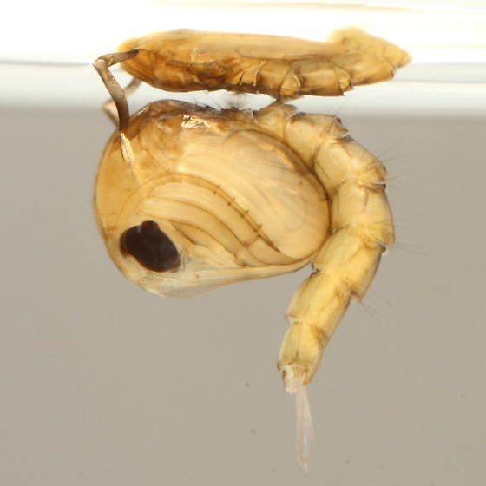
Activity 2: Watch the videos of the life cycle record the data.
Step 2: Place the given texts below each picture to describe the picture.
Animal | Stages in their life cycle
 | Stage 1 | Stage 2 | Stage 3 | Stage 4
Mosquito | picture | picture | picture | picture
Mosquito | Egg | Larva (wriggler) | Pupa | Adult (Mosquito)

Slide 16
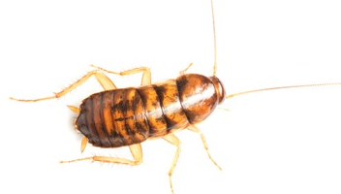
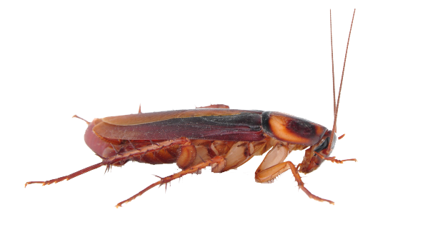
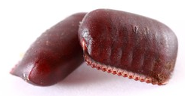
Activity 2: Watch the videos of the life cycle record the data.
Step 2: Place the given texts below each picture to describe the picture.
Animal | Stages in their life cycle
 | Stage 1 | Stage 2 | Stage 3 | Stage 4
Cockroach | picture | picture | picture | picture
Cockroach | Egg | Nymph | Adult (Cockroach)

Slide 17
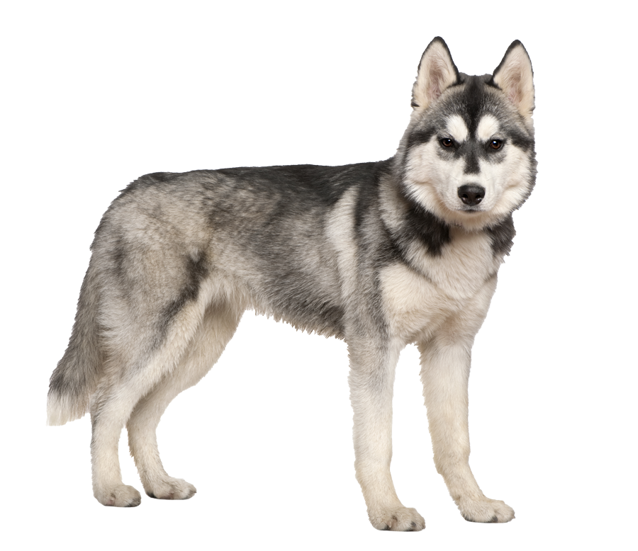
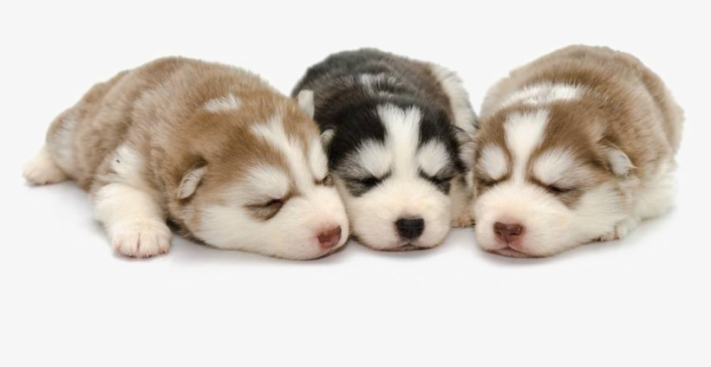
Activity 2: Watch the videos of the life cycle record the data.
Step 2: Place the given texts below each picture to describe the picture.
Animal | Stages in their life cycle
 | Stage 1 | Stage 2 | Stage 3 | Stage 4
Dog | picture | picture | picture | picture
Dog | Young (puppy) | Adult (dog)

Slide 18
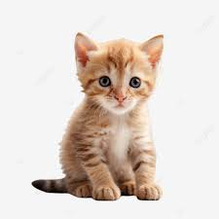
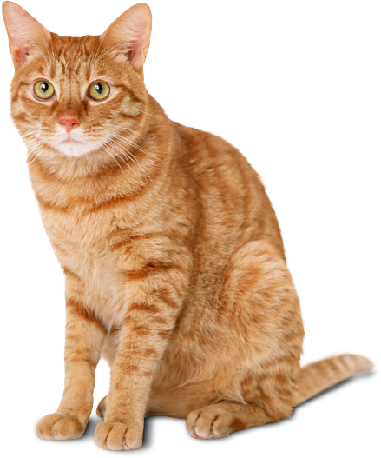
Activity 2: Watch the videos of the life cycle record the data.
Step 2: Place the given texts below each picture to describe the picture.
Animal | Stages in their life cycle
 | Stage 1 | Stage 2 | Stage 3 | Stage 4
Cat | picture | picture | picture | picture
Cat | Young (Kitten) | Adult (Cat)

Slide 19
Activity 3: Create models of the life cycle of animals.
Animal | Stages in their life cycle
 | Stage 1 | Stage 2 | Stage 3 | Stage 4
Frog | picture | picture | picture | picture
Frog | Egg | Tadpole | Adult (Frog)

Slide 20

Activity 3: Create models of the life cycle of animals.
Stage 1
Egg
Life cycle of a frog
Stage 3
Stage 2
Adult
Tadpole

