Slide 1
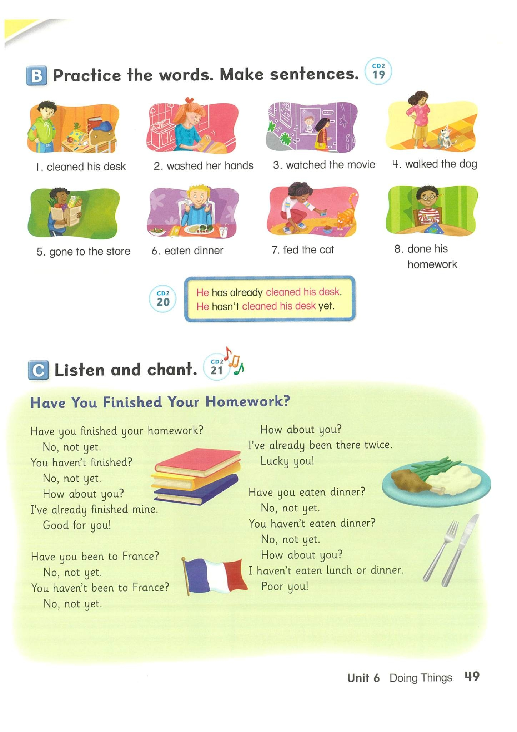
cleaned his desk

Slide 2
washed her hands

Slide 3
watched the movie

Slide 4
walked the dog

Slide 5
gone to the store

Slide 6
eaten dinner

Slide 7
fed the cat

Slide 8
done his homework

Slide 9






Choose the correct answer.
1.
a.
fed the cat
b.
cleaned his desk
c.
gone to the store
Time’s up!

Slide 10
Choose the correct answer.
2.
a.
eaten dinner
b.
fed the cat
c.
done his homework
Time’s up!

Slide 11
Choose the correct answer.
3.
a.
washed her hands
b.
walked the dog
c.
gone to the store
Time’s up!

Slide 12
Choose the correct answer.
4.
a.
washed her hands
b.
walked the dog
c.
done his homework
Time’s up!

Slide 13
Choose the correct answer.
5.
a.
fed the cat
b.
eaten dinner
c.
walked the dog
Time’s up!

Slide 14

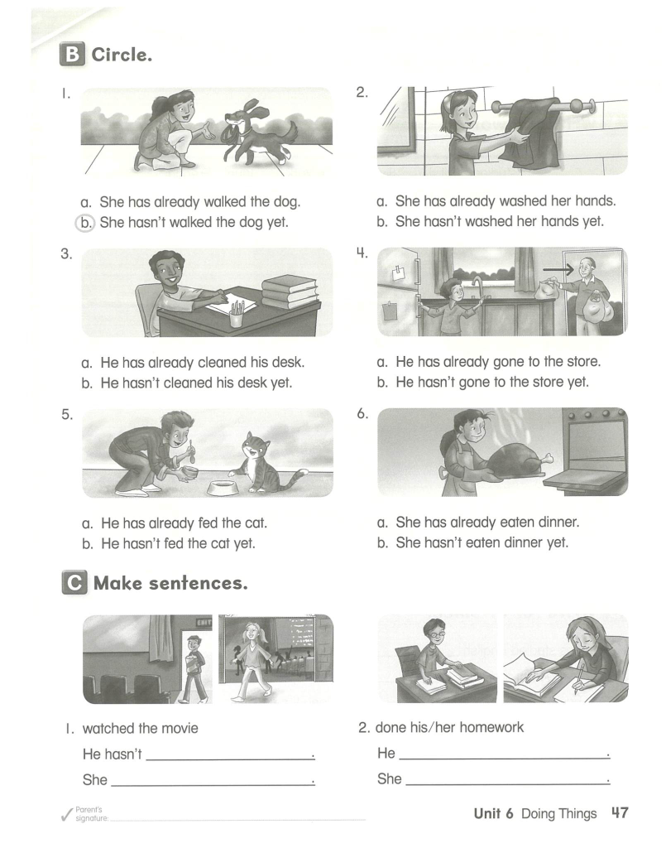
Let’s make sentences.
He has already cleaned his desk.

Slide 15
Let’s make sentences.
He hasn’t cleaned his desk yet.

Slide 16
Let’s make sentences.
He hasn’t cleaned his desk yet.
He has already cleaned his desk.

Slide 17
Let’s try.
a. She has already washed her hands.
b. She hasn’t washed her hands.

Slide 18
Let’s try.
a. He has already fed the cat.
b. He hasn’t fed the cat yet.

Slide 19

Now, it is your turn. Page 47

Slide 20
Now, it is your turn. Page 47

Slide 21
Now, it is your turn. Page 47

Slide 22
Now, it is your turn. Page 47

Slide 23
Now, it is your turn. Page 47
watched the movies yet.
hasn’t done his homework yet.
has already watched the movies.
has already done her homework.

Slide 24
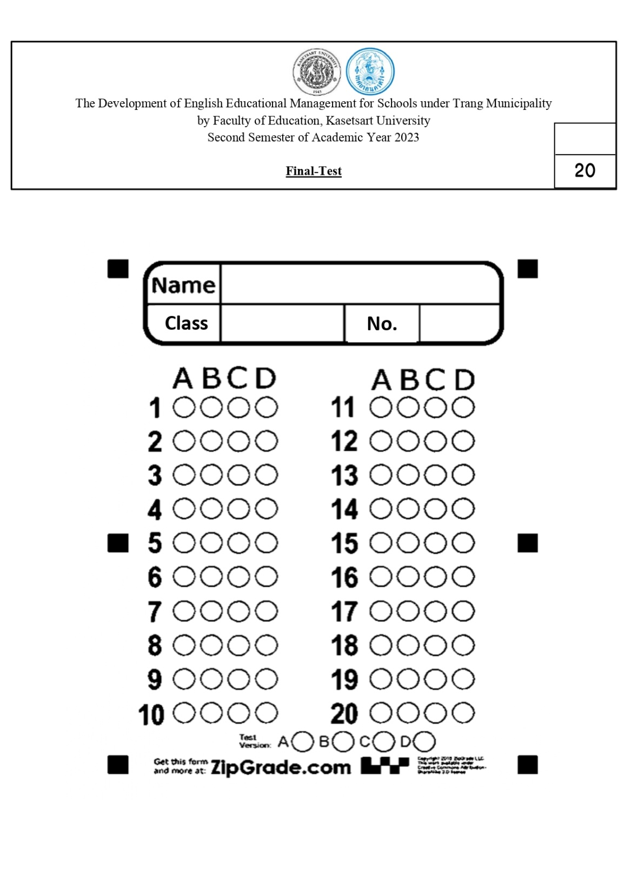
Quiz Time
1.
a. He has already fed the cat.
b. He hasn’t fed the cat.
c. She has already fed the cat.
d. She hasn’t fed the cat.

Slide 25

Quiz Time
1.
a. He has already fed the cat.
b. He hasn’t fed the cat.
c. She has already fed the cat.
d. She hasn’t fed the cat.

Slide 26
Quiz Time
1.
a. fed the cat
b. eaten dinner
c. washed her hands
d. cleaned his desk

Slide 27
Quiz Time
2.
a. gone to the store
b. done his homework
c. eaten dinner
d. fed the cat

Slide 28
Quiz Time
3.
a. fed the cat
b. eaten dinner
c. done his homework
d. walked the dog

Slide 29
Quiz Time
4.
a. fed the cat
b. walked the dog
c. watched the movie
d. washed her hands

Slide 30
Quiz Time
5.
a. cleaned his desk
b. done his homework
c. washed her hands
d. Watched the movie

Slide 31
Quiz Time
6.
a. She has already walked the dog.
b. She hasn’t walked her dog.
c. She has already washed her hands.
d. She has already gone to the store.

Slide 32
Quiz Time
7.
a. She has already watched the movie.
b. She has already eaten dinner.
c. She hasn’t eaten dinner yet.
d. She has already fed the cat.

Slide 33
Quiz Time
8.
a. He has gone to the store.
b. He hasn’t gone to the store yet.
c. She has gone to the store.
d. She hasn’t gone to the store.

Slide 34
Quiz Time
9.
a. She has already fed the cat.
b. He hasn’t walked the dog yet.
c. She has already done his homework.
d. He hasn’t done his homework yet.

Slide 35
Quiz Time
10.
a. He has already cleaned his desk.
b. He has already washed his hands.
c. He has already watched the movie.
d. He has already gone to the store.

Slide 36
Quiz Time
1.
a. fed the cat
b. eaten dinner
c. washed her hands
d. cleaned his desk

Slide 37
Quiz Time
2.
a. gone to the store
b. done his homework
c. eaten dinner
d. fed the cat

Slide 38
Quiz Time
3.
a. fed the cat
b. eaten dinner
c. done his homework
d. walked the dog

Slide 39
Quiz Time
4.
a. fed the cat
b. walked the dog
c. watched the movie
d. washed her hands

Slide 40
Quiz Time
5.
a. cleaned his desk
b. done his homework
c. washed her hands
d. Watched the movie

Slide 41
Quiz Time
6.
a. She has already walked the dog.
b. She hasn’t walked her dog.
c. She has already washed her hands.
d. She has already gone to the store.

Slide 42
Quiz Time
7.
a. She has already watched the movie.
b. She has already eaten dinner.
c. She hasn’t eaten dinner yet.
d. She has already fed the cat.

Slide 43
Quiz Time
8.
a. He has gone to the store.
b. He hasn’t gone to the store yet.
c. She has gone to the store.
d. She hasn’t gone to the store.

Slide 44
Quiz Time
9.
a. She has already fed the cat.
b. He hasn’t walked the dog yet.
c. She has already done his homework.
d. He hasn’t done his homework yet.

Slide 45
Quiz Time
10.
a. He has already cleaned his desk.
b. He has already washed his hands.
c. He has already watched the movie.
d. He has already gone to the store.

Slide 46
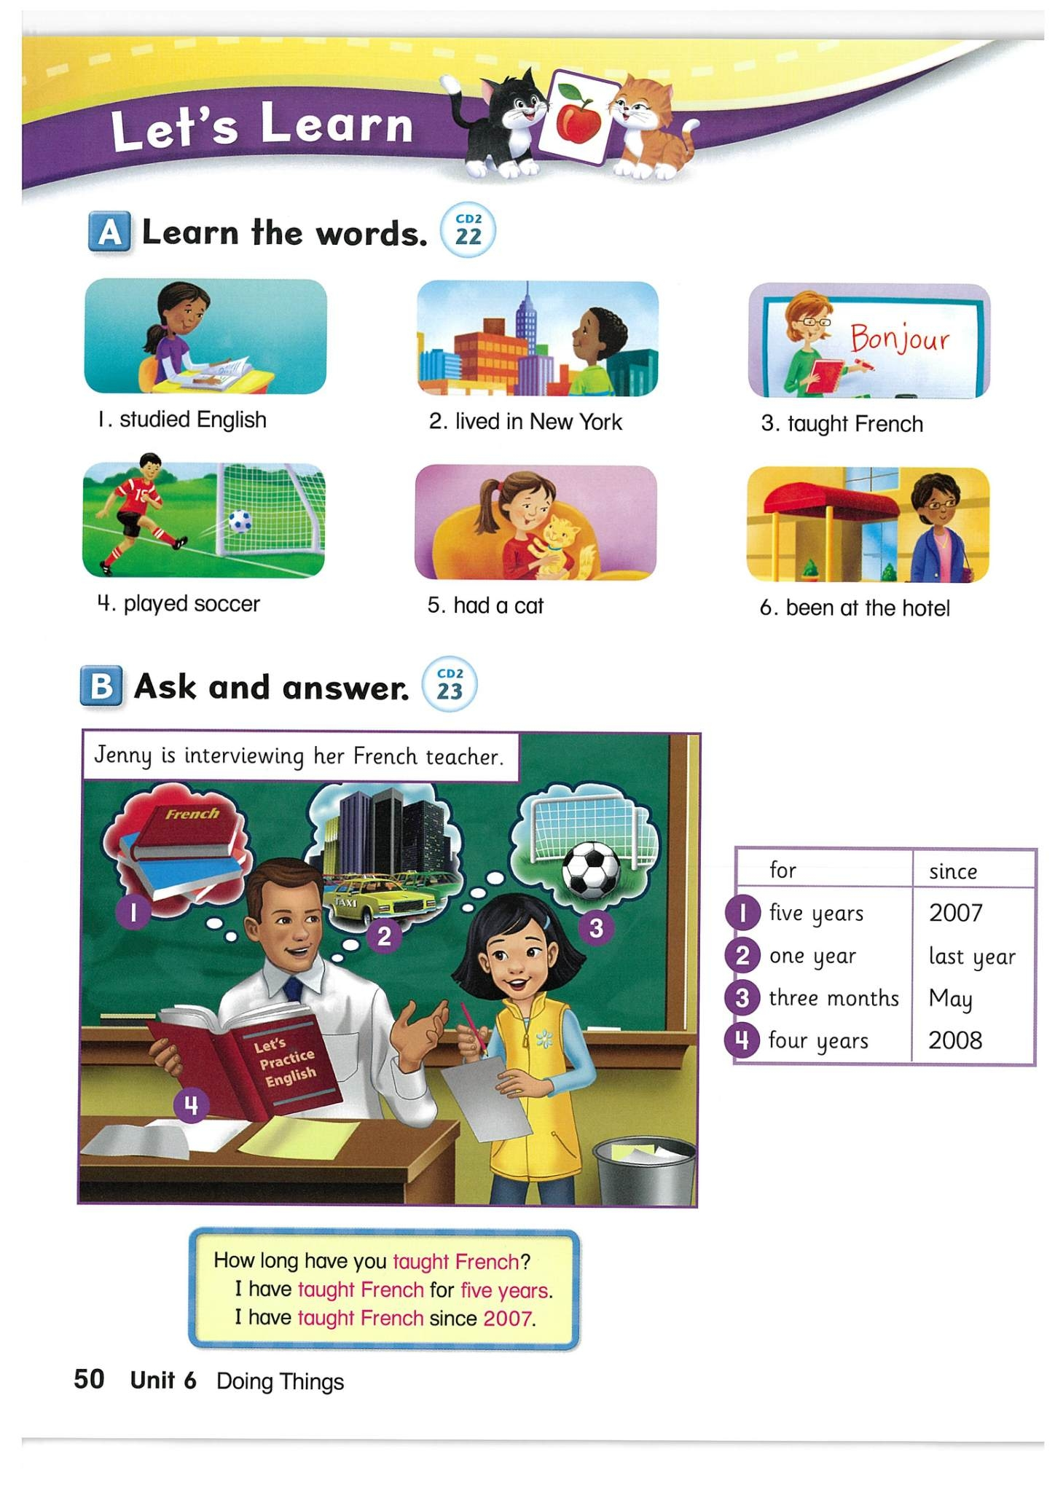
studied English

Slide 47
lived in New York

Slide 48
taught French

Slide 49
played soccer

Slide 50
had a cat

Slide 51
been at the hotel

Slide 52
Choose the correct answer.
1.
a.
studied English
b.
taught French
c.
had a cat
Time’s up!

Slide 53
Choose the correct answer.
2.
a.
had a cat
b.
played soccer
c.
studied English
Time’s up!

Slide 54
Choose the correct answer.
3.
a.
taught French
b.
studied English
c.
been at the hotel
Time’s up!

Slide 55
Choose the correct answer.
4.
a.
had a cat
b.
played soccer
c.
lived in New York
Time’s up!

Slide 56
Choose the correct answer.
5.
a.
studied English
b.
taught French
c.
lived in New York
Time’s up!

Slide 57
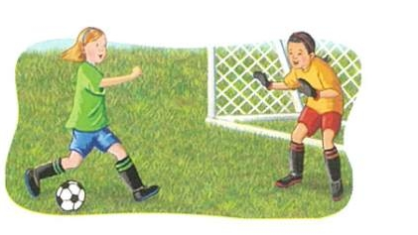
How long has he played soccer?
Played soccer/ one hour
He has played soccer for one hour.

Slide 58

How long has she had a cat?
had a cat / May
She has had a cat since May.

Slide 59
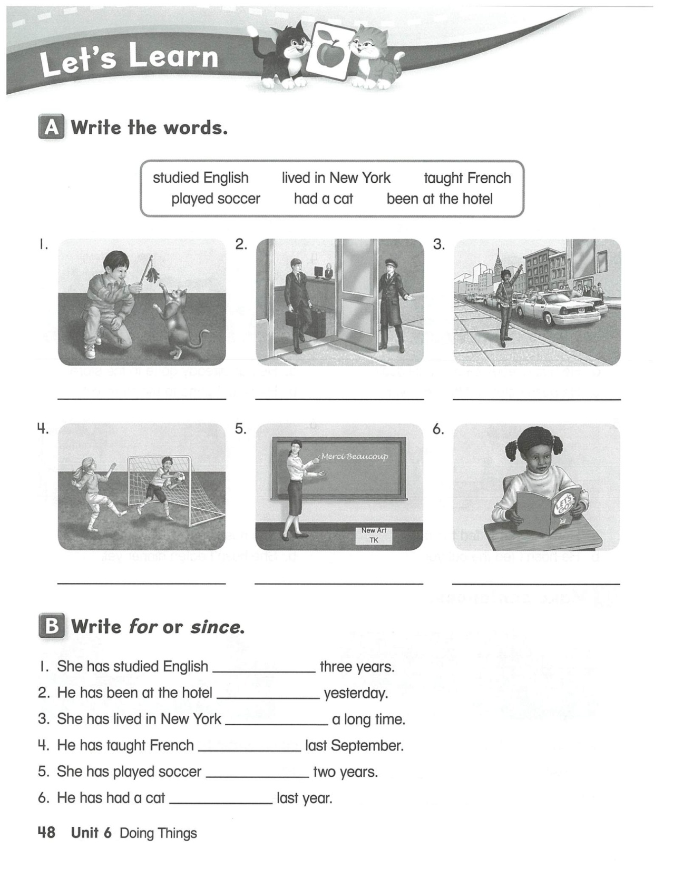
Now, it is your turn. Page 48

Slide 60


Choose the correct missing sound.
1.
a.
ai
b.
ee
r_____n
c.
y
Time’s up!

Slide 61
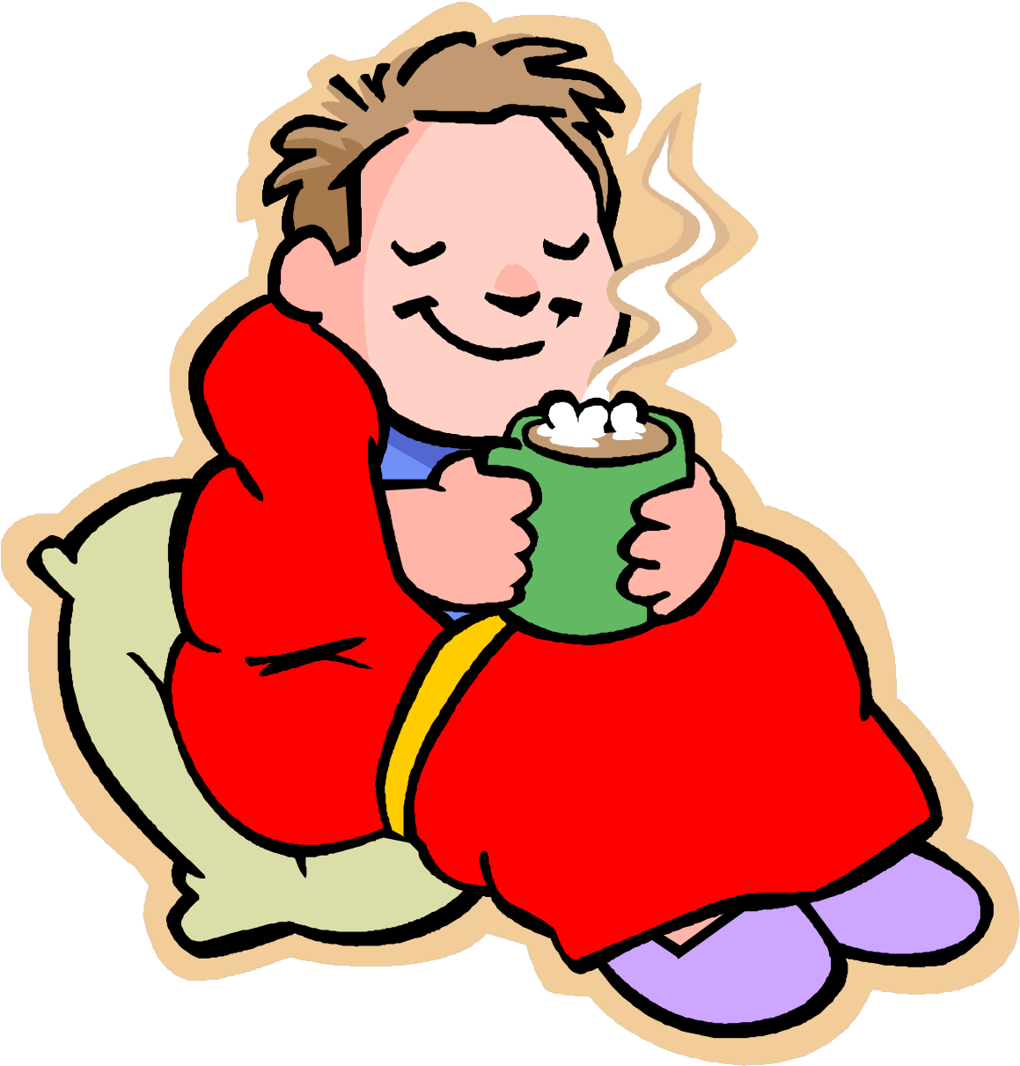
Choose the best response to the question.
4.
Dose he want hot chocolate?
a.
Yes, he does.
b.
Yes, she does.
c.
No, he doesn’t.
Time’s up!

Slide 62



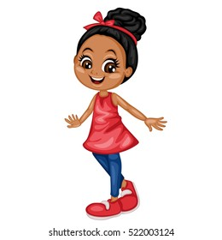
Bye

