Slide 1



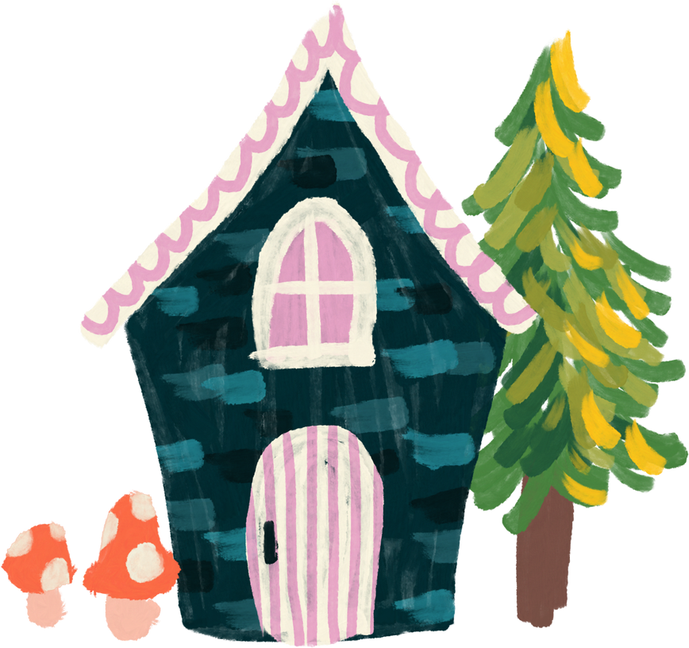
Unit 6
Household items

Slide 2
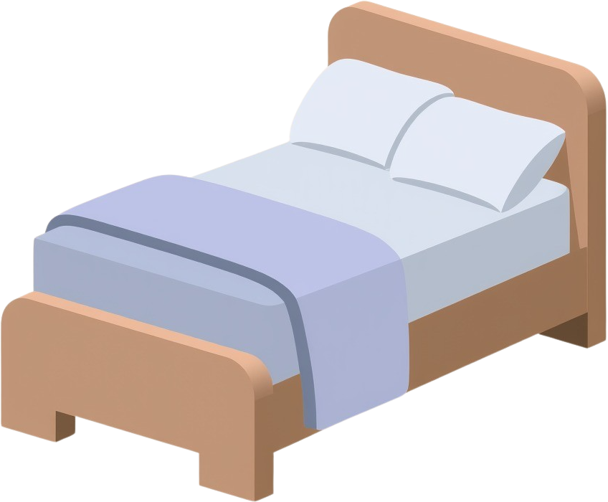

a bed

Slide 3
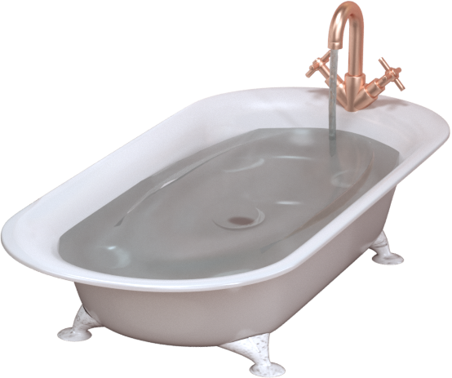

a bathtub

Slide 4
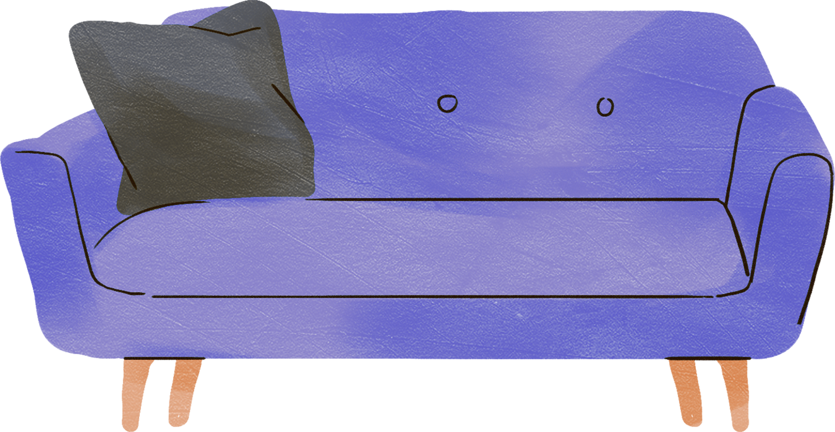
a sofa

Slide 5
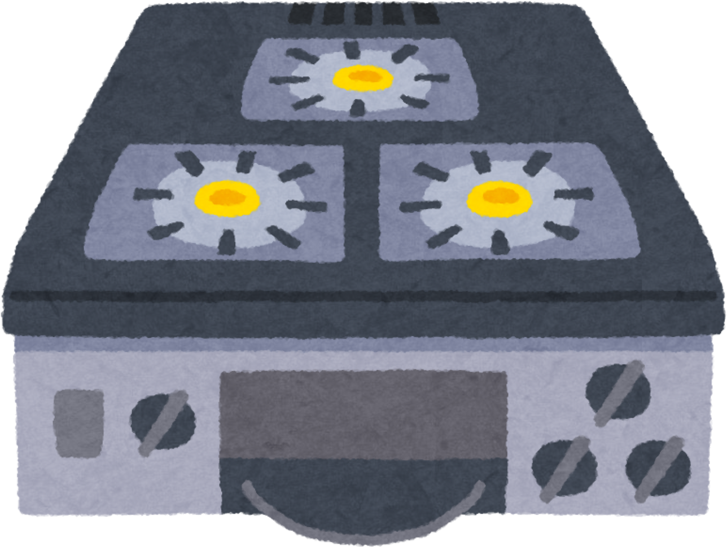
a stove

Slide 6
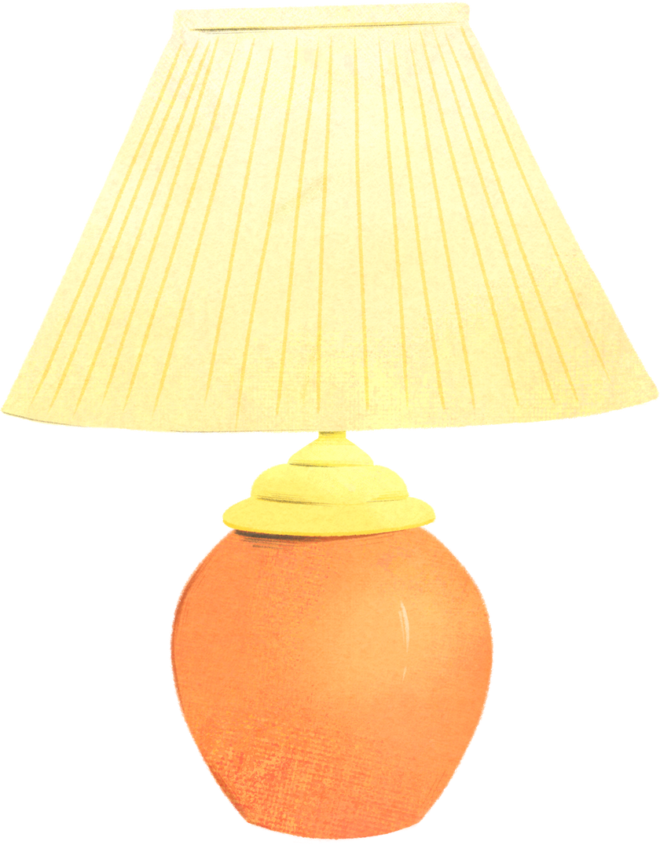
a lamp

Slide 7
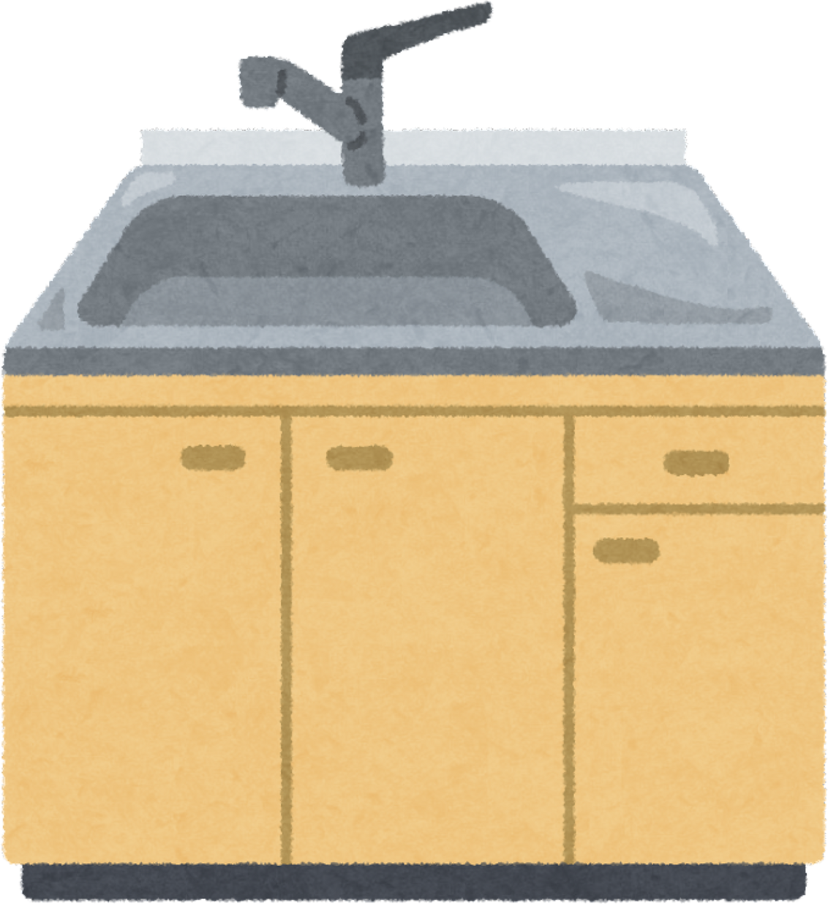
a sink

Slide 8

a TV

Slide 9

a refrigerator

Slide 10
What is missing?

Slide 11
1

Slide 14
2

Slide 17
3

Slide 20
4

Slide 23
5

Slide 26
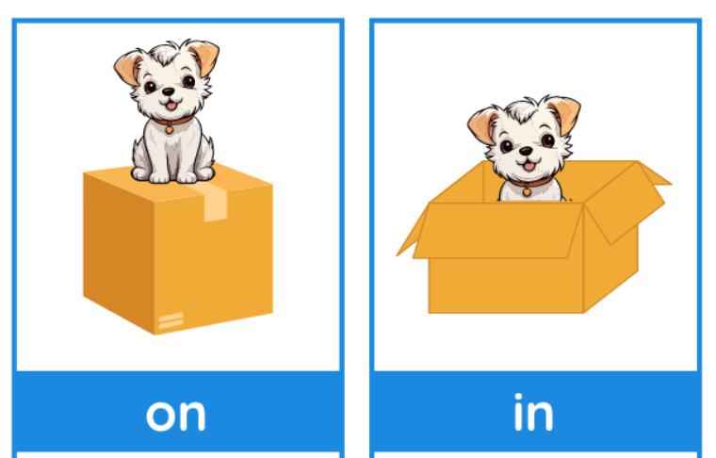
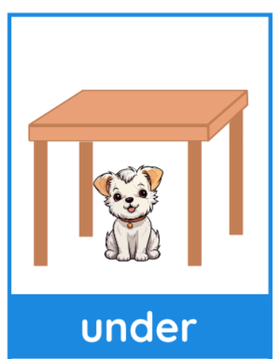
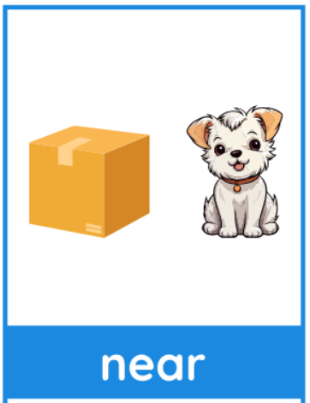
Prepositions of place
by

Slide 27

Where is the cat?
on
It is ___ the bed.

Slide 28
Where is the cat?
in
It is ___ the bathtub.

Slide 29
Where is the cat?
It is ___ the bed.
under

Slide 30
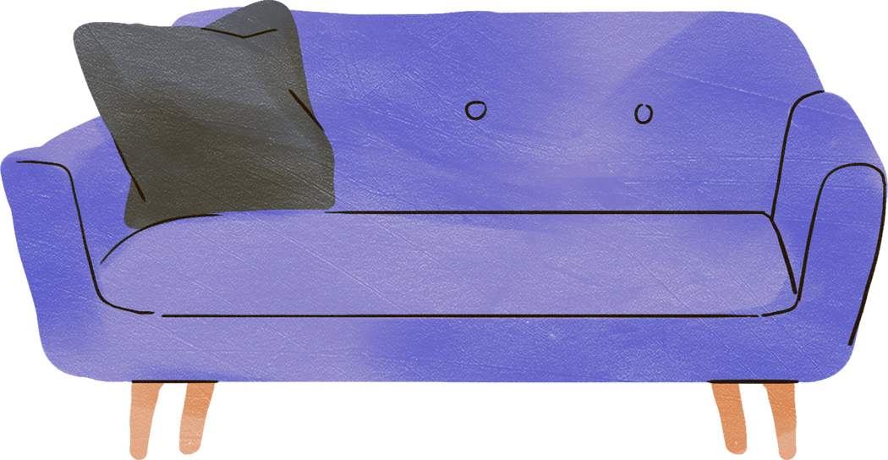
Where is the cat?
It is ___ the sofa.
by

Slide 31
Thank you!

