Slide 1

HIDDEN PICTURE
“Who Am I”

Slide 2
Instructions:
How to play the game?
Let the student pick a tile, let them click the tile until some part of the picture hidden shows.
Let the student guess what the picture is, then click SHOW to check if they guess it correct.
Students who guess right will get the prize.

Slide 3

An Orange Pumpkin
SHOW

Slide 4

A Blue Whale
SHOW

Slide 5

A Yellow Star
SHOW

Slide 6

A Purple Eggplant
SHOW

Slide 7
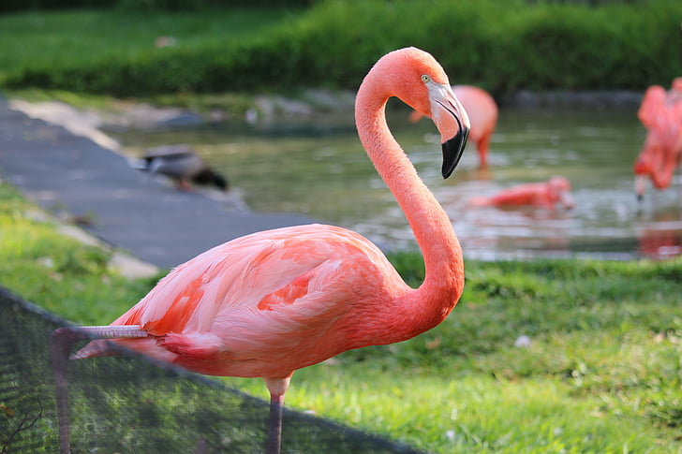
A Pink Flamingo
SHOW

Slide 8

A Red Tomato
SHOW

Slide 9

Black Rose
SHOW

Slide 10

Paint
SHOW

Slide 11

Crayons
SHOW

Slide 12
A Blue Whale
SHOW

Slide 13

A Green Broccoli
SHOW

