Slide 1

COUNTRIES, NATIONALITIES, AND LANGUAGES

Slide 2
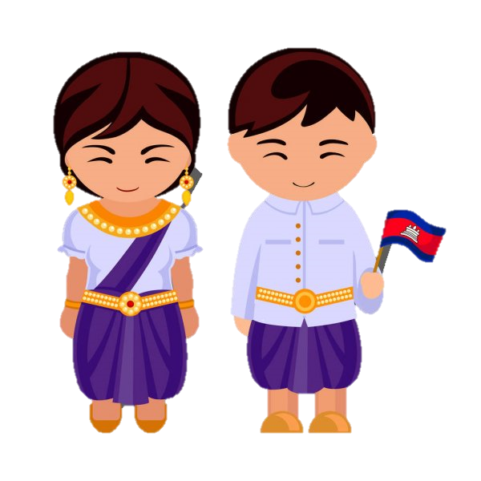
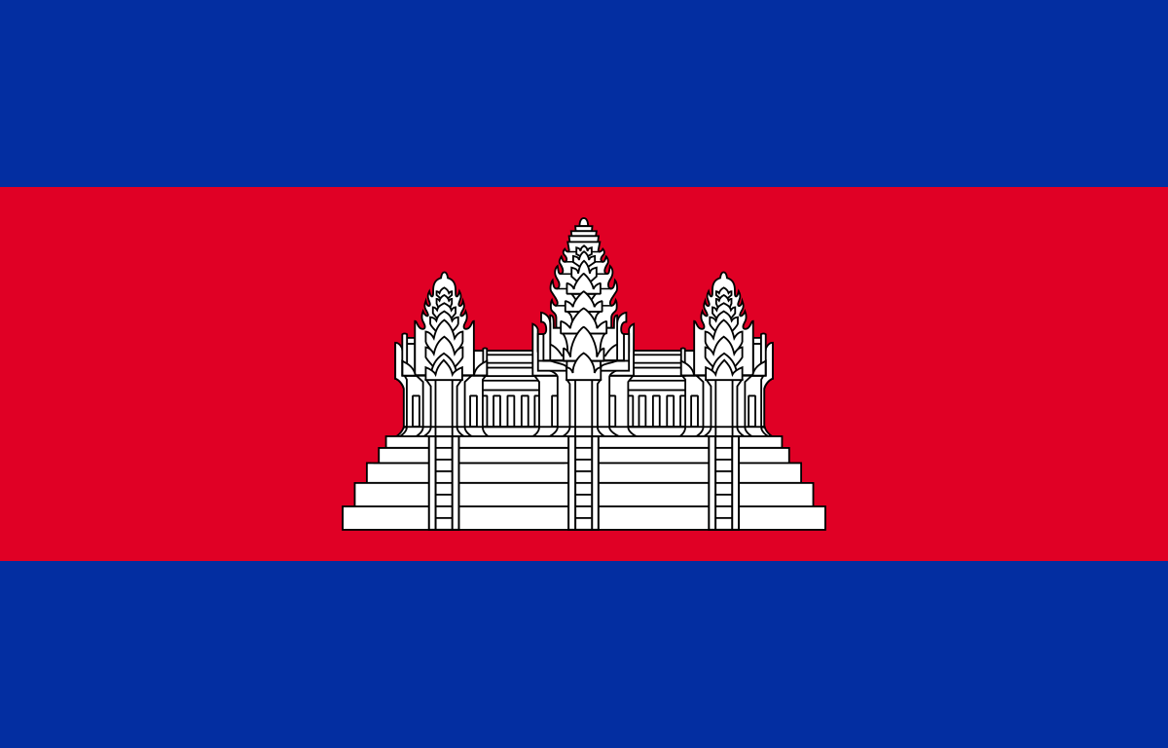
Cambodian
Nationality: Cambodian
Country: Cambodia
Language:
Khmer

Slide 3


Nationality: Chinese
Country: China
Language:
Chinese

Slide 4


Country: Japan
Nationality: Japanese
Language:
Japanese

Slide 5
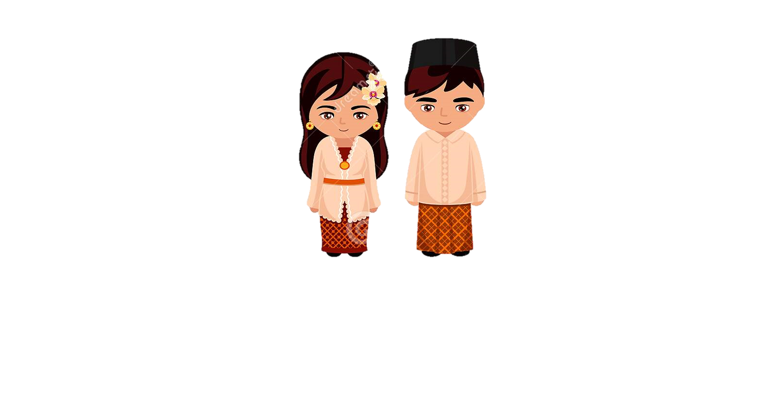

Country: Indonesia
Nationality: Indonesian
Language:
Indonesian

Slide 6


Country: Malaysia
Nationality: Malaysian
Language:
Malay

Slide 7

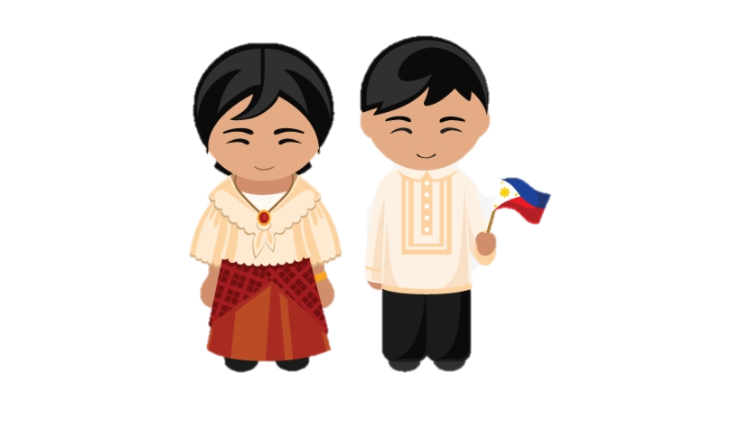
Country: Philippines
Nationality: Filipino
Language:
Filipino

Slide 8
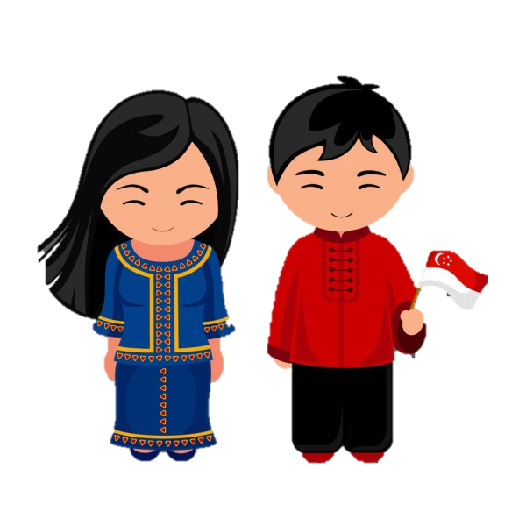

Country: Singapore
Nationality: Singaporean
Language:
Malay,English, Chinese

Slide 9


Country: South Korea
Nationality: South Korean
Language:
Korean

Slide 10
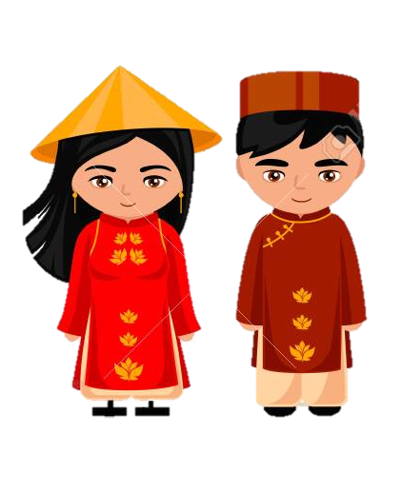

Country: Vietnam
Nationality: Vietnamese
Language:
Vietnamese

Slide 11
What language is spoken in Indonesia?
Indonesian is spoken in Indonesia.

Slide 12
What language is spoken in China?

Slide 13
What language is spoken in Japan?

