Slide 1
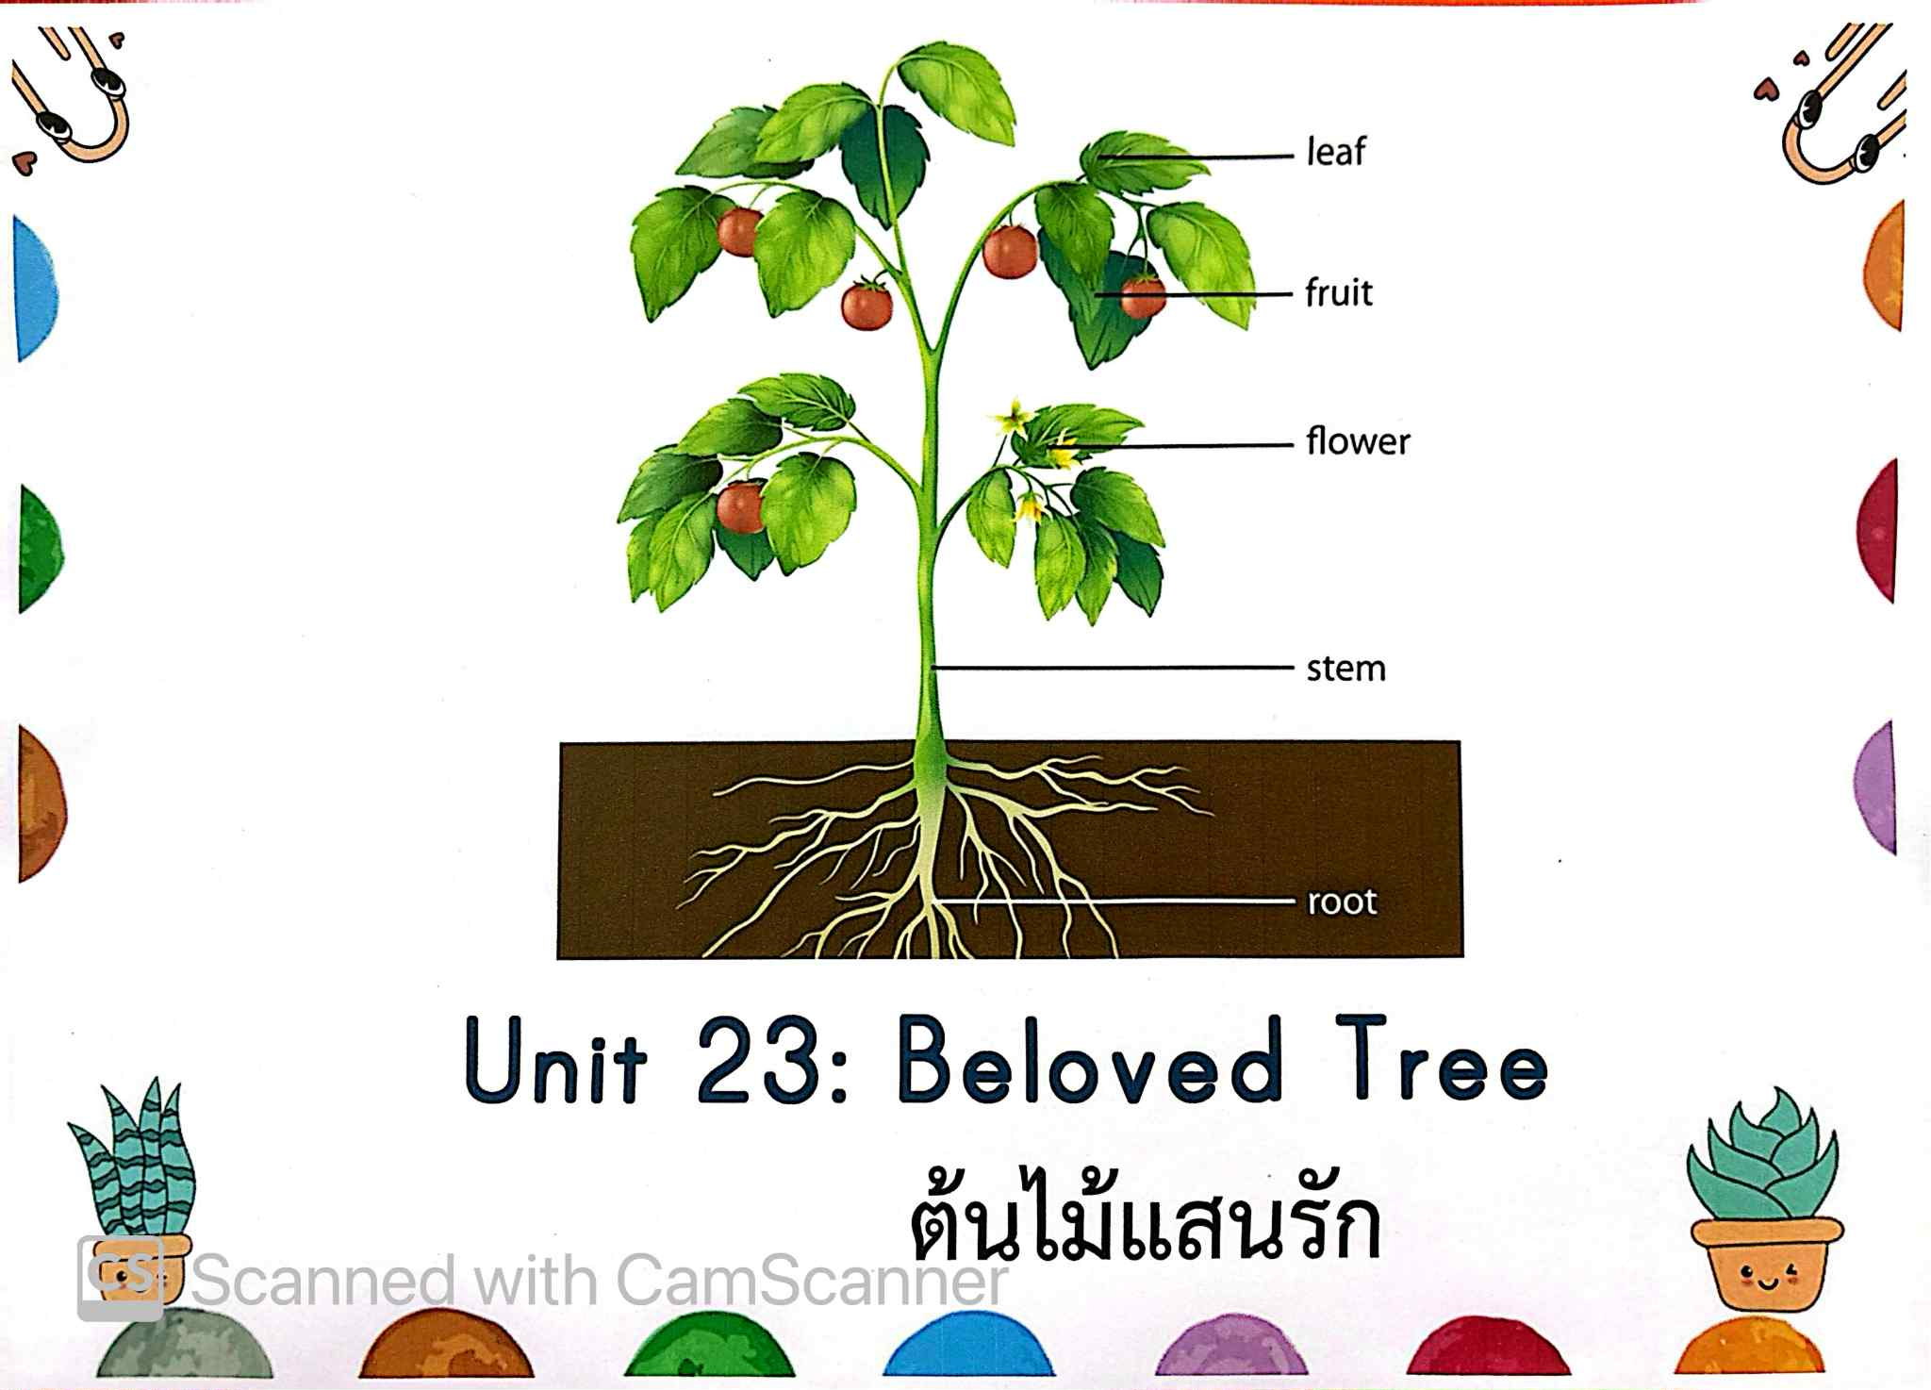

Slide 2
Daily Routine:
Morning Greetings
Weather Check
Days of Week
Months of the Year
Classroom rules

Slide 3
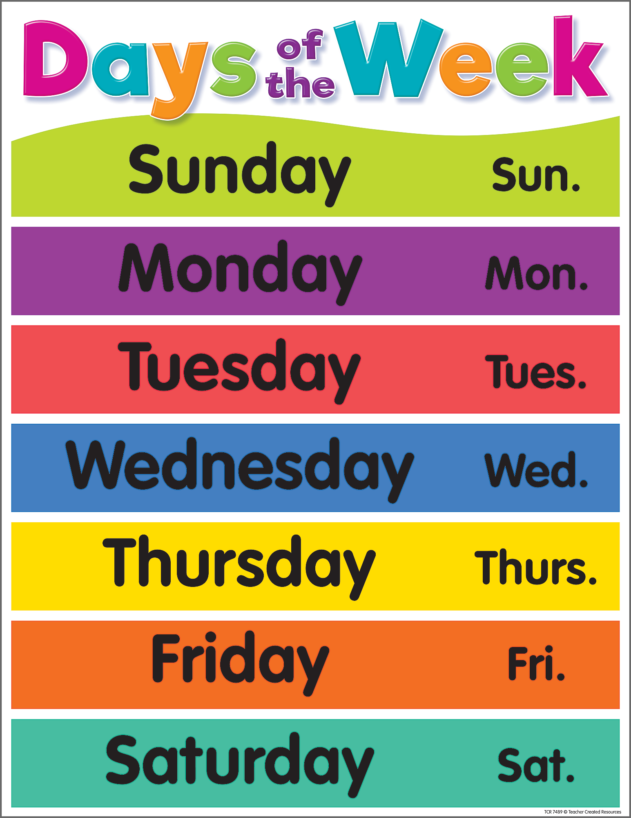

Slide 4
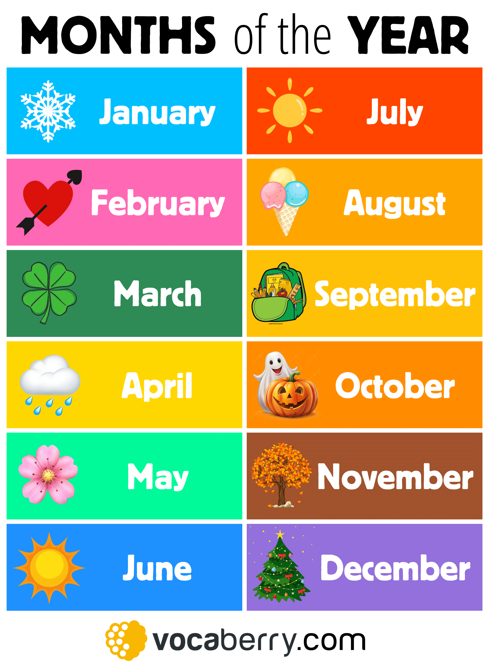

Slide 5
Review
Can you share something about what we did yesterday in class?

Slide 6
Vocabulary of the Week
Plant cycle
Grow
Seed
Sprout
Seedling
A plant
Air
Soil
Water
Sunlight

Slide 7
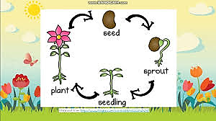
Plant Cycle

Slide 8
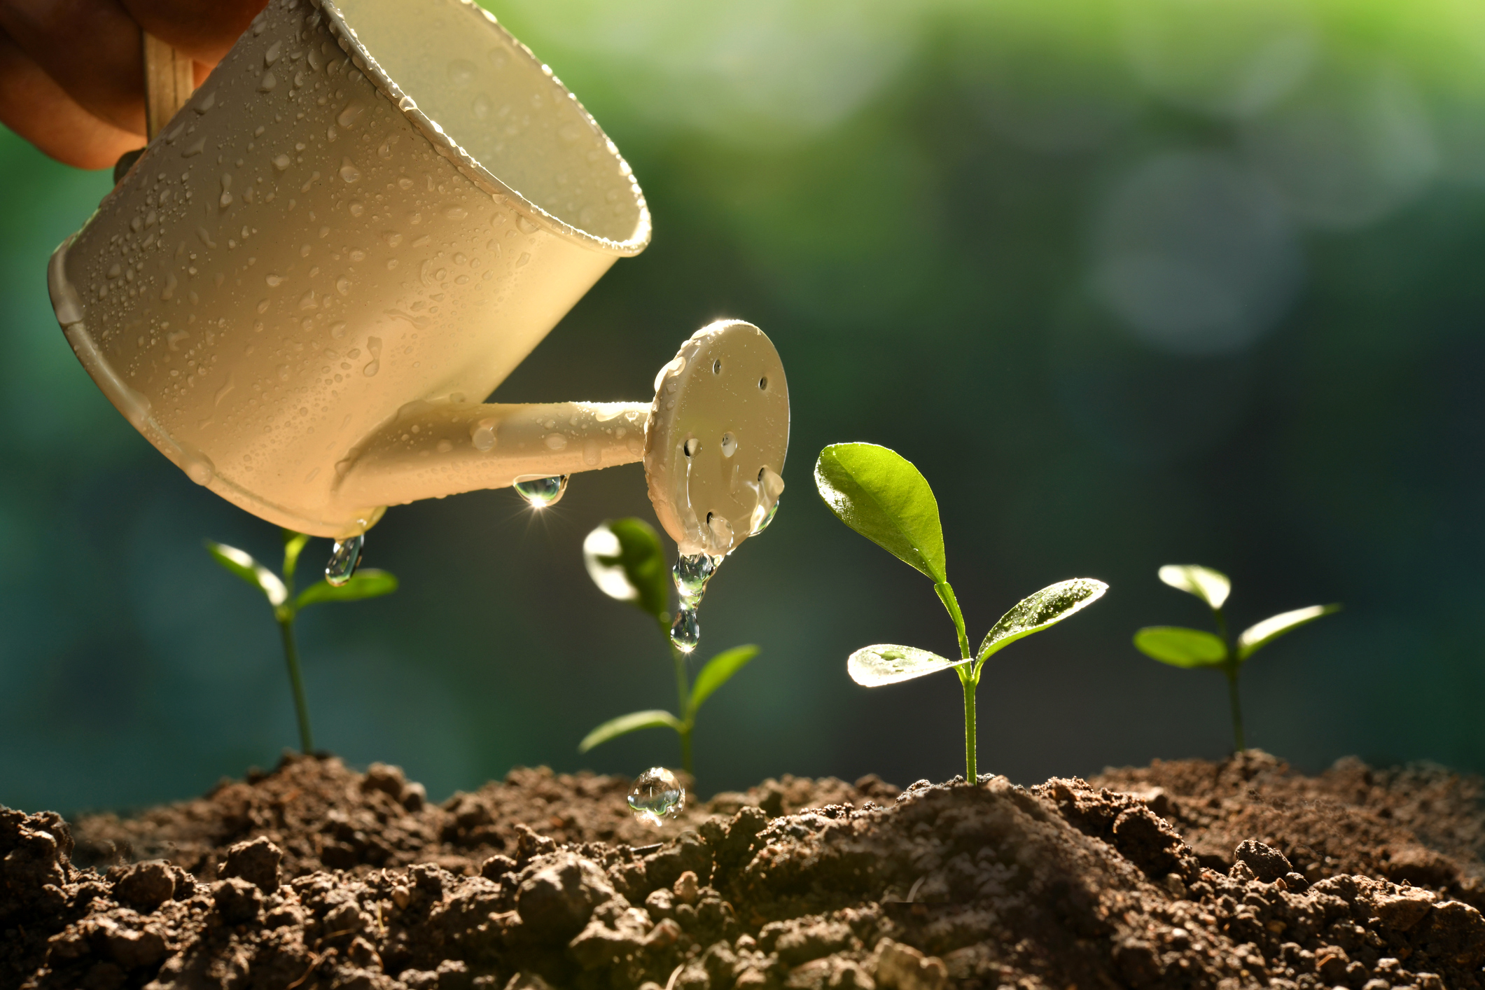
Grow

Slide 9
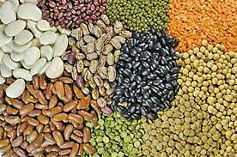
Seed

Slide 10
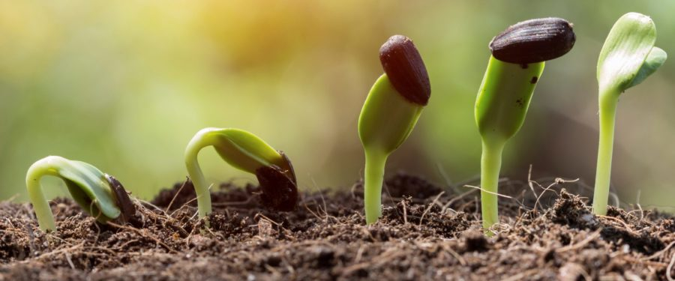
Sprout

Slide 11
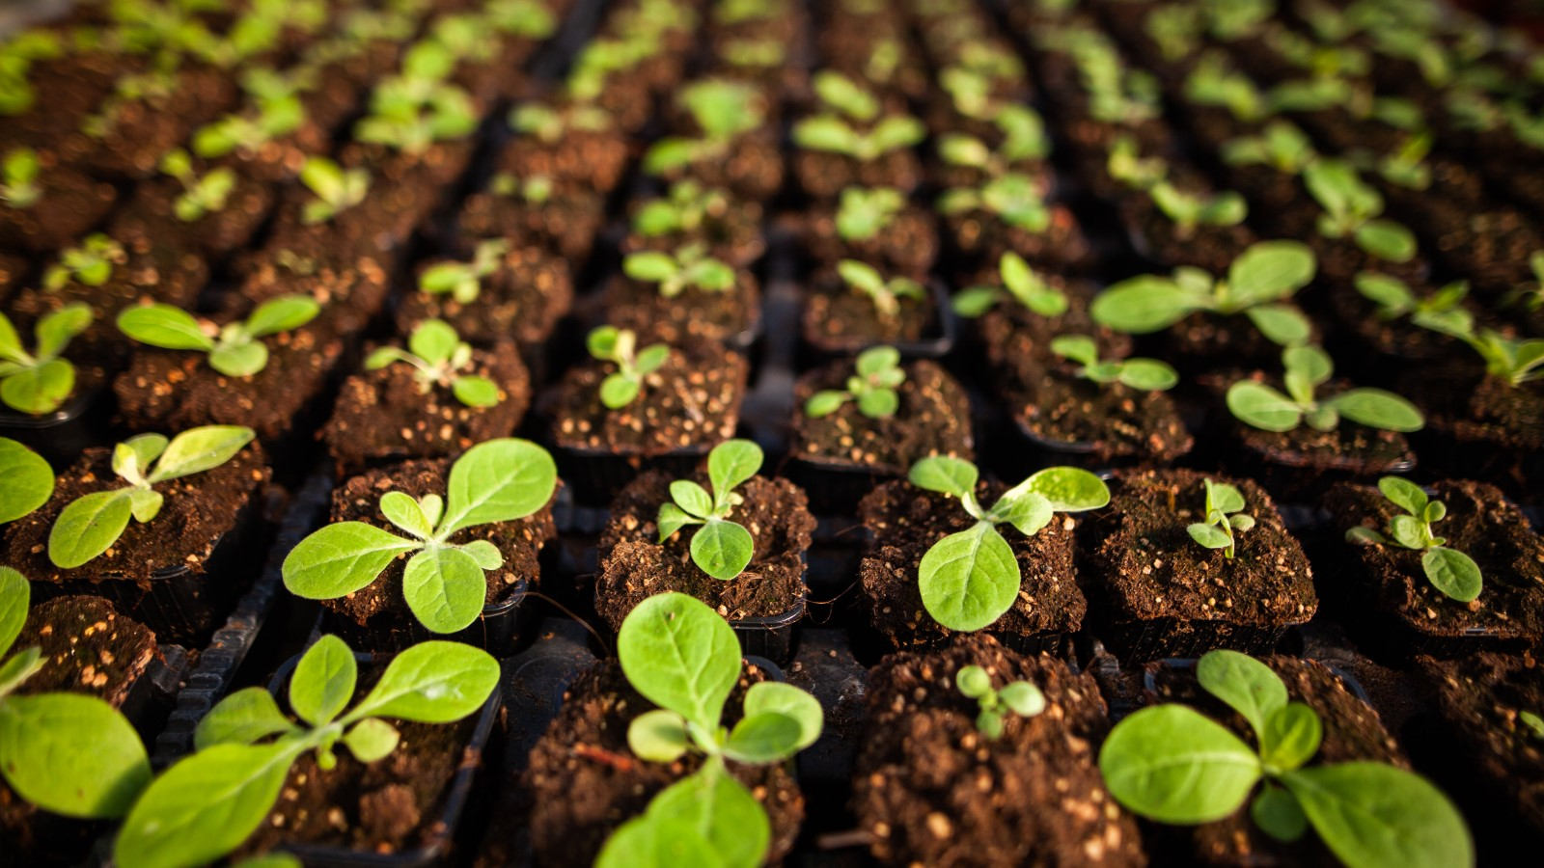
Seedling

Slide 12
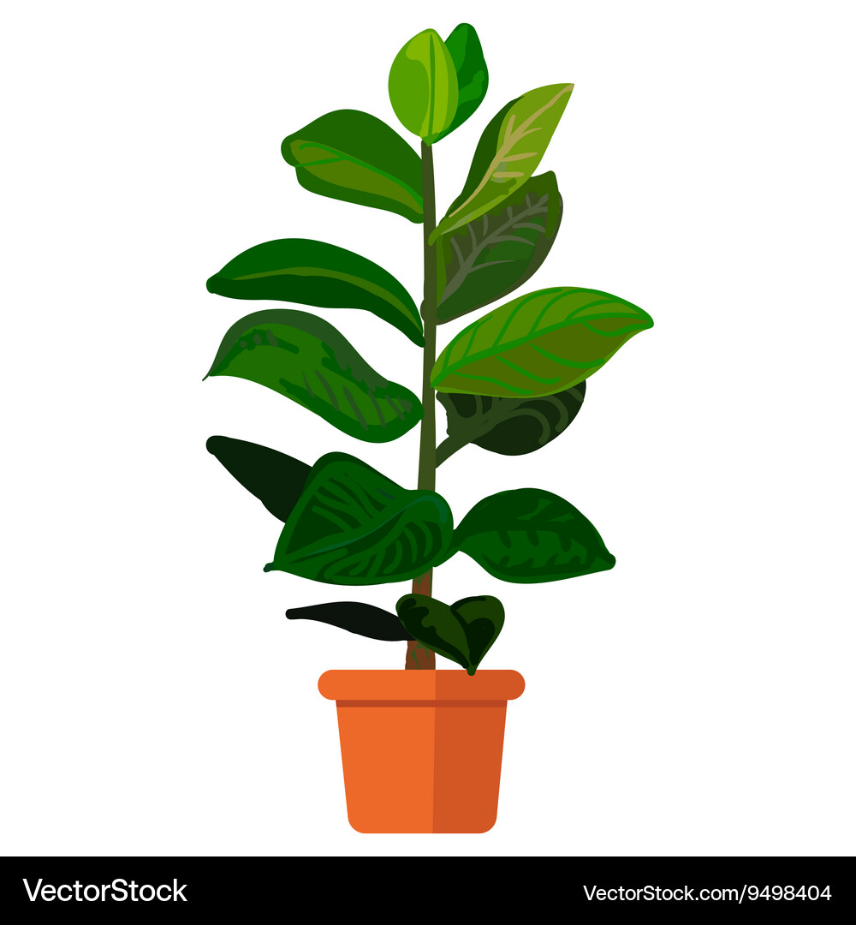
A Plant

Slide 13

Plant needs?

Slide 14
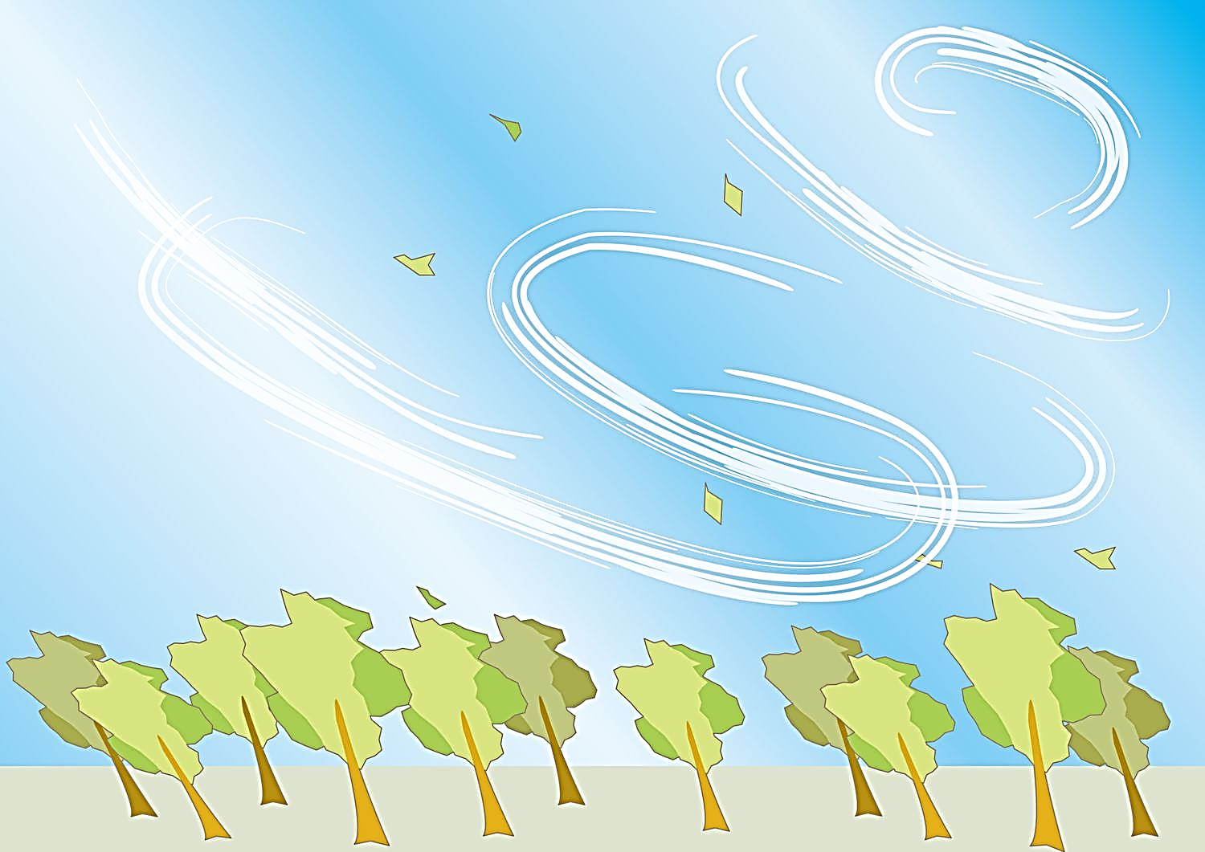
Air

Slide 15
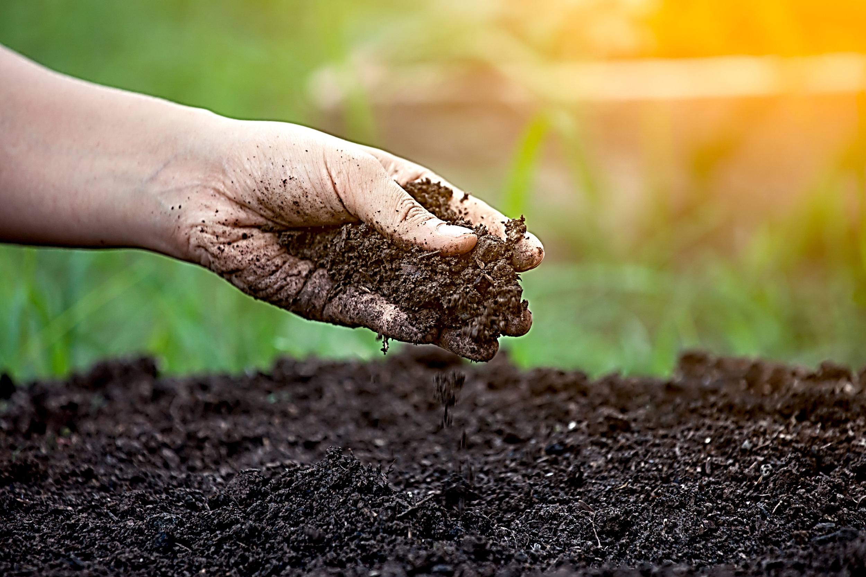
Soil

Slide 16

Water

Slide 17
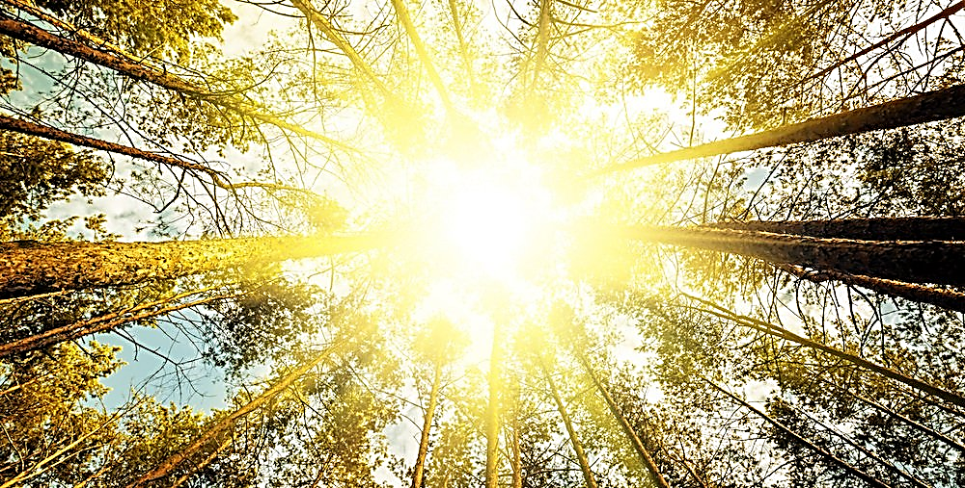
Sunlight

Slide 18

air

Slide 19
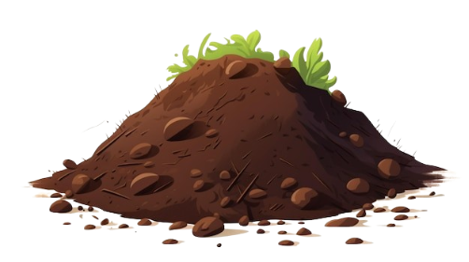
soil

Slide 20
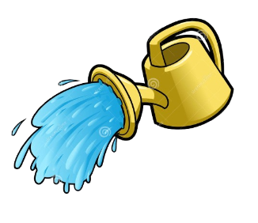
water

Slide 21

sun

Slide 22




Dialogues!

Slide 23

A: What does a plant need?
B: A plant needs water to grow.

Slide 24
What will happen if we cut more trees?

Slide 25
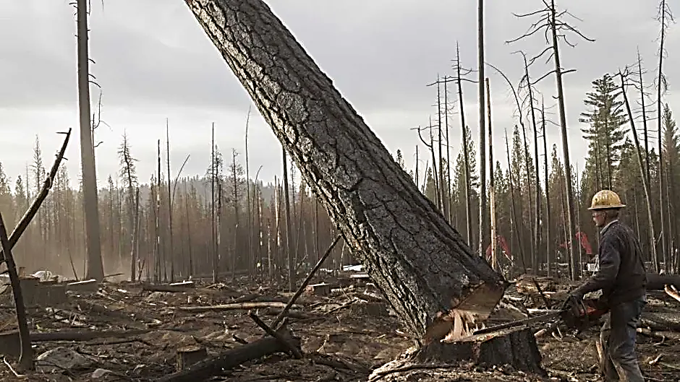
Heat

Slide 26
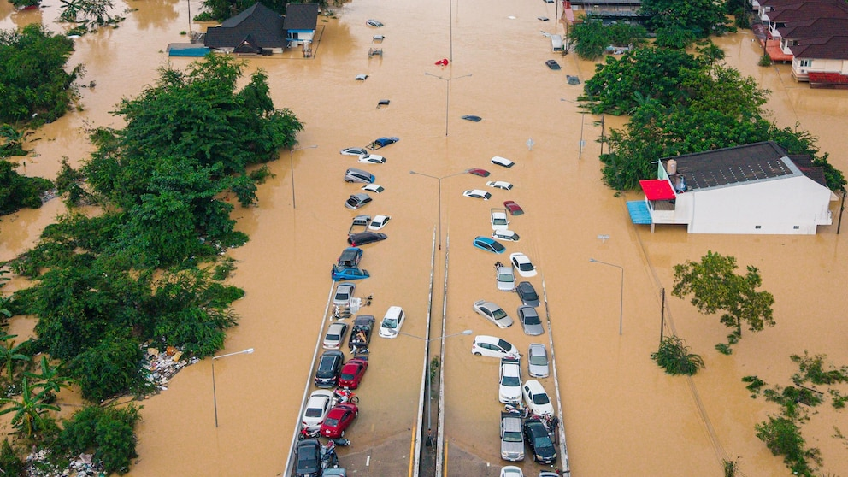
Flood

Slide 27
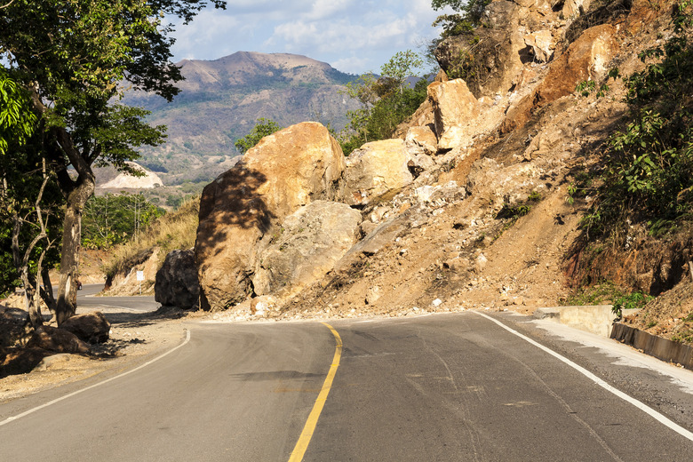
Erosion

Slide 28
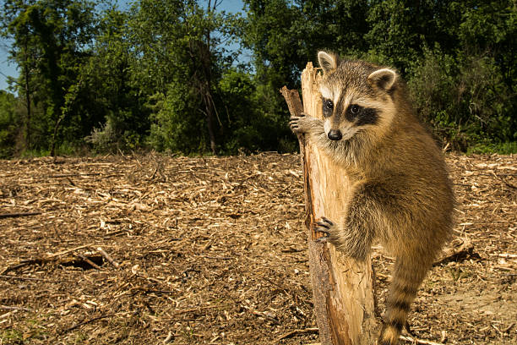
Animals lost their homes

