Slide 1
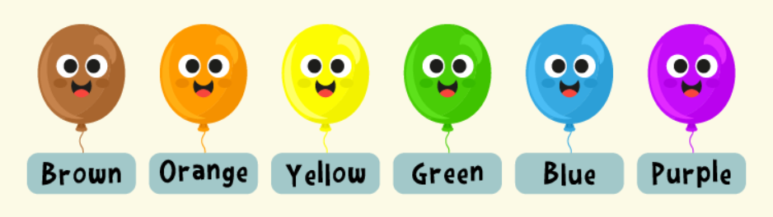
Fun Colors
→

Slide 2

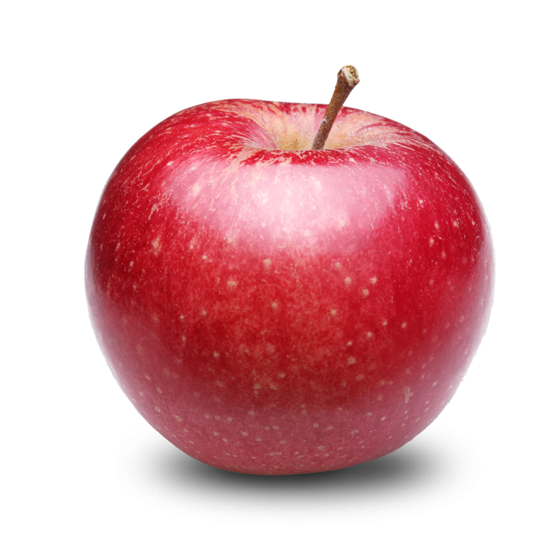
red
←
→

Slide 3


blue
←
→

Slide 4
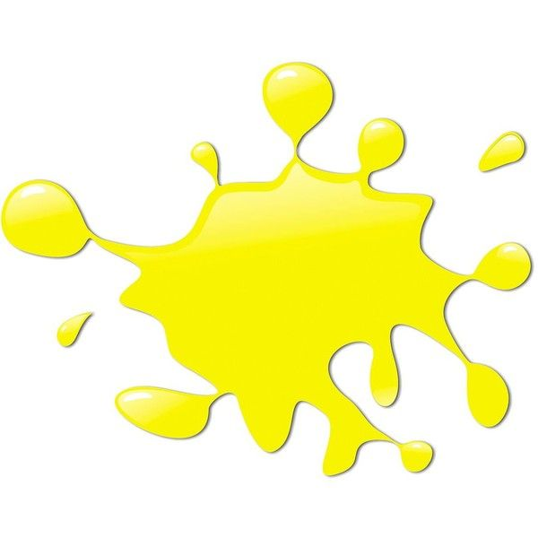
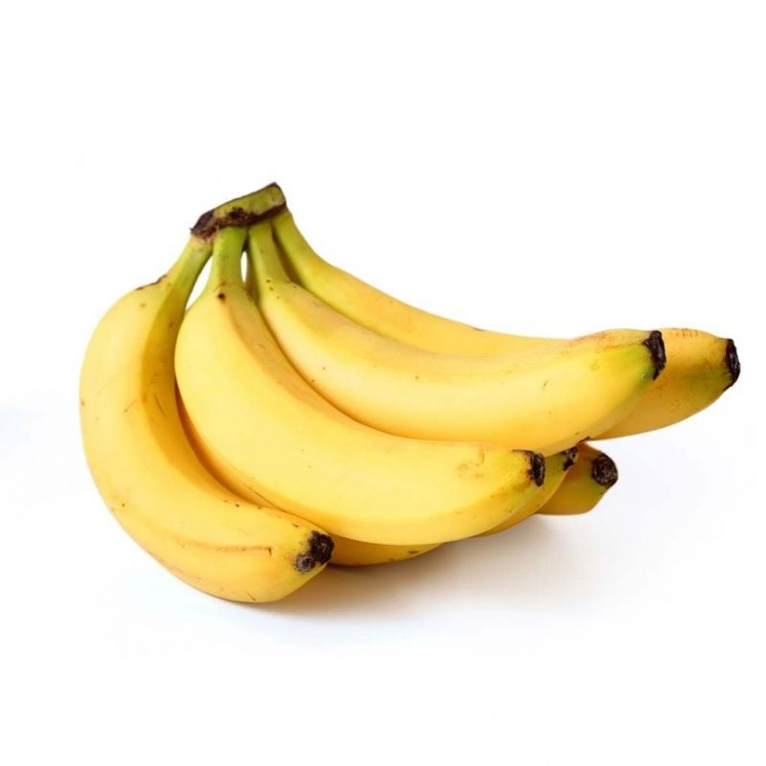
yellow
:D
←
→

Slide 5

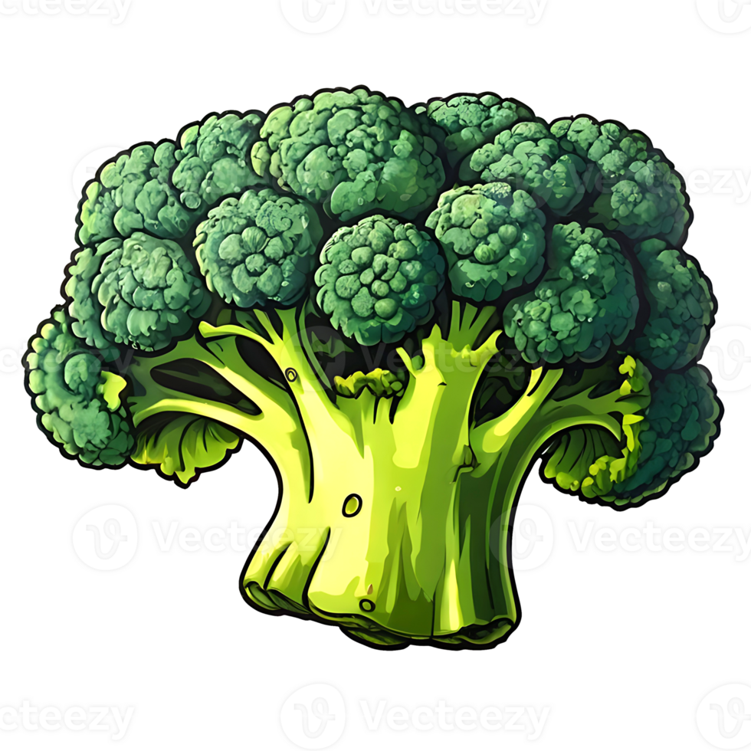
green
←
→

Slide 6


orange
←
→

Slide 7


purple
←
→

