Slide 1
Chores
The Future

Slide 2
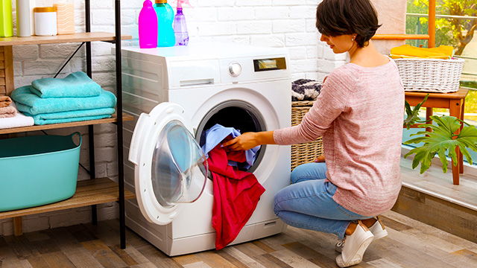
do the laundry

Slide 3
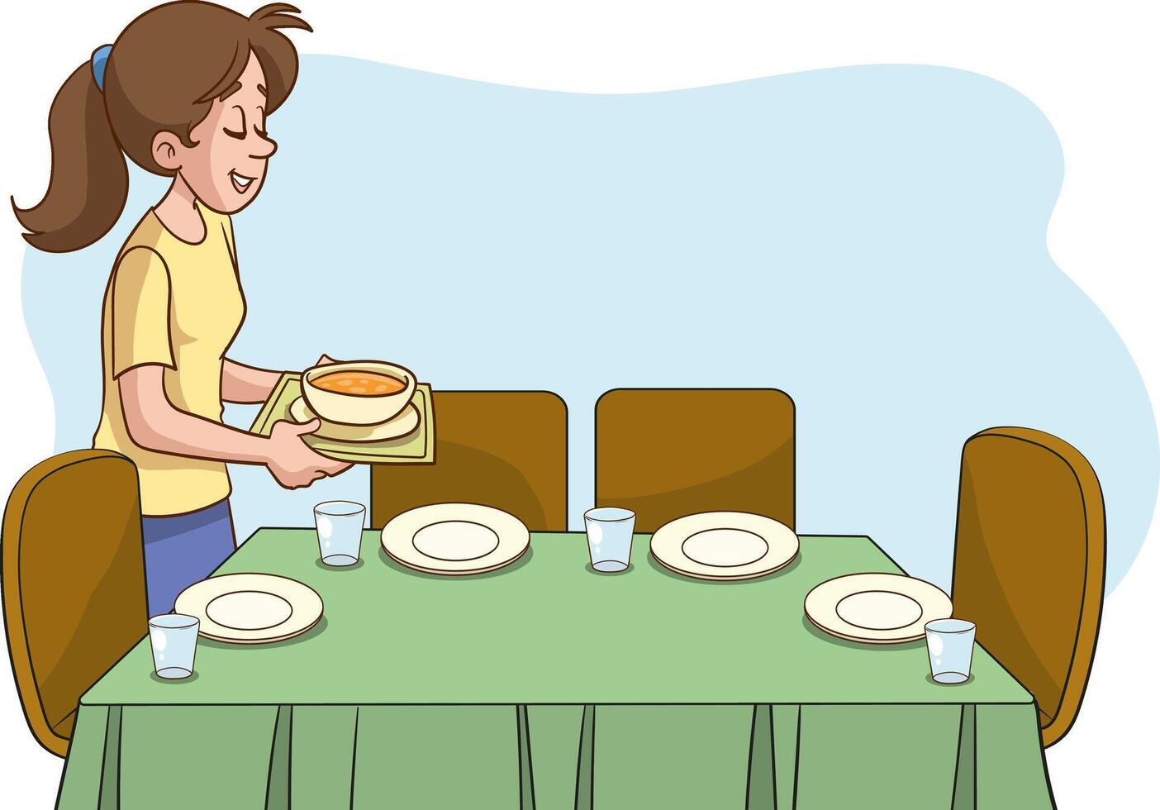
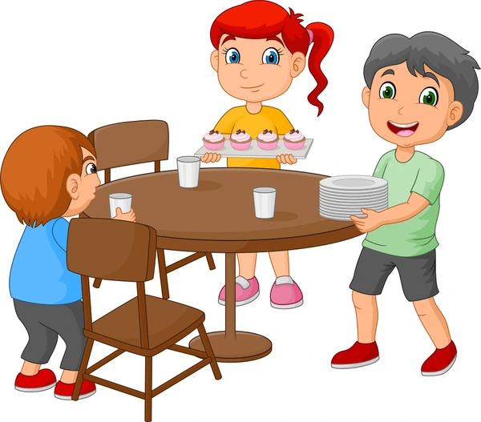
set the table

Slide 4
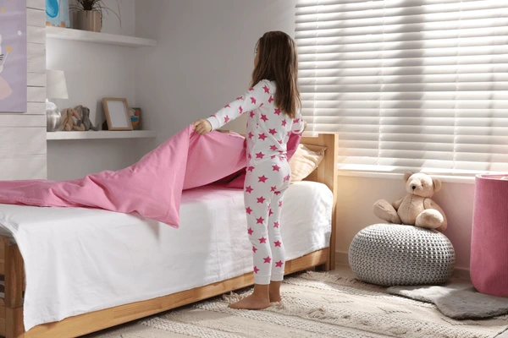
make the bed

Slide 5
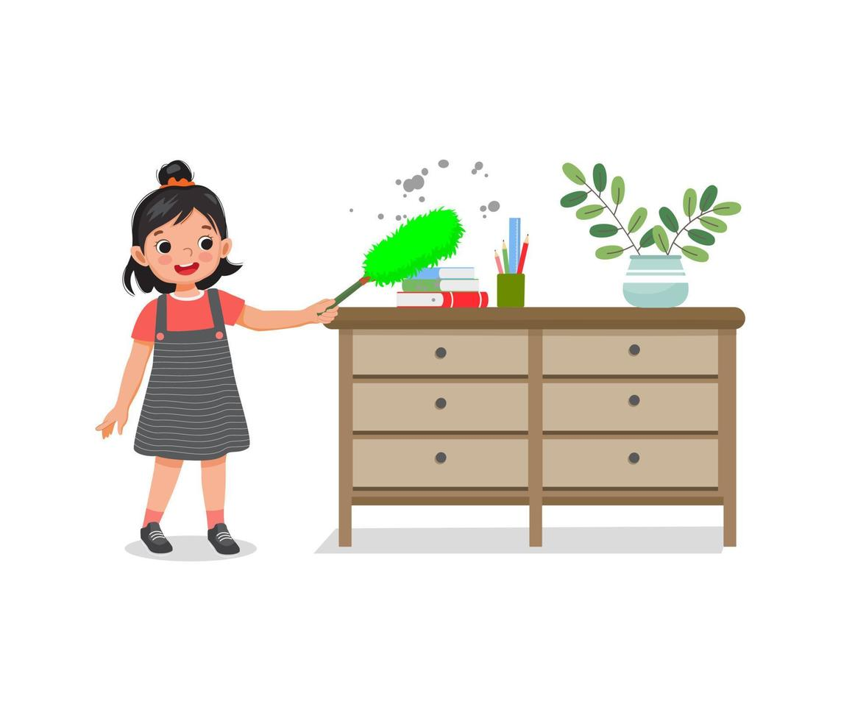
dust the furniture

Slide 6
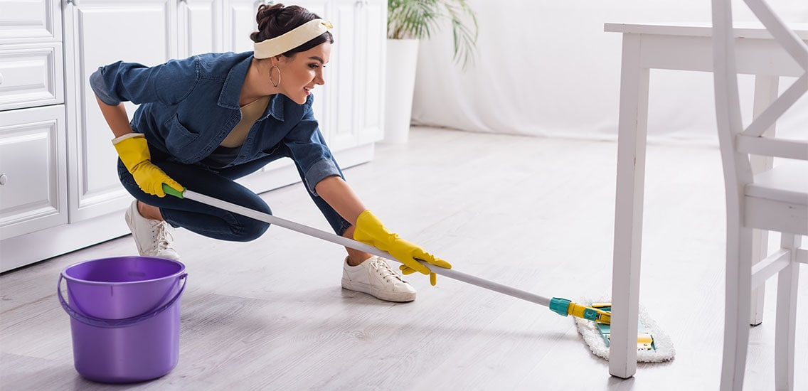
mop the floor

Slide 7
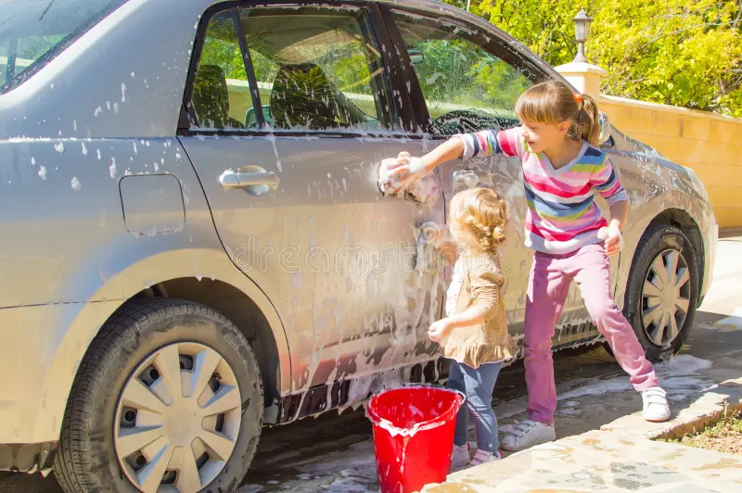
wash the car

Slide 8
Will they mop the floor?
No, they will not

Slide 9

Will she mop the floor?
No, she will not
will not=won’t
No, she won’t

Slide 10
Will she wash the car?
Yes, she will.

Slide 11

Will he dust the furniture?
Yes, he will.

Slide 12
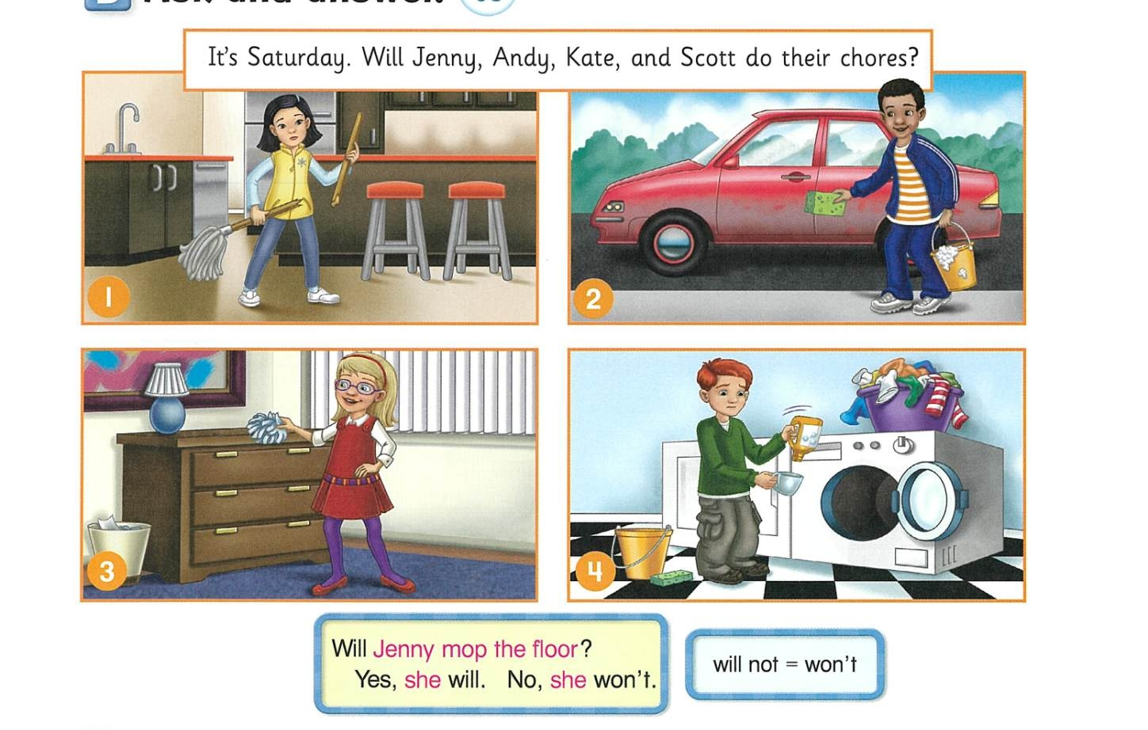

Slide 13
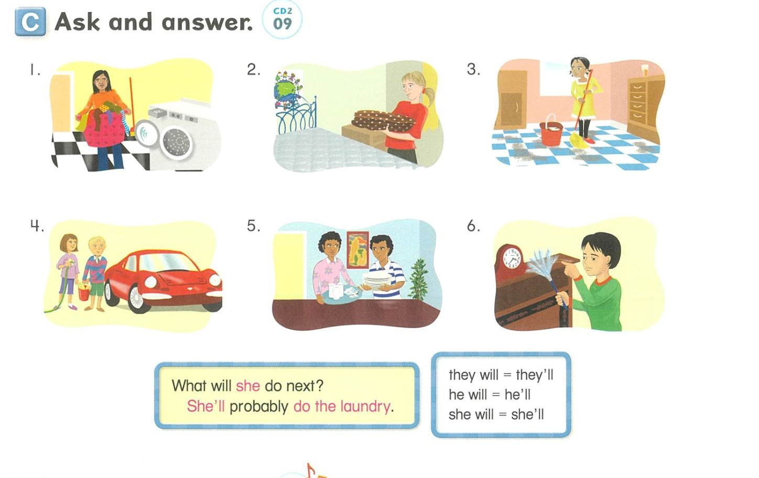

Slide 14
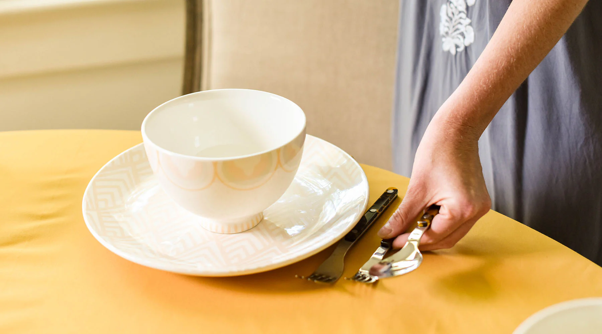
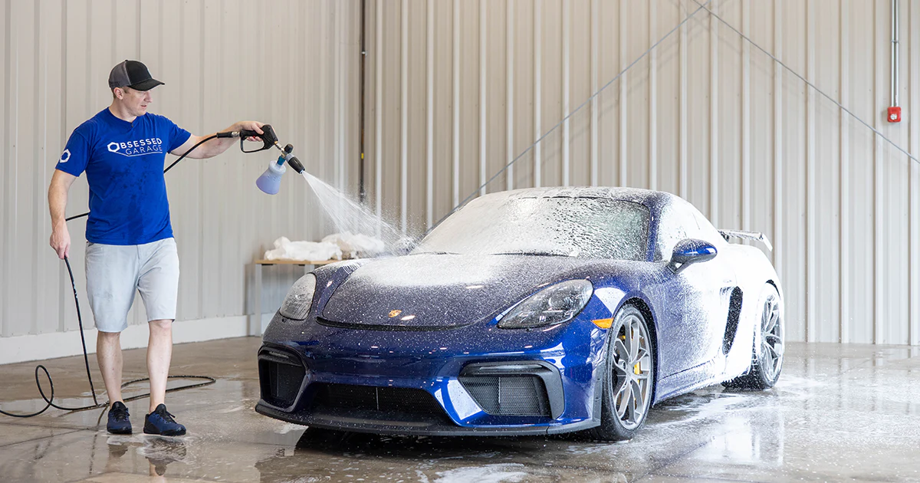
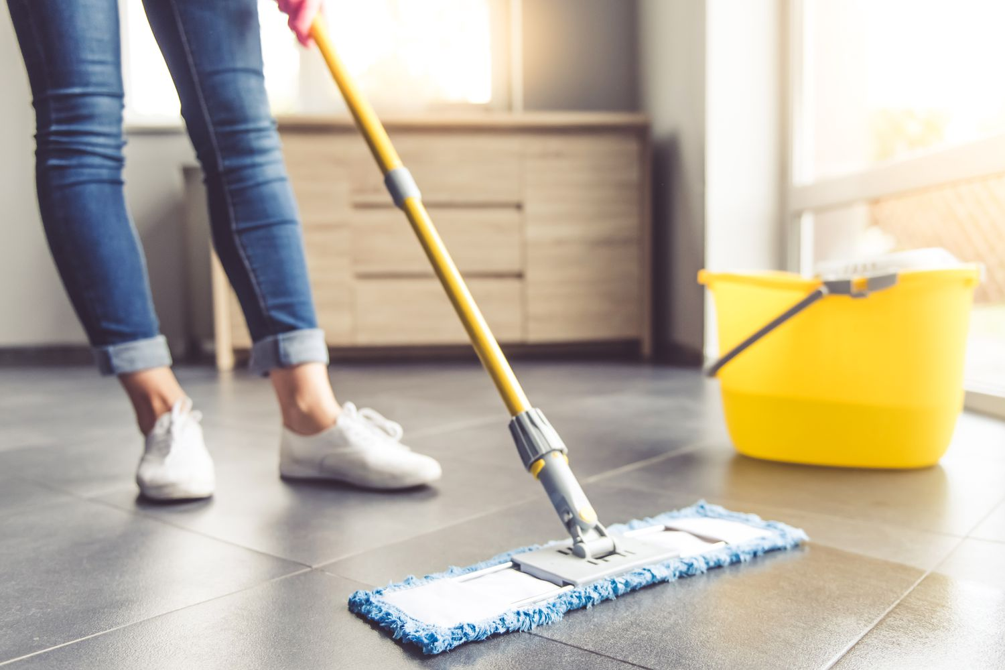
Mop the floor
A
B
C

Slide 15
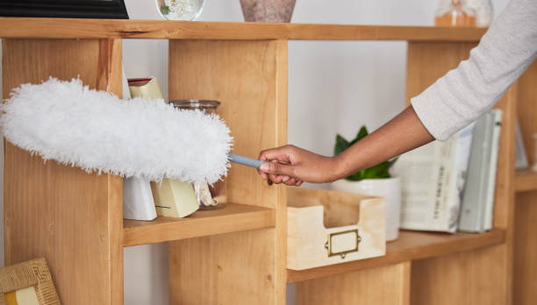
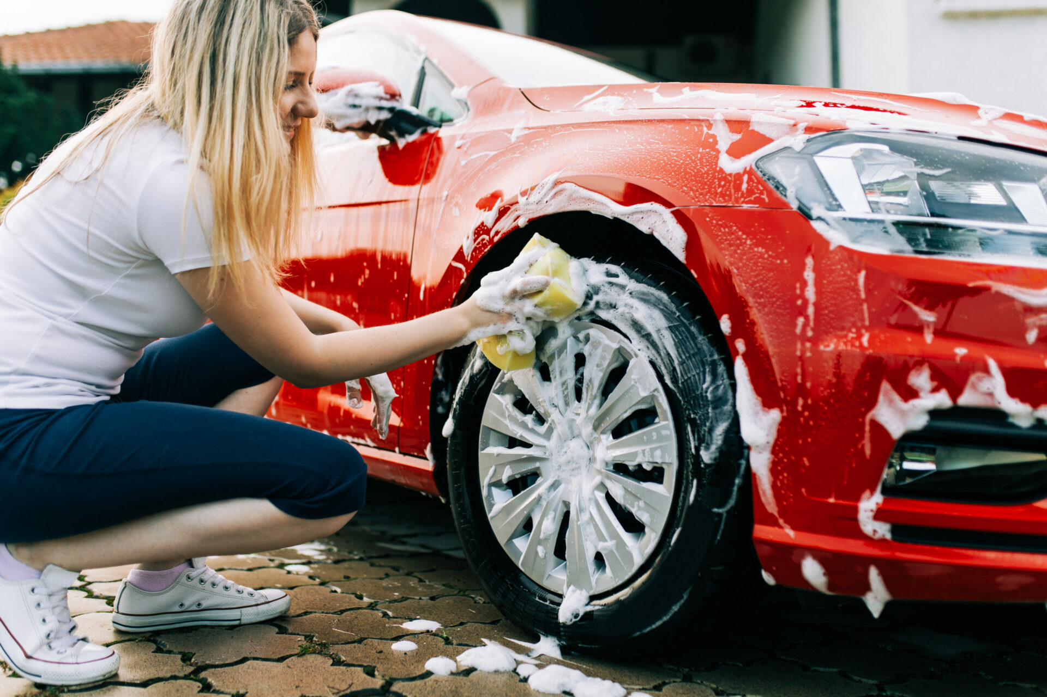
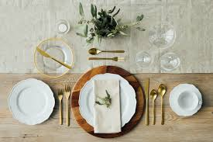
Wash the car
B
C
A

Slide 16
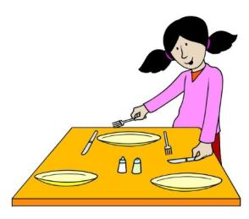
A. Dust the furniture
B. Set the table
C. Do the laundry

Slide 17

A. Mop the floor
B. Set the table
C. Do the laundry

Slide 18

A. Wash the car
B. Make the bed
C. Dust the furniture

