Slide 1
Sea Breeze and Land Breeze
Grade 6 Science

Slide 2
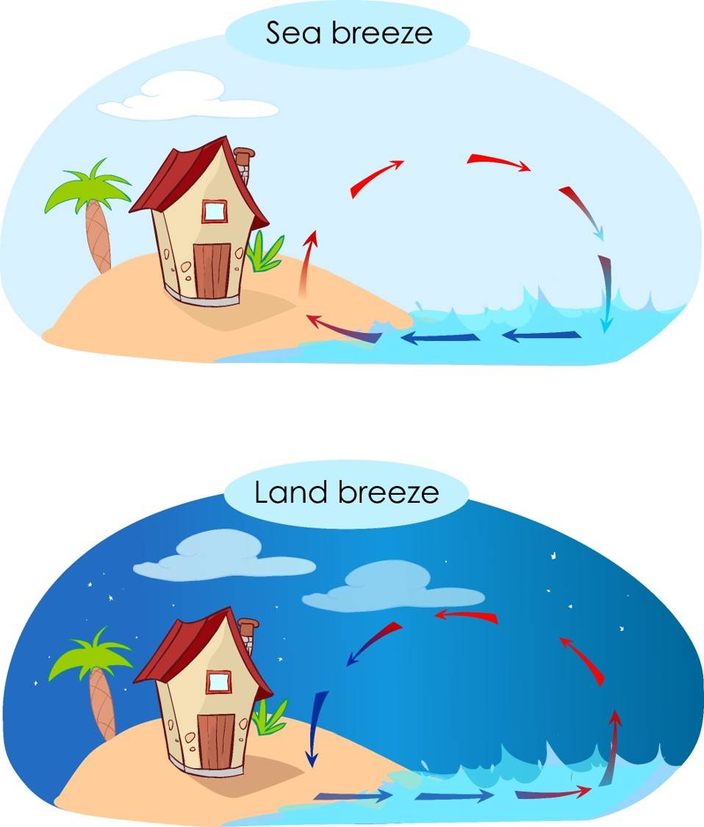

Slide 3
What is Wind?
Wind is moving air.
Air moves from high pressure to low pressure.

Slide 4
What is Sea Breeze?
Sea breeze happens during the day.
Land heats up faster than sea.
Cool air moves from sea to land.

Slide 5
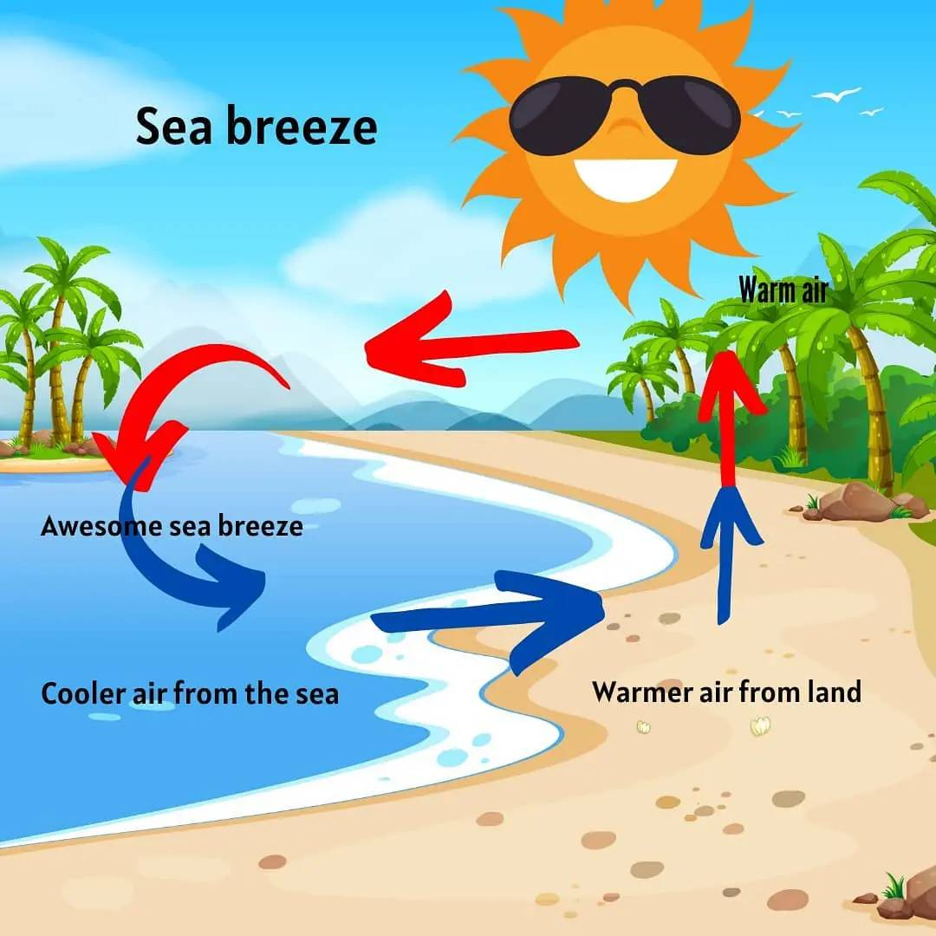

Slide 6
How Sea Breeze Works
1. Sun heats the land.
2. Warm air rises over land.
3. Cool air from sea moves to land.

Slide 7
What is Land Breeze?
Land breeze happens at night.
Land cools faster than sea.
Cool air moves from land to sea.

Slide 8
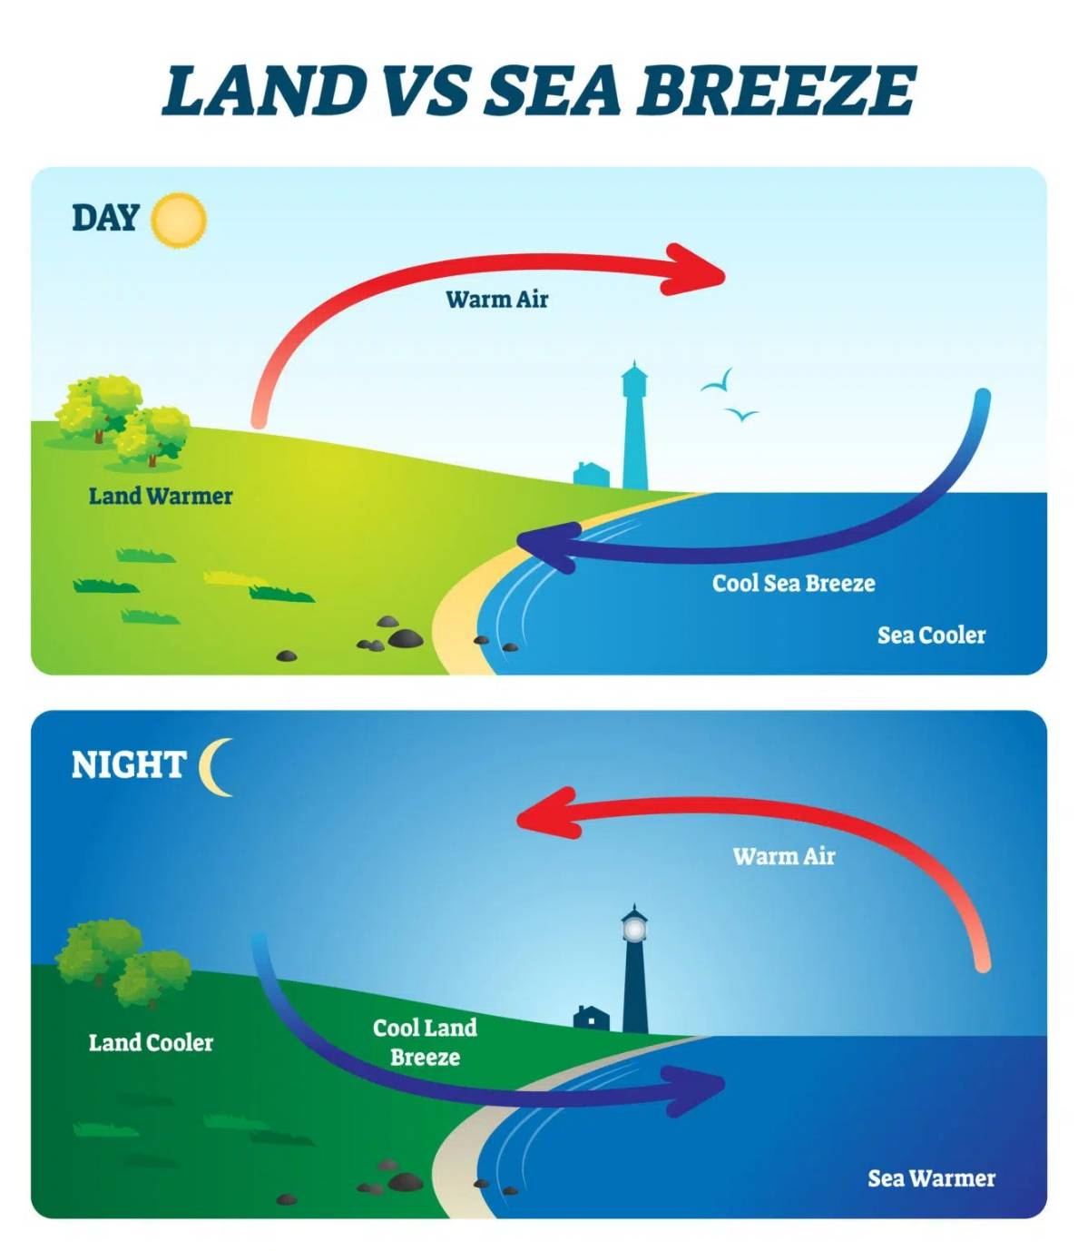

Slide 9
How Land Breeze Works
1. Land cools at night.
2. Warm air rises over sea.
3. Cool air moves from land to sea.

Slide 10
Sea Breeze vs Land Breeze
Sea Breeze:
• Day time
• From sea to land
Land Breeze:
• Night time
• From land to sea

Slide 12
Why Are They Important?
• Help control temperature
• Affect weather cause rainfall.
• Help sailors and fishermen

Slide 13
Summary
Sea breeze happens in the day.
Land breeze happens at night.
They are caused by heating and cooling of land and sea.

