Slide 1
P o l y n o m I a l s

Slide 2
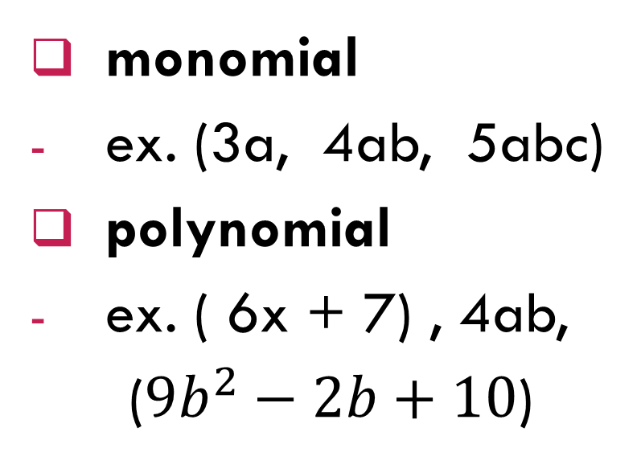
V o c a b u l a r y
term
- a number, a variable or a product of both
variables
- English small letters
coefficient
- a number in front of the variable
constant
- a number without a variable
degree
- the exponent of the variable
monomial
ex. (3a, 4ab, 5abc)
polynomial
ex. ( 6x + 7) , 4ab,
(${9b}^{2}−2b+10$)

Slide 3
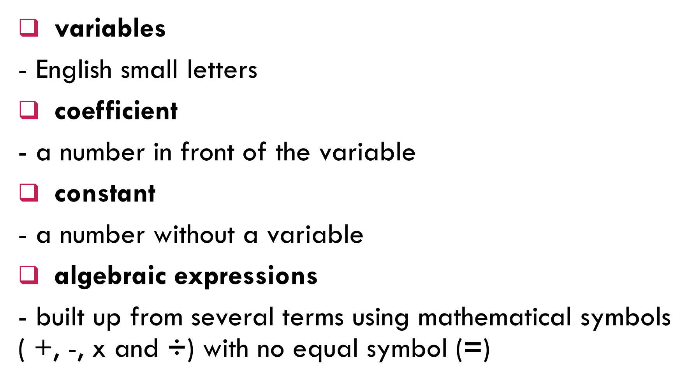
V o c a b u l a r y
variables
- English small letters
coefficient
- a number in front of the variable
constant
- a number without a variable
algebraic expressions
- built up from several terms using mathematical symbols ( +, -, x and $\text{÷}$) with no equal symbol (=)
monomial
ex. (3a, 4ab, 5abc)
polynomial
ex. ( 6x + 7) , 4ab,
(${9b}^{2}−2b+10$)

Slide 4

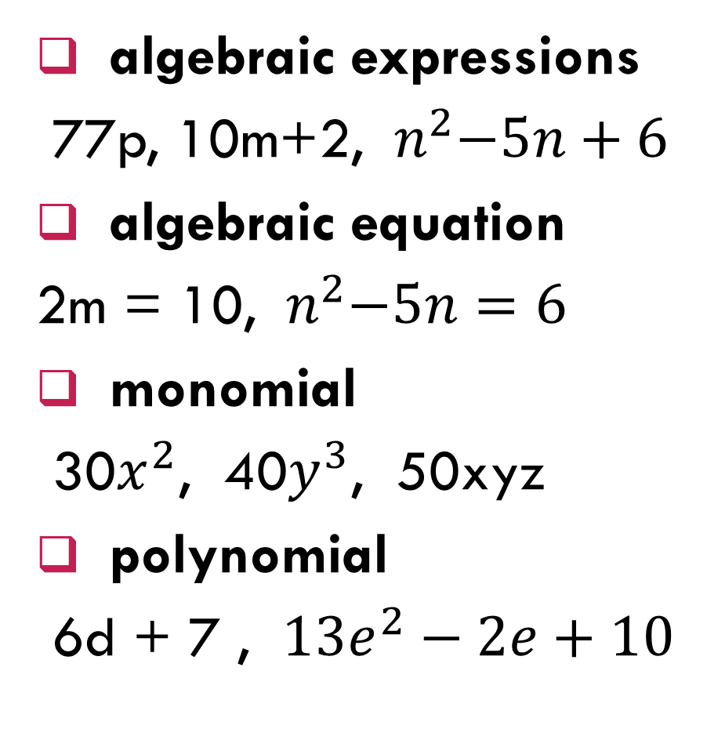
algebraic expressions
77p, 10m+2, ${ n}^{2}−5n+6$
algebraic equation
2m = 10, ${ n}^{2}−5n=6$
monomial
30$x^{2}$, 40$y^{3}$, 50xyz
polynomial
6d + 7 , ${13e}^{2}−2e+10$
variable
coefficient
$${9b}^{2}=9$$
$${ n}^{2}−5n=6$$
constant

Slide 5
flip
x
-x
Then, -(x) = -x
flip
-x
x
Then, -(-x) = x
x
-x
Then, x + (-x) = 0

Slide 6
3x
x
x
x
3x = x + x + x
-3x
-x
-x
-x
-3x = (-x) + (-x) + (-x)
flip
-x
x
x
x
-x
-x
Then, -(3x) = -3x
-x
-x
-x
flip
x
x
x
Then, -(-3x) = 3x
x
-x
x
-x
Then, 3x + (-3x) = 0
x
-x

Slide 7
Representing algebra expressions using algebra discs
4x + 2
x
x
x
x
1
1
4x + 2 = x + x + x + x + 1 + 1
x + 2y
x
y
y
x + 2y = x + y + y

Slide 8




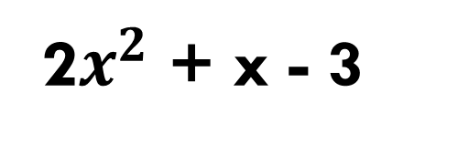
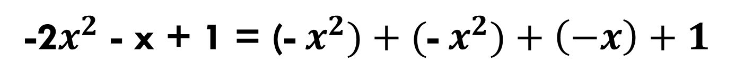
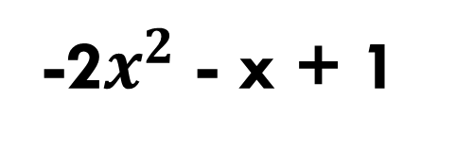
Representing algebra expressions using algebra discs
2$x^{2}$ + x - 3
$${ x}^{2}$$
$${ x}^{2}$$
x
-1
-1
-1
2$x^{2}$ + x - 3 = ${ x}^{2}+{ x}^{2}+x+\left(−1\right)+\left(−1\right)+(−1)$
-2$x^{2}$ - x + 1
-${ x}^{2}$
-${ x}^{2}$
-x
1
-2$x^{2}$ - x + 1 = (-${ x}^{2})+($-${ x}^{2})+\left(−x\right)+1$

Slide 9
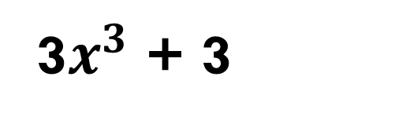



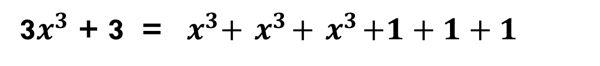
Representing algebra expressions using algebra discs
3$x^{3}$ + 3
$${ x}^{3}$$
$${ x}^{3}$$
$${ x}^{3}$$
1
1
1
3$x^{3}$ + 3 = ${ x}^{3}+{ x}^{3}+{ x}^{3}+1+1+1$

Slide 10
Addition of Monomials

Slide 11
V o c a b u l a r y
variables
- English small letters [ex. 8ab (ab are variables)]
coefficient
- a number in front of the variables [ex. 8ab (8 is a coefficient)]
sum
- answer from addition [ex. 2 + 2 = 4 (4 is the sum)]
difference
answer from subtraction [ex. 6 - 4 = 2 (2 is the difference)]

Slide 12
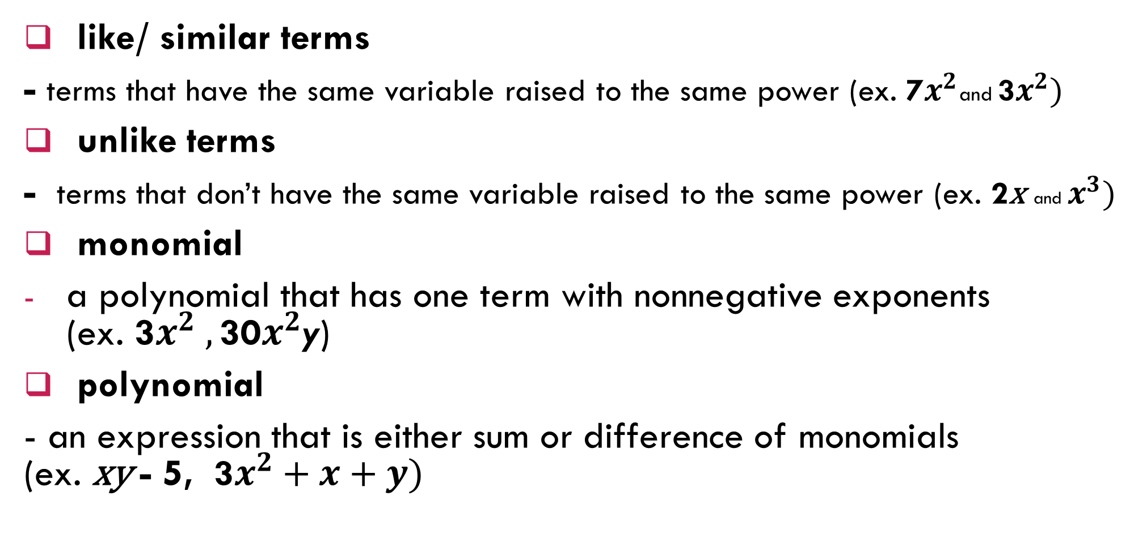
V o c a b u l a r y
like/ similar terms
- terms that have the same variable raised to the same power (ex. 7$x^{2}$and 3$x^{2})$
unlike terms
- terms that don’t have the same variable raised to the same power (ex. 2x and $x^{3})$
monomial
a polynomial that has one term with nonnegative exponents (ex. 3$x^{2} ,\text{30}x^{2}$y)
polynomial
- an expression that is either sum or difference of monomials (ex. xy - 5, 3$x^{2}+x+y)$

Slide 13

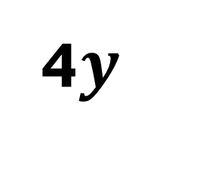
The coefficient is 4
The variable is y
The degree is 1
4$y$
${−b}^{2}$
The coefficient is -1
The variable is b
The degree is 2

Slide 14
Addition of Monomials
3x + 4x
x
x
x
x
Therefore,
3x + 4x = 7x
x
x
x
x
x
x
x
x
x
x

Slide 15
Addition of Monomials
3x + (- 4x)
x
-x
x
-x
Therefore,
3x + (- 4x ) = -x
x
-x
x
-x
x
-x
x
-x
-x
-x

Slide 16
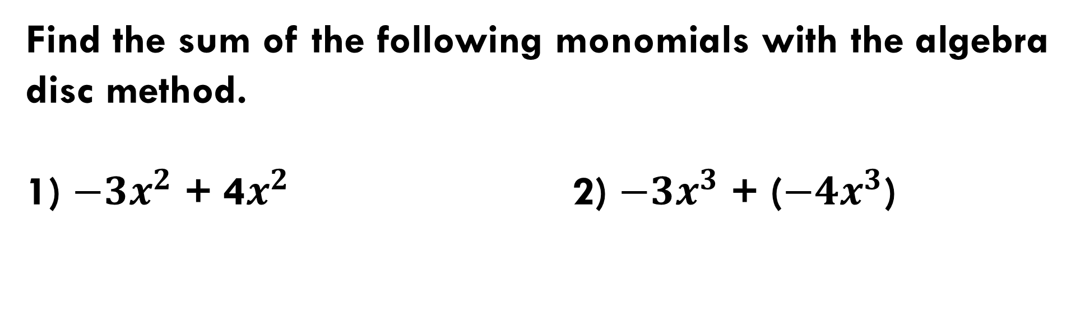
Addition of Monomials
Find the sum of the following monomials with the algebra disc method.
1) ${−3x}^{2}$ + 4$x^{2}$ 2) $−3x^{3}$ + (${−4x}^{3}$)

Slide 17
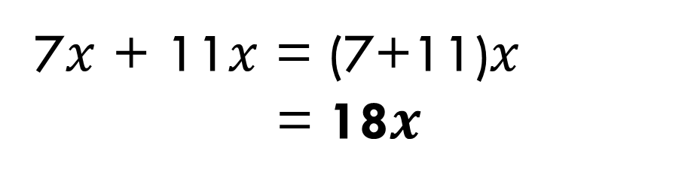
Addition of Monomials
Find the sum of the following monomials.
7x + 11x
7$x$ + 11$x$ = (7+11)$x$
= 18$x$
Sum of like monomials = The sum of coefficients x The sets of variables of monomials

Slide 18
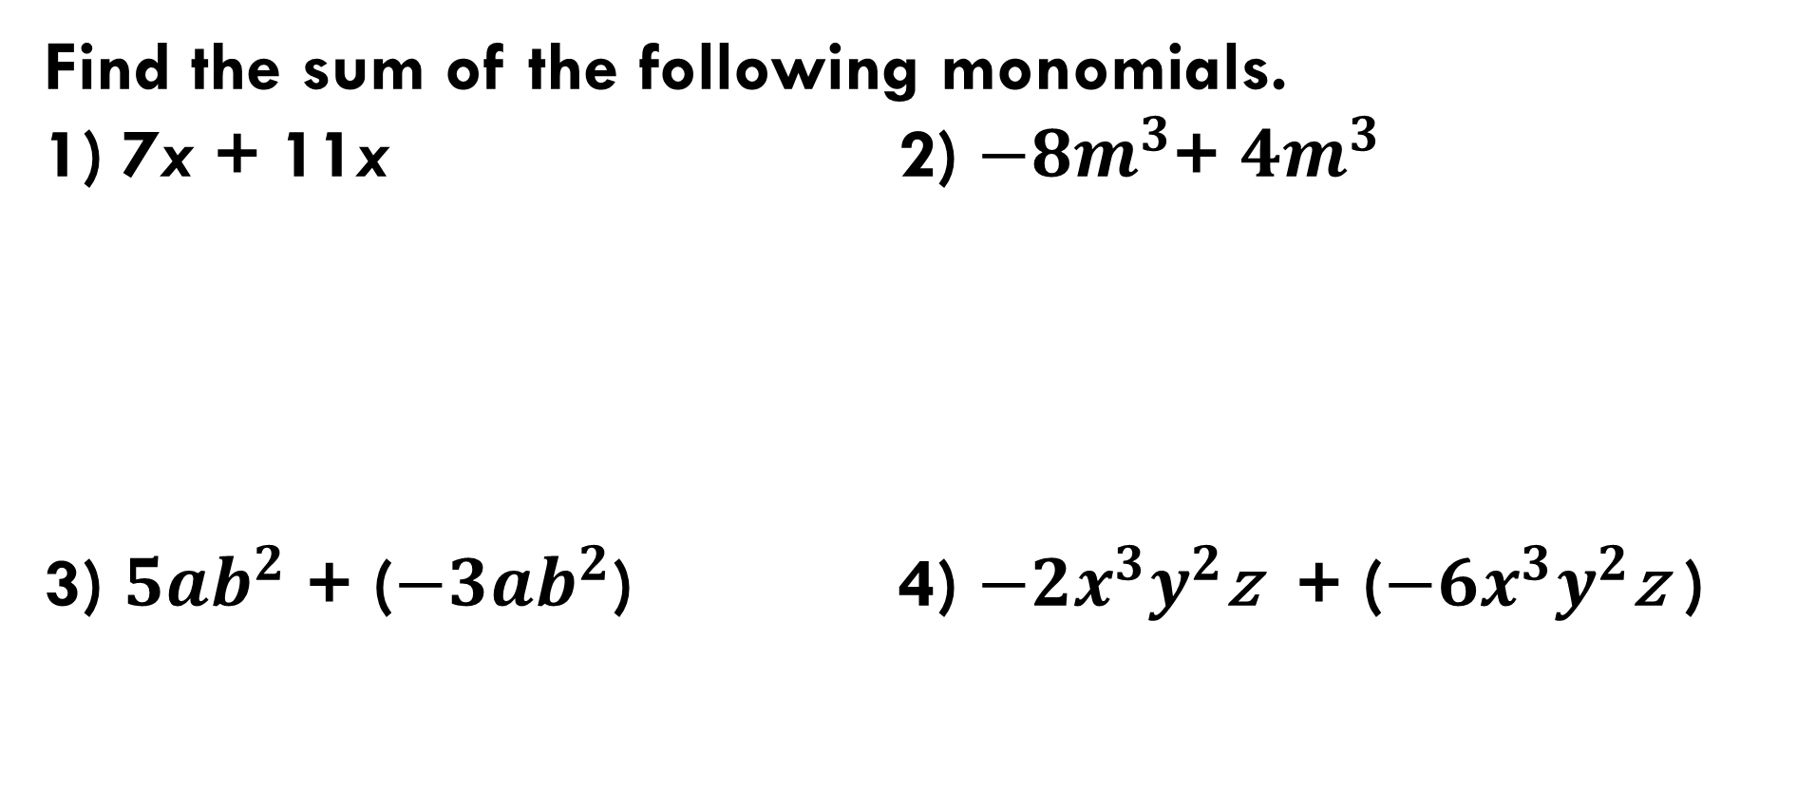
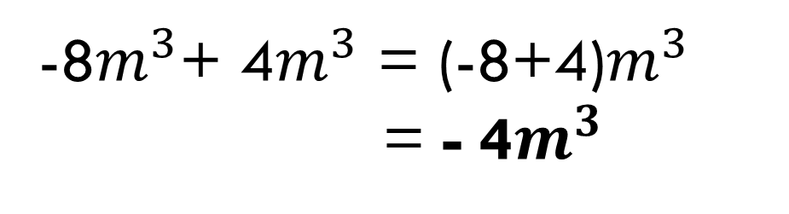
Addition of Monomials
Find the sum of the following monomials.
1) 7x + 11x 2) $−8m^{3}$+ $4m^{3}$
3) ${5ab}^{2}$ + (${−3ab}^{2}$) 4) $−2x^{3}y^{2}$z + ($−6x^{3}y^{2}$z )
7$x$ + 11$x$ = (7+11)$x$
= 18$x$
-8$m^{3}$+ 4$m^{3}$ = (-8+4)$m^{3}$
= - 4$m^{3}$

Slide 19
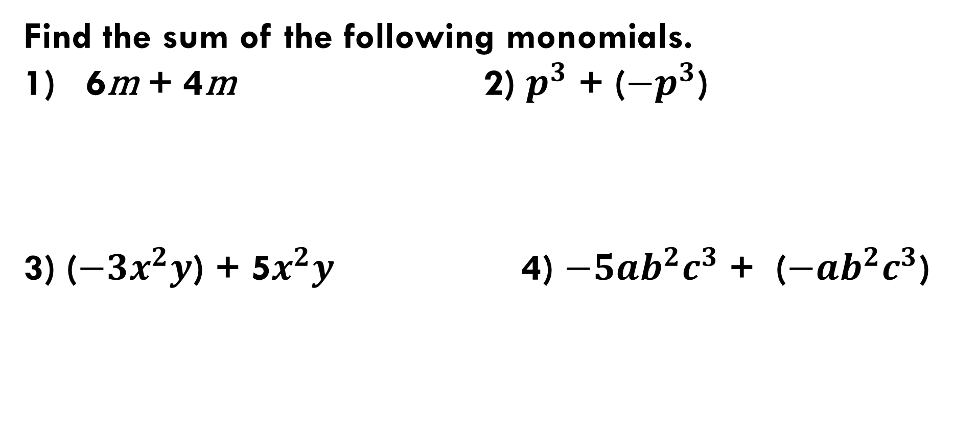
Addition of Monomials
Find the sum of the following monomials.
6m + 4m 2) $p^{3}$ + (${−p}^{3}$)
3) (${−3x}^{2}y$) + 5$x^{2}y$ 4) ${−5ab}^{2}c^{3}$ + ($−{ab}^{2}c^{3}$)
Open your book on page 114

Slide 20
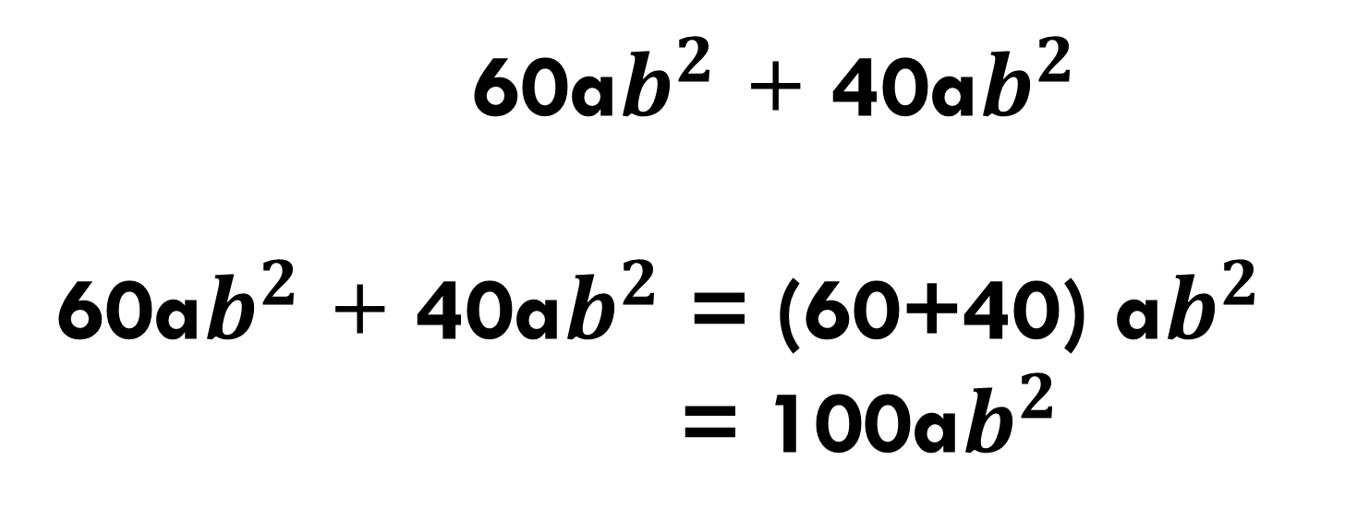
R E M E M B E R
Sum of like monomials = The sum of coefficients x The sets of variables of monomials
60a$b^{2}$ + 40a$b^{2}$
60a$b^{2}$ + 40a$b^{2}$ = (60+40) a$b^{2}$
= 100a$b^{2}$

Slide 21
Subtraction of Monomials

Slide 22
Subtraction of Monomials
4x - 3x
x
-x
x
-x
Therefore,
4x - 3x = x
x
-x
x
-x
x
-x
x
-x
x
x

Slide 23
Subtraction of Monomials
4x - (- 3x)
x
x
x
x
Therefore,
4x - (- 3x) = 7x
x
x
x
x
x
x
x
x
x
x

Slide 24
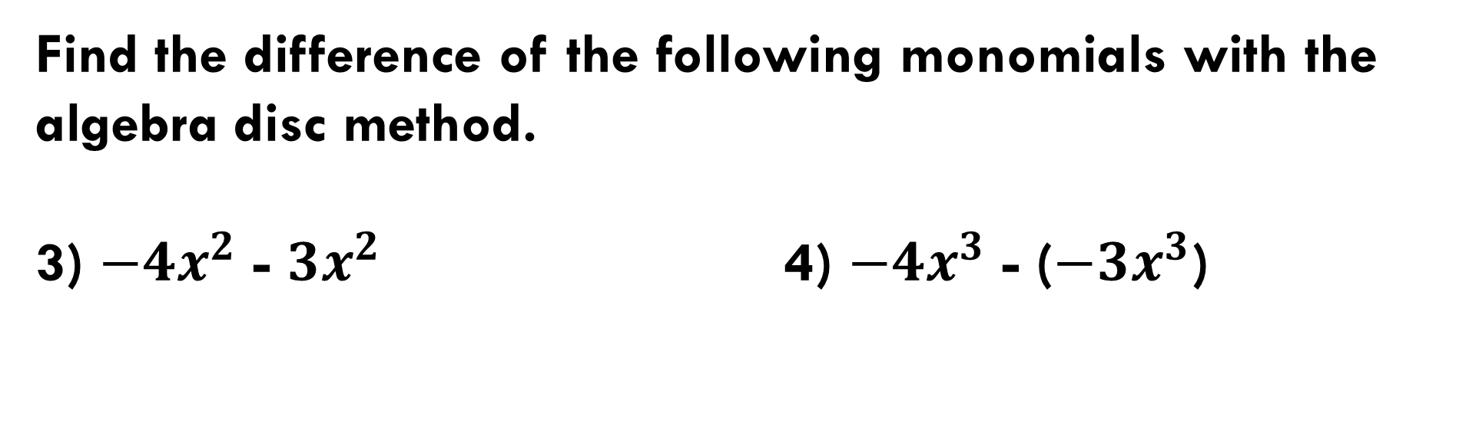
Subtraction of Monomials
Find the difference of the following monomials with the algebra disc method.
3) ${−4x}^{2}$ - $3x^{2}$ 4) $−4x^{3}$ - ($−3x^{3}$)
Open your book on page 116

Slide 25
Difference between like monomials
=
Difference between coefficients x The sets of variables of monomials
4x - 2x
4x - 2x = (4 - 2)x
= 2x

Slide 26
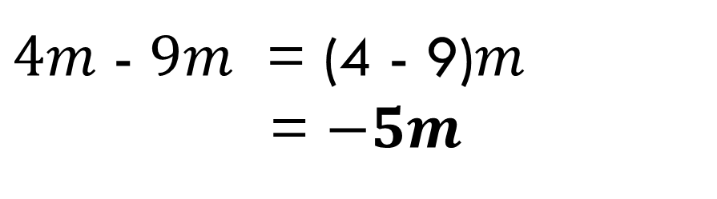
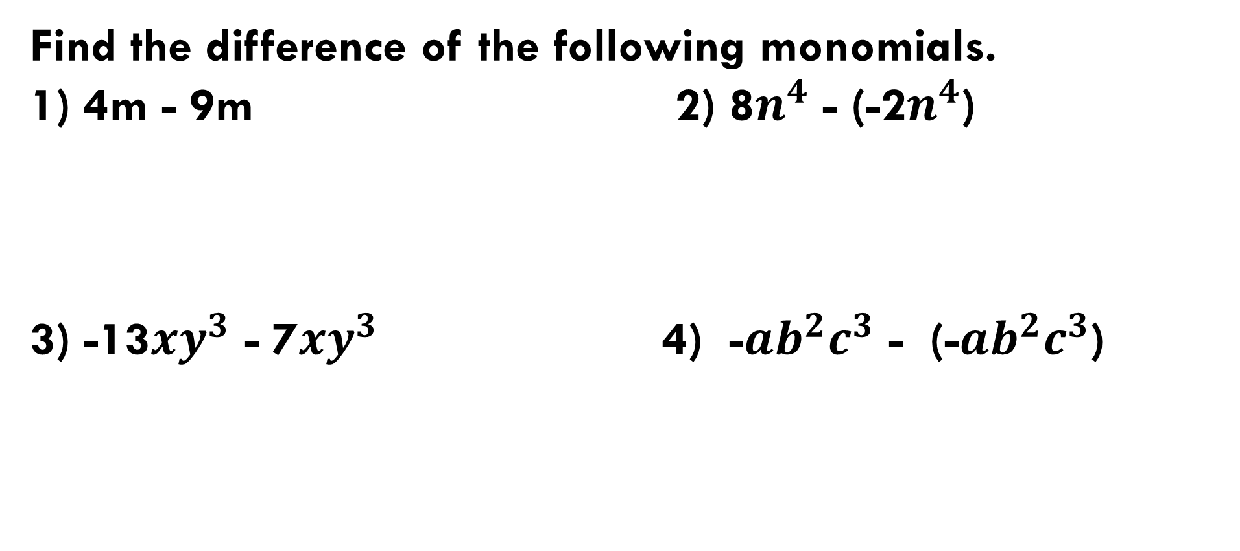
Subtraction of Monomials
Find the difference of the following monomials.
1) 4m - 9m 2) 8$n^{4}$ - (-2$n^{4}$)
3) -13${xy}^{3}$ - 7${xy}^{3}$ 4) -${ab}^{2}c^{3}$ - (-${ab}^{2}c^{3}$)
$4m$ - $9m$ = (4 - 9)$m$
= $−5m$
Open your book on page 117

Slide 27
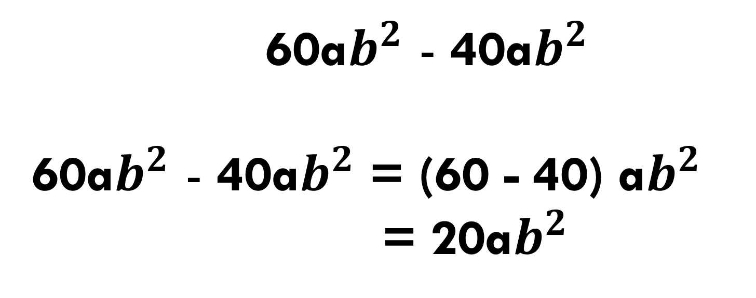
R E M E M B E R
Difference between like monomials
=
Difference between coefficients x The sets of variables of monomials
60a$b^{2}$ - 40a$b^{2}$
60a$b^{2}$ - 40a$b^{2}$ = (60 - 40) a$b^{2}$
= 20a$b^{2}$

Slide 28
Addition of Polynomials

Slide 29
Addition of Polynomials
(x + 2) + (5x – 4)
= x + 2 + 5x - 4
x
x
x
-1
x
-1
x
-1
x
-1
grouping the like terms
1
x
-1
x
1
-1
x
1
x
-1
x
x
1
-1
x + 5x + 2 – 4
= 6x - 2
x + 2 + 5x - 4
Therefore, (x + 2) + (5x – 4) = x + 5x + 2 – 4
= 6x - 2

Slide 30
Addition of Polynomials
(x + 2) + (5x – 4)
x + 2
5x - 4
6x - 2

Slide 31
Addition of Polynomials
(2x - 3) + (-3x + 2)
= 2x - 3 - 3x + 2
-1
-x
-x
-1
x
-1
-x
1
grouping the like terms
x
-x
-1
1
x
-1
-x
1
x
-x
-1
1
2x - 3 - 3x + 2
2x - 3x - 3 + 2
= -x - 1
Therefore, (2x - 3) + (-3x + 2) = 2x - 3x - 3 + 2
= -x - 1

Slide 32
Addition of Polynomials
(2x - 3) + (-3x + 2)
2x - 3
-3x + 2
-x - 1

Slide 33
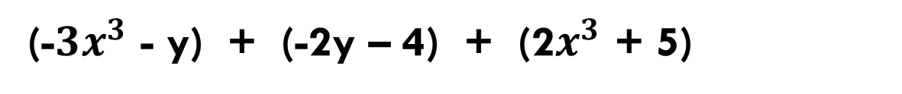
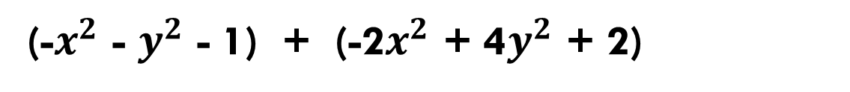
Addition of Polynomials
(-$x^{2}$ - $y^{2}$ - 1) + (-2$x^{2}$ + 4$y^{2}$ + 2)
(-${3x}^{3}$ - y) + (-2y – 4) + (2$x^{3}$ + 5)

Slide 34

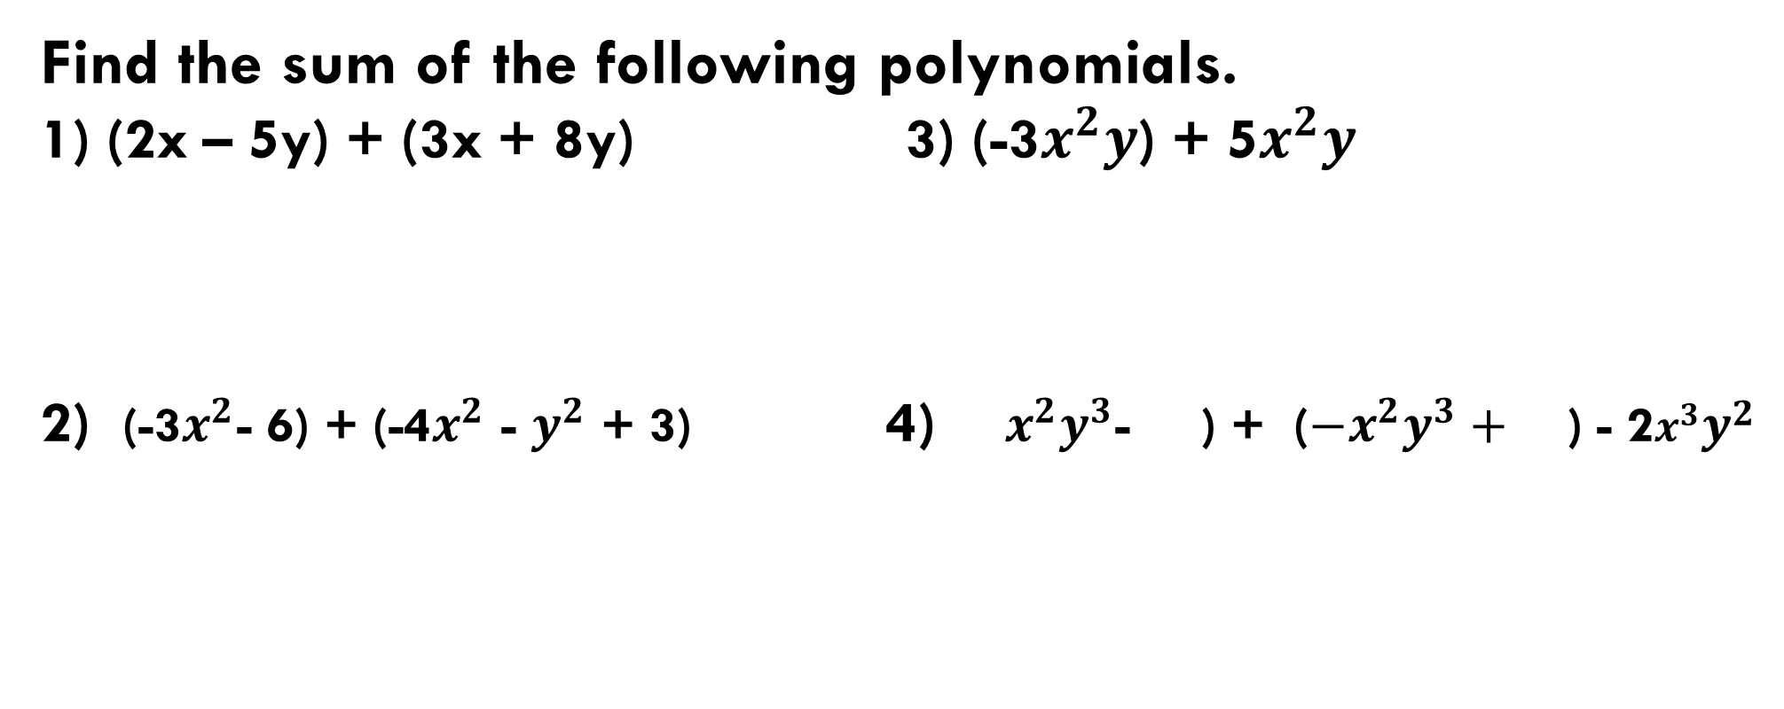


Addition of Polynomials
Find the sum of the following polynomials.
1) (2x – 5y) + (3x + 8y) 3) (-3$x^{2}y$) + 5$x^{2}y$
2) (-3$x^{2}$- 6) + (-4$x^{2}$ - $y^{2}$ + 3) 4) ${x^{2}y}^{3}$- ) + (${−x}^{2}y^{3}+$ ) - 2$x^{3}y^{2}$
$$\frac{1}{2}$$
$$\frac{5}{2}$$
$$\frac{3}{4}$$
Open your book on page 122

Slide 35
Subtraction of Polynomials

Slide 36
Subtraction of Polynomials
(x + 1) - (3x + 1)
= x + 1 + [-(3x) +1]
-x
grouping the like terms
-x
x
1
-x
-x
-
x
x
x
1
x
1
-x
-1
x
-x
1
-1
x + 1 + [-(3x) +1]
x + 1 - 3x - 1
x - 3x + 1 - 1
= -2x
Therefore, (x + 1) - (3x + 1) = x - 3x + 1 - 1
= -2x

Slide 37
Subtraction of Polynomials
(x + 1) - (3x + 1)
x + 1
-3x - 1
-2x
+

Slide 38
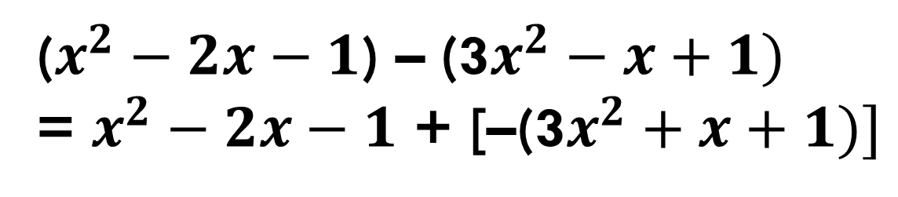
Subtraction of Polynomials
($x^{2}−2x−1$) – (3$x^{2}−x+1)$
= $x^{2}−2x−1$ + [–(3$x^{2}+x+1)]$
Open your book on page 125

Slide 39
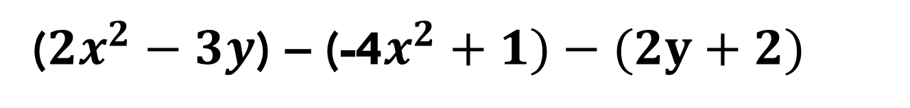
Subtraction of Polynomials
(${2x}^{2}−3y$) – (-4$x^{2}+1)−(2y+2)$
Open your book on page 125

Slide 40

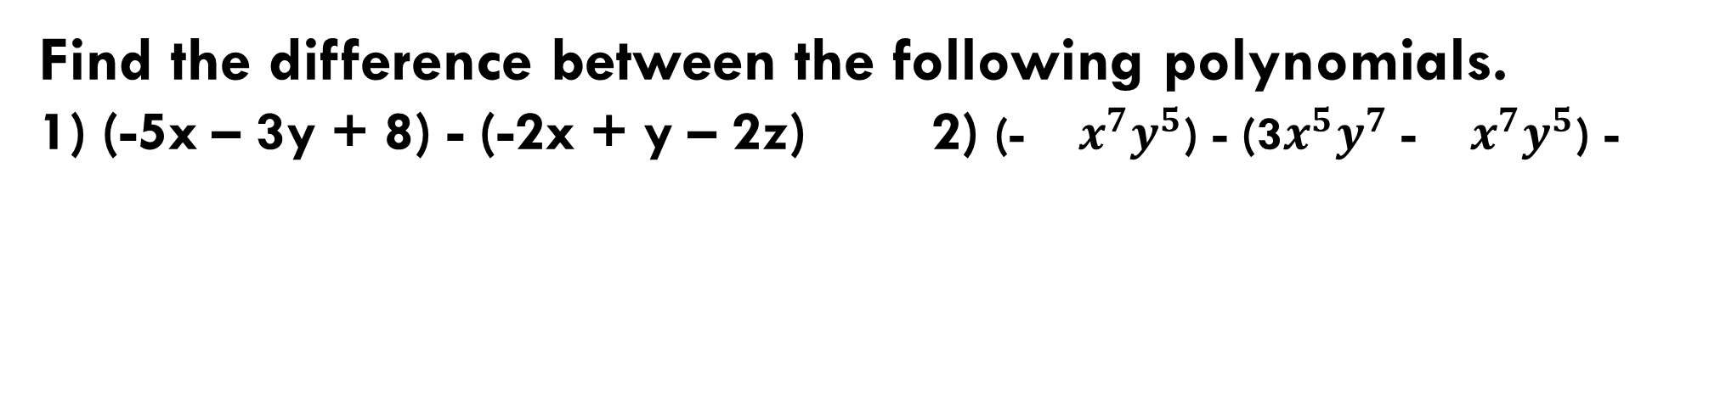


Subtraction of Polynomials
Find the difference between the following polynomials.
1) (-5x – 3y + 8) - (-2x + y – 2z) 2) (- $x^{7}y^{5}$) - (3$x^{5}y^{7}$ - $x^{7}y^{5}$) -
$$\frac{3}{5}$$
$$\frac{3}{5}$$
$$\frac{7}{3}$$
Open your book on page 126

