Slide 1
Is there a chance that Thailand will have a snowstorm tomorrow?

Slide 2
You have 2 chocolate bars, 3 bags of chips, and 1 pack of cookies. If you randomly pick one snack, is there a chance you’ll pick a chocolate bar?

Slide 3
The weather application says there’s a 70% chance
of rain on Sunday.
What does that really mean?

Slide 4
Probability

Slide 5
Probability
means possibility
the measure of how likely a random event will occur/happen

Slide 6
Vocabulary
experiment – a process of observation
outcome – a possible result
random – done/happening without a plan
sample space – all possible outcomes
event – a specific outcome or group of outcomes
toss – to flip

Slide 7
Coin tossing
HEAD and TAIL

Slide 8
Coin tossing
Toss your coin

Slide 9
Coin tossing
If you flip a coin, what is the possibility of getting a HEAD?

Slide 10
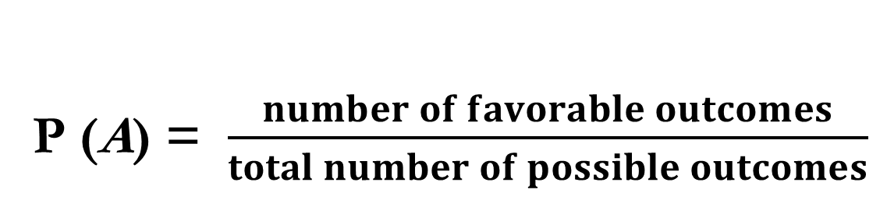
Probability
P (A) = $\frac{number of favorable outcomes}{total number of possible outcomes}$

Slide 11
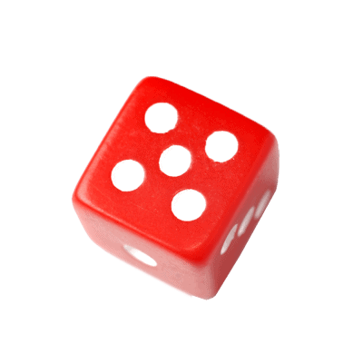
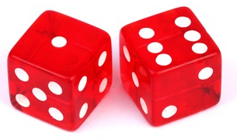
Dice rolling

Slide 12
Dice rolling
Roll your die

Slide 13
Dice rolling
What is the probability of rolling a 3 on a
six-sided die?

Slide 14
Dice rolling
What is the probability of rolling a 7
on a six-sided die?

Slide 15
Dice rolling
What is the probability of rolling an even number on a six-sided die?

Slide 16
Dice rolling
a sum of 8 from rolling
two six-sided dice at once

Slide 17
What is the probability of rolling a number greater than 4 on a die?

Slide 18
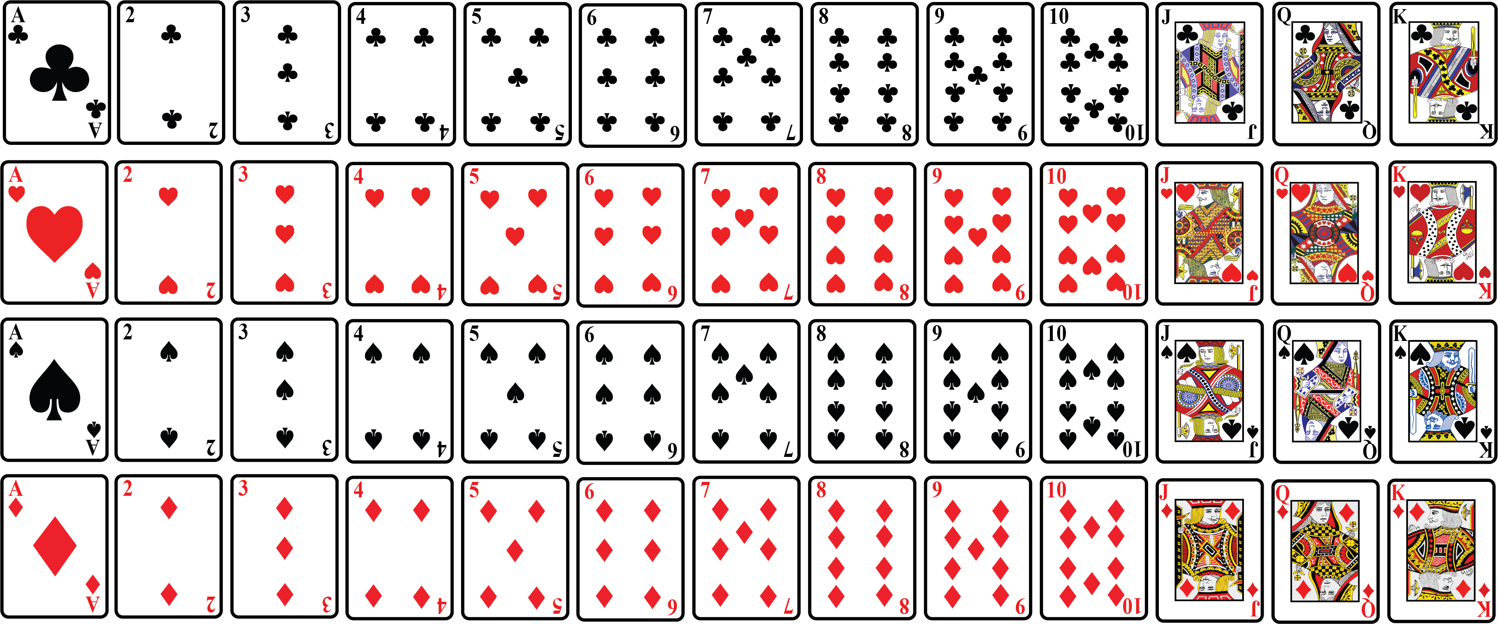

Slide 19
Deck of cards picking
What is the probability of picking a red card?

Slide 20
Deck of cards picking
What is the probability of picking a queen?

Slide 21
Deck of cards picking
What is the probability of picking a black card?

Slide 22
What is the probability of picking an ace from a deck of cards?

Slide 23
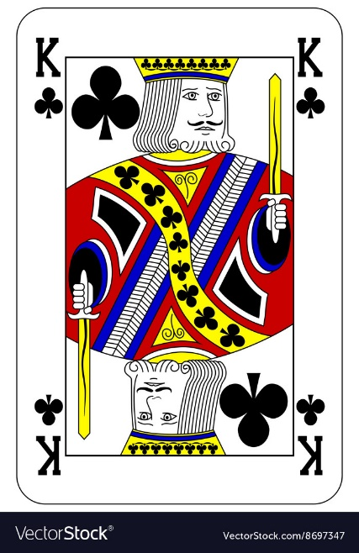
What is the probability of picking
the king of clubs
from a deck of cards?

Slide 24
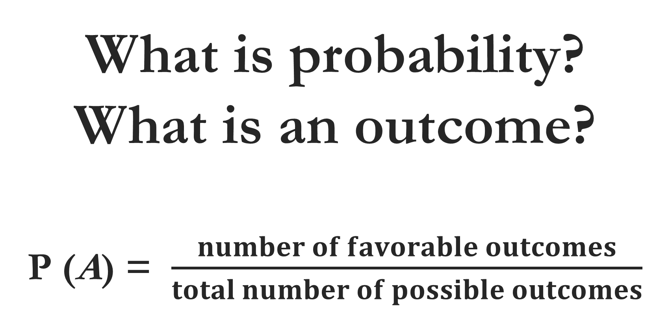
What is probability?
What is an outcome?
P (A) = $\frac{number of favorable outcomes}{total number of possible outcomes}$

Slide 25
If a bag has 3 red, 4 blue, and 5 green marbles, what is the probability of picking a blue marble?

Slide 26
A spinner is divided into 8 sections numbered 1 to 8. What is the probability
of landing into
an even number?

Slide 27
There are 12 marbles in a jar: 5 black, 4 pink and 3 purple. What is the probability
of picking a
black or pink marble?

Slide 28
There is a container full of colored bottles, red, blue, green and orange. Some of the bottles are picked out and displaced. You did this 1000 times and got the following results:
No. of blue bottles picked out: 300
No. of red bottles: 200
No. of green bottles: 450
No. of orange bottles: 50

Slide 29
Given: Set R = {1, 2, 3, 4, 5, 6, 7, 8, 9, 10, 11, 12}
The probability of having:
a 10
a 13
odd numbers
even numbers
an odd number visible by 3
an even number visible by 3

Slide 30
Impossible (never happen) --- 0% -- 0
Unlikely (least to happen) --- 25% -- 0.25
Even chance (half/middle) --- 50% -- 0.5
Likely (possible) --- 75% -- 0.75
Certain (very sure) --- 100% -- 1

Slide 31
a b c d e
Impossible Unlikely Even chance Likely Certain 0 0.25 0.5 0.75 1
There are 7 days in a week.
Out of 20 items, you got 15.
In Thailand, it will snow in March.
If you flip a coin, it will come down heads.
All months of the year have 28 days.
It will be daylight in Bangkok at midnight.

Slide 32
a b c d e
Impossible Unlikely Even chance Likely Certain 0 0.25 0.5 0.75 1
The day before Monday is Sunday.
Of the 40 seedlings, only 10 survived.
Next year, the month after November has 30 days.
The third person to knock on the door will be a female.
The chance that the last outcome in rolling a number cube is an even number.

