Slide 1

SCIENCE QUIZ

Slide 2

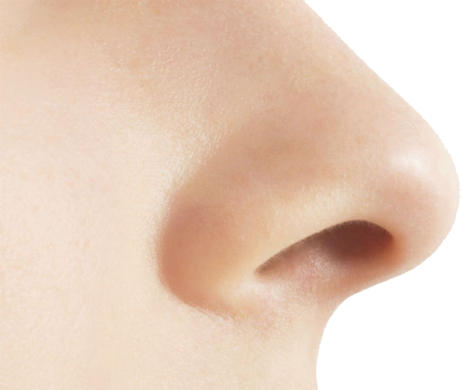
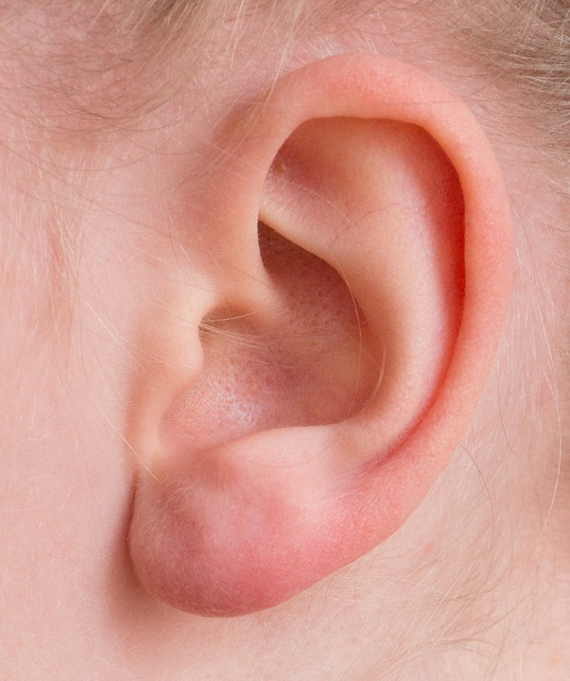
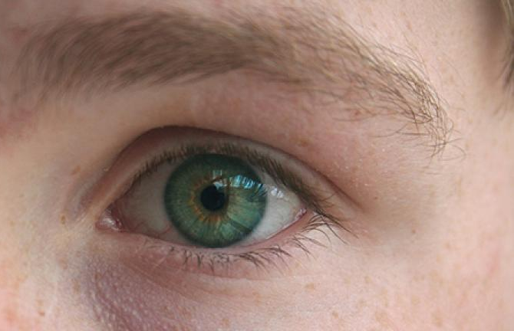

Which part of your body do you use to see?
A. nose
B. ear
C. eye

Slide 3
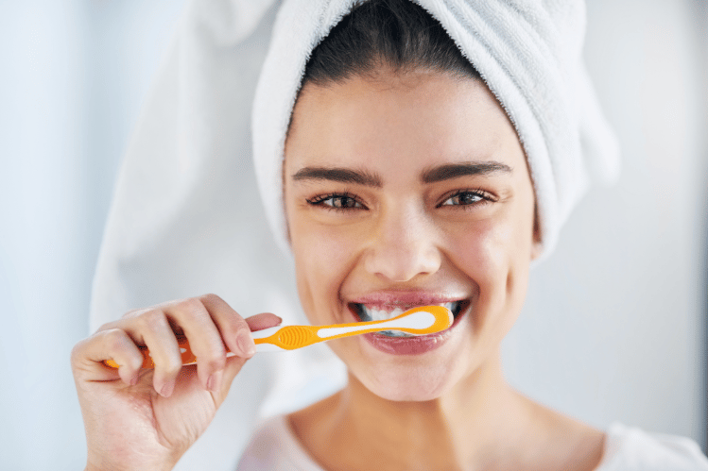
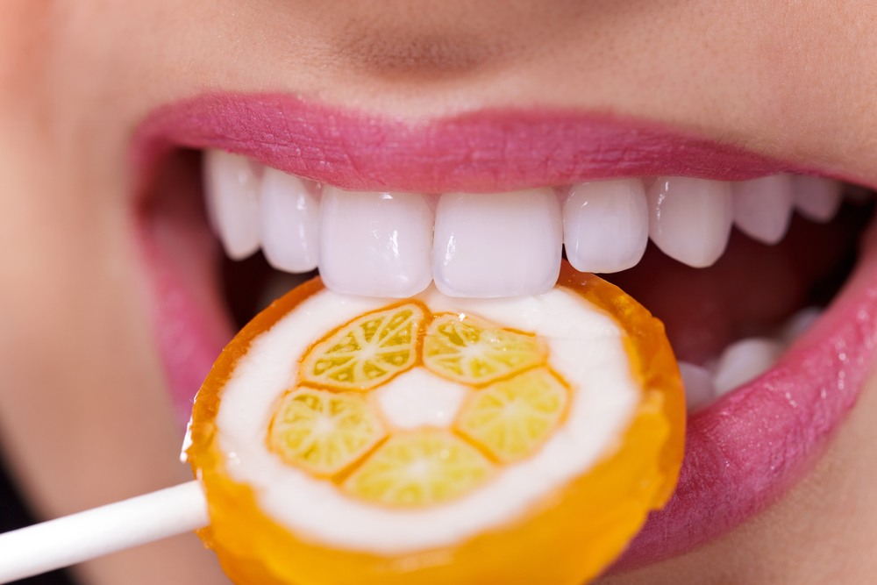
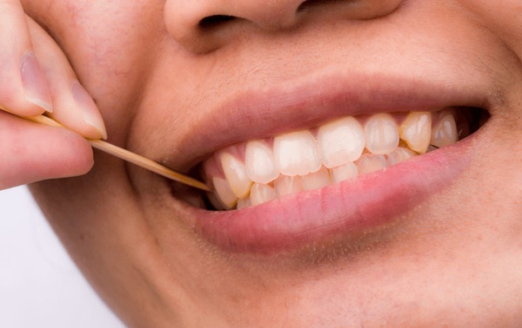
Which is the correct way to care for your teeth?
A. Brush your teeth.
B. Use a toothpick.
C. Eat a lot of candy.

Slide 4
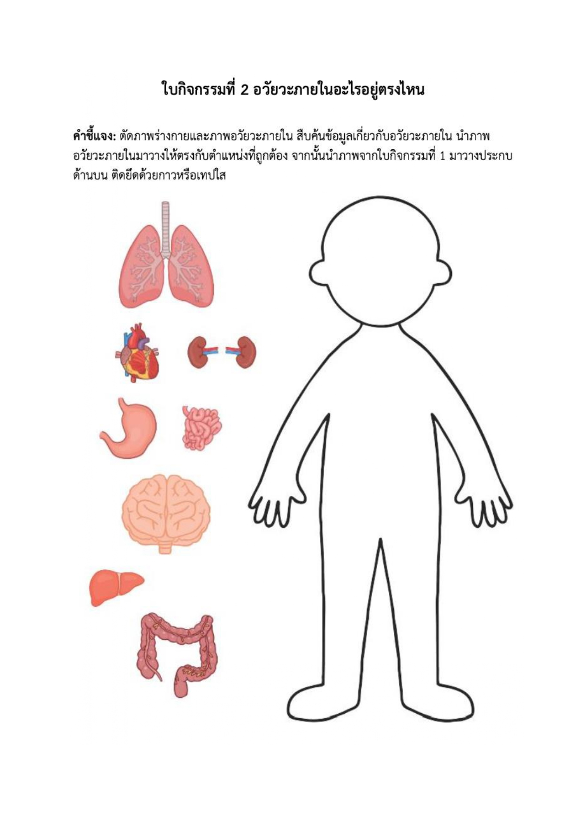
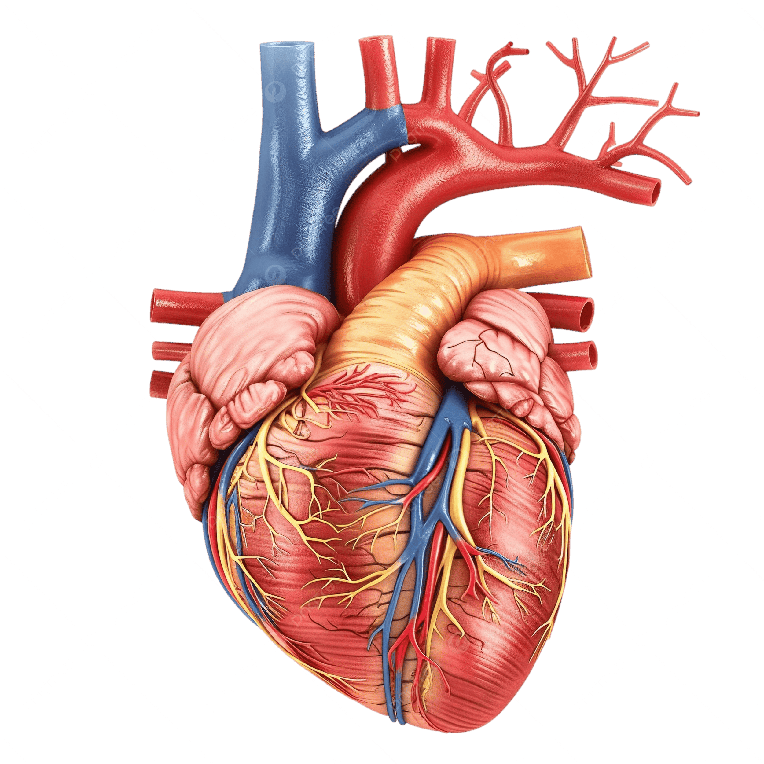
Which body part pumps blood?
A. large intestine
B. heart
C. lungs

Slide 5
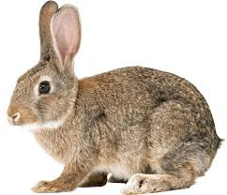
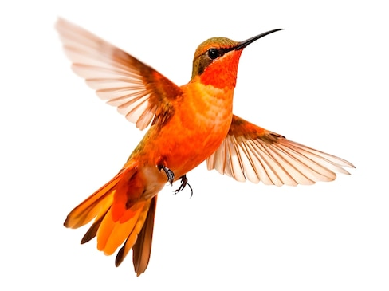
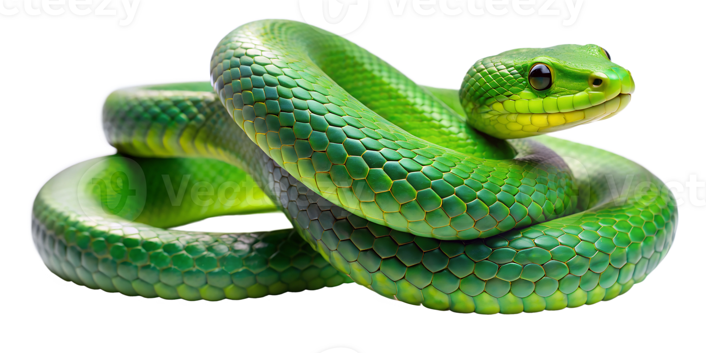
Which animal slithers?
A. rabbit
B. bird
C. snake

Slide 6
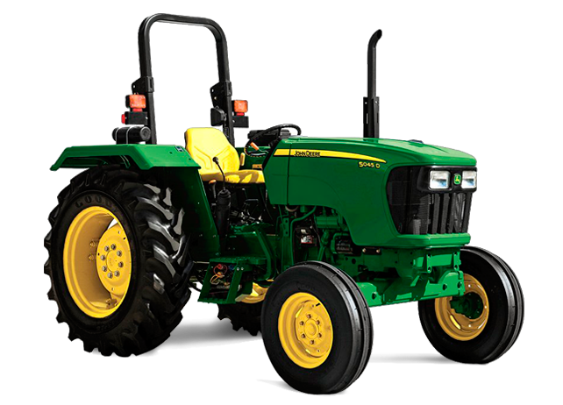
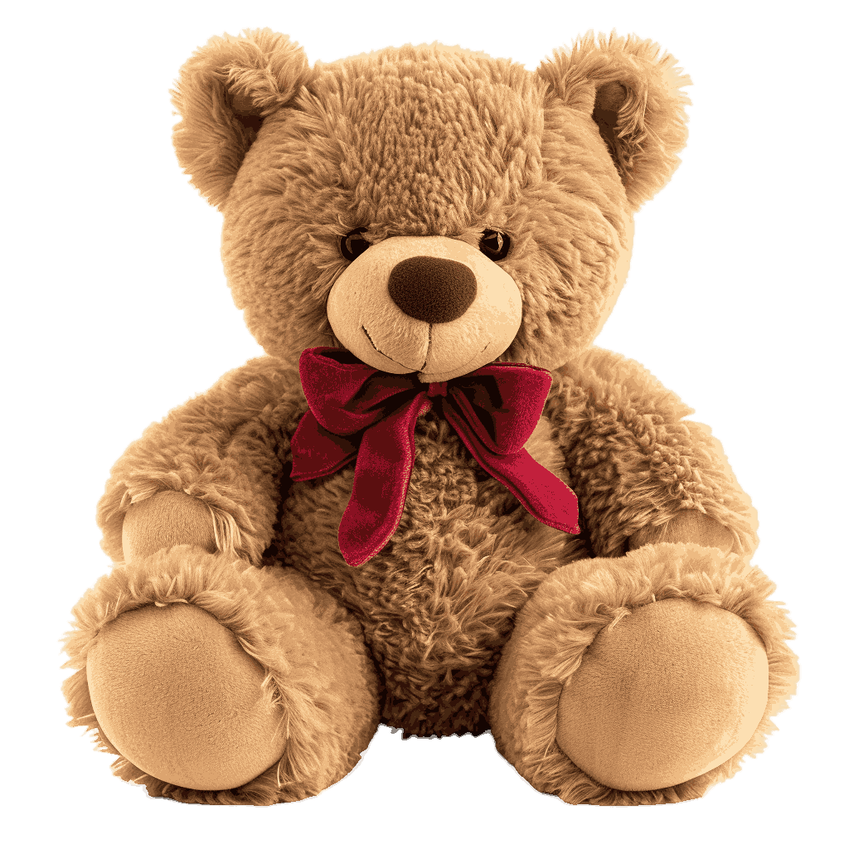
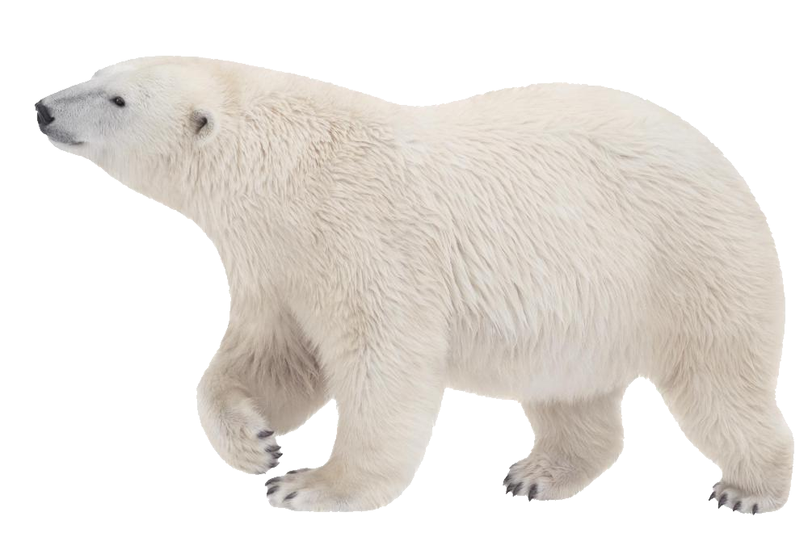
Which is a living-thing?
A. tractor
B. teddy bear
C. polar bear

Slide 7
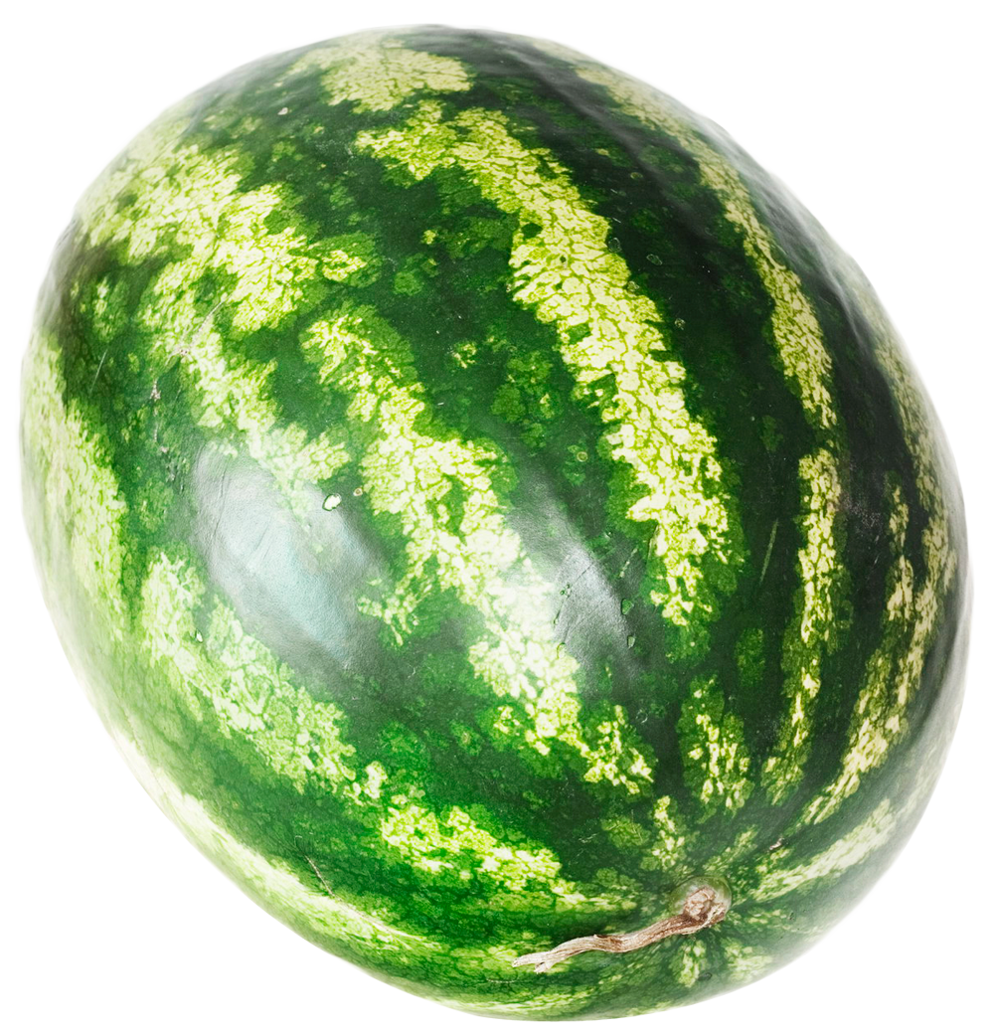
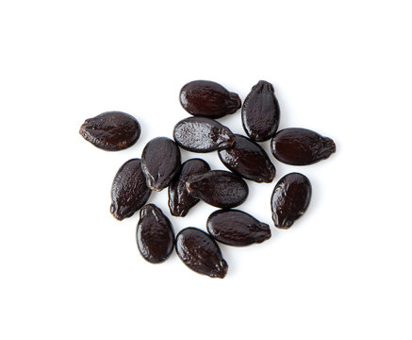
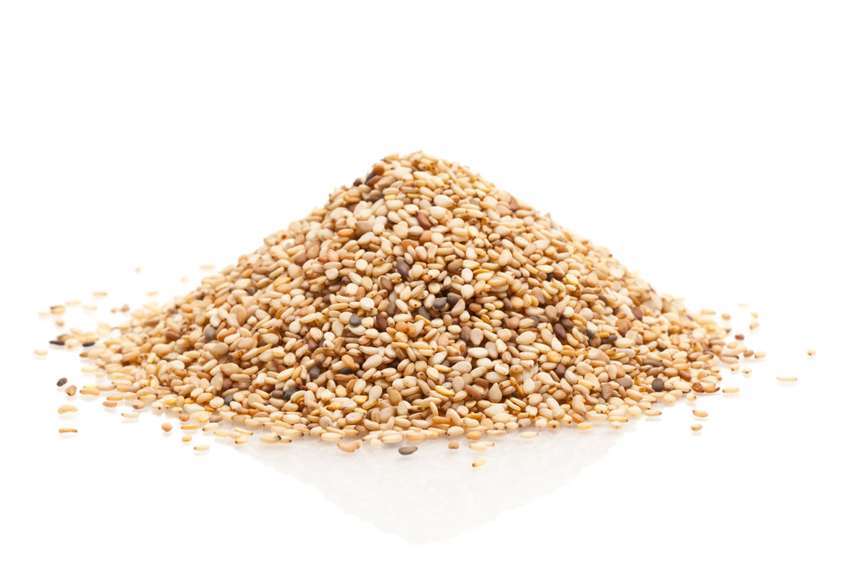
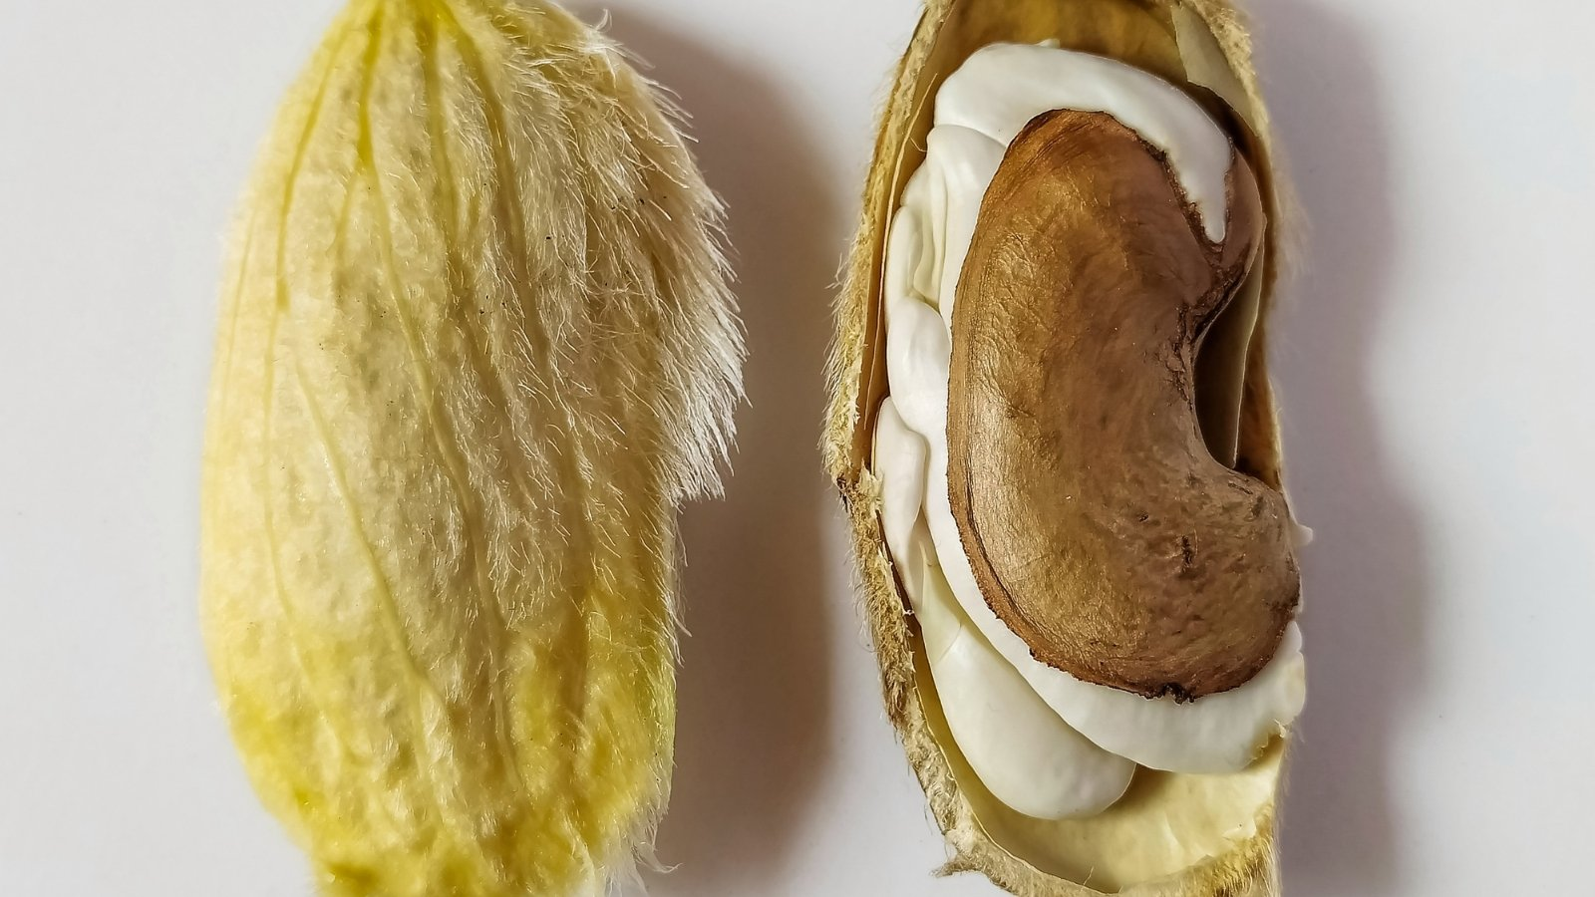
Which ones are watermelon seeds?
A.
B.
C.

Slide 8
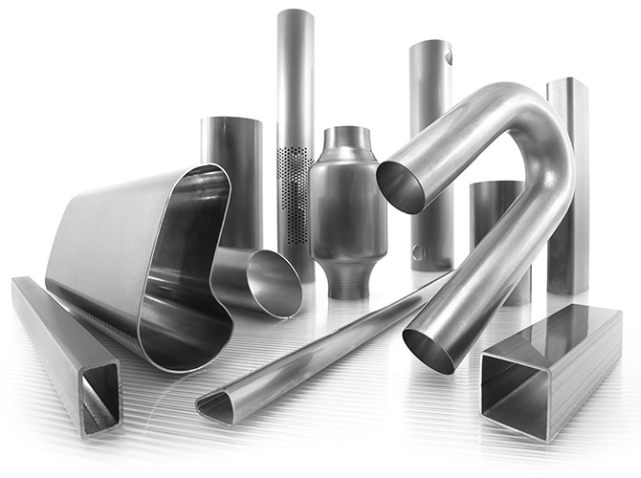
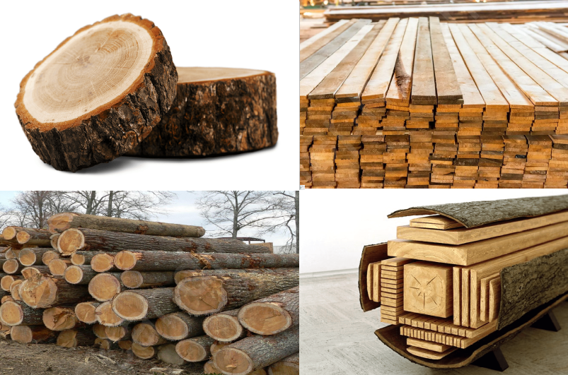
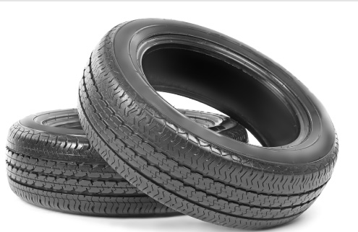
Which material is hard and shiny?
A. rubber
B. metal
C. wood

Slide 9
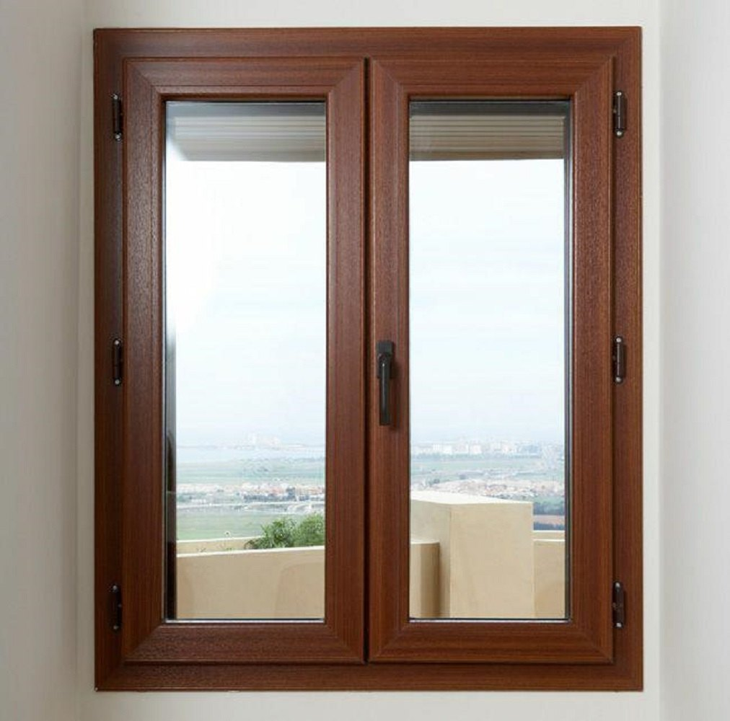

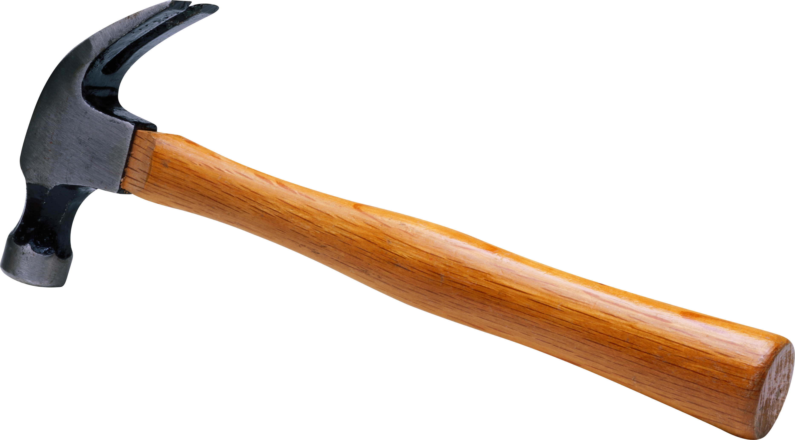
Which of these is made of glass?
A. hammer
B. window
C. ball

Slide 10
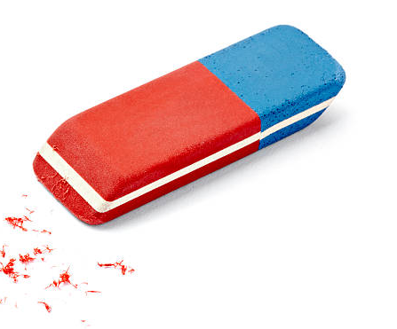
What is an eraser made of?
A. cloth
B. rubber
C. plastic

Slide 11
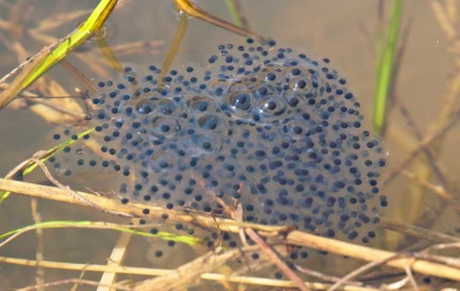

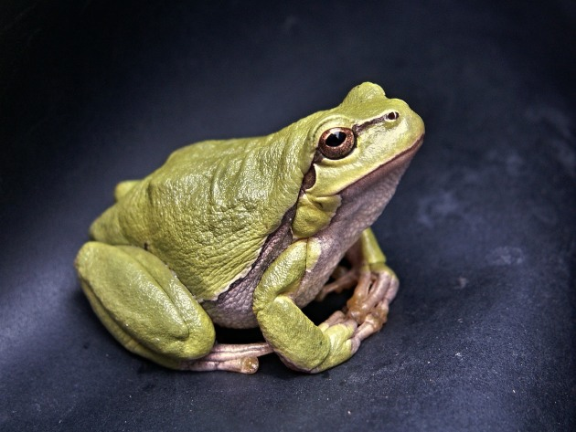

Look at this life cycle.
Stage 1
Egg
Life cycle of a frog
Stage 3
Stage 2
Adult
What is the missing stage?

Slide 12
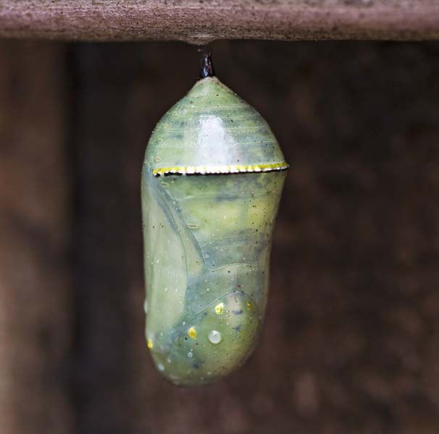
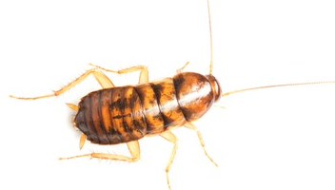
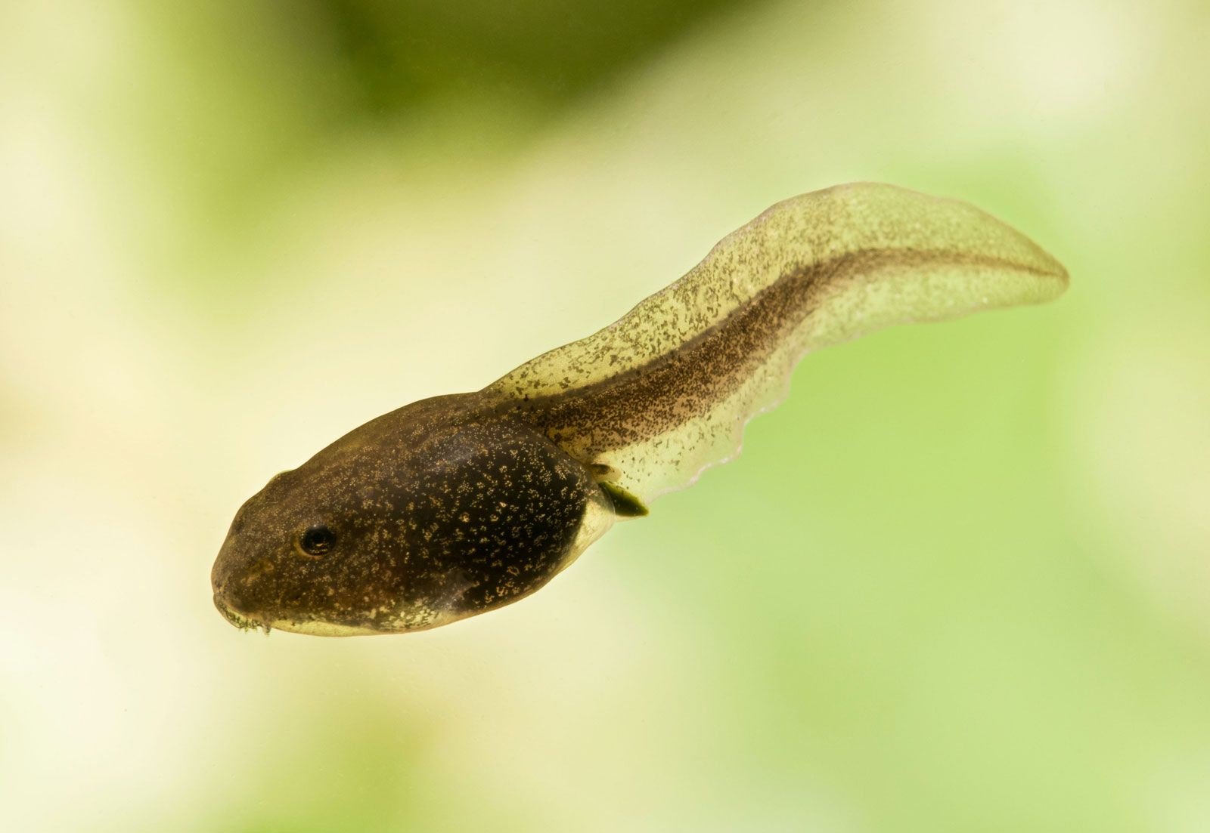
Which one is the missing stage of the life cycle?
A. tadpole
B. pupa
C. nymph

Slide 13

MATH QUIZ

Slide 14
What is next?
?
A.
B.
C.

Slide 15
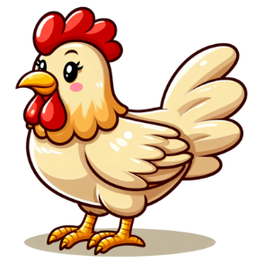

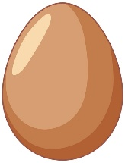


What is missing?
?
A.
B.
C.

Slide 16



What is missing?
?
A.
B.
C.

Slide 17
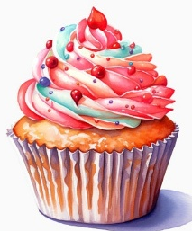



Addition
If
= 2
= 3
= 4
= 5
6
+
+
=
Answer

Slide 18
Addition
If
= 2
= 3
= 4
= 5
7
+
+
=
Answer

Slide 19
Addition
If
= 2
= 3
= 4
= 5
14
+
+
=
Answer

Slide 20
Addition
If
= 2
= 3
= 4
= 5
+
=
14
+
+
Answer

Slide 21
Addition
If
= 2
= 3
= 4
= 5
+
=
20
+
+
Answer

Slide 22




Subtraction
If
= 4
= 6
= 8
= 10
-
=
0
Answer

Slide 23

Subtraction
If
= 4
= 6
= 8
= 10
-
=
6
Answer

Slide 24

ENGLISH QUIZ

Slide 25


A
B
C
D
E
F
What is this classroom object?
G
H
I
ANSWER

Slide 26
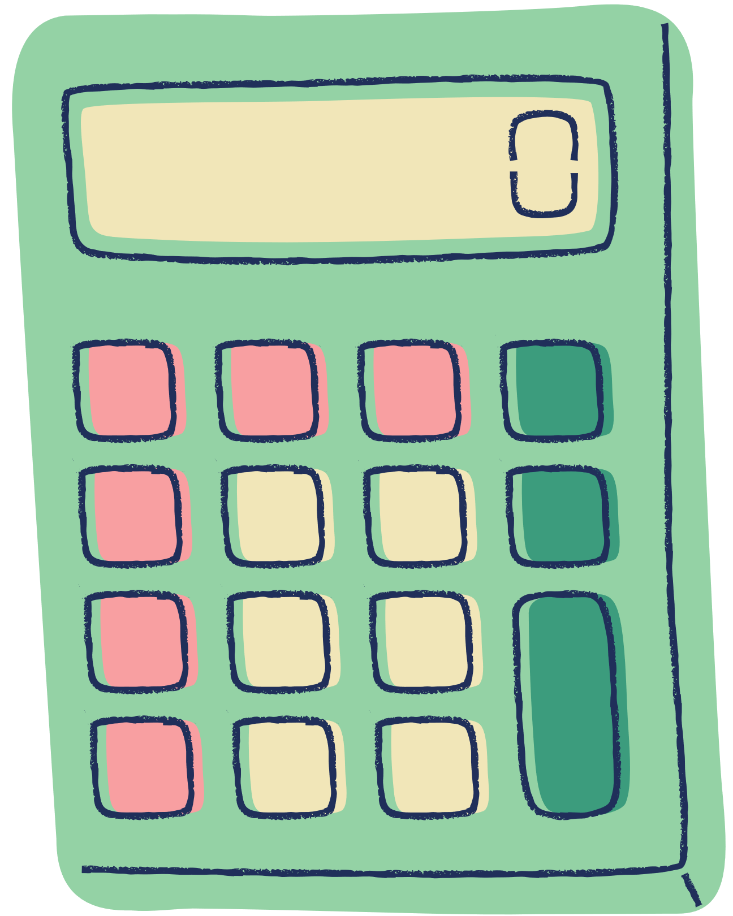
A
B
C
D
E
F
What is this classroom object?
G
H
I
ANSWER

Slide 27
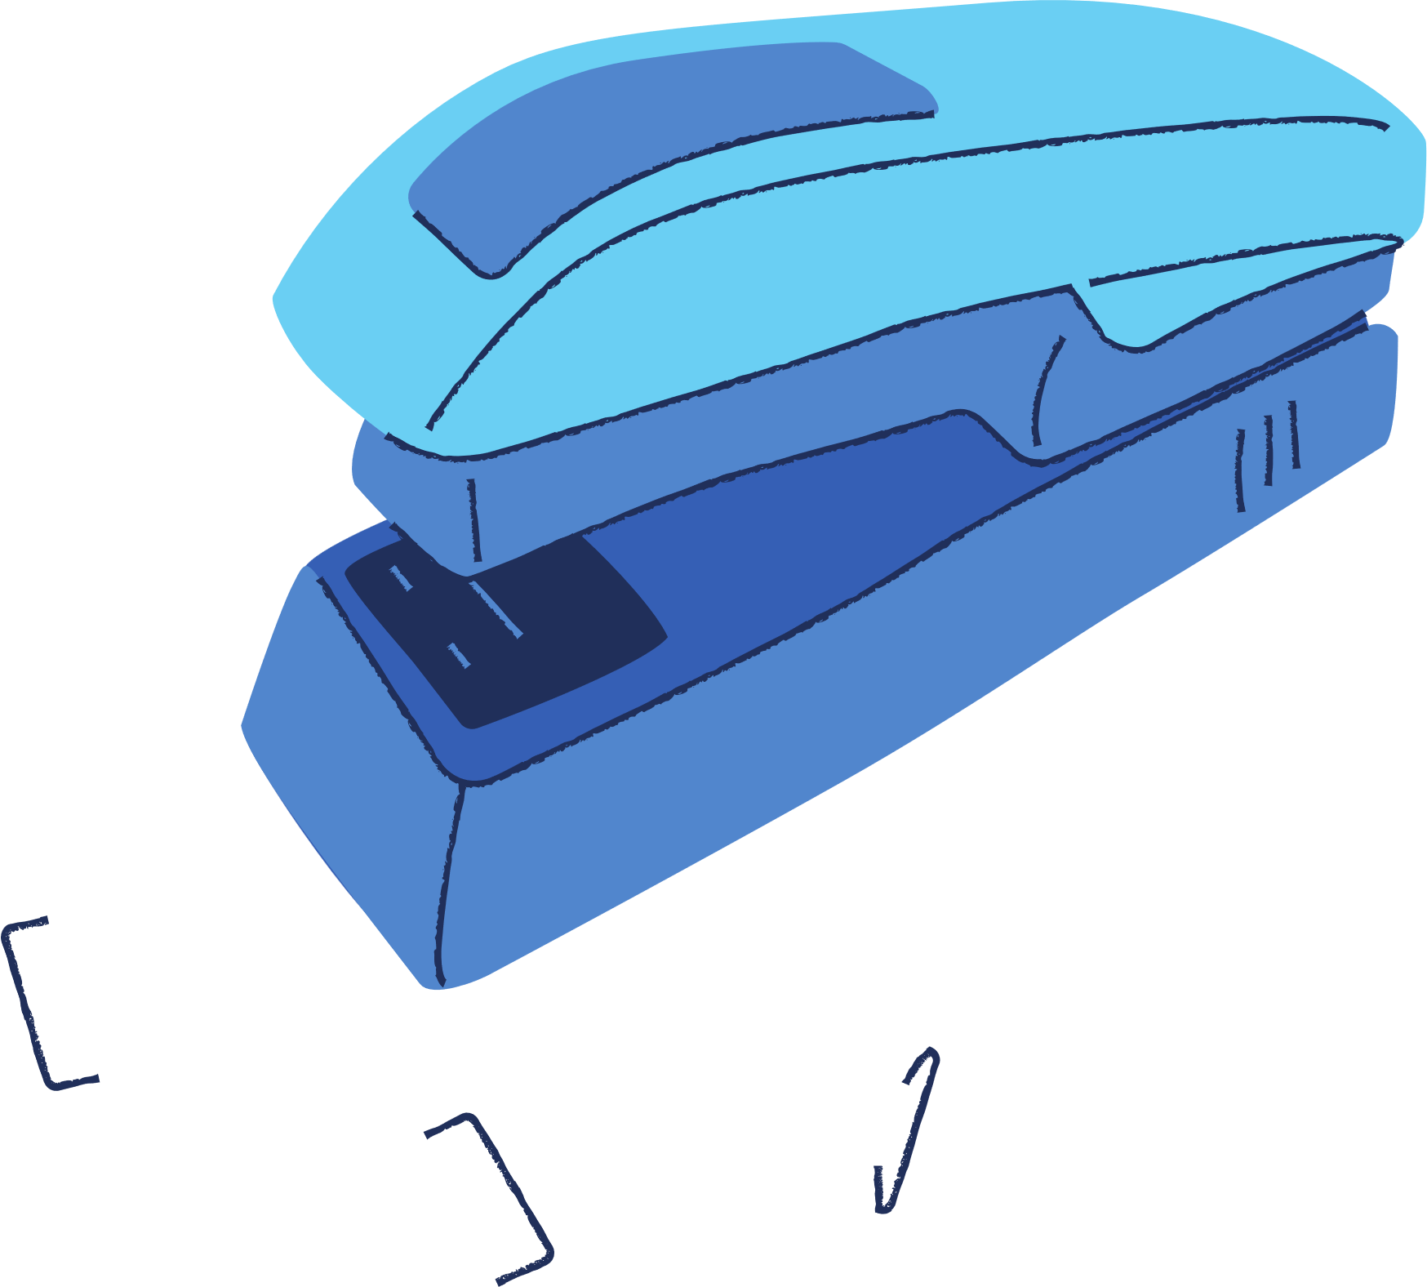
A
B
C
D
E
F
What is this classroom object?
G
H
I
ANSWER

Slide 28
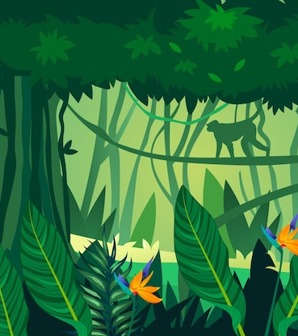
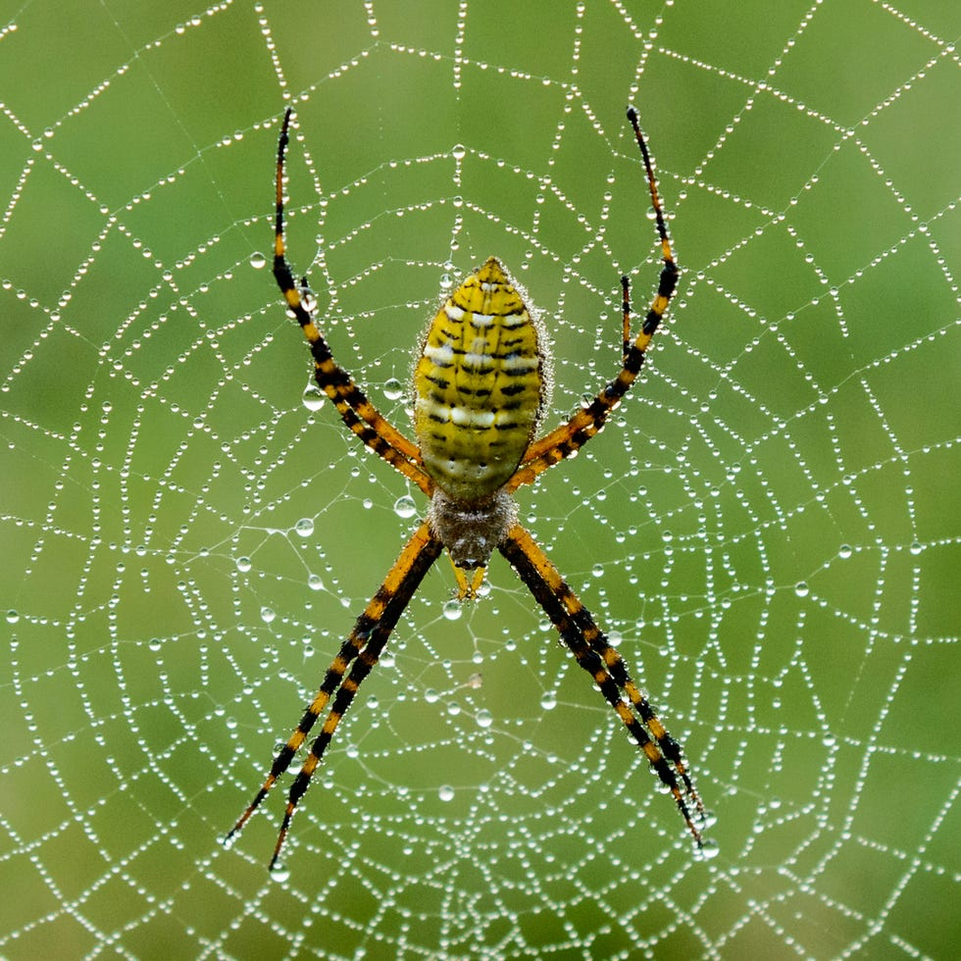
A
B
C
D
E
F
What is this animal?
G
H
I
ANSWER

Slide 29
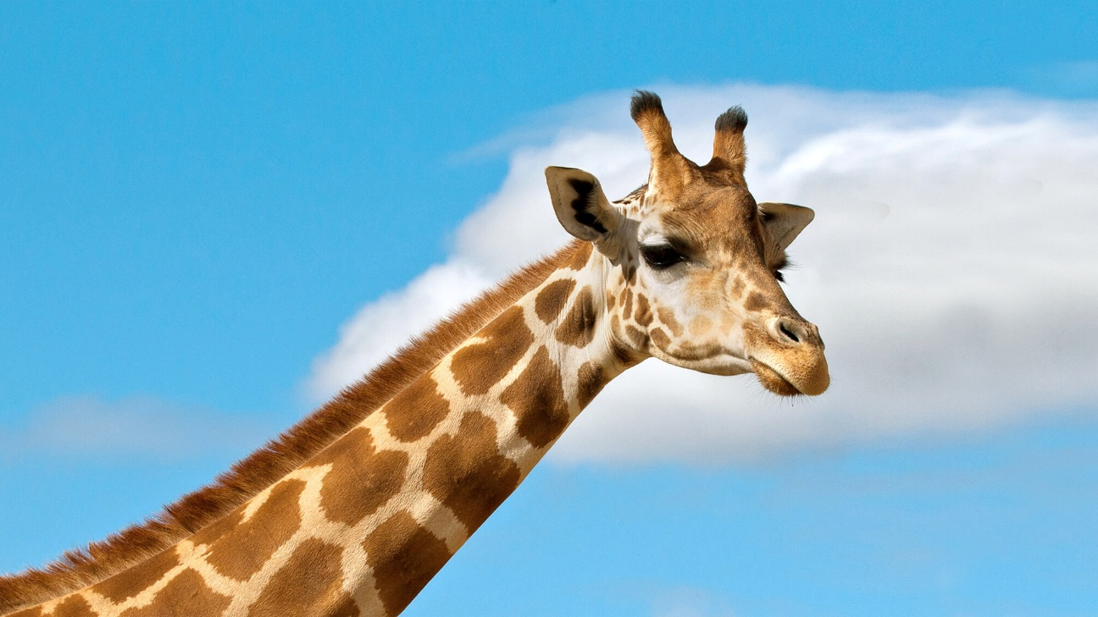
A
B
C
D
E
F
What is this animal?
G
H
I
ANSWER

Slide 30

Vocabulary
Build the word
m
e
n
s
a
t
g
r

Slide 31
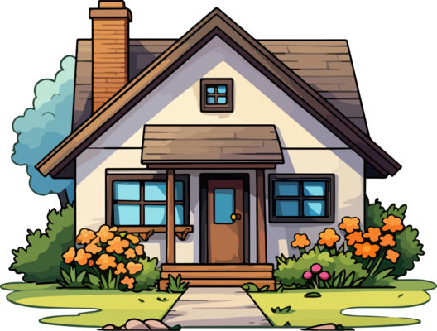
Vocabulary
Build the word
o
n
s
e
h
u
a

Slide 32

Vocabulary
Build the word
b
o
e
d
c
t
r
o

Slide 33
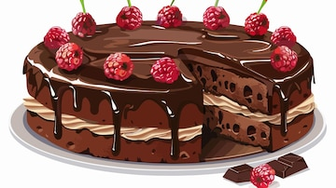
Vocabulary
Answer
Build the word
f
c
l
g
e
k
v
a

Slide 34
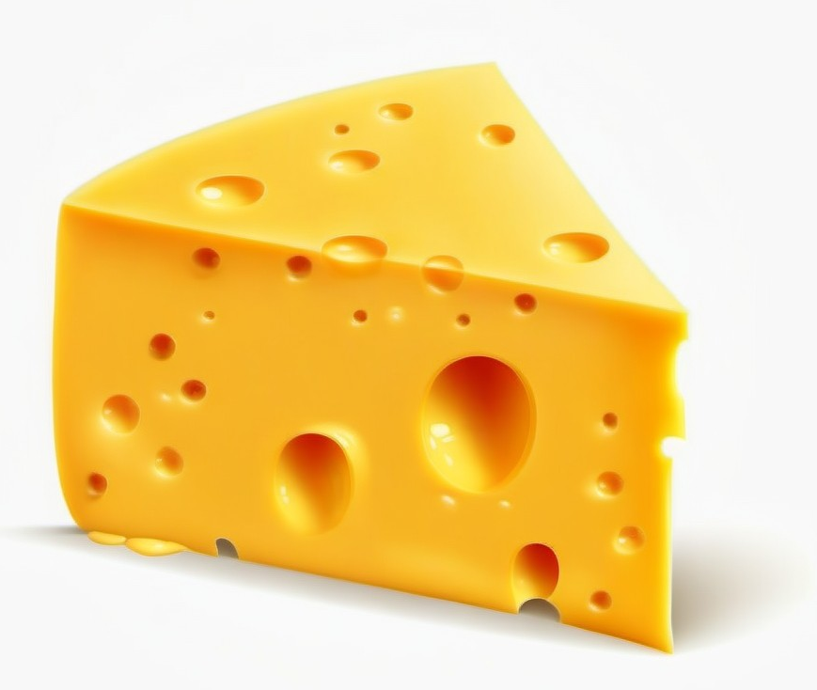
Vocabulary
Answer
Build the word
t
h
c
e
p
e
s
e

